Slide 1
Absolutism
A system in which the ruler, usually a monarch, holds absolute power (complete authority) over the government and the lives of the people
Monarch = a king or queen who rules a territory, usually for life and by hereditary right
The opposite of a constitutional government or democracy, such as that found in the United States
In 17th Century Europe, absolutism was tied to the idea of the divine right of kings
Divine right = belief that the authority to rule comes directly from God

Slide 2
Essential Understandings
The Age of Absolutism takes its name from a series of European monarchs who increased the power of their central governments.
Characteristics of Absolute Monarchies:
Centralization of power
Concept of rule by divine right

Slide 3
Power of a Monarch
In the 17th Century, people looked to the monarch for political stability
Absolute monarchs had tremendous powers
Make laws
Levy taxes
Administer justice
Control the state’s officials
Determine foreign policy
No written Constitution or Bill of Rights
Most people did not have any rights at all

Slide 4
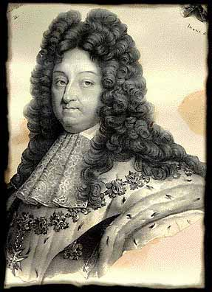
France
Louis XIV
(r. 1643-1715)

Slide 5
Key Terms
Huguenots
St. Bartholomew’s Day Massacre
Henry IV
Edict of Nantes
Cardinal Richelieu
Sun = symbol of absolute power
Intendant
Versailles
Balance of power

Slide 6
Background: France’s Wars of Religion (1560s-1590s)
Religious wars between the Catholic majority and the French Protestants, called Huguenots, tore France apart
St. Bartholomew’s Day Massacre = worst incident; Catholic royals slaughtered 3,000 Huguenots
This symbolized the complete breakdown of order in France

Slide 7
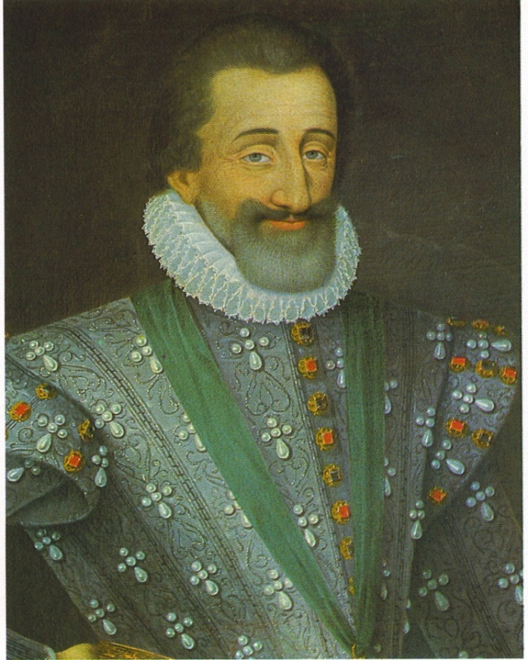
Background: Henry IV
1589: Henry IV, a Huguenot prince, inherited the French throne
For four years he fought against fierce Catholic opposition
To end the conflict, he converted to Catholicism
To protect Protestants, however, he issued the Edict of Nantes (1598), which granted the Huguenots religious toleration and other freedoms

Slide 8
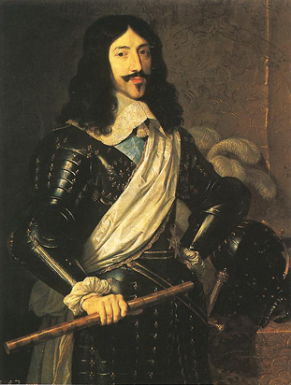
Louis XIII
Son of Henry IV
Inherited throne at age 9
Cardinal Richelieu appointed chief administer
Focused on strengthening the central government (extending royal power)
Sought to destroy the Huguenots and the nobles, two groups that did not bow to royal authority
Handpicked his successor, Cardinal Mazarin

Slide 9
Louis XIV
Son of Louis XIII
Inherited throne at age 5
Believed in his divine right to rule
Took the sun as the symbol of his absolute power: just as the sun stands at the center of the solar system, so the Sun King stands at the center of the nation
The Estates General, the medieval council made up of representatives of all French social classes, didn’t meet once during Louis XIV’s reign and therefore played no role in checking royal power

Slide 10
Louis XIV’s Policies
Expanded the bureaucracy and appointed intendants, royal officials who collected taxes, from the middle classes
Cemented his ties with the middle classes
Checked the power of nobles and Church
Recruited soldiers
French army became strongest in Europe
Army was used to enforce his policies at home and abroad
Use mercantilist policies to bolster the economy
New lands cleared for farming, encouraged mining and other basic industries, and built up luxury trades
Imposed high tariffs on imported goods to protect French manufacturers

Slide 11
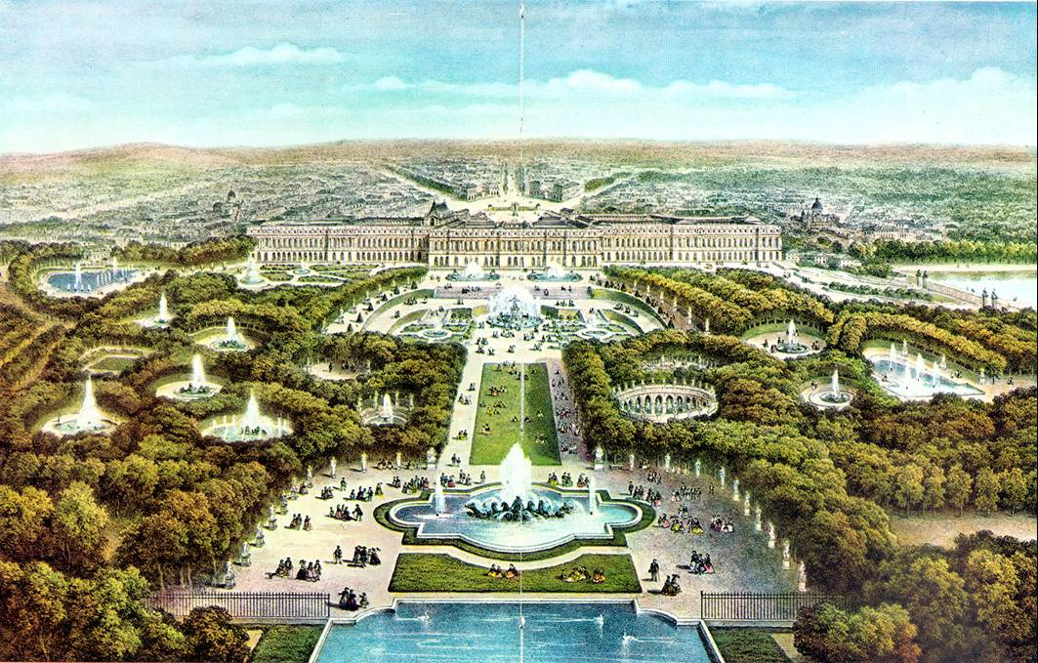
Versailles Palace of Versailles video
Louis XIV spared no expense to make this the most magnificent building in Europe
Was the perfect symbol of the Sun King’s wealth and power
Served as the Louis XIV’s home and the seat of the government
Each day began in the King’s bedroom with a major ritual known as the levee, or rising
High-ranking nobles competed for the honor of holding the royal washbin or hand the king his diamond-buckled shoes
Purpose: These nobles were a threat to the power of the monarchy; thus, by luring nobles to Versailles, Louis XIV turned them into courtiers angling for privileges rather than rivals battling for power

Slide 12
Weakening France’s Economy
How did Louis XIV’s actions weaken France’s economy?
Waging war to expand France’s borders drained his treasury (other European nations wanted to maintain the balance of power = a distribution of military and economic power among European nations to prevent any one country from dominating the region)
Expelling Huguenots, whom Louis XIV saw as a threat to religious and political unity, removed some of his most productive subjects

Slide 13
Louis XIV’s Accomplishments
Strengthened royal power, the army, the economy, and the arts to make France the leading power of Europe
Prevented dissent from within by keeping the nobles busy in the king’s court instead of battling for power (levee)
Versailles became a symbol of royal power and wealth

Slide 14
Louis XIV’s Historical Significance/Legacy
Louis XIV’s efforts (political, military, and cultural achievements) placed France in a dominant position in Europe
His efforts didn’t, however, bring prosperity to the common people of France – his numerous wars and extravagant palaces effectively bankrupted the nation

Slide 15
Essential Understanding
Political democracy rests on the principle that government derives power from the consent of the governed (the people). The foundations of English rights include the jury trial, the Magna Carta, and common law.
The English Civil War and the Glorious Revolution prompted further development of the rights of Englishmen.

Slide 16
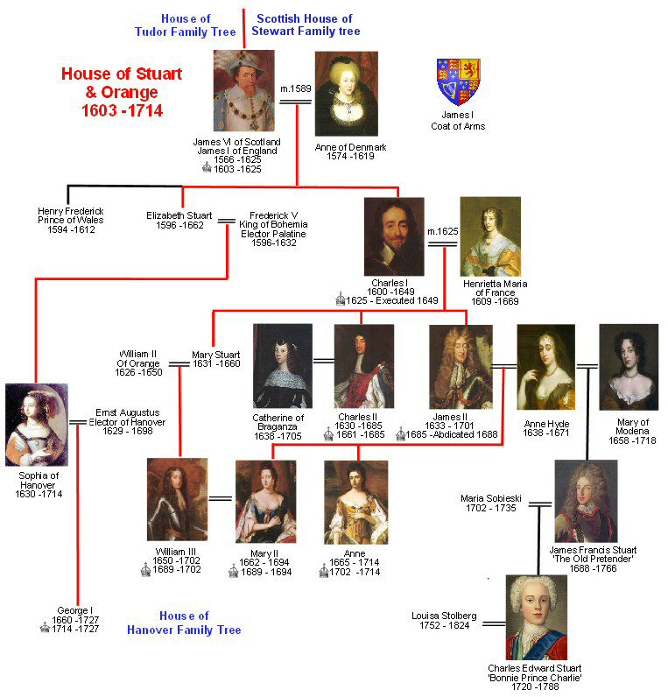

Slide 17
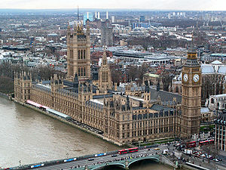
Monarchy vs. Parliament
Parliament: England’s legislative body
House of Lords which represented the nobility
House of Commons (the lower house) which represented everyone else
Parliament controlled the finances!
The Tudor’s dealt with Parliament well - the Stuarts did not!
Palace of Westminster

Slide 18
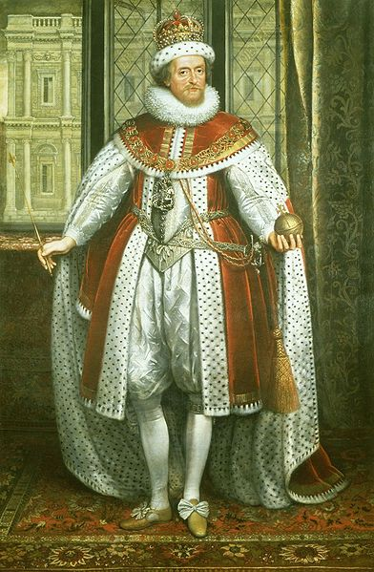
James I’s Accomplishments & Historical Significance
Often offended the Puritans in Parliament (Elizabeth flattered them to get her way)
Expanded English international trade and influence was actively pursued through the East India Company
The Thirty Years' War (1618–1648) was one of the most destructive conflicts in European history – began during his reign
James handed down to his son, Charles I a fatal belief in the divine right of kings, combined with a disdain for Parliament
These beliefs and attitudes led to the English Civil War and the execution of Charles I

Slide 19
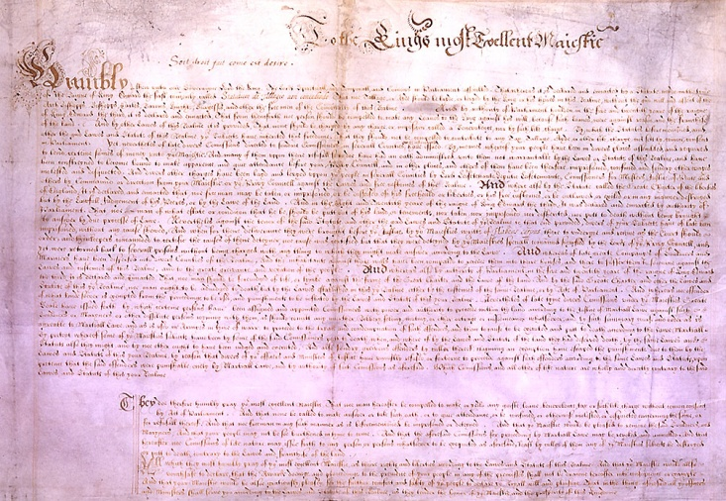
Petition of Right - 1628
The King would not:
imprison subjects without due cause
levy taxes without Parliament’s consent
house soldiers in private homes
impose martial law in peacetime
After agreeing to the petition, Charles I ignored it because it limited his power
The petition was important: it set forth the idea that the law was higher than the king

Slide 20
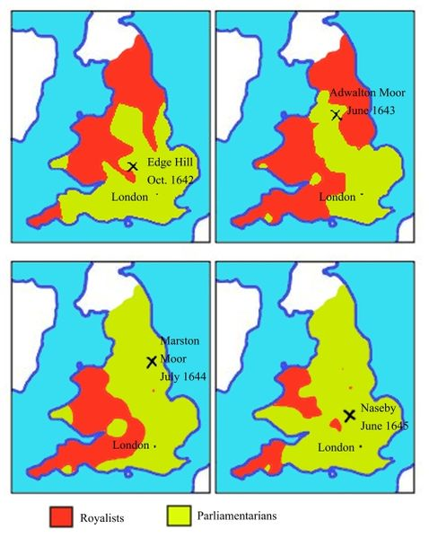
English Civil War: 1642-1649
Cavaliers: Supporters of the king or Royalists versus
Roundheads: Puritan supporters of Parliament
Oliver Cromwell, military genius, lead the New Model Army (Parliament)
His army was made up chiefly of extreme Puritans known as the Independents, who believed they were doing battle for God
Parliament won!

Slide 21
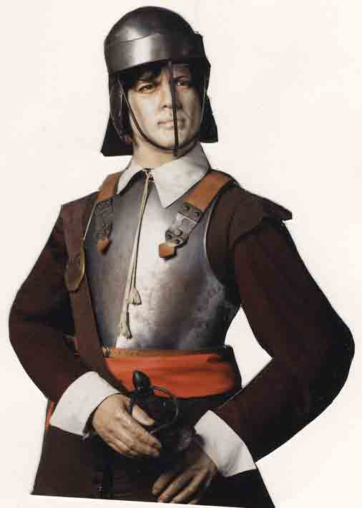
Royalists Cavaliers
Parliamentarians Roundheads
House of Lords
N & W England
Aristocracy
Large landowners
Church officials
More rural
House of Commons
S & E England
Puritans
Merchants
Townspeople
More urban

Slide 22
Charles I’s Accomplishments & Historical Significance
Petition of Right imposed limits on the monarch’s power
Back and forth with Parliament led to the English Civil War (dissolving, then calling, then trying to arrest Parliament)
Executed for treason – the first time a reigning monarch faced a public trial and execution by his own people

Slide 23
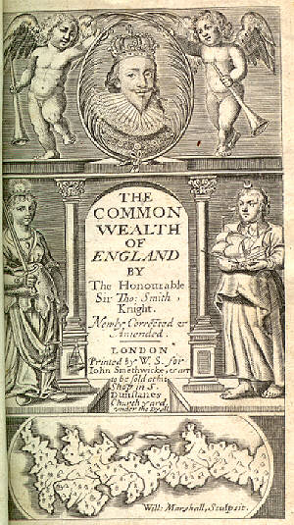
Commonwealth of England 1649-1653
Cromwell ruled with Rump Parliament
Rump Parliament abolished the monarchy and the House of Lords, and declared England a republic, or commonwealth
1653 - Cromwell dismissed Parliament (too difficult to work with) and set up a military dictatorship

Slide 24
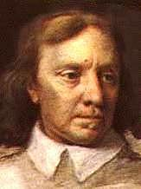
The Protectorate 1654-1660
Cromwell “Lord Protector”
Ruled until his death in 1658
He was buried in Westminster Abbey
When the Royalists returned to power his corpse was dug up, hung in chains, and beheaded

Slide 25
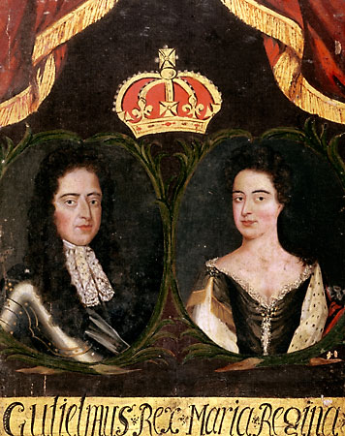
Glorious Revolution 1688
Parliament did not want James II’s Catholic son to assume the throne
The Dutch leader, William of Orange, a Protestant and husband of James’s daughter Mary, was invited to rule England
James II and his family fled, so with almost no violence, England underwent its “Glorious Revolution”

Slide 26
Charles II’s & James II’s Accomplishments & Historical Significance
Under the restoration Stuarts (Charles II and James II), Parliament kept much of the power it gained during the time of Cromwell and the Commonwealth
Conflict over religion remained a serious issue:
Stuarts = Catholic
Parliament = Church of England (Anglican)
Parliament invited William and Mary to rule England, which led to the Glorious Revolution

Slide 27
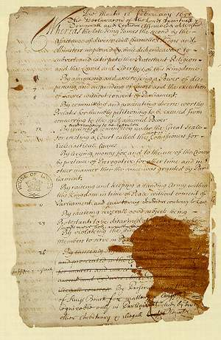
The Bill of Rights 1689
The Bill of Rights set the foundation for a constitutional monarchy
Helped create a government based on the rule of law and a freely elected Parliament
Parliament’s right to make laws and levy taxes
Standing armies could be raised only with Parliament’s consent
Right of citizens to bear arms
Right to a jury trial

Slide 28
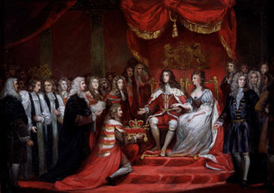
William and Mary Mary r.1689-94 and William r.1689-1702
Required to accept the Bill of Rights in order to rule - which they did
They are the only monarchs in British history to have reigned jointly

Slide 29
Bill of Rights
Main provisions:
The King could not suspend the operation of laws.
The King could not interfere with the ordinary course of justice.
No taxes levied or standard army maintained in peacetime without Parliament’s consent.
Freedom of speech in Parliament.
Sessions of Parliament would be held frequently.
Subjects had the right of bail, petition, and freedom from excessive fines and cruel and unusual punishment.
The monarch must be a Protestant.
Freedom from arbitrary arrest.
Censorship of the press was dropped.
Religious toleration.

Slide 30
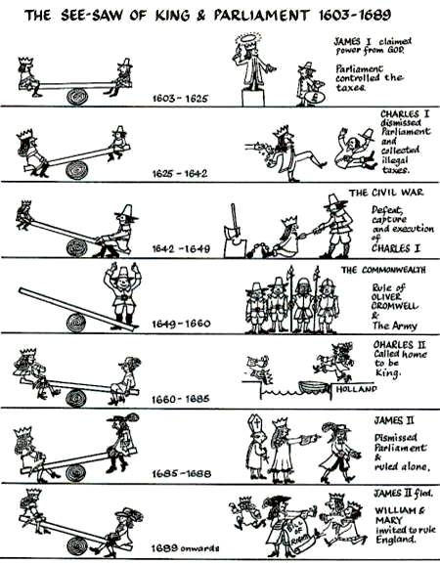

Slide 31
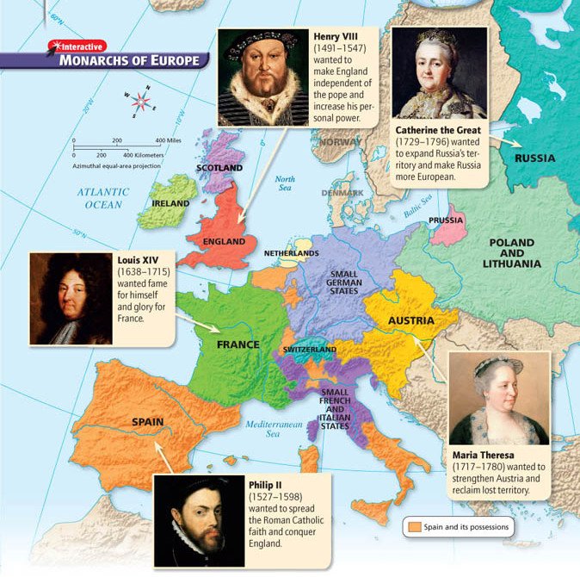

Slide 32
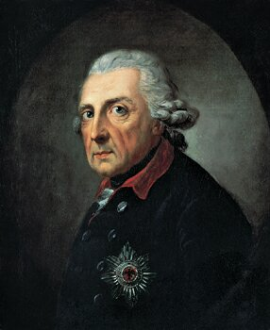
Prussia
Frederick II the Great
(r. 1740-1786)

Slide 33
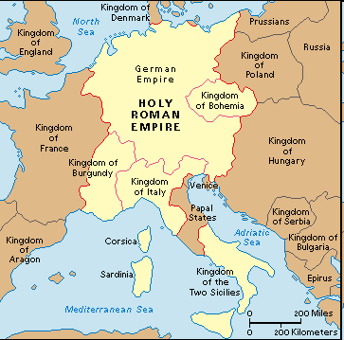
Holy Roman Empire
Patchwork of hundreds of small, separate states
Ruled by emperor who had little power over the many rival princes
This power vacuum contributed to the outbreak of the Thirty Years’ War, along with religious division between the Protestant north and the Catholic south

Slide 34
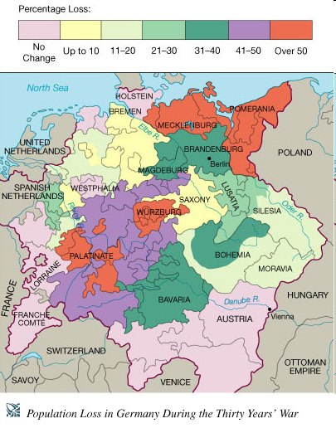
Thirty Years’ War (1618-1648)
Series of wars
Began in Bohemia (present-day Czech Republic) in the German states
Ferdinand, the Catholic king of Bohemia, wanted to suppress Protestants and assert royal power over nobles
Defenestration of Prague = a few rebellious Protestant noblemen tossed two royal officials out of a castle window
This act sparked a local revolt, which widened into a European war

Slide 35
Results of the Thirty Years’ War
Roving armies of ‘mercenaries’ (soldiers for hire) burned villages, destroyed crops, and killed without mercy
↓
Famine and disease
↓
Depopulation (as many as one third of the people in the German states may have died as a result of the war)

