Slide 1
French Absolutism, Enlightenment, & Revolution
Outcome: Absolutism & Absolute Monarchs

Slide 2
Constructive Response Questions
Describe what an absolute monarch is and provide two examples:

Slide 3
What Will We Learn?
Absolutism in Europe
France and the Huguenots
Henry of Navarre
Louis XIV (14th)

Slide 4
What is Absolutism??
Absolutism in Europe
Absolute Monarch: kings or queens who held all of the power within their states’ boundaries
Their goal was to control every aspect of society including religion
Most believed they had divine right: belief that God created the monarchy and that the monarch acted as God’s representative on earth.
An absolute monarch answered only to God, not to his or her subjects
Over the next few centuries, many absolute monarchs would appear in Europe
Decline of feudalism, rise of cities, growth of national kingdoms all helped to centralize authority
Rising middle class typically sided with the monarchs

Slide 5
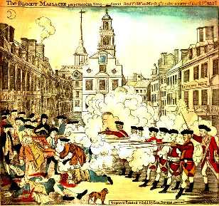
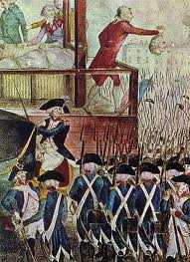
Absolutism
Result: Absolute monarchs would alter Europe’s future and eventually help bring about massive change such as The French Revolution and American Revolution.

Slide 6
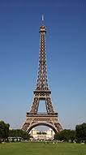
France

Slide 7
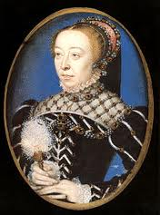
Henry II & Catherine de Medicis

Slide 8
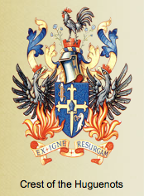
Absolutism & Absolute Monarchs
Religious Wars and Power Struggles in France
King Henry II of France died in 1559 with four sons; real power behind the throne was their mother Catherine de Medicis
Religious wars between French Catholics & Huguenots created chaos in France
Huguenots were French Protestants

Slide 9
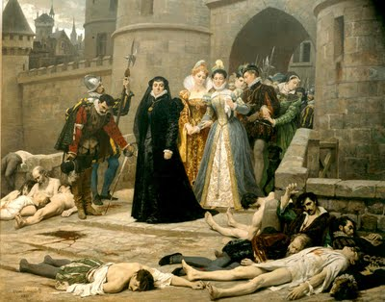
Absolutism & Absolute Monarchs
St. Bartholomew’s Day Massacre of 1572
Massacre of 3,000 to as high as 50,000 Huguenots
Occurred when Huguenot nobles were in Paris attending the marriage of Catherine de Medicis’ daughter (Catholic) to Henry of Navarre (Huguenot)
Henry of Navarre survived

Slide 10
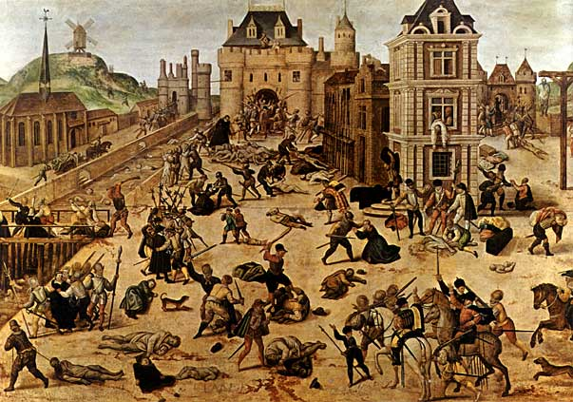
St. Bartholomew’s Day Massacre

Slide 11
Henry of Navarre

Slide 12
Absolutism & Absolute Monarchs
Henry of Navarre
Henry inherited the throne when Catherine and her last son died
Henry became the first ruler of the Bourbon dynasty in France
Many Catholics opposed Henry so he abandoned Protestantism and became a Catholic
Henry’s explanation was “Paris is well worth a mass.”
Declared Huguenots could live in peace in France by created the Edict of Nantes; a declaration of religious toleration
He had restored the French monarchy to a position of strong power
In 1610, a fanatic leaped into Henry’s royal carriage and stabbed him to death for his religious compromises

Slide 13
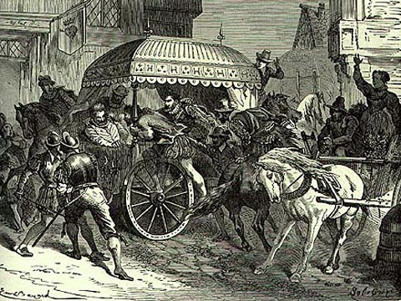
Death of Henry

Slide 14
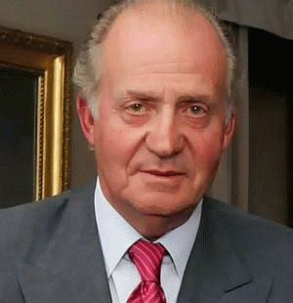
Absolutism & Absolute Monarchs
Result: Henry had restored the French monarch to a strong position and created one of the most famous ruling families in Europe. Even the king of Spain today is a member of the Bourbons.
Juan Carlos of Spain

Slide 15
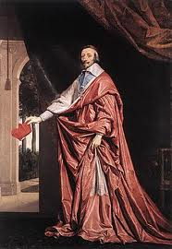
Louis XIII (13th) & Cardinal Richelieu

Slide 16
Absolutism & Absolute Monarchs
The Bourbon Dynasty’s Power
Louis XIII (13th) was a weak king
He appointed a strong minister to help: Cardinal Richelieu
Cardinal Richelieu became, in effect, the ruler of France
Richelieu moved against the Huguenots by forbidding Huguenot cities to have walls
He also moved against the nobles’ power by having them take down their fortified castles and used government agents instead of using nobles in bureaucracy
Richelieu felt the only thing standing in France’s way of becoming the most powerful country in Europe was the Hapsburg rulers (Spain, Austria, Netherlands, H.R.E.)

Slide 17
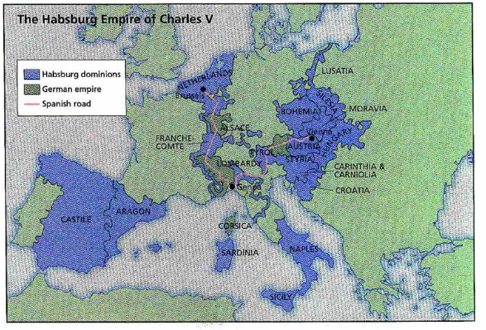
Hapsburg Dominance

Slide 18
Louis XIV (14th)

Slide 19
Absolutism & Absolute Monarchs
Louis XIV (14th)
Was 4 years old when he became king
Richelieu’s successor, Cardinal Mazarin, had increased taxes and strengthened the central government which led to anti-Mazarin riots
During the riots, Louis’s life was threatened; Louis vowed revenge
The noble’s rebellion failed for 3 reasons
They distrusted each other
The government used violent repression
Peasants and townspeople grew weary of fighting

Slide 20
Absolutism & Absolute Monarchs
Louis’s Power
Louis took total control at age 22
He excluded the nobles from his councils to strengthen his own power
Increased the power of the intendants, or government agents, who collected taxes and administered justice
Louis made the nobles dependent on him by making them live with him in the palace
Wanted to make France self-sufficient (Mercantilism: wealth = power) to prevent wealth from leaving France so they manufactured everything needed in France

Slide 21
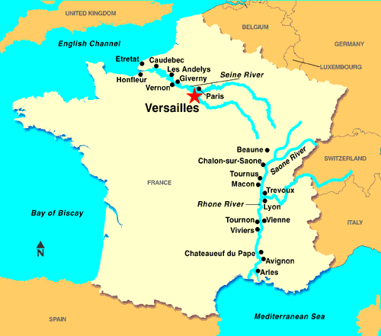
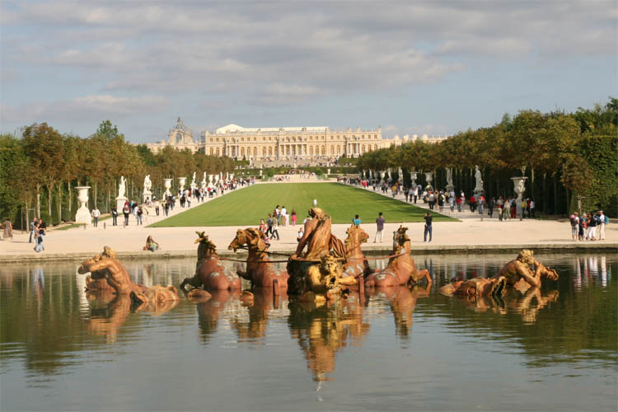
Absolutism & Absolute Monarchs
Louis built Versailles, perhaps the biggest and most beautiful palace on earth

Slide 22
Aerial look…

Slide 23
Versailles

Slide 24
Hall of Mirrors

Slide 25
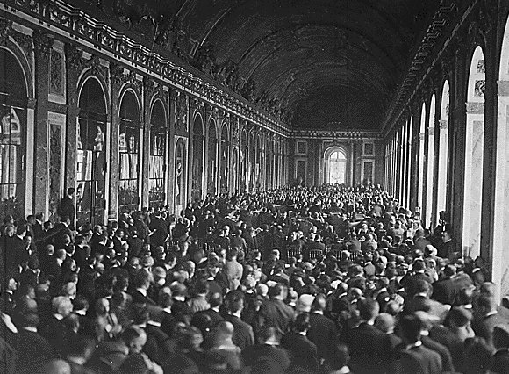
The Signing of the Treaty of Versailles

Slide 26
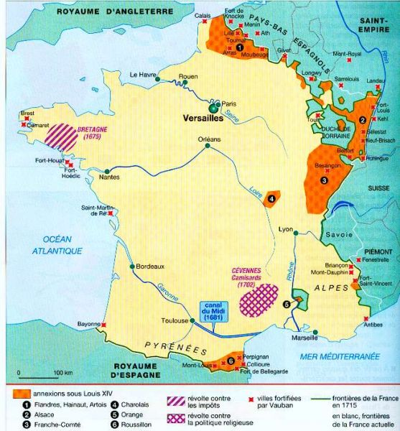
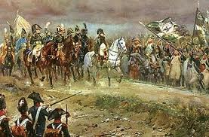
Absolutism & Absolute Monarchs
Louis’s Power (continued…)
France had 20 million people (more than England or the Dutch)
The French army was far ahead of other states’ in size, training, and weaponry

Slide 27
Absolutism & Absolute Monarchs
Louis’ Legacy
Louis invaded the Spanish Netherlands and gained 12 towns in 1667
He tried to fight more wars but the rest of Europe allied against him to ensure France would not dominate all of Europe
The King of Spain died after promising his throne to Louis’s 16 year old grandson
Led to the War of Spanish Success; fear the Bourbons would control Spain and France
The Treaty of Utrecht terms stated that Louis’ grandson could have Spain as long as France and Spain did not unite

Slide 28
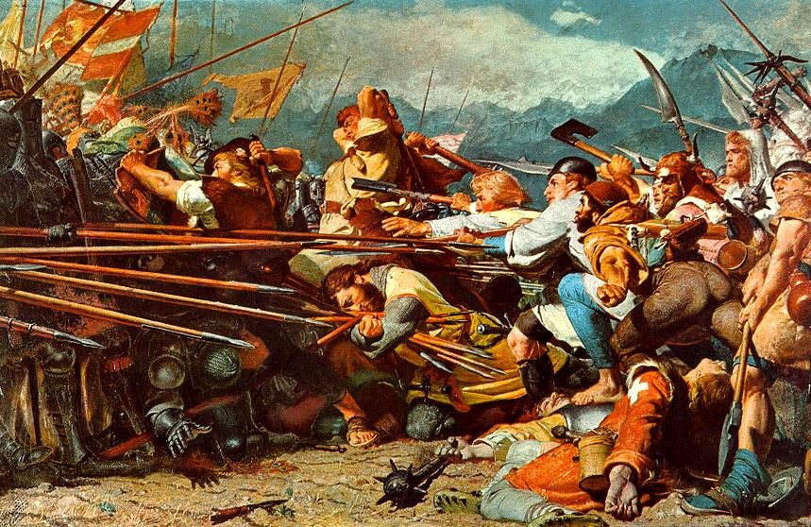
War of Spanish Succession 1701-1714

Slide 29
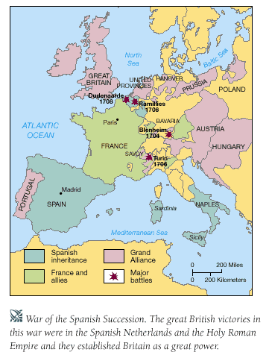

Slide 30
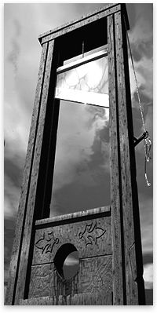
Absolutism & Absolute Monarchs
Louis’ Legacy (continued…)
When Louis died in his bed in 1715, people rejoiced in France
He had left France a very powerful state
France ranked #1 in Europe in art, literature, and statesmanship
France was the military leader of Europe
Due to warfare and the palace at Versailles, France was deeply in debt
Resentment over the tax burden of the poor was plague his heirs and lead to revolution

Slide 31
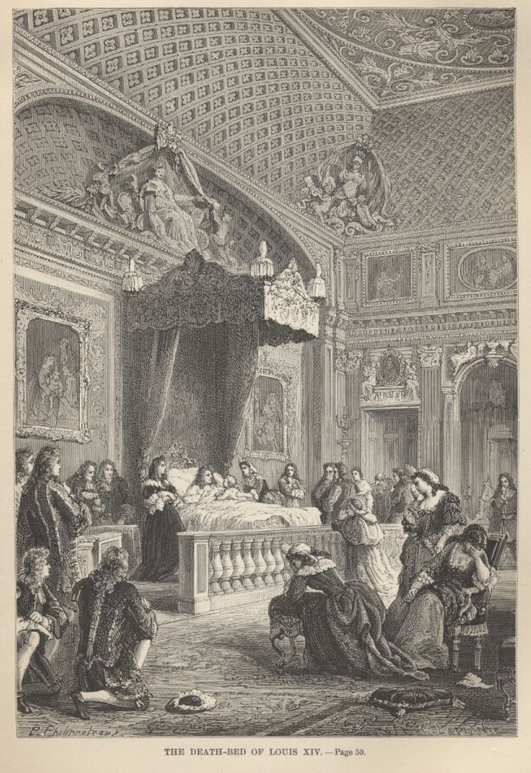
The Sun King’s Deathbed

Slide 32
Constructive Response Questions
Describe what an absolute monarch is and provide two examples:

