Slide 1
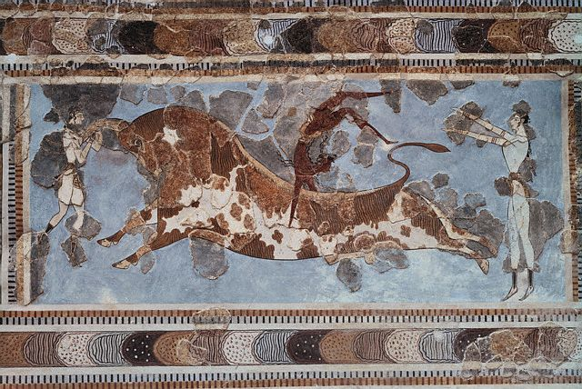
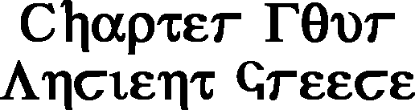

Slide 2

Impact of Geography
The rugged terrain and scattered islands of ancient Greece led to the development of many different independent city-states.
Mountains
The city states formed south of the mountains, or in the valleys between them.
Isolation
Because they were isolated, the Greek city states each had their own distinct culture.
This isolation also prevented unification of the Greek city-states.

Slide 3
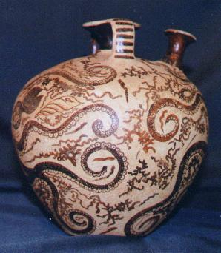
Seas
The Greek city-states were located around the Aegean Sea, near the Mediterranean Sea.
Seafaring
Many of the Greek city-states developed trading fleets to trade with the surrounding areas.
They had limited agricultural resources, so trade was necessary. (Interdependence)
The soil of ancient Greece was poor and not good for agriculture.

Slide 4
Black Sea
Aegean Sea
Black Sea
Dardanelles (Hellespont)
Access to Black Sea
Bosporus
Access to Black Sea
Crete
Knossos
Center Minoan civ.
Attica
Peloponnesus
Troy
Controlled Dardanelles
Mycenae
Asia Minor
Persian Empire
Bosporus
Dardanelles
Troy
Aegean
Sea
Attica
Asia Minor
Mycenae
Peloponnesus
Crete
Knossos

Slide 5
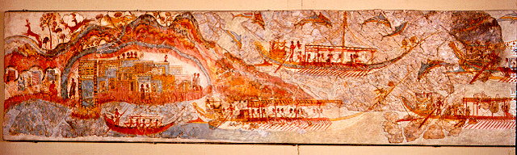
The Age of Bronze
Minoan Civilization (2700-1450 B.C.)
Was a complex and rich culture based on the Aegean island of Crete.
Crete Largest island in the Aegean
Knossos Great Minoan city on Crete. Home to king Minos, after whom the Minoan are named.
Trading Empire
Objects of Minoan manufacture suggest there was a network of trade with mainland Greece (notably Mycenae), Cyprus, Syria, Anatolia, Egypt, Mesopotamia, and westward as far as the coast of Spain . (wikipedia)

Slide 6
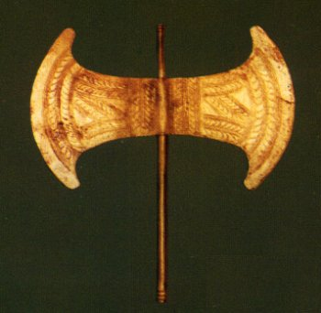

Palace of Knossos
The center of Minoan civilization.
King Minos
Legendary king of the Minoans
Labyrinth
Palace Maze to hold the minotaur, according to legend.
Now scholars think it may refer to the two sided axes used for human sacrifice.
Some think there may be some evidence that the Minoans practiced human sacrifice, leading to the legend of the Minotaur.
Legend of the Minotaur
Mythical beast that was half man and half bull which used to kill young men and women from Knossos. Was killed by the Greek hero Theseus .
Labyrinth comes from the word labrys, referring to a double, or two-bladed, axe. Its representation had a religious and probably magical significance
(wikipedia)

Slide 7
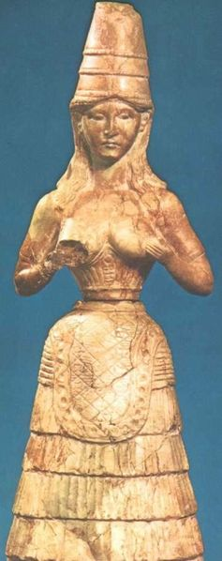
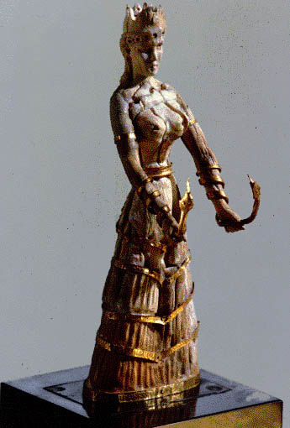
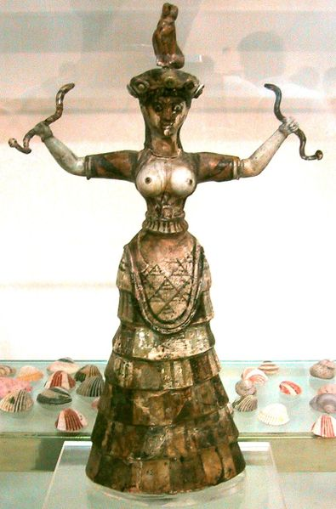
The Minoans were Polytheistic
They seem to have worshipped mostly goddesses, but there is some evidence of male gods.
It is thought that Minoan gods influenced later Greek Mythology.

Slide 8
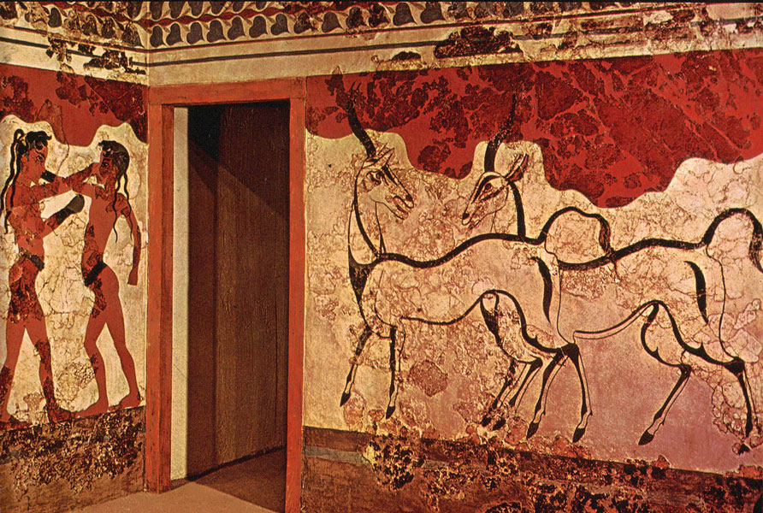
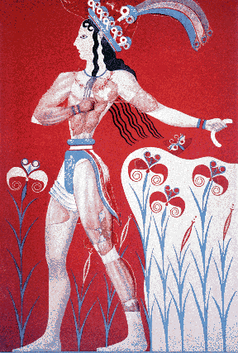
Destruction
The reason for the destruction of the Minoan civilization is uncertain.
It may have been a natural disaster such as a volcanic eruption, earthquake, or drought.
One of that the volcanic island of Thera exploded, causing major environmental catastrophe.
Theory of Atlantis
Some people speculate that the island of Thera, and the Minoan Civilization may be the lost civilization of Atlantis.

Slide 9
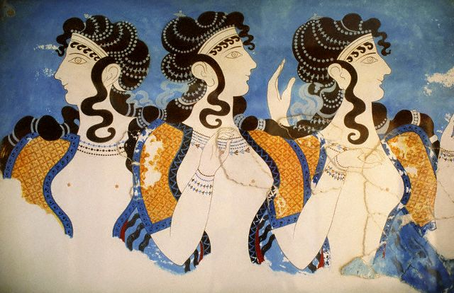
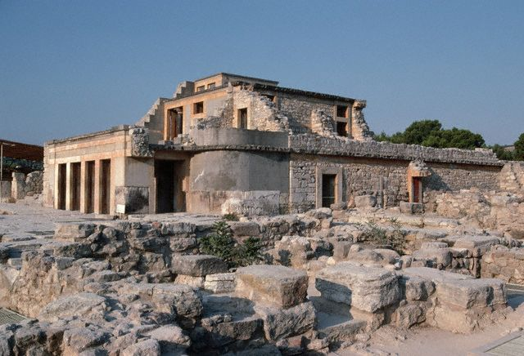
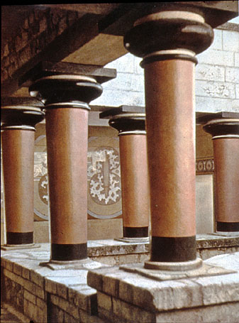
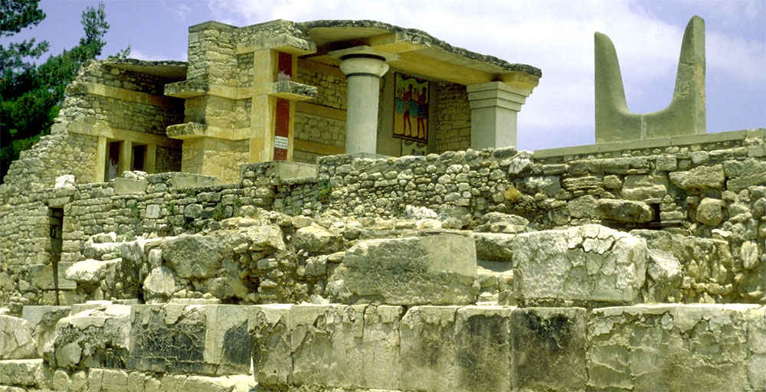
Knossos

Slide 10
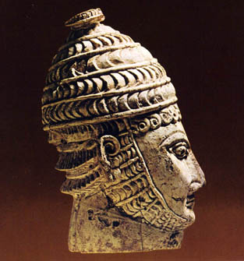
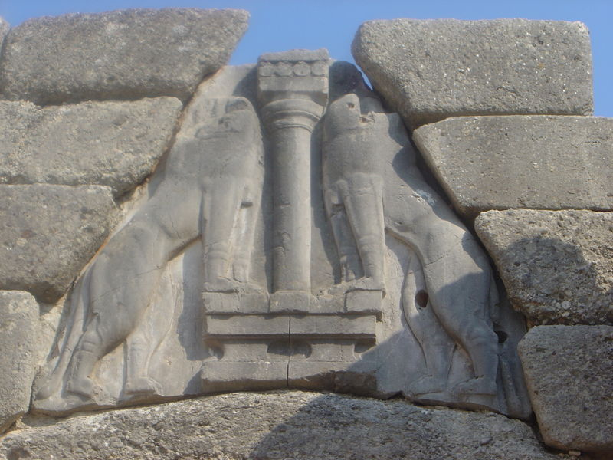
Mycenae
First people to speak Greek
Mycenaean Civilization
(1400-1200 B.C.)
Arose after the defeat of the Minoans
Monarchies
Each city state was ruled by its own powerful king.
Walled Cities
These cities were often at war with one another and so the cities were surrounded by high walls for protection.

Slide 11
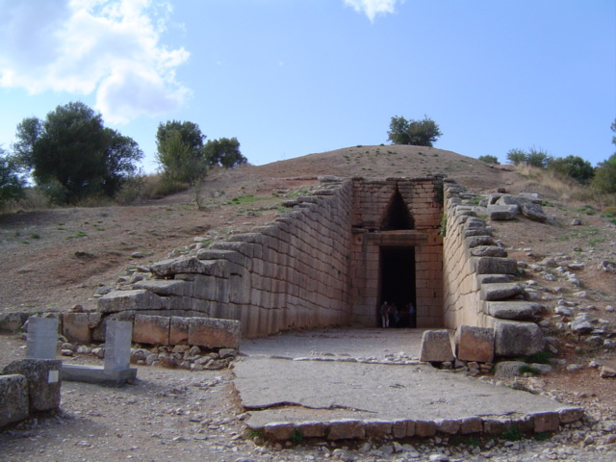
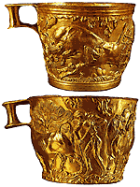
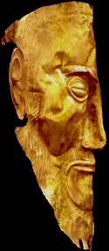
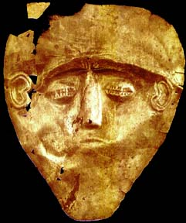
Tholos Tombs
Tombs for members of the royal family.
Were built into hillsides and looked like a beehive. They were full of riches for the dead.

Slide 12
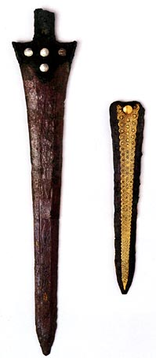
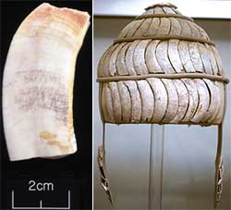
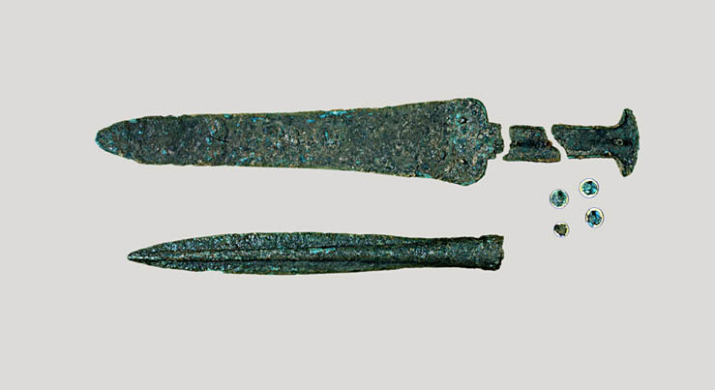
Warrior People
The Mycenaean people were a warrior people who prided themselves on heroism in battle.
Some believe they conquered Crete and many of the other Aegean islands.

Slide 13
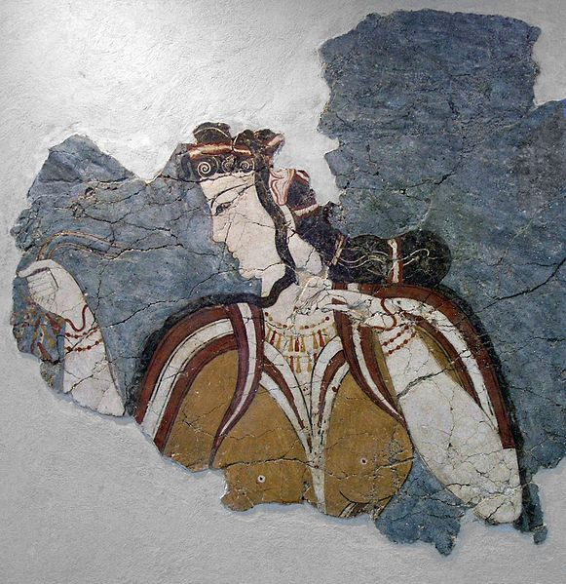
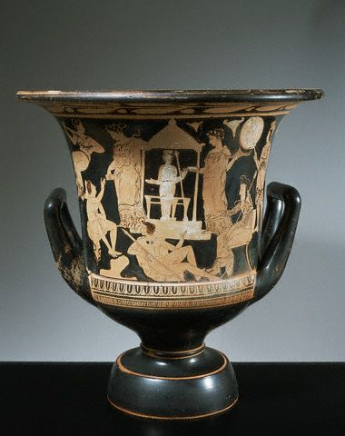
Fall of the Mycenaean civilization
Attributed to foreign invasion
Developments of the Dark Age
Around 1100 BC the Mycenaean civilization collapsed. Numerous cities were sacked and the region entered what historians see as a dark age. During this period Greece experienced decreasing population and they lost their literacy. Historians have traditionally blamed this decline on an invasion by another wave of Greek people, the Dorians, with some Mycenaeans fleeing to Cyprus as well as other Greek islands and parts of Anatolia. (Wikipedia)

Slide 14
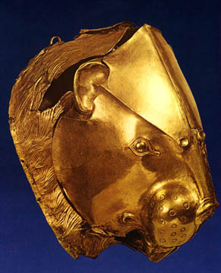
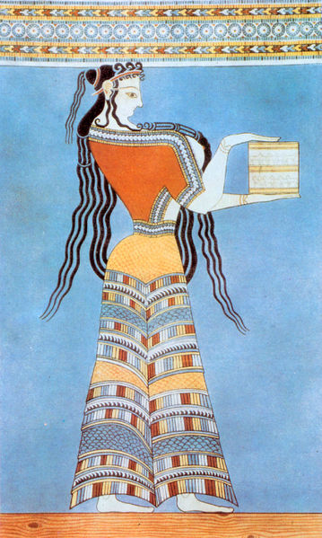
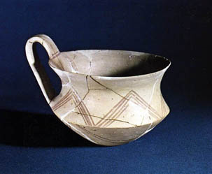
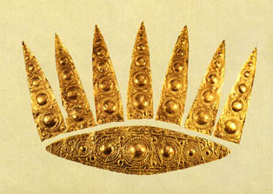
Mycenaean Artifacts

Slide 15
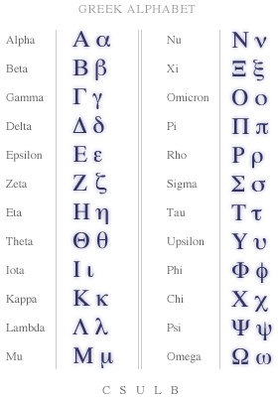
Iron replaces bronze
Allowed for better tools and weapons.
New farm tools helped to revive agriculture.
Revival of Trade
New colonies began to trade with each other.
Adoption of Phoenician alphabet
Simplified the language, made it easier to learn and spread.

Slide 16
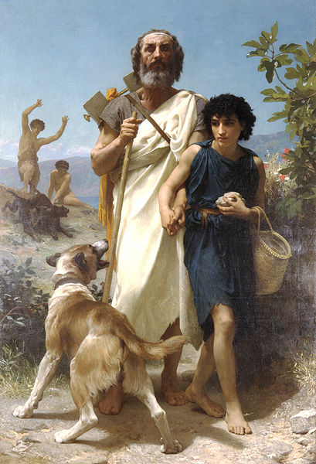
Homer
Epic Poetry
Homer wrote great stories about heroes and wars.
These included the Iliad and Odyssey
Arete
The Greek ideal of Courage and Honor
Greek Heroism
Won through a struggle or contest. Willingness to fight to protect family and friends to preserve honor for yourself and your family.

Slide 17
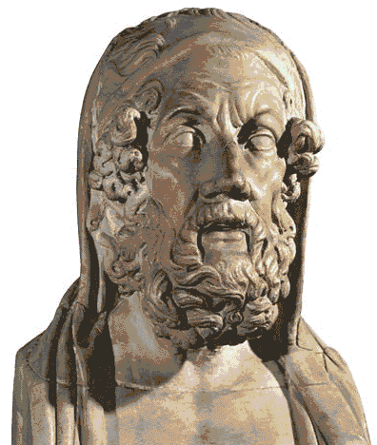
The Trojan War:
The Iliad and Odyssey
Homer
Greek Poet.
It is said that he was a blind storyteller who wandered from town to town.
Two great Epic poems are attributed to Homer.
The Iliad and The Odyssey

Slide 18
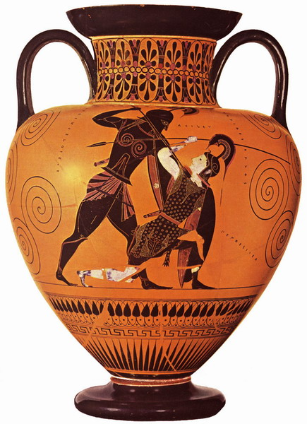
Iliad
The Iliad says the war was faught for love, but in reality is was over money and access to the Dardanelles.
Sparta: Has princes of Troy as guests
Menelaus: King of Sparta
Hector and Paris: Trojan Princes
Helen: Wife of Menelaus
Mythology says that she was the most beautiful woman in the world.
Hector and Paris negotiate a peace treaty with Menelaus. In the meantime, Paris falls in love with Helen and convinces/kidnaps her and takes her back to Troy.

Slide 19
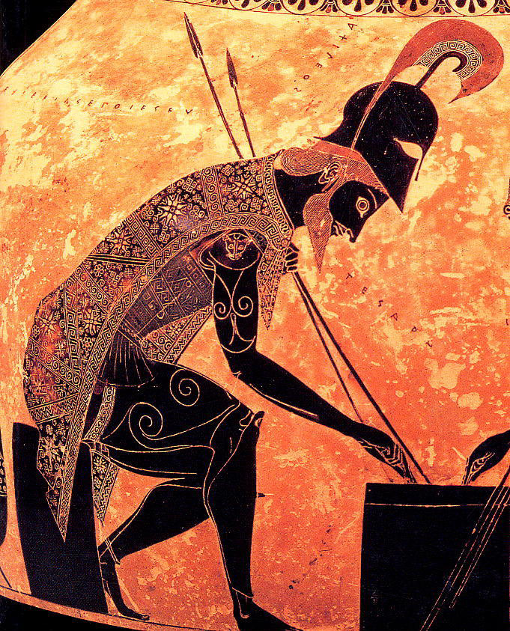
Agamemnon
The brother of Menelaus, he offers to go get his brother’s wife back.
Achilles
Great hero of the Greeks, he was said to be immortal because his mother had dipped him in the river Styx as an infant.
Only his heel did not go in the river, hence your Achilles heel.
Destruction of Troy: The war dragged on for 10 years,

Slide 20
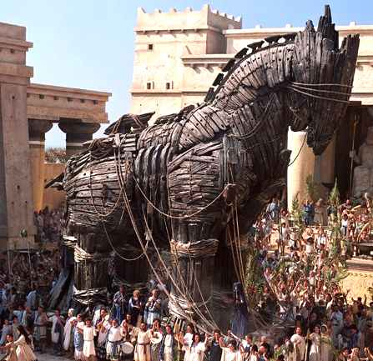
The Trojan Horse
“Beware of Greeks Bearing Gifts!”
According to The Odyssey, the Greeks constructed the horse and pretended to sail away leaving the horse as a gift.
The Trojans brought the horse inside the city and had a huge celebration.
After everyone was asleep soldiers, who were hidden in the horse, snuck out and opened the gates of the city
The Greeks burned Troy to the ground.

Slide 21
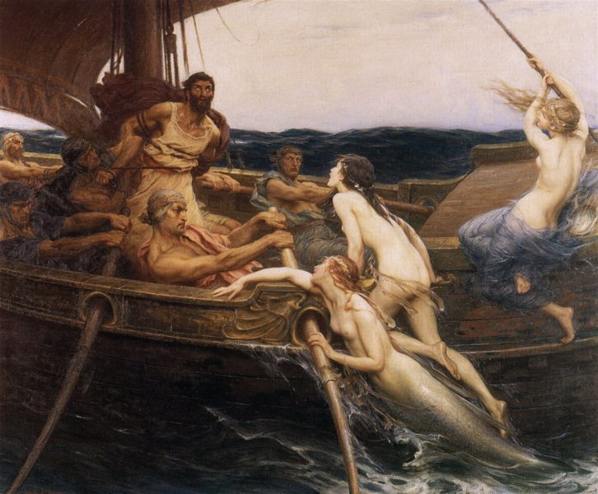
The Odyssey
Odysseus:
From Ithaca
Was a hero of the Trojan War, he is the one who came up with the idea of the Trojan Horse.
The Odyssey is the story of his voyage home to be reunited to his wife Penelope
It takes him 10 years and many trials and tribulations to get there.
Ulysses and the Sirens, 1909,
by Herbert James Draper (1863-1920).

Slide 22
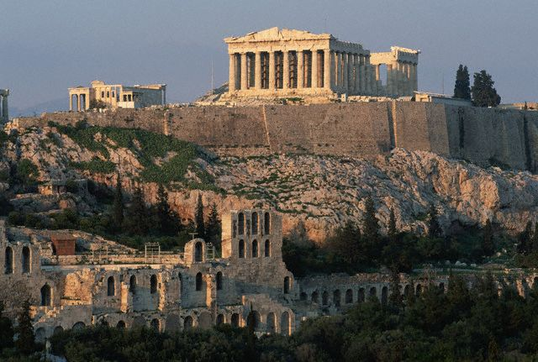
The Greeks became overcrowded and began to spread out and started new colonies. These eventually became city-states.
Polis: A Greek city-state, it was the basic political unit of Greece.
The Polis was designed to promote civic and commercial life.
Acropolis: The upper part of the city where the temples and public buildings were located.
The Acropolis sat atop the Polis.

Slide 23
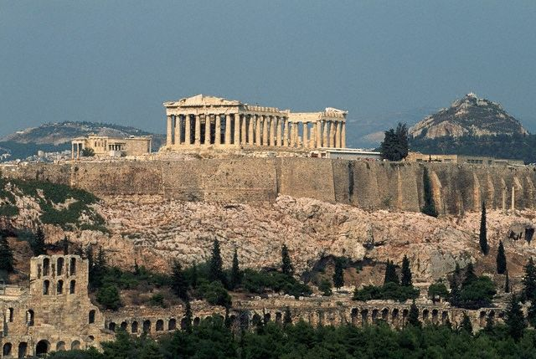
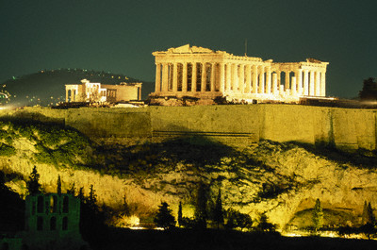
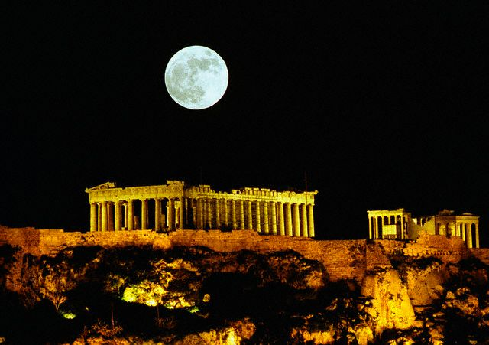
The Acropolis

Slide 24
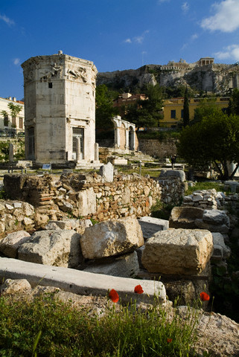
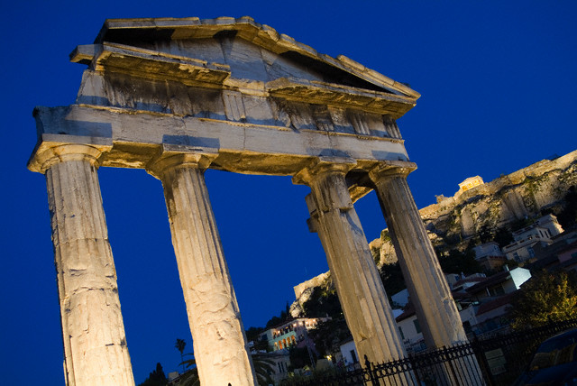
Agora
The Agora was the open-air market place of a Greek Polis.
It was usually below the Acropolis.
The nice climate of Greece allowed for people to be outdoors and take an active part in commerce and politics.

Slide 25
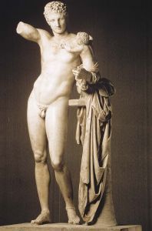
Groups within the Polis
Social structure and citizenship in the Greek polis
• Citizens (free adult males) had
political rights and the responsibility
of civic participation in government.
• Women and foreigners had no political
rights.
• Slaves had no political rights.
Slavery was not based on race in ancient Greece. Slaves were prisoners of war or debt slaves who could not repay a debt.

Slide 26
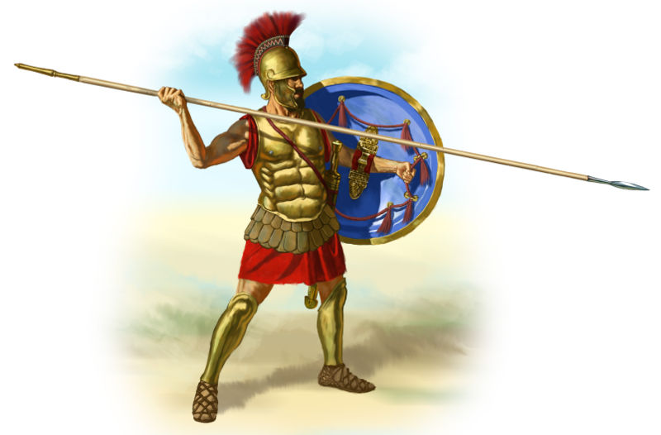
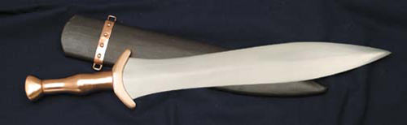
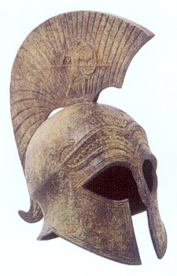
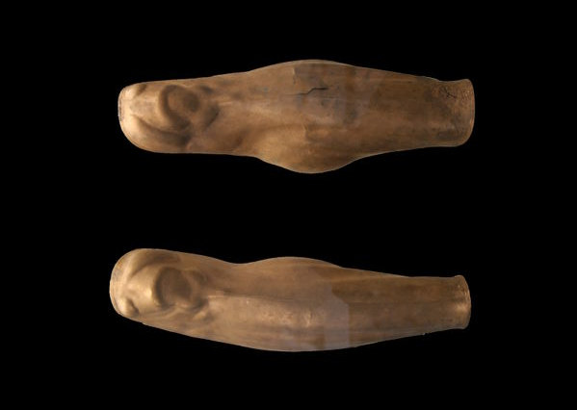
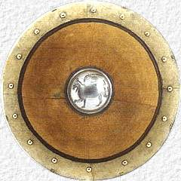
Hoplites
Heavily armed infantry, or foot soldiers.
Each carried a round shield, a short sword, and a thrusting spear about nine feet long.
Round shield covered with leather.
Greaves, or leg armour
Bronze Helmet

Slide 27
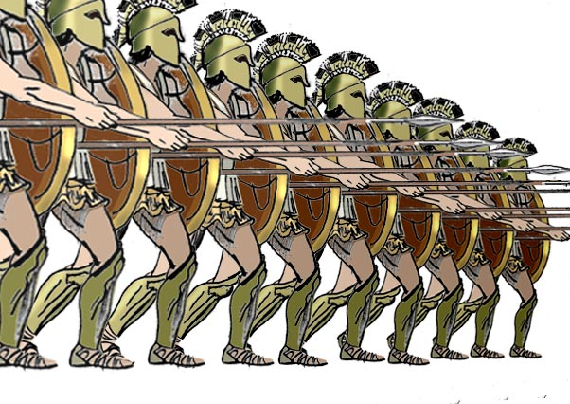
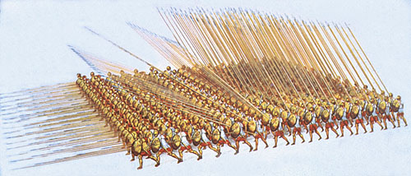
Hoplite battle unit, with a close formation that created a wall of shields to protect the soldiers.
Troops were disciplined to hold a line which created a nearly impenetrable forest of points to the front.
Phalanx

Slide 28

Greek Colonies
Overcrowding: Lack of arable (fertile) farmland made overcrowding a major problem.
Est. of Colonies: As these areas became too crowded, the Greeks spread out and started new colonies.
Cultural and Economic Diffusion: The spread of colonies spread Hellenic (Greek) culture throughout the Aegean and into the Mediterranean.
Trade: As trade increased Greece shifted from a barter economy based on trade to a money economy with coins.

Slide 29
Bosporus
Macedonia
Dardanelles
Troy
Aegean
Asia Minor
Ionia
Athens
Peloponnesus
Sparta
Crete
Knossos

Slide 30

Patron god was Ares, the god of war.
Territory expansion, unlike other city states, which split up and moved elsewhere when the ran out of land, Sparta simply took over the territory of its neighbors and made them slaves.
Helots were the captured people of the Spartans, the name meant capture. They were from the territory of Messenia.
The helots initially revolted, but the Spartans developed such a strong military that they were able to keep them in check.
A Wall of Men: The city-state of Sparta did not have an outer wall, they said that they did not need it because they had a wall of men.

Slide 31



Slide 32

Life in Ancient Sparta
Birth: At birth a child was checked
Children seen as defective or too weak
were left on a hillside to die.
If a child passed, they were bathed in wine
and given to a Helot nurse so their mother would not spoil them.
Childhood: Age 7
At this age a boy would start his military training.
Military Training
Learning to cheat, lie, and steal
Boys were trained in physical fitness and fighting styles.
They were fed too little on purpose so they would have to learn to be cunning to survive.
-There is a story about a boy who stole a fox and was caught. He allowed the fox to claw him to death rather than admit he had stolen it, this preserved this honour of his family.

Slide 33

Military Service At the age of 20 men started regular military service. They were allowed to marry, but had to live in the barracks with the other men until the age of 30.
At age 30, they were allowed to vote and live at home.
Retirement Men stayed in the military until the age of 60.
“Come home carrying your shield or on it”
Sparta would never surrender or retreat in battle, even if greatly outnumbered.
Spartan Women Women in Sparta had more rights than women in most of the rest of Greece.
Women were trained in physical fitness and expected to exercise and bear strong children, especially sons.
Women were expected to mount a fierce defense of their homes if they were attacked while the men were away.

Slide 34

Spartan Government
Oligarchy: Rule by a small group
Ephors (And two kings)
There were five Ephors who were elected from the citizenship of Sparta each year. They took an oath uphold the rule of the kings. The Kings took an oath to uphold the law.
The Ephors may have kept order while the kings were leading armies in battle.
Council of Elders (Gerousia) The law-making body of Sparta. Was only open to people over 60 years old. They prepared laws for the assembly of citizens to vote on.

Slide 35


Social Isolation
Sparta was considered backward and uncultured by the other city states of Greece. They were not interested in art or culture. They didn’t write down their history, but are considered by many to have been one of the greatest militaries that every lived.

Slide 36


Athens went through several stages in its government
It eventually became the world’s first democracy.
Monarchy: Rule by a king or queen
Athens was traditionally first ruled by kings
As the polis of Athens increased trade and became more wealthy a social class of Aristocrats emerged.
These eventually became an Aristocracy.
Aristocracy
A form of Oligarchy, rule by the upper-class landowners.
The upper-class ruled Athens for a period of time, taking advantage of the majority of people, who were poor. These poor people were forced into debt slavery and began to demand reforms.

Slide 37

Tyranny: Rule by someone who takes power, not necessarily bad, some were good rulers.
Draco: Codified the laws of Athens.
He came up with Athens's first written law code. The laws were very harsh, but did made some advancements
-codified laws allowed for precedent and knowledge of the law.
-the law distinguished between murder and involuntary killing.
The punishment for most things was death.
The term Draconian, which means harsh, comes from his name.
Solon “so long to debt slavery”
Solon was an aristocrat and reformer.
Solon cancelled debts for the poor and ended debt slavery.
He refused, however, to attempt land reform which still left many of the poor landless.

Slide 38
Pisistratus
Another Athenian Reformer
He instituted land reform by taking land from the rich and giving it to the poor.
Cleisthenes
Created a council of five hundred that ran foreign affairs, and oversaw the treasury. He restructured the entire political system to put more power in the hands of the people and remove it from the aristocrats.
The Athenian Assembly was made up of male citizens was given authority to pass laws after free and open debate.
This created the foundations for democracy in Athens.
Democracy: Rule in which people vote and make laws/choose leaders.
Direct Democracy: When people vote directly on laws.

Slide 39

Challenge of Persia The Persian Empire occupied Asia minor to the east. They took over the area of Ionia in 519 B.C..
Ionian Revolt
In 499 B.C. the Ionian Greeks asked the mainland Greeks to help them rebel against the Persians.
Those Greeks will pay for this
We’re on the way
Help!
Athens sent warships to help them, but they were not strong enough to defeat the Persian army.
Darius
The made the Persian King, Darius, very angry with Greece, he vowed to seek revenge against the Athenians for messing in Persian affairs.

Slide 40

Battle of Marathon 490 B.C.:
In 490 B.C. Darius sent 600 (according to Herodotus) ships and thousands of soldiers to invade Greece. He wanted to punish the Athenians for helping the rebels.
The Persian army landed at Marathon, north of Athens, in 490 B.C.
The Persians greatly outnumbered the Greeks.
The Persians and Greeks dug into defensive positions and didn’t do anything for several days.
After a few days, the Persians decided to attack Athens by sea and split their forces to send some to Athens and leave the others there to hold off the land.
While they were loading their ships, the Athenians attacked and defeated them.
The Greeks won the Battle of Marathon

Slide 41


Marathon
Legend says that the Greeks sent their fastest runner Phiddipidies to carry home news of the victory.
He sprinted 26.2 miles from the battle site to the city-state of Athens.
He arrived and said, “Rejoice, we conquer,” and died from exhaustion
The Marathon race is named after this event.
This event didn’t actually happen

Slide 42
The Real Story
After the Greeks had defeated the Persians at the beach of Marathon the Persian naval forces were still sailing toward Athens.
After fighting for three hours that morning, the soldiers who were not wounded marched the approx. 26 miles back to Athens to defend the city against the Persian naval forces.
The soldiers made it in about 6-7 hours, when the Persians saw them guarding the city, they didn’t even attempt to land, they just sailed away.

Slide 43

The Greek (Athenian) ruler Themistocles knew this was a temporary victory.
He encouraged the Athenians to build up their fleet and prepare for battle with the Persians.
In 480 B.C. Darius’ son Xerxes sent a larger force to conquer Greece.
He sent 200,000 soldiers and nearly 1,000 ships.
By this time Athens had convinced Sparta to join them in battle. The Persian War united the city-states of Greece for the first time.
Twenty Greek city-states joined together to meet the Persian invaders.
Sparta took charge of the army.

Slide 44

Spartan Bravery
An alliance of Greek states joined together to fight the Persian Empire.
The Persians greatly outnumbered the Greek army, but the Greeks held them off for 3 days.
When defeat was imminent the Spartans ordered the other Greeks to leave.
Only 700 Thespiae volunteers agreed to stay and fight with the Spartans.
There were 300 Spartan forces and 700 others to take on a Persian army speculated to have been over 1 million (but was closer to 200,000).

Slide 45


The Spartans situated themselves in a narrow mountain pass to gain a strategic advantage.
They battled The Immortals, the elite Persian Troops.
They were betrayed by a local resident who led the Persians behind the troops.
The Greeks were surrounded and fought bravely to the death. They took many of the Persians with them.
The Bravery of the Spartans won time for the other Greek to flee Athens and mount a defense at Salamis.

Slide 46

Destruction of Athens: The Persians marched south after their victory at Thermopylae and destroyed the city of Athens, burning it to the ground.
Salamis
The Athenians had already moved to Salamis, a small nearby island.
Thermopylae
Salamis
Athens
More than 800 Persian ships attacked the Athenian navy near the island.
The large Persian ships could not maneuver in the water. The smaller Greek ships destroyed them by ramming their ships.
Plataea: Final battle of the Persian Wars, the Greeks won.

Slide 47

Growth of the Athenian Empire
Delian League: After the Persian War the Greek sense of uniqueness and culture was increased.
The Greeks formed a military alliance called the Delian league.
Athens was the head of the Delian League.
The Delian league eliminated the Persian Empire from Greek territory.
Athens used the league to assert power and build an Athenian Empire.
They moved the treasury to Athens, and forced people to stay in the league against their will.
This led to resentment from some of the other city-states.

Slide 48

The wise and skillful leadership of Pericles brought about a Golden age in Athens.
This was from about 460 to 429 B.C. and is often called the Age of Pericles.
Pericles believed that all male citizens, regardless of wealth or social class, should take part in government.
He paid salaries to men who held public office. This enabled the poor to serve in the government.
Pericles stated, “We alone, regard a man who takes no interest in public affairs, not as harmless, but as a useless character.
Construction Projects: Pericles rebuilt the city of Athens after its destruction in the Persian wars using Delian funds.

Slide 49

The Parthenon
The Parthenon was built on the Acropolis in Athens.
It was dedicated to their patron goddess, Athena, the goddess of wisdom.
It had 46 Doric columns, was 237 feet long and 110 feet wide.
During construction, the builders knew the columns appeared to bend when viewed from a distance. Each column has a slight curve so it appears straight.

Slide 50
The Assembly: The law-making body of Athens.
The assembly met several times a month and needed at least 6,000 members present to take a vote.
This was direct democracy, a large number of citizens took part in the day to day affairs of the government.
Members of the Polis
Political Rights: Free Adult Males. Aristocratic males who owned land.
No Political Rights: Women and Foreigners had no political rights.

Slide 51

Political reforms of Pericles
Pericles made participation in the government more accessible.
Ostracism
To defend against overly ambitious political members of the assembly could write a name on a piece of broken pottery and name a person they considered harmful.
If they were named by at least 6,000 members they would be banned from the city for 10 years.
Cultural Center of Greece: During the Age of Pericles, Athens became the center of Classical Greek Culture.

Slide 52

The Peloponnesian War
Many Greeks resented the Athenian domination.
The Greek world split into rival camps.
To counter the Delian League, Sparta and other enemies of Athens formed the Peloponnesian League.
A 27 year war broke out in 431 B.C. engulfing all of Greece

Slide 53
Athens faced a serious geographic disadvantage from the start.
Sparta was located inland, the Athenian navy was no good against them.
When Sparta invaded Athens, Pericles allowed people from the countryside to move inside the city.
Overcrowding led to a plague that killed a third of the people.
Internal struggles undermined the Democratic government of Athens.
Sparta even allied with Persia, their old enemy, against the Delian League.
Finally, in 404 B.C., with the help of the Persian navy, the Spartans captured Athens and stripped it of its fleet and empire.

Slide 54
Effects of the Peloponnesian War
The Peloponnesian war ended Athenian greatness.
In Athens Democratic government suffered: Corruption and selfish interests replaced order.
Fighting continued to disrupt the Greek world.
Sparta itself suffered defeat at the hands of Thebes, another Greek city-state.
Greece was left vulnerable to invasion.
Cultural development was arrested.

Slide 55

Daily Life in Classical Athens
Slavery
At its height Athens had over 100,000 slaves.
Slavery was common, and most people owned at least one slave.
Most worked in the fields, or in the home as cooks and maids.
Many were prisoners of war or debt slaves.
Athenian Economy
Was based on agriculture and trade.
Trade
Grapes and Olives were the two main exports.

Slide 56

Family and Role of Women
The Athenian family was the husband, wife, and children.
It also sometimes included extended relatives and slaves.
Women could not own property and had to have a male guardian.
If they were not married they lived with their father or another male relative.
Woman were married at age 14 or 15 and were not given any formal education.
They were expected to remain in the home and out of sight.
They were not allowed to leave the house without a companion.

Slide 57

Section 4: The Culture of Classical Greece
Greek Religion: Was used to explain natural phenomena.
Greek gods and goddesses had human characteristics.
Creation
Mother Earth (Gaea) and Ouranos (Father Earth)
Gave birth to creation
The Monsters
First children of Mother and Father Earth.
Included the Cyclops
The Titans
Children of Creation, they came before the gods of Olympus.
They were led by Chronos, father time.

Slide 58



King of the gods, the ruler of Mount Olympus, and god of the sky and thunder, in Greek mythology. His symbols are the thunderbolt, bull, eagle and the oak.
He was married to the goddess Hera, although he was not very faithful.
The Roman name for Zeus is Jupiter.

Slide 59


god of the sea, as well as of horses and, as "Earth-Shaker", of earthquakes.
Roman name is Neptune

Slide 60



The god of the dead
Hades was the ruler of the Greek Underworld (which itself is sometimes confusingly referred to as "Hades" also). In mythology, he was the brother of Zeus and Poseidon
Roman Name is Pluto

Slide 61



goddess of civilization, specifically wisdom, weaving, crafts and the more disciplined side of war (violence and bloodlust were Ares' domain). Athena's wisdom encompasses the technical knowledge employed in weaving, metal-working, but also includes the cunning intelligence (metis) of such figures as Odysseus. The owl and the olive tree are sacred to her.
Was the patron goddess of Athens
Roman name is Minerva

Slide 62



archer-god of medicine and healing, light, truth, archery and is a god of music and poetry
Frequently referred to as the god of the sun.
Roman name is also Apollo

Slide 63



goddess of love, lust, beauty, and sexuality. Her Roman equivalent is the goddess Venus.

Slide 64

Characteristics of the Greek gods
The gods and goddess of ancient Greece had human characteristics.
Mt. Olympus: Traditional home of the Greek gods.
Rituals
The Greeks wanted to win favor with the gods so they made offerings and practiced prayers and rituals frequently.
They believed the gods played a role in their daily lives.
Oracles: Sacred shrine where priest or priestess made predictions.
Delphi: Home of the Oracle of Apollo, the most
famous of the oracles.

Slide 65




The Greeks began the practice of performing plays in outdoor amphitheatres.
Theatre began as a religious festival worshipping Dionysus, the god of wine and fertility, but evolved into the art form we are familiar with today.
A group of actors, called the chorus, stood on stage and talked about what was happening in the play.
Only men were allowed to be actors.
The actors wore large masks, perhaps with amplification devices in them, perhaps so that it was easy to tell the emotion of the actor by looking at their mask.
Tragedy and Comedy were the two areas of Greek theatre

Slide 66


There were two types of Greek plays, Comedy and Tragedy.
Two of the fathers of Greek Tragedy were Aeschylus and Euripides
Aeschylus
(c525-456 BC)
“Greek playwright whose tragedies are the first known plays. He was a soldier in the Athenian army, and fought at the historic battle of Marathon in 490 BC. The war was the subject of his play Persians (472), the earliest known play by any playwright.”

Slide 67


Sophocles
Greek Tragic playwright.
His most famous play is Oedipus Rex, or Oedipus the King.

Slide 68

Greek Philosophy
Philosophy: An organized system of thought.
A Philosopher was a Lover of Wisdom
Sophists: Group of traveling teachers in ancient Greece. They argued that it was beyond the human mind to understand the Universe and that people should focus on understanding themselves . To them success was more important than moral truths.

Slide 69


Socrates c. 469-399 B.C.
Socrates Encouraged people to examine their own beliefs and ideas.
He wrote no books, but questioned fellow citizens about their beliefs and ideas.
He used a method of questioning now called the Socratic method; learning through the use of critical thinking, reason and logic (question and answer)
Socrates believed this was the way to seek truth and self-knowledge.
To the people he was an annoyance and a threat to their way life.
When Socrates was 70 he was put on trial for “corrupting the city’s youth and failing to respect the gods.”
He was loyal to the laws of Athens, and accepted his death penalty and drank a glass of Hemlock, a deadly poison.
“The unexamined life is not worth living.”
“Know Thyself”

Slide 70


Plato c. 427-347 B.C.
Plato was shocked by the death of his teacher Socrates. He stayed away from Athens for 10 years.
When he returned, he established the Academy, a school that lasted for the next 900 years.
Plato emphasized the importance of reason.
He believed that through rational thought, people could recognize perfect beauty, and learn to organize an ideal society.

Slide 71
He believed in a world of “forms” where the perfect form of everything on earth existed.
He wrote The Republic, a book that describes an ideal state. He felt the state should regulate every aspect of citizens’ lives. He believed society should be made up of three groups:
  Workers: to produce necessities of life.
  Soldiers: to defend the state
  Philosophers: to rule
He thought that women could rank among the elite. In general, he felt that men surpassed women in mental and physical tasks, but some women were better than some men.
He believed that talented women should be educated and all people should take military training and raise children in communal centers for the good of the republic.

Slide 72
Aristotle c. 384-322 B.C.
Plato’s most famous student, Aristotle, developed his own ideas about the best kind of government.
He found good and bad examples of all types of government.
He was suspicious of democracy, he thought it led to mob rule.
He supported rule by a single strong and virtuous leader.
He addressed the question of how people should live. He felt people should pursue the “golden mean,” a moderate course between extremes.
He believed that reason should be the guiding force for learning.
He set up a school, the Lyceum.
He left behind many writings which became the basis for later educational systems in Europe.
Was the tutor of Alexander the Great.

Slide 73


History
Herodotus c. 480-430 B.C.
Herodotus is known as the “Father of History.”
His book History contains two main parts.
The first, a description of the population of the Persian Empire, a guide to their customs and geography.
The second, the history of the wars between Persia and Greece.
The Persian king Xerxes

Slide 74



Architecture
Greek Columns
Doric
Ionic
Corinthian

Slide 75



Architecture and Sculpture
Realism
Hellenistic sculpture took a departure from the Greek idealized style to a style emphasizing realism.

Slide 76




Mathematics
Euclid c. 365B.C. –300 B.C.
Often called the “Father of Geometry,” Euclid wrote the book The Elements, which became the foundation for Geometry.
Pythagoras c. 580 B.C.-500 B.C.
.The Pythagorean Theorem is attributed to Pythagoras and his followers a² + b² = c^{2.}

Slide 77

Science
Archimedes
c. 287 B.C. to 212 B.C.
A Greek mathematician and scientist, he was most likely educated in Alexandria, Egypt.
Legend says that while trying to solve a problem of measuring volume, he discovered the principle of the up-thrust on a floating body. He did this by getting into the bathtub and noticing the water overflow onto the floor at which time he shouted “Eureka,” meaning “I have found it.”
His major contributions to mathematics include discovering the formulae for the areas and volumes of spheres, cylinders, parabolas, and other geometric figures.
He was killed by a Roman soldier during the siege of the city of Syracuse because he ignored the soldier’s challenge while he was engaged in a math problem.

Slide 78

Medicine
Hippocrates c. 460 B.C.-337 B.C.
Hippocrates is known as the “Father of Medicine.”
Very little is known about his personal life.
He was a philosophic doctor collecting information on the various parts of the body and seeing the body as the sum of its parts, not as all of the parts individually.
The Hippocratic oath, which doctors take today promising that they will deny no one medical attention, is associated with him, although he most likely did not write it.

