Slide 1
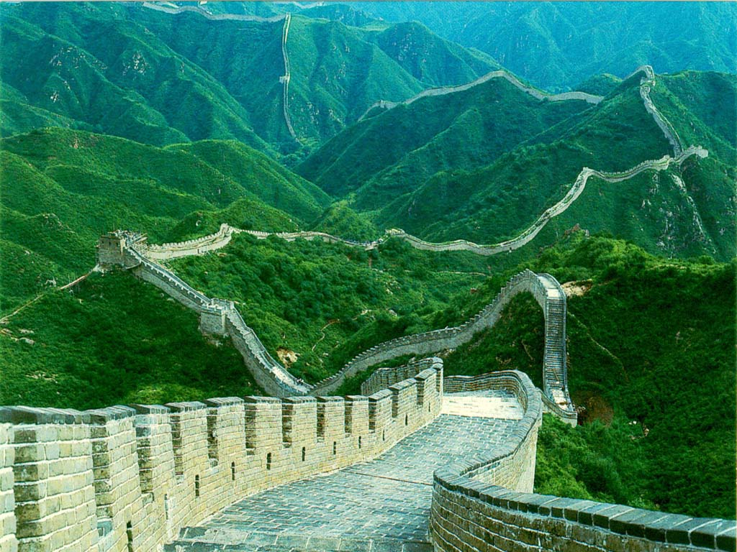
Ancient China

Slide 2
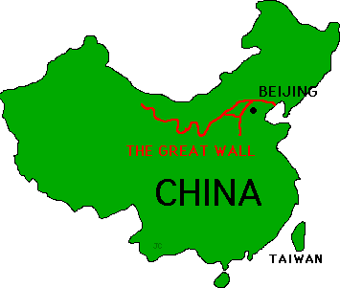
Four dynastic cycles –
Shang, Zhou, Qin and Han
Dynasty – family of kings
Ruling dynasty began to falter, usually another one arose and the pattern started anew

Slide 4
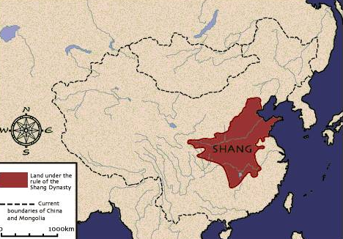

Slide 5
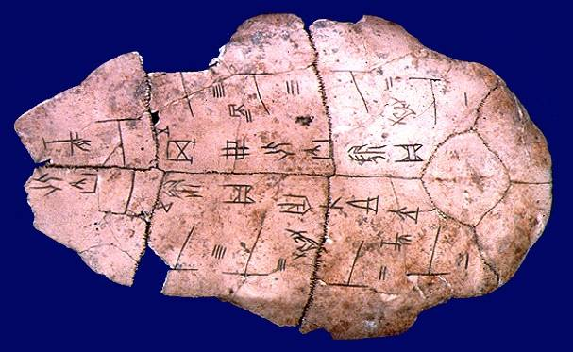

Slide 6
The Evolution of Chinese Writing during the Shang
Pictographs
Semantic-Phonetics – Written Language

Slide 7
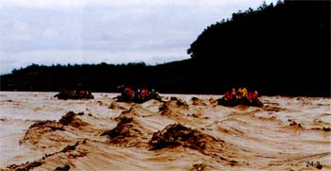
Zhou Dynasty (1027 – 256 BCE)
Ruled through alliances with regional Princes. Extended territory to Yangzi River and promoted standard Mandarin Chinese language.
China’s feudal period
Extended the territory
“Middle Kingdom” – China’s core – rich land between Huang He to Yangtze – wheat and rice growing
“Mandate of Heaven” – justification for Chinese imperial rule
Confucianism and Taoism appear during this dynasty
The Yellow River or Huang He, received it name “River of Sorrow” because it often flooded and destroyed crops
Oracle Bones
A way to communicate with the ancestors. Animal bonds were carved with questions, then heated or broken. A priest then interpreted the breaks.

Slide 8
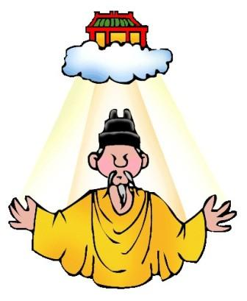
The Mandate of Heaven
1. The leader must lead by ability and virtue.
2. The dynasty's leadership must be justified by succeeding generations.
3. The mandate could be revoked by negligence and abuse; the will of the people was important.
4. The Chinese later expanded this idea to explain the dynastic cycle, when ruler became weak or corrupt, Heaven withdrew its Mandate and gave it to another ruler.

Slide 9
Confucianism
Concerned with worldly goals, social order, and good government
H armony exists when people accept their place in society
5 key relationships
Father to son
Elder brother to younger brother
H usband to wife
Ruler to subject
Friend to friend

Slide 10
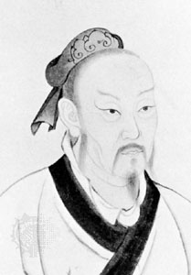
Confucius, China’s most influential philosopher, taught that harmony resulted when people accepted their place in society.
Confucianism – Stressed the values of filial piety, loyalty to superiors and respect for inferiors, honesty, hard work, and concern for ethics.
Confucius, c. 551- 478 B.C.E. – Chinese philosopher who wrote an elaborate political philosophy that became the core of China’s cultural and political thinking for centuries. Those who adopted his teachings saw him not as a deity bust as a master of ethics.
Confucius

Slide 11
Daoism (Taoism)
Sought to live in harmony with nature
You are at harmony with the Tao only when you accomplish “not-doing”
Reject conflict and strife
Founded by Lao Tzu
Yin is the darker element; it is passive, dark, feminine, downward-seeking, and corresponds to the night. Often symbolized by water or earth
Yang is the brighter element; it is active, light, masculine, upward-seeking and corresponds to the day. Often symbolized by fire or wind.
“When you are content to be simply yourself and don’t compare and compete, everybody will respect you”
- Tao Te Ching

Slide 12
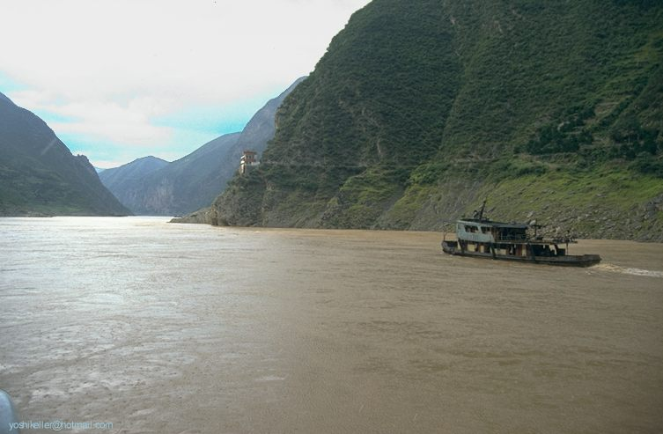
Warring States Period 402-201 B.C.E. – period when the Zhou system disintegrated, it is during this time period that we see the new philosophy of “Legalism” arise
Qin dynasty takes over
Qin Shi Huangdi –First emperor – characterized by centralizations of state rule elimination of local and regional competitors
Yangzi River Valley
Expanded boundaries of China to include Hong Kong
The Great Wall of China was built in this era

Slide 13
Legalism
Legalist disdained Confucian virtues in favor of authoritarian state that was ruled by force. For legalists, human nature was evil and required restraint and discipline- the army would control and the people labor- in the perfect state.

Slide 14
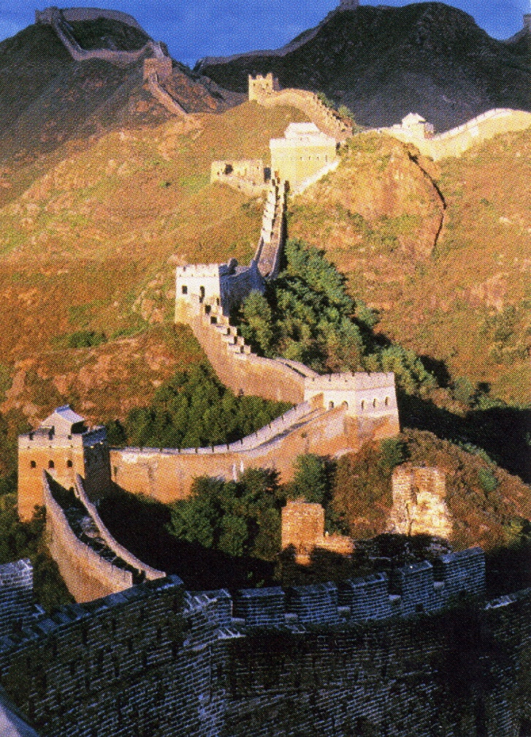
Qin Dynasty
221 – 206 BCE
Shi Huangdi - “First Emperor”
Standardized weights and measurements
Roads, canals, and Great Wall of China
Book burning
Heavy taxes, forced labor, cruel politics

Slide 15
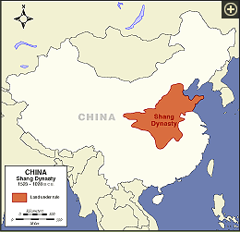
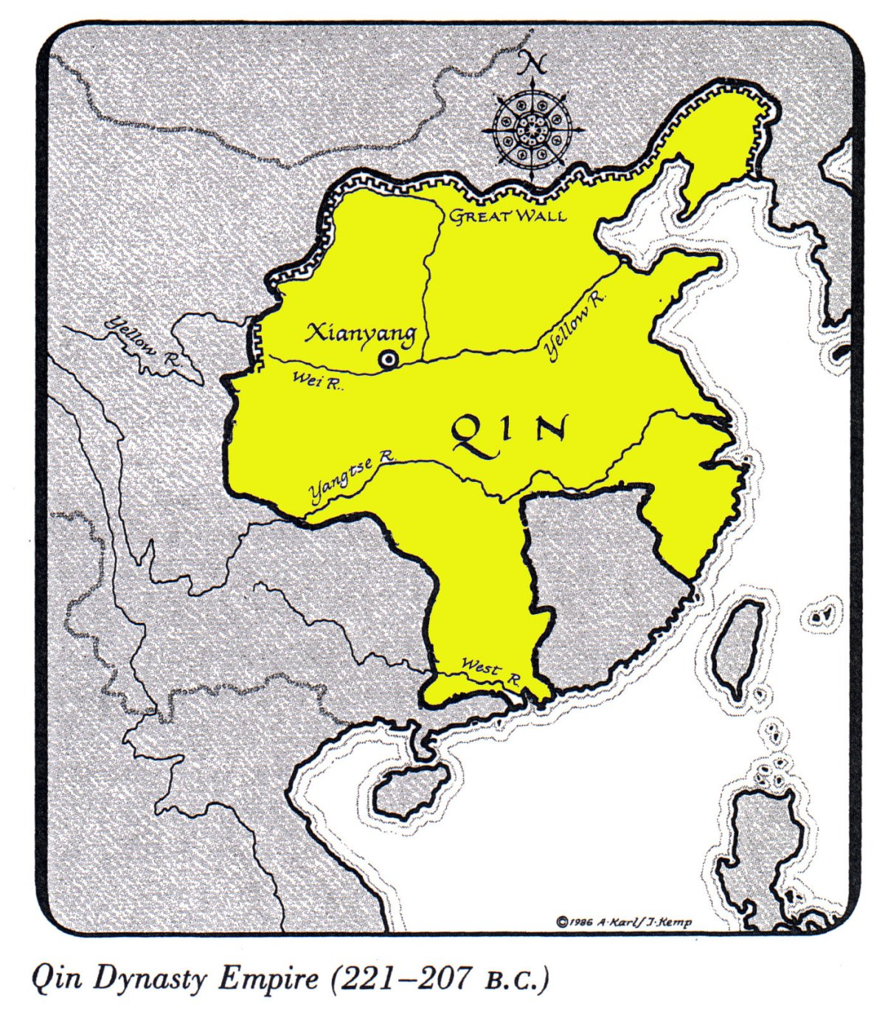
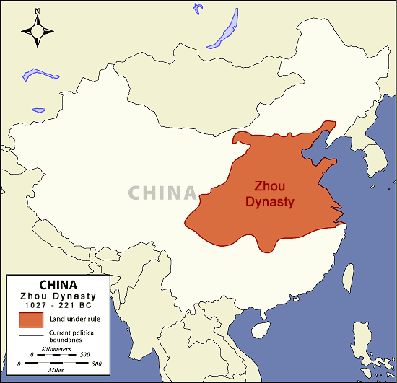

Slide 16
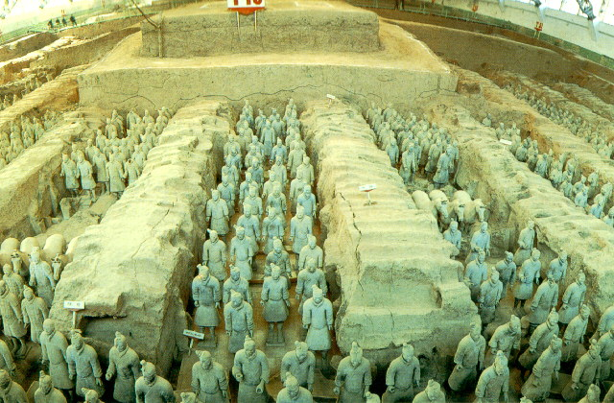
Terra Cotta Warriors – During Qin Dynasty

Slide 17
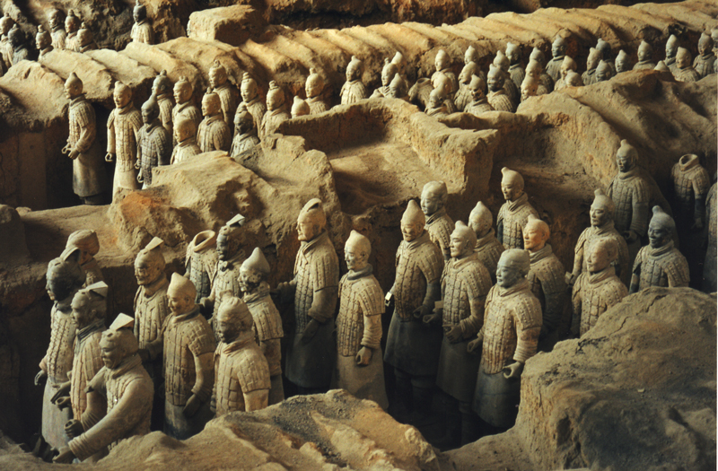
Terra-Cotta Army

Slide 18
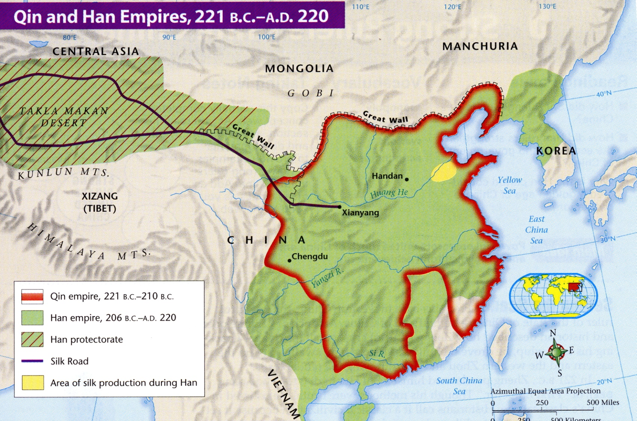

Slide 19
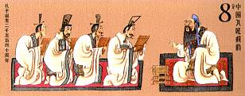
The Han dynasty: (202 B.C.E. – 220 C.E.) – Followed the Qin dynasty Chinese considered themselves - “People of the Han”
Era generally characterized by stability, prosperity, and peace. Contemporary often compared to the Roman Empire.
Han Rulers strengthened Chin’s government, expanded China’s borders and Influenced and opened up the Silk Road, a major trade route that would link China and the west for centuries.

Slide 20
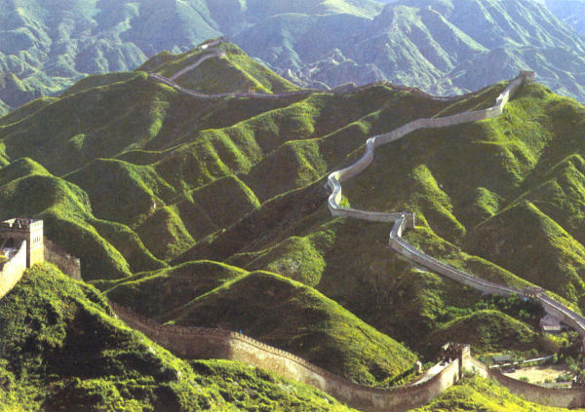
The Great Wall – started during the Qin dynasty
The Han period was one of the golden ages of Chinese civilization with tremendous advances in the sciences, astronomy, technology, medicine and the arts.
Paper was invented
Ox-drawn plows and new collar
Pulleys and winding gear

Slide 21
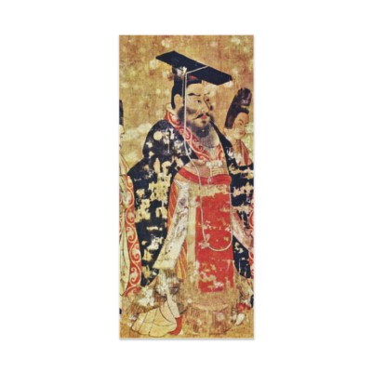
Wu Ti, 140 -87 B.C.E
Enforced peace throughout most of the continent of Asia
Supported Confucianism and established shrines to promote worship of the ancient philosopher as a god.
Notes:
Wu Ti, 140-87 B.C.E. was the most famous Han ruler. 1. He enforced peace throughout most of the continent of Asia, rather like the Pax Romana of one hundred years later. 2 Han rule time of peace and prosperity for China 3. Urged support of Confucianism and established shrines to promote worship of the ancient philosopher as a god.

Slide 22
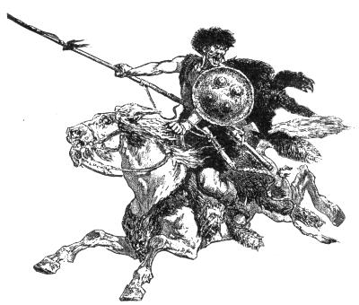
Demise of the Han Dynasty
The Huns, a nomadic people from central Asia overturned the Han dynasty and occupied China from 220 C.E. until 531 C.E.
Between 220 and 589 China was in a state of chaos. By the time stability restored the classical and formative period of Chinese civilization had ended.
Notes:
A nomadic people from North central Asia. Organized into hordes, indomitable horsemen. They first appeared in the third century B. C. E. when the Great Wall of China was built to keep them out. They occupied China from the third century to 531 C. E. About 372 they invaded the Volga Valley and advanced west push the Ostrogoths and Visagoths before them., thus starting the waves of migration that destroyed the Roman Empire In 432 they forced Emperor Theodosius II to pay tribute to Attila from his head quarter in Hungary, levied tribute in nearly all central and eastern Europe but was defeated in Gaul in 451. The Huns withdrew after his death and little is know of their later movements.

Slide 23
The Fall of the Han Dynasty
Warlords
Tax burden leads to rebellion
Canals and roads in disrepair
Divided into 3 kingdoms
Invaders
Reigns short and violent
Nomad mercenaries

Slide 24
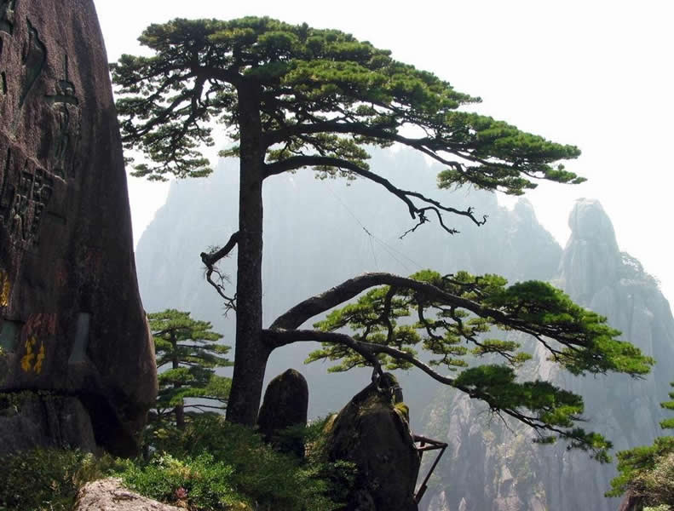
Era of Divisions
The demise of the Han Dynasty and occupation of China by the Huns resulted in a chaotic time known as the Era of Divisions that lasted from 220 C.E. until 531 C.E.

Slide 25
Religion and Culture
Role of education – achieve social ends
Confucianism – ethical system based on relationships and personal virtue, predominant philosophy
Legalism – countered Confucianism – authoritarian state and harsh rule
Daoism – harmony with nature and humble living. Laozi – was Daoism founder
Art – decorative, carved jade and ivory, silk screens, calligraphy
Science/math – Astronomy important

Slide 26
Economy and Society
Economy focused on agriculture
Sharp class division existed –
a. landowning aristocracy and educated bureaucrats
b. Laboring masses, peasants
c. Mean People – unskilled labor
Extensive internal trade
Social China – tight family structure was valued
A. Hierarchical
B Deferential
C Patriarchal

Slide 27
Chinese Civilization Fits Together
Politics and culture meshed around Confucian bureaucracy
Economic innovation –emphasis on order and stability and family structure
L ittle outside contact – Large island of civilization (China), surrounded by barbarians with nothing to offer
Divergence in philosophies of Confucianism, Daoism and eventually Buddhism.
Synthesis of Chinese life accounts for durability

Slide 28
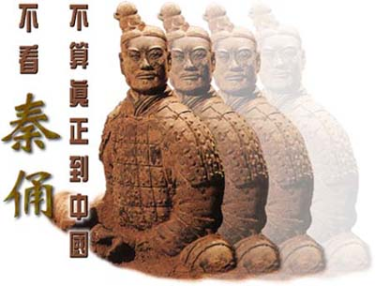
Global Connections: Classical China and the World
L ongest lasting in world history
Best-run bureaucracy and technologies
Source of the world’s largest trade network, the Silk Road.
Silk Road networks provided the framework for later global trading patterns

Slide 29
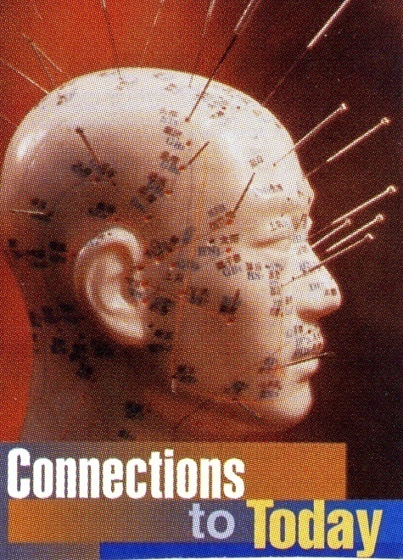
Achievements
Astronomers-used stars and planets to improve calendar and timekeeping
Seismograph invented
Acupuncture
Paper making
Ship building
Bronze work and silk making

