Slide 1
Europe 8000 BCE – 600 CE
Unit 1 Section 4

Slide 2
Early Civilizations of Europe and the Mediterranean
Farming communities emerged in S. Europe by 6000 BCE – this was after similar developments in Africa, the Middle East, & E. Asia
By 3500 BCE agricultural communities existed throughout Europe & the population density of the region increased as food sources became more reliable.
When Europe finally developed into civilizations and empires it set a cultural and intellectual foundation for the Western World

Slide 3
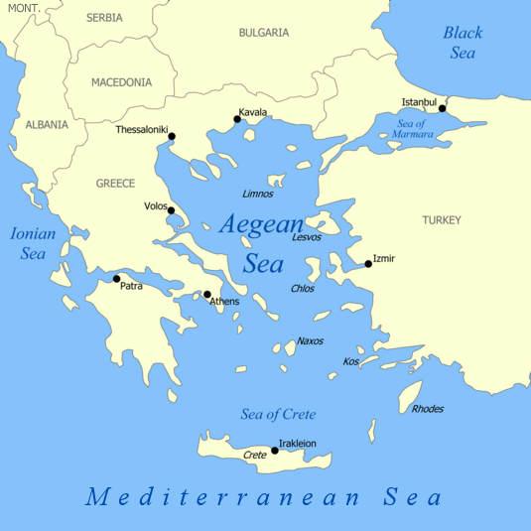

Slide 4
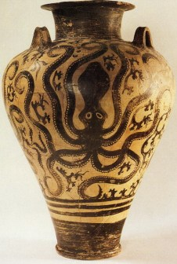
Minoans
http://www.youtube.com/user/historyteachers#p/search/0/Jz3d5x-MUT4 - Watch with Minoan worksheet
The 1st complex civilizations in Europe developed on the Mediterranean island of Crete and on the Greek Peninsula
Limited natural resources forced them to become a seafaring people that were trade-based societies with close commercial and political ties to their neighbors
By 2000 BCE the Minoan civilization had emerged on the island of Crete (Similar advancements to societies of Mesopotamia & Egypt):
Centralized government
Grand architecture
Metal use
Writing
Record-keeping

Slide 5
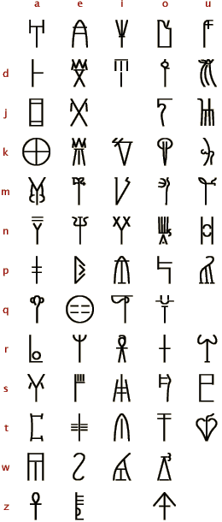
Mycenaeans
Around 1450 BCE the Mycenaean Greeks destroyed much of the Minoan civilization and became the next significant civilization in the region
Borrowing the architectural, economic and political components of the predecessors, the Mycenaeans were centered on the Greek peninsula and the islands of the Aegean Sea
They used the Minoan writing system as a basis of their own – Linear B – which endured as an early form of Greek

Slide 6
Mycenaean Collapse
Highly skilled sailors, the Mycenaeans built a trade-based economy
Evidence of this can be found in clay pots throughout the Mediterranean and Middle East that once contained wine and olive oil and were traded for metals, grain, amber and ivory
Mycenaeans were tough and warlike but were undone around 1200 BCE by the economic and political collapse of their trading partners
Example:
The destruction of the Hittite kingdom of Anatolia
The Middle East was destabilized
Key Relationships were lost
Mycenaean civilization declined
The cosmopolitan nature of the Middle East & E. Mediterranean (1700-1100 BCE) gave way to a 300 year period of poverty and isolation

Slide 7
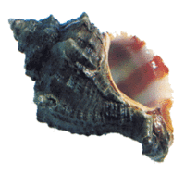
Phoenicians
From the instability a group of small city-states arose on the east coast of the Mediterranean
Though power shifted amongst the city-states – the Phoenician city-states prospered economically and politically by trading natural resources, food, and luxury items
The most lasting contribution of the Phoenicians was their alphabetic system of writing symbols which represented sounds that could be then be used to construct words

Slide 8
Phoenicians - Carthage
In the 9th Century BCE the Phoenicians established a trade network around the entire Mediterranean and colonized the region as their population grew
One of the most significant colonies was Carthage
Located in present day Tunisia, strategic position to control the middle portion of the Mediterranean
By 500 BCE Carthage was one of the world’s largest and most ethnically diverse cities
It was not a large territory but it had a strong navy and an army of mercenaries which protected its access to sea trade & influential politically until it was destroyed by the Romans in 202 BCE

Slide 9
Continental Europe – The Celts
Geography, Climate and soil – as well as natural resources – supported agriculture and herding
Little is known of the earliest societies because of a lack of writing
By 300 BCE the Celts had significantly influenced the language and culture of Europe by migrating from central Europe and settling across much of the continent
Not a uniform migration due to organization around kinship and not a larger Celtic civilization

Slide 10
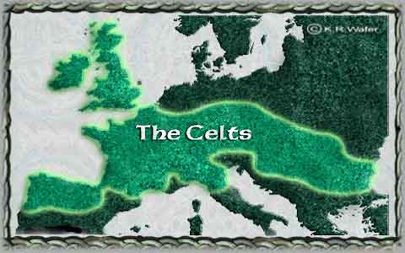

Slide 11
Social Structure of the Celts
Land-owning warriors
Priests performed religious rituals and supported education and judiciary
Commoners worked the land
Women focused on domestic tasks like raising children, though they did possess marriage and property rights better than their counterparts’ in Greece and Rome
Marriage was viewed as a partnership

Slide 12
The Greek City-States – Archaic Period
1st European Empire grew out of the resource-poor region of Greece
The Dark Age that had settled in after the fall of the Mycenaean civilization lifted when Phoenician merchants helped reconnect the Greek peninsula to the regional trade network
By 800 BCE Greek sailors were bringing goods and ideas home, and the Archaic period of Greek history had begun
Importing the Phoenician alphabet the Greeks added vowels
This was easier to learn than other forms of writing
Widespread literacy
However, Greek culture was largely preserved through the oral tradition and use of storytelling, theater, and philosophical dialogues

Slide 13
The Greek City-States – Archaic Period
Shortly into the Archaic period, Greece saw a population explosion – likely caused by more effective farming and increased prosperity
With population growth, villages expanded and Greece became a collection of city-states
Each city-state, or polis, cherished its independence
This led to conflicts among the heavily armed infantrymen (known as hoplites) – who were not professional soldiers but rather citizens called upon in times of crisis
Military techniques employed by the Greeks did not require extensive training
Priorities were courage and strength to bear arms
Battles/Campaigns were usually quick which allowed soldiers (most were farmers) to return to their land

Slide 14
Greek Influence
Population increase during the 8th Century BCE also set off a period of colonization
From 750 to 550 BCE the Greek people and culture spread around the Black Sea, across North Africa, and through southern Italy and Sicily
With encounters with new people and lands, the Greeks took on an air of superiority and reinforced their bonds among themselves
Their language and customs made them unique in these new lands
They referred to themselves as Hellenes and to non-Greeks as barbaroi – where we get the word barbarian
Greek presence spread technology:
Use of coins began in western Anatolia in the 6th Century BCE and spread quickly through the Greek world
Though not perfect (regional differences made for complications) coinage expedited trade and recordkeeping

Slide 15
Politics and Social Structure
Greek society and politics evolved and eventually resembled the democratic society for which ancient Greece is known
Early – councils of nobles challenged and eventually surpassed Greek kings
Such nobles gained their wealth and status from owning large amounts of land
Peasants worked the land and only kept a portion of what they grew for themselves
Working alongside peasants were debt slaves – who had defaulted on loans from the landowner an subsequently lost their freedom
Making up the Middle class were the small farm owners, merchants and craftsmen
In the mid 7th & 6th Centuries BCE city-states saw the rise of tyrants
Ambitious & aggressive members of the nobility
Seized control with support from the middle class which wanted more power
Tyrants tried to set up an heir system but it did not last
Eventually communities reacted by installing an oligarchy (rule by a small group) or a democracy – all free adult males participated

Slide 16
Greek Culture
http://www.youtube.com/user/historyteachers#p/search/2/fwYYxVGsS0E - use with Greek Philosophers Worksheet
Religion was based on a pantheon of anthropomorphic gods representing the power of nature
Altars and temples were constructed so that sacrifices could be made to these gods, and seers were employed to communicate with the gods and provide advice and insight
During the Archaic period the role and value of the individual grew in importance
Colonists were valued for their efforts & Tyrants who assumed power believed in the strength and ability of the individual
Celebration of the individual is known as humanism which is a guiding principle of the Western World
Early Greeks challenged the traditional approach to knowledge
Pre-Socratic philosophers sought rational explanations for the origins and workings of the world
Socrates and his disciple Plato, and Plato’s student Aristotle would lay the foundation of Western Philosophy by asking probing questions about truth, knowledge and ethics

Slide 17
By 480 BCE the 2 Dominant City-States
Sparta
Athens
Strength came form its army of highly trained and well-armed professional soldiers
Individual existed to support the state
To maintain internal peace coinage and trade were banned for their potential to promote inequality
Formed cautious alliances with their neighbors and tried to remain isolated
Had a clear social structure that made connections between wealth and power
Those in the top three classes could hold office
Those who constituted the 4th class and owned little to no property could participate in politics but could not hold office
Though not a direct democracy it did break the mold of rule by one or few that existed throughout much of the world at this time
By 450 BCE, Pericles altered the system to allow even those with little land to hold office and participate in government

Slide 18
Persian Wars
Both Athens and Sparta played a role in the next phase of Greek history – the fight against the Persian Empire in the 5th & 4th Centuries BCE
Initially, Persian control of Greek city-states in Western Anatolia was met with a revolt that the Persians eventually put down
These revolts inspired the Persian leader Darius to punish those city-states that supported the revolt (including Athens)
Many Greek city-states suffered harsh defeats in what is known as the Persian Wars
Darius’ son Xerxes would state a larger invasion of Greece in 480 BCE and succeed in attacking Athens
Southern city-states aligned with Sparta formed the Delian League and by the middle of the 5th Century BCE the Persians were expelled from Greek lands – thus begins the classical era of Greek history

Slide 19
Classical Greek Social Structure
Athens used its strong navy and economic strength to subjugate members of the Delian League
Neighboring city-states were required to pay yearly payments to Athens to fund the military as well as theatre, philosophy, art and science
Politically, classical Greece was a democracy of the 10-15% of the population that were free adult males
Foreign-born slaves made up 30% of the population
The typical Athenian family owned one or more slaves
Most slaves served in a domestic capacity and developed relationships with their owners by working in close proximity to them
However, Greeks viewed slaves as inferior beings who were better off under Greek control

Slide 20
Role of Women
Women’s roles depended on where they lived
In Sparta they had the important role of raising strong children
Their presence and voices in public were welcomed
In Athens women lacked access to education, had limited legal protection, were confined to their homes and were expected to produce children
Treatment of women in Athens resembled that of slaves and was rationalized by men that women were by nature promiscuous and promiscuity could destabilize society

Slide 21
Peloponnesian War
War broke out in 431 BCE between the city-states aligned with Athens and those aligned with Sparta
After nearly 30 years the Spartans with financial help form Persia for their navy, defeated the Athenians and temporarily assumed leadership of Greece
The Greek city-states quickly tired of strict Spartan rule – unrest continued
In northern Greece the kingdom of Macedonia was growing into a military power

Slide 22
Macedonian Dominance
http://www.youtube.com/user/historyteachers#p/search/3/Idh5pWvr8yU - Use with Macedonia Worksheet
Philip II (359-336 BCE) had improved his military’s technology and techniques:
Longer spears
Catapults
Use of cavalry to support infantry
Defeated southern Greek states and led to all-Greek attack on the Persian Empire
Alexander (356-323 BCE & son of Philip II) avenged Persia’s attacks on Greece by defeating Darius III of Persia
Alexander’s ambition led to Greek control of most of the Persian Empire
To control such a large empire, loyal Macedonians and Greek aides were in charge of the city-states
Later he left Persian officials in place, allowed Persian soldiers in military and adopted aspects of Persian culture
Alexander’s death was sudden @ age 32 and the empire fell into chaos and was broken into 3 kingdoms ruled by Macedonians

Slide 23
Hellenistic Age
Land from northern Egypt to nearly the Indus Valley was influenced by Greek culture
Long-distance trade and the growth of libraries, universities, literature, and art made Greek culture available
Local people accepted Greek culture because it was economically advantageous
The 3 Hellenistic kingdoms had the same difficulties defending a long frontier that the Persians had experienced
A combination of Persian system of local control with Alexander’s policy of establishing city-states as administrative centers

Slide 24
Romans
While the Greeks established a foundation for the modern Western world, their legacy was cemented by their European successors – the Romans
Located in central Italy, Rome had many geographic advantages that the Greeks lacked:
Fertile soil
Long growing seasons
Vast forests
Iron Deposits

Slide 25
Politics of Roman Republic
The Roman Republic (507-31 BCE) was a society of small, independent farms.
As time passed some individuals acquired large portions of land and as a group these wealthy men constituted the Senate which dominated Roman politics
All male citizens were allowed to attend Senate meetings but votes of the wealthy were worth more than those of the poor – thus society was governed by the elite
The inequality caused tensions in the Roman Republic – periodically the working class held strikes in in hopes of gaining more political rights

Slide 26
Roman Expansion
In the 5th Century BCE Rome assumed a leadership position among central Italian cities that had formed a group for defense.
By the 3rd Century BCE Roman expansion accelerated as its highly trained and disciplined armies conquered new land in a never-ending effort to provide a buffer zone against enemies on the frontier
As Rome expanded its control, it granted citizenship to conquered peoples and required men from these lands to join the army
When Romans finally defeated the Carthaginians in 202 BCE – they were the supreme power in the western Mediterranean region

Slide 27
Roman Expansion
The vast Roman Republic was governed by senators
Served 1-year posts as governors of the Roman provinces
Chosen for their connections rather than ability – many governors were corrupt and ineffective
Local people cooperated because like Greek influence – it was economically advantageous
The adoption of the Roman lifestyle – Romanization – was a significant outcome of Roman expansion even though the eastern Mediterranean continued to be dominated by Greek language and culture

Slide 28
Republic to Empire
The Roman expansion put strains on the system which led to failure
Italian peasant farmers who were the backbone of the military – spent long periods away from their land
In their absence, land was purchased or obtained by wealthy individuals & consolidated into large tracts of land that were more profitable and used for grazing and not for grain production
This forced Italy to rely on imported grain and left a now landless population to compete against the cheap slave labor provided by war prisoners
The Republic had obligated landowning men to serve in the military but as the landowning population decreased so too did the size of the army
The poor, landless population had difficulty finding work
This led to changing their allegiance from the Republic to ambitious military leaders who would battle one another for power

Slide 29
Roman Empire Emerges
By the dawn of the Common Era, Rome had shifted from Republic to Empire
Octavian Caesar emerged in 31 BCE as a military dictator disguised as republican ruler
He added the territory of Egypt, portions of the Middle East and central Europe
New title of Augustus
He and his successors ruled with the approval of the Senate and ultimately became the source of laws and even viewed as gods after their death

Slide 30
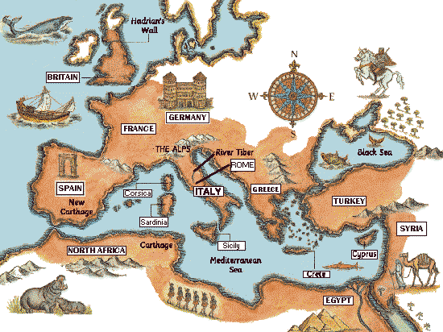

Slide 31
Social Stratification
In the cities there was a large economic and physical gap between the rich and the poor
The wealth of the urban upper class came from a large and productive agricultural foundation or from manufacture and trade that prospered during the Pax Romana (Roman Peace)
The poor in the cities inhabited crowded, low-lying slums
In rural areas the poor became tenant farmers as the source of slaves diminished when Roman expansion reach its limits

Slide 32
Roman Society
http://www.youtube.com/user/historyteachers#p/search/2/me4E5wDCK2Q - Use with Viva Roma No. V worksheet
Roman society was based on the family and patron/client relationship
The oldest male was head of the family and its slaves
The heads of wealthy families served as patrons for the dozens or hundreds of clients who worked and defended their land
In return for this service clients received legal protection and financial aid from their patrons

Slide 33
Women & Religion
Women in the Roman Republic could not own property or represent themselves in legal proceedings
Some upper-class women were able to influence their husbands or eldest sons
Religion was greatly influenced by the Romans’ contact with the Greeks
Sacrifices were made to ensure protection of the gods, whose myths and identities were taken from the Greeks and given Roman names
Christianity was born in Roman-controlled Palestine and early Christians were persecuted
Over time the Roman Empire’s disenfranchised (poor, women and slaves) were drawn to the teachings of Jesus

Slide 34
Large Empire issues
Control over such a large empire could be attributed to the technological innovations:
Arches
Aqueducts
Roads
Concrete
3rd Century Crisis (235 – 284 CE):
High turnover of rulers
Economic problems
Infiltration of the Germanic tribes in the Central European frontier
Trade declined to the point that barter replaced coinage
Wealth of the cities declined dramatically

Slide 35
Diocletian’s Efforts
Diocletian became emperor in 284 CE and in an effort to stabilize the economy:
Fixed prices
Forced workers in key industries to stay in their professions
Any stability that came from this was offset by resentment among the people toward government being intrusive and regimented

Slide 36
Constantine & Christianity
http://www.youtube.com/watch?v=uYhMQNPa8mM – use with Constantine worksheet
Successor to Diocletian was Constantine
Religious tolerance
Moved the capital of the Roman Empire to east Byzantium which he renamed Constantinople
By the late 3rd Century Christian coverts included the wealthy and the educated
As it gains in popularity it is adopted by the empire as the official religion
Constantine is said to have had a vision of a cross prior to a military victory and credited the victory to the Christian God:
Ended persecution of Christians
Supported the Church
Guaranteed freedom of religion for all others
Seeing the economic & political advantage to conversion to Christianity – more convert to the faith
During the 3rd Century Crisis there was less of an issue with more educated, wealthy and Christians congregating in the Eastern portion of the empire

Slide 37
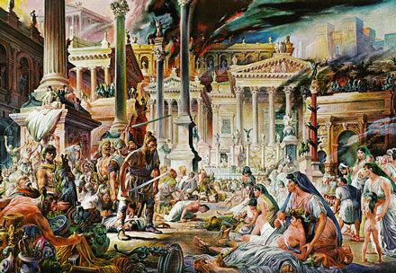
Roman Empire Collapses
In 395 CE the Roman Empire officially split into an eastern and western portion
Rome was sacked in 410 CE and by 476 CE the western portion of the Roman Empire had disintegrated into a collection of kingdoms under Germanic rulers and entered the medieval era
Rome still was significant because it was the home of the Patriarch of Rome – modern day Pope
Culturally the medieval era saw a decline in literacy and the emergence of local dialects that will become the modern Romance languages:
Portuguese
Spanish
French
Italian
Romanian

Slide 38
Aftermath
In the East, the Byzantine Empire continued the legacy of the Greek and Roman Empires
Tensions arose between the east and the west over doctrinal disputes and eventually led to the division in Christianity
Under Justinian (527-565 CE) the Byzantine Empire recapture parts of North Africa and Italy
Justinian established a collection of laws (Justinian Code) that would become the basis of European legal systems in the coming centuries

