Slide 1

The French Revolution
(Beginnings)

Slide 2
The Revolution Begins
Inequalities in the old (ancient) regime helped cause the French Revolution

Slide 3
The Old Order
The Old (ancient) Regime
Old Regime: Social and political system of France during the 1770’s
Estates: The three social classes of France’s old regime
The Privileged Estates
1st Estate is the Catholic clergy, they are < 1% of population, own 10% of land
2nd Estate, rich nobles, 2% of population, own 20% of land

Slide 4
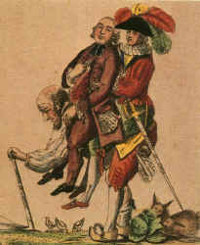
The Third Estate
97% of the people are peasants, workers, or middle class (bourgeoisie)
They have few privileges, pay heavy taxes, and want change

Slide 5
The Forces of Change
1) Enlightenment ideas: These ideas inspire some in the Third estate
2) Economic Troubles
  High taxes and rising costs damage economy by 1780’s
  King Louis XVI & Marie Antoinette spend money extravagantly
  Louis XVI doubles nation’s debt; banks refuse to lend more money

Slide 6
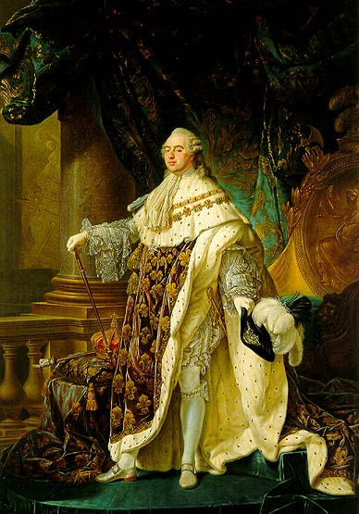
Louis XVI: A Weak Leader
Louis’ poor decisions and lack of patience added to France’s problems
He calls Estates General– meeting of representatives from all three estates

Slide 7
Meeting of the Estates General
Each Estate had one vote
  3rd estate = 97% of population…1 vote
  2nd estate = 2% of population… 1 vote
  1st estate = <1% of population…1vote
  The 3rd estate was always outvoted by the other two.
  They wanted the votes counted by number of people.

Slide 8
Meeting of the Estates General, continued
Members of the 3rd Estate delegation declare themselves the National Assembly
Members of the 3rd estate delegation (National Assembly) are locked out of meeting hall

Slide 9
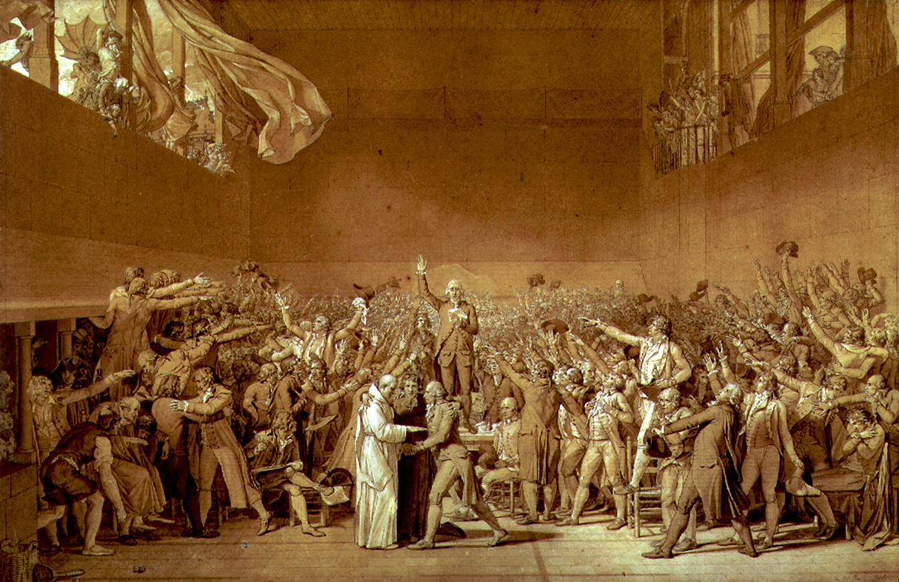
The Tennis Court Oath
Fearing dismissal by Louis XVI, members of the delegation swear an oath to establish a constitution on a nearby tennis court.

Slide 10
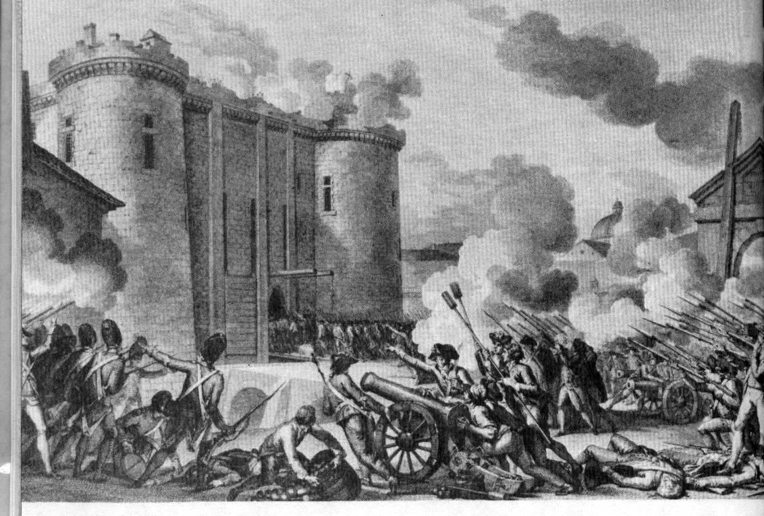
Storming the Bastille
Rumors circulate through Paris that Louis wants to suppress the National Assembly
Mob attacks and seizes Bastille killing guards on July 14, 1789

Slide 11
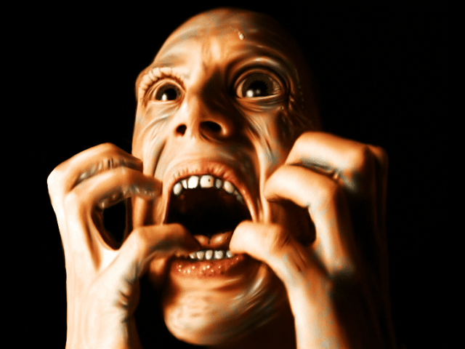
A Great Fear Sweeps France
Rumors and panic spread throughout France
Great Fear: attacks by peasants taking place across France

Slide 12
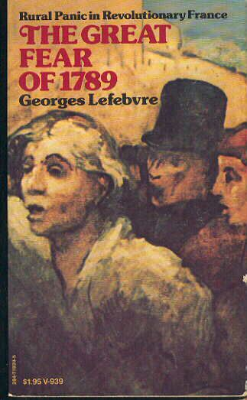
Great Fear
Political crisis combined with famine in 1789
Peasants were starving and left their homes
Price of bread rose
Rumors told of government troops seizing peasants crops
Peasants panicked, attacked homes of nobles, destroyed feudal records, and stole grain

Slide 13
The National Assembly Reforms France
The Rights of Man
National Assembly adopts Declaration of Rights of Man and Citizen…proclaiming that govt. rested on the consent of the people (popular sovereignty) not divine right of kings
Modeled on U.S. Declaration of Independence

Slide 14

Declaration of Rights of Man vs. Declaration of Independence
Declaration of Independence
“…all men are created equal”
“…among these rights are life, liberty, and the pursuit of happiness”
Declaration of Rights of Man
“…all men remain free and equal in rights”
“…rights of liberty, property, security, and resistance to oppression”

Slide 15

DON’T FORGET!
Both of these documents were heavily influenced by Enlightenment thinkers, especially John Locke

Slide 16
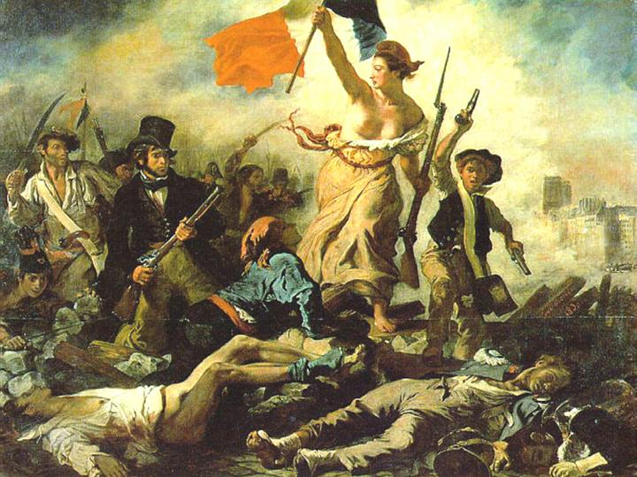
Slogan of the French Revolution
“Liberté, Egalité, Fraternité”

Slide 17
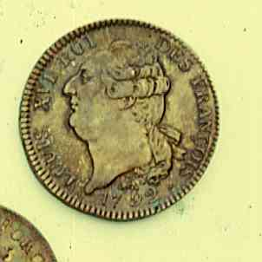
Louis Attempts to Escape
Concerned for his future, Louis XVI flees Paris disguised as a servant.
He is caught near the border of The Netherlands
Someone recognizes him from a coin
Louis XVI is dragged back to Paris as a traitor

Slide 18
A Limited Monarchy
In September 1791, the National Assembly finishes the new constitution
They create a new body, the Legislative Assembly to pass laws

Slide 19
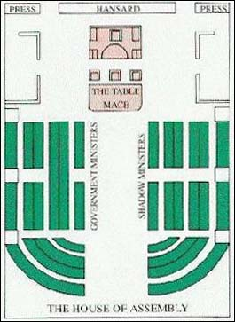
Factions Split France
Major problems including debt and food shortages remain
Assembly split into Radicals, Moderates, & Conservatives
Radical
Conservative
Moderate

Slide 20
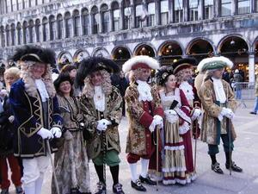
The Conservatives
Émigrés
Nobles who flee the country
Want the old regime back

Slide 21
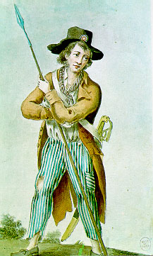
The Radicals
Sans-culottes
Literally those without culottes (short pants worn by the wealthy or nobility in France)
Lower class who want more change from the revolution

Slide 22
WAR!
Austrians and Prussians want Louis in charge of France
Radicals in charge of French revolutionary government declare war!
Prussian forces threaten Paris
The war went on from 1792 to 1815

Slide 23
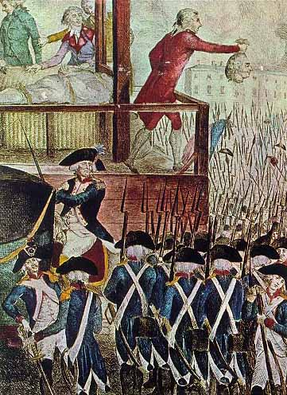
Panic in Paris!
With Prussians threatening the capital, Parisian mobs jail the royal family and kill their guards
The mob breaks into prisons,
killing over 1,000 people,
including many who support
the king
Pressured by the mob, the
Legislative Assembly deposes the king and then dissolves
The National Convention takes office in December, forming the French Republic- no king and citizens elect their representatives

Slide 24
Jack and Jill went up the hill to fetch a pail of water
Jack fell down and broke his crown
And Jill came tumbling after.
Up got Jack, and home did trot
As fast as he could caper
He went to bed and bound his head
With vinegar and brown paper.
Side note
http://www.rhymes.org.uk/jack_and_jill.htm

Slide 25
The roots of the story, or poem, of Jack and Jill are in France. Jack and Jill referred to are said to be King Louis XVI - Jack -who was beheaded (lost his crown) followed by his Queen Marie Antoinette - Jill - (who came tumbling after). The words and lyrics to the Jack and Jill poem were made more acceptable as a story for children by providing a happy ending! The actual beheadings occurred in during the Reign of Terror in 1793. The first publication date for the lyrics of Jack and Jill rhyme is 1795 - which ties-in with the history and origins.
Side note

Slide 26
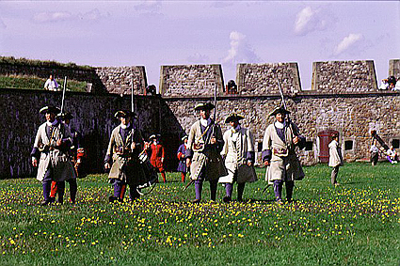
The War continues
The French army wins great victory against Prussia and Austria
In 1793, Britain, Spain, & Netherlands join forces against France

Slide 27
The Terror Grips France
France is divided: Not all people support all the changes of the Revolution (think about the state taking over the church)

Slide 28
Robespierre assumes control
  Jacobin leader rules France for a year
  Becomes leader of the Committee for Public Safety.
  Robespierre = dictator
  “Liberty cannot be secured unless criminals lose their heads!” – Robespierre

Slide 29
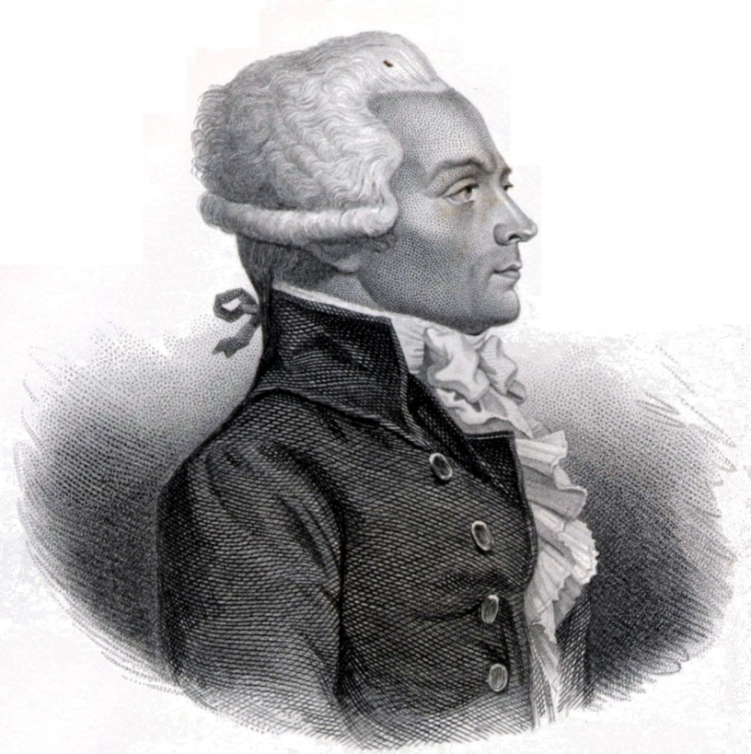
Reign of Terror
Robespierre’s rule in which thousands of people are killed becomes known as the Reign of Terror
85% of those killed during the Terror are middle or lower class
Many who were killed were former revolutionaries and allies of Robespierre

Slide 30
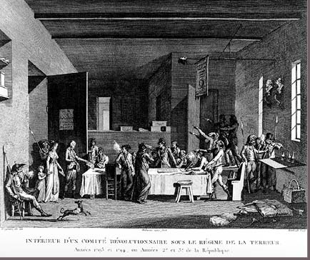
The Reign of Terror
Revolutionary committees conduct hasty trials and issue thousands of death sentences to “traitors to the revolution.”

Slide 31
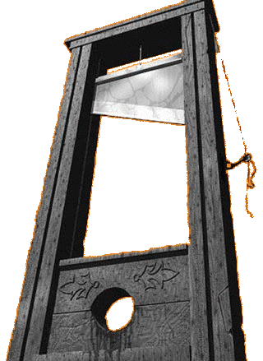
The Reign of Terror
No one feels safe, everyone is afraid (Reign of Terror)
Ordinary people are fearful because anyone and everyone can be denounced as a traitor to the Revolution and beheaded
People start denouncing neighbors or others whom they have a grudge against (think Salem witch trials)

Slide 32
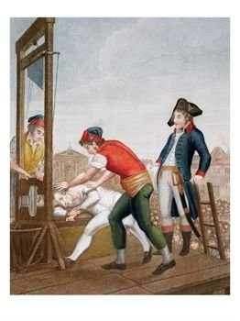
End of the Terror
Another change in government
  In July 1794, Robespierre arrested and executed
  Terror results in public opinion shifting away from radicals

Slide 33
End of the Terror…continued
Moderate leaders write new constitution
Two house legislature and 5 man directory restore order
Middle class and professional people of the bourgeoisie were now the dominant force in government.
The directory held power from 1795-1799

Slide 34
The Directory in trouble
France made peace with Prussia and Spain, but war with England and Austria continued
Corrupt Directory leaders began stealing money
Bread prices rose causing sans-culottes to riot
Émigrés returned to France, reviving reactionary, royalist feelings in peasants
Peasants upset about church reforms
During the election of 1797 supporters of constitutional monarchy won majority of seats in legislature.

Slide 35
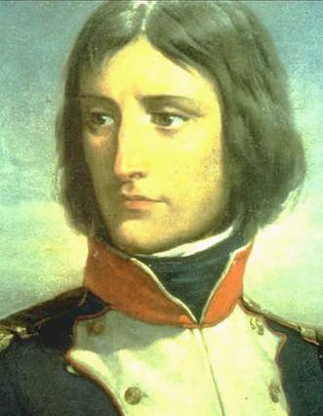
The Directory becomes desperate!
With their government threatened from within and without, the directory appoints Napoleon Bonaparte commander of armies
They hope he will be able to control the threats so that they can govern

Slide 36
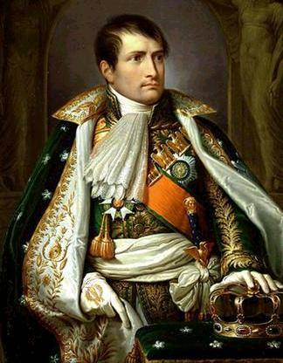

Napoleon as “First Consul”
With the government in disarray, Napoleon launched a successful coup d’ etat on Nov 9 1799.
He proclaimed himself “First Consul” [Julius Caesar’s title] and did away with the elected Assembly [appointing a Senate instead].
  In 1802, he made himself sole “Consul for Life.”
  Two years later he proclaimed himself “Emperor.”

Slide 37
Napoleon’s Major Reforms
Introduced revolutionary ideas to other European countries
Nationalized the Educational System
Napoleonic Code-combined traditional laws with those of the Revolution

Slide 38
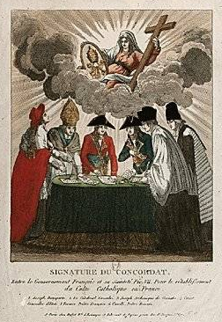
Concordat of 1801
Napoleon wanted to heal the divisions within the Catholic Church that had developed after the confiscation of Church property and the Civil Constitution of the Clergy.
But, Napoleon’s clear intent was to use the clergy to prop up his regime.

Slide 39
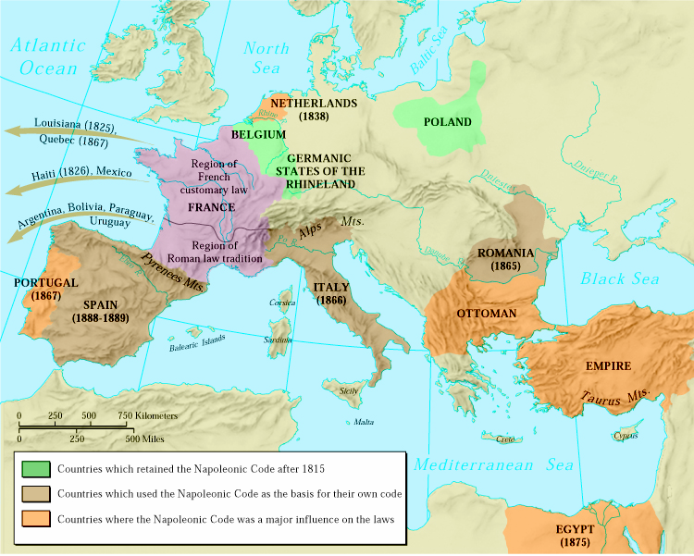
The Influence of the Napoleonic Code
Wherever it was implemented [in the conquered territories], the Code Napoleon swept away feudal property relations.

Slide 40
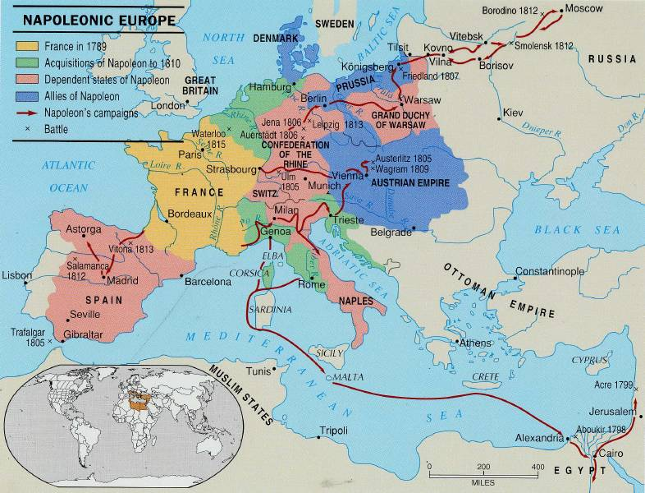
Napoleonic Europe

Slide 41
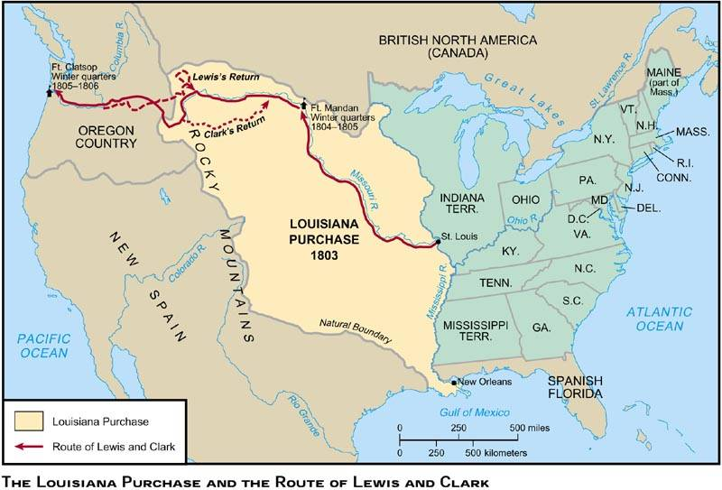
Louisiana Purchase, 1803
$15,000,000

Slide 42
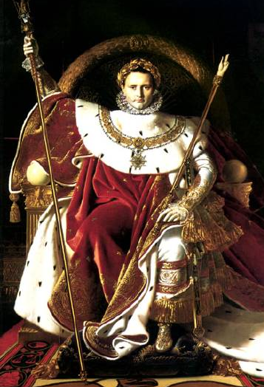
“Napoleon on His Imperial Throne”
1806
By Jean Auguste
Dominique Ingres

Slide 43
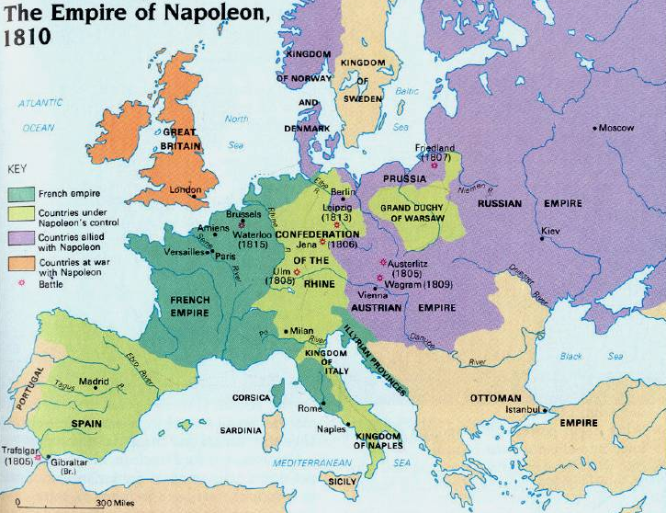
Napoleon’s Empire in 1810

Slide 44
Russia
In July, 1812 Napoleon led his
Grand Armee of 614,000 men
eastward across central Europe
and into Russia.
  The Russians avoided a direct
  confrontation with Napoleon.
  They retreated to Moscow, drawing the French into the interior of Russia [hoping that it’s size and the weather would act as “support” for the Russian cause].
  The Russian nobles abandoned their estates and burned their crops to the ground, leaving the French to operate far from their supply bases in territory stripped of food.

Slide 45
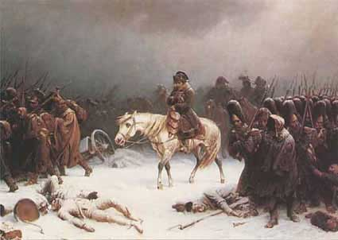
Napoleon’s Retreat
from Moscow (Early 1813)
100,000 French troops retreat—40,000 survive!

Slide 46
Napoleon Abdicates!
Allied forces occupied Paris on March 31, 1814.
Napoleon abdicated on April 6 in favor of his son, but the Allies insisted on unconditional surrender.
Napoleon abdicated again on April 11.
Napoleon exiled to Elba with an annual income of 2,000,000 francs.
The royalists took control and restored
Louis XVIII to the throne.

Slide 47
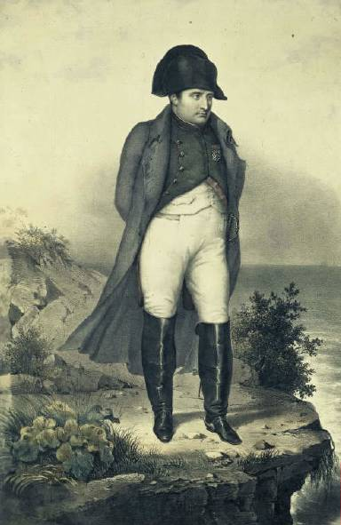
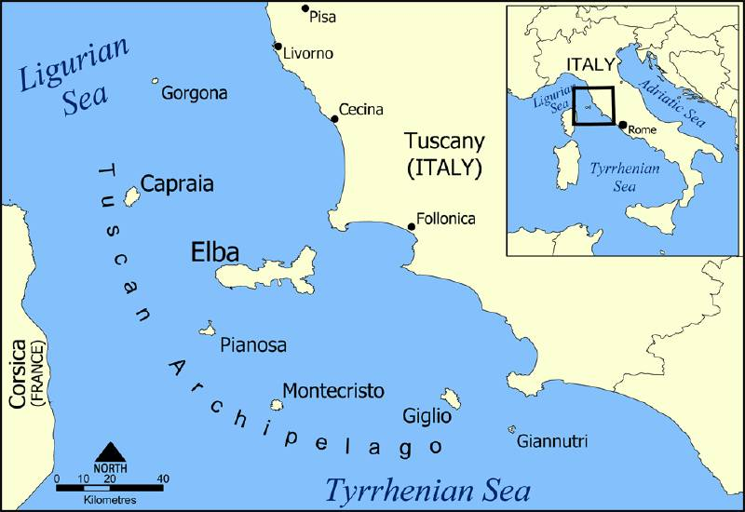
Napoleon in Exile on Elba

Slide 48
Napoleon’s 100 Days
Napoleon’s
“100 Days”
1815:
France →
← Britain, Russia.
Prussia, Austria,
Sweden, smaller
German states
Napoléon escaped Elba and landed in France on March 1, 1815 → the beginning of his 100 Days.

Slide 49
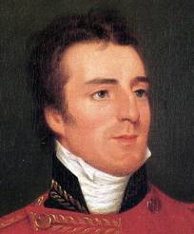
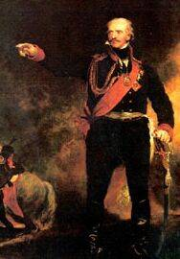
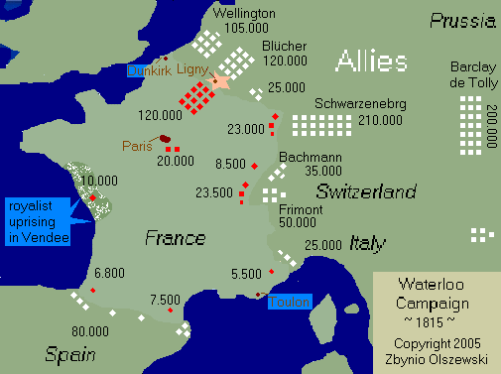
Napoleon’s Defeat at Waterloo
(June 18, 1815)
Duke
of
Wellington
Prussian
General
Blücher

Slide 50
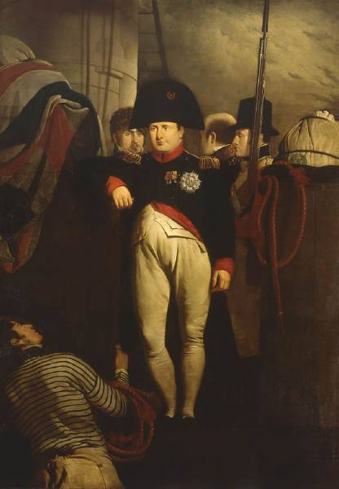
Napoleon
on His Way
to His
Final Exile on
St. Helena

Slide 51
The Congress
of
Vienna

Slide 52
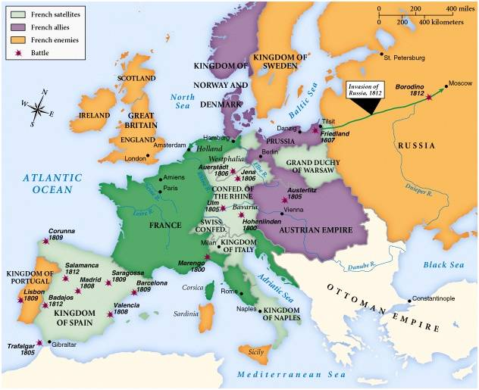
Europe in 1812

Slide 53
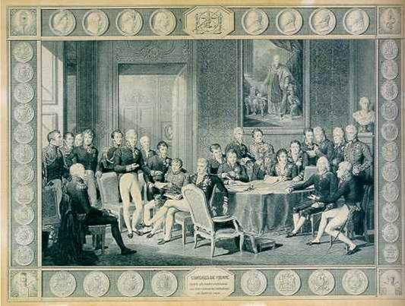
The Congress of Vienna
(September 1, 1814 – June 9, 1815)

Slide 54
Main Objectives
It’s job was to undo everything that Napoleon had done:
  Reduce France to its old boundaries → her frontiers were pushed back to 1790 level.
  Restore as many of the old monarchies as possible that had lost their thrones during the Napoleonic era.
Supported the resolution: There is always an alternative to conflict.

Slide 55
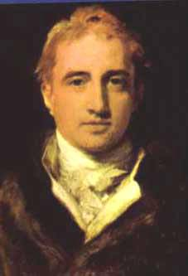
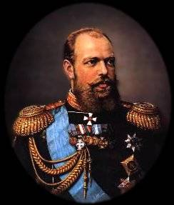
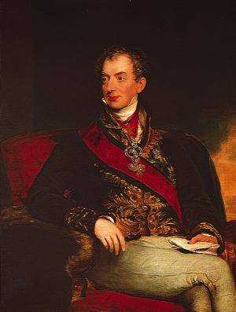
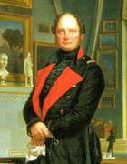
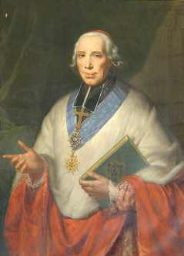
Key Players
at Vienna
Tsar Alexander I (Rus.)
Foreign Minister,
Viscount Castlereagh (Br.)
The “Host”
Prince Klemens von Metternich (Aus.)
King Frederick William III (Prus.)
Foreign Minister, Charles Maurice de Tallyrand (Fr.)

Slide 56
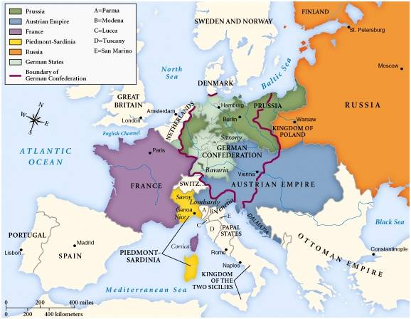
Europe After the Congress of Vienna

