Slide 1
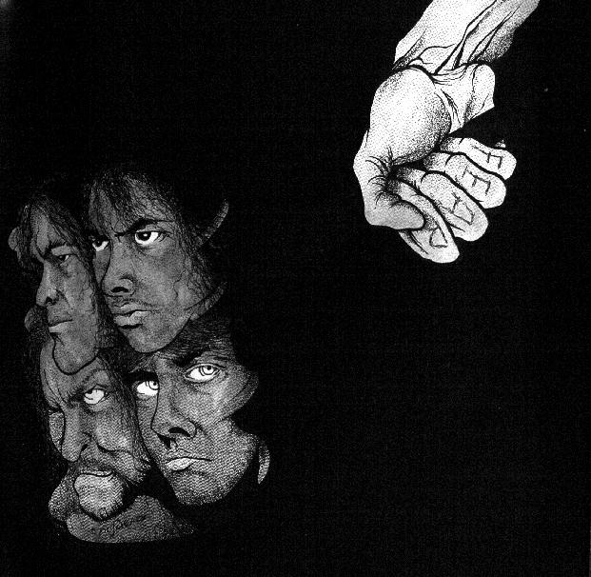
Imperialism

Slide 2
LOOKING BACK – Review
What is required for a nation to industrialize?
B) What is the incentive for a nation to industrialize?
1) Factors of Production
Land
Labor
Capital
Entrepreneurs
Political Stability
Transportation Network
Trading Markets
Wealth
Power & Nationalism
Spreading of Culture

Slide 3
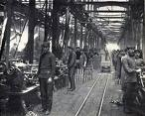
Industrial Revolution
Definition
Causes
The age of increased out-put of machine made goods.
Agricultural Revolution
Increase demand for goods
Inventions
Examples
Visual Representation
ENGLAND
U.S.A.
JAPAN
GERMANY

Slide 4
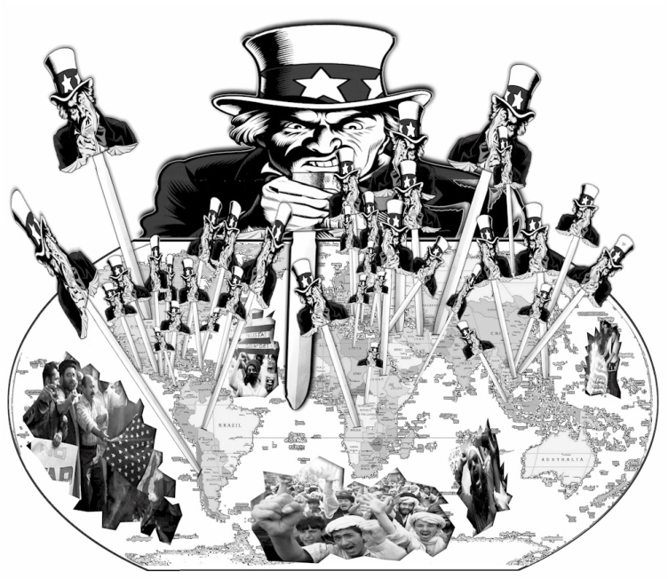
IMPERIALISM
Definition
Causes
Ambition
Industrial Revolution
Need Resources
Need Trading Markets
Religion
Nationalism
The policy of setting up colonies & building up empires by dominating another nation politically, economically, & socially
Examples
Visual Representation
England
Italy
France
Germany
U.S.A
Portugal
Belgium

Slide 5
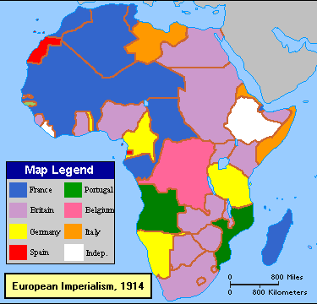
Imperialism in Africa
By 1914 the continent of Africa was almost entirely controlled by European imperial powers.
These powers looked to control the economy, society, and government of the conquered peoples.
How were European powers able to gain control of most of Africa?

Slide 6
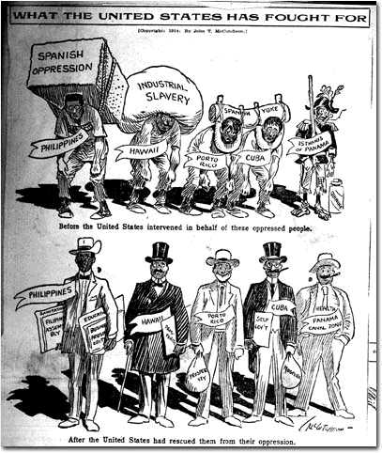
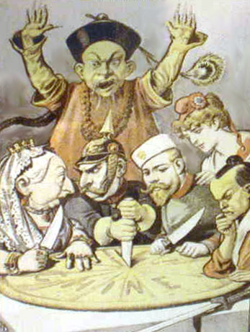
What is Imperialism?
The policy of setting up colonies & building up empires.
Countries look to extract resources & spread their culture.
Imperial nations convinced themselves that what they were doing was positive for everyone involved.
Is it all good?
Is it all bad?

Slide 7
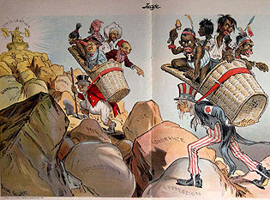
Good? or Evil?
Imperialism

Slide 8
Why did it start?
CAUSES
Industrial Revolution
Nationalism
Religion
"The White man's burden"

Slide 9
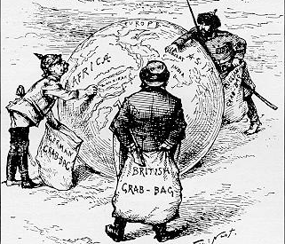
Why did it start?
Industrial Revolution
Nations did not have enough resources in their own country
Industrial Nations produced so many goods that they needed new markets
Increased need for Resources
Forces to look elsewhere for resources
Nations competed for colonies

Slide 10
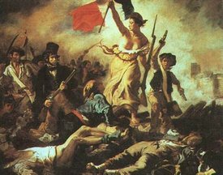
Why did it start?
Nationalism
More colonies = More Power
Extreme pride in their country led them to want more power
Industrial Nations competed for colonies

Slide 11
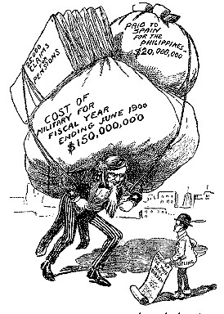
Why did it start?
White Man’s Burden
Mission = Spread Christianity & the Industrial Revolution
Westerners viewed anyone with different religion & life as “backwards”
Westerners felt it was their duty to “civilize” the “backwards” people of the world
An attempt to justify imperialism

Slide 12
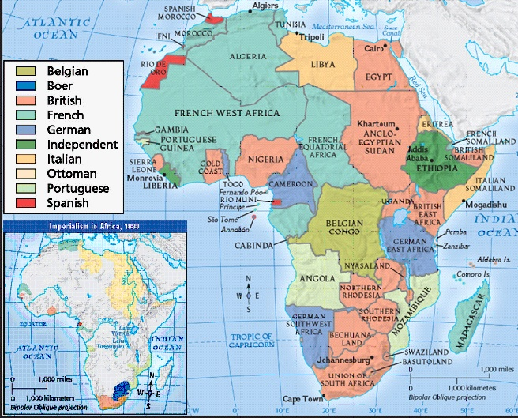
Industrial Powers race to colonies
AFRICA
Christian Missionaries were the first “explorers” of Africa’s interior
Belgium sent representatives to negotiate with African chiefs
Contracts were in English
Those who refused were shot
Chiefs were forced to give up their land
In the 1870s, European powers looked to fully colonize Africa. The map shows how Imperialist nations divided the continent.

Slide 13
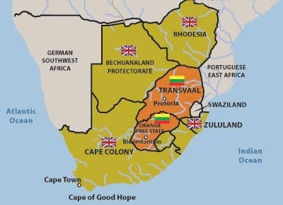
AFRICA
Causes
Boer War
1880-1881
England v. Dutch Farmers
England dedicated to expansion
British settlers in Dutch colonies outnumbered Boers
British gained control of area → new language & culture
British outlawed slavery
Boers left the area & founded Transvaal & Orange Free State
Diamonds were discovered in land of the Boers
British settlers continued to move north & on Dutch controlled land

Slide 14
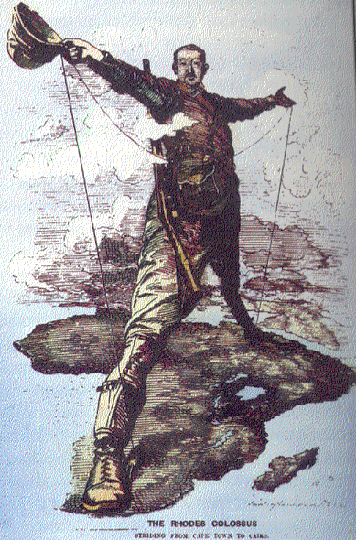
AFRICA
Boer War
Outcomes
1880-1881
England v. Dutch Farmers
The Boers resisted British victory & practiced guerilla warfare
British arrested & imprisoned Boers
Boers finally gave up (1910)
Orange Free State & Transvaal became part of British Africa
Created the Union of South Africa
From Cape to Cairo
Cecil Rhodes vision of a English-speaking Empire became a reality.

Slide 15
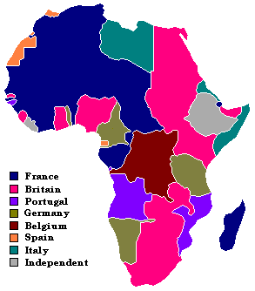
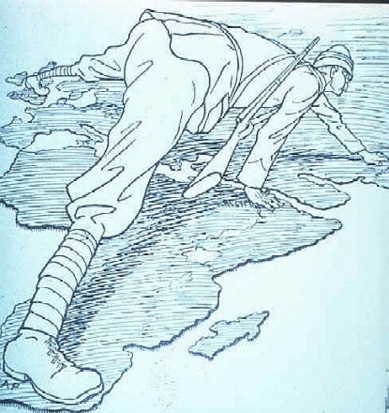
The Scramble for Africa
Liberia & Ethiopia were the only independent African Nations

Slide 16
Scars left on Africa
Created problems between African tribes
Forced ethnic groups into same nation
Destroyed African culture
In many parts, segregation & class system based on color were introduced
Africa has yet to recover → corruption, instability, violence & authoritative regimes are common

Slide 17
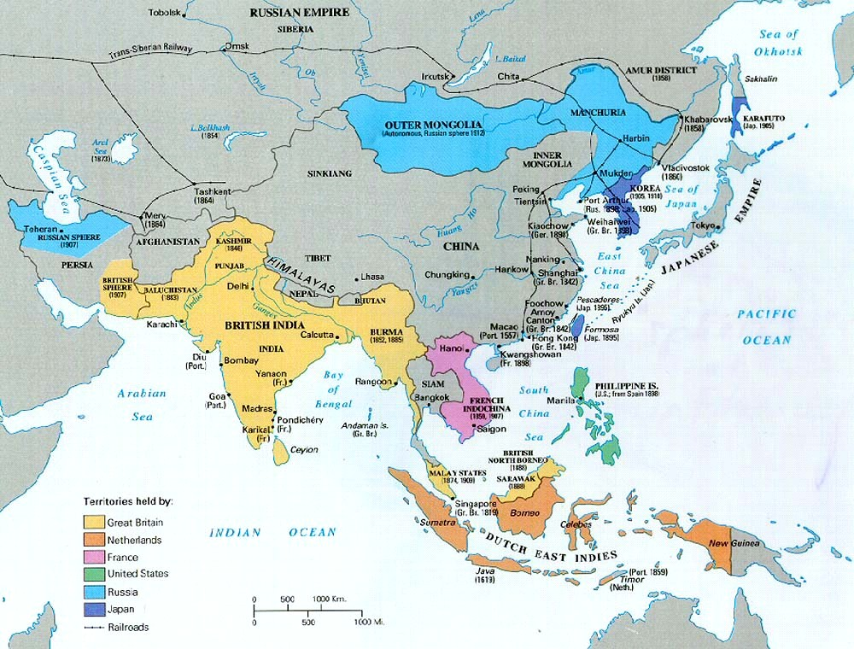
ASIA
Whose Next?

Slide 18
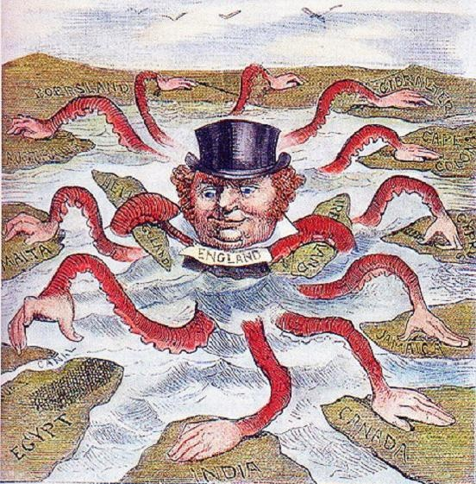
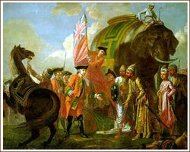
British Imperialism in India
MAIN IDEA – The Sepoy Mutiny resulted in the British gaining full control of India.
Prior to 1850, Chinese & Japanese rulers allowed only limited trade with the West. European powers turned attention on India

Slide 19
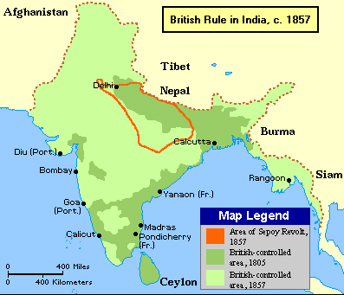
INDIA
Background
1700 → Once powerful Mogul Empire was falling apart
1760s → England won the French-Indian War; forcing France out of India
British East Indian Company took over trading in India
Company controlled much of India for 100-years
British forced their culture on India
Prior to 1850, Chinese & Japanese rulers allowed only limited trade with the West. European powers turned attention on India

Slide 20
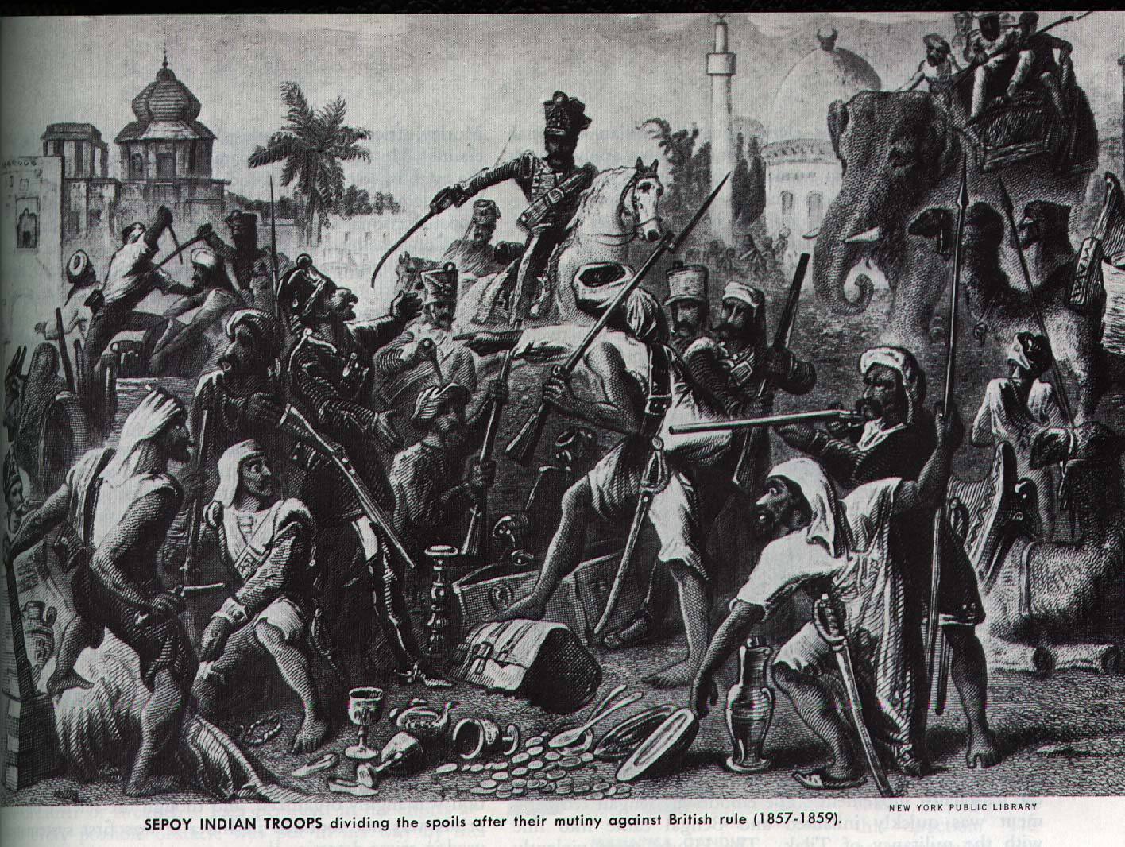
INDIA
Sepoy Rebellion (1857)
Indians felt that British were trying to change their culture
Economic problems & sense of nationalism increased resentment
Sepoy soldiers mutinied & refused to accept new rifle
British response → Jail opponents
Sepoys united & led a rebellion
British East India Company & British company united to regain control
Sepoy → Indian soldier in the British Army

Slide 21
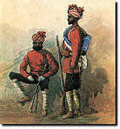
INDIA
Sepoy Rebellion (1857)
Religious differences & weak leadership doomed India
OUTCOME →
British fully controlled India
Indian nationalist movements begin
British East India Company removed from power
It is this consciousness of the inherent superiority of the European which has won for us India. However well educated and clever a native may be, and however brave he may prove himself, I believe that no rank we can bestow on him would cause him to be considered an equal of the British officer.

Slide 22
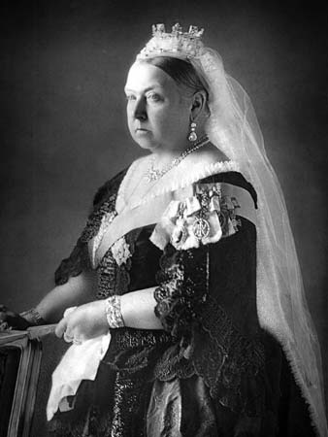
Who is this person?
Queen Victoria of England
Reign - June 1837 to January 1901
Period of rule known as the Victorian era
Ruled during peak of Industrial Revolution
Expanded British Empire
Ruled over most powerful nation in the world
The grandmother of Europe

Slide 23
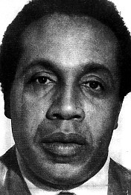
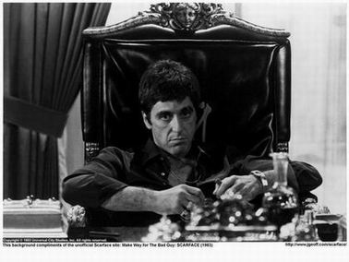
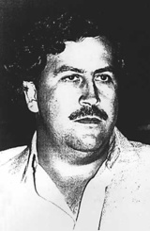
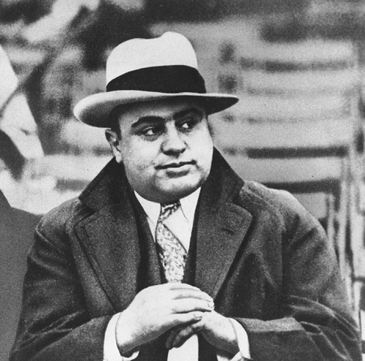
What does she have in common with these bad guys?

Slide 24
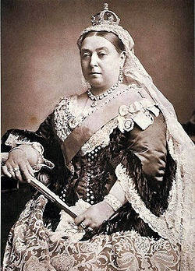
International Drug Smuggler
Oversaw a major drug-trafficking criminal organization
Very few current drug cartels can even touch the England of the 19th Century
England shipped tons of opium into China, which it traded for Chinese goods and for tea.
Created a nation filled with drug addicts
Queen Victoria of England

Slide 25
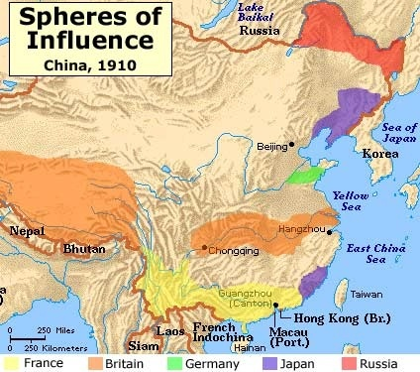
Opium Wars
Causes
Outcomes
Britain won
China forced to give up trading post
China unable to hold foreigners accountable under Chinese laws
The British East India Company smuggled opium into China, ignoring local laws. China fiercely resisted the sale of opium & pleaded for Britain to stop.
Facts
Visual Representation
Two wars fought
England easily defeated China
Greatly weakened China
Lin Zexu led movement against sale of opium

Slide 26
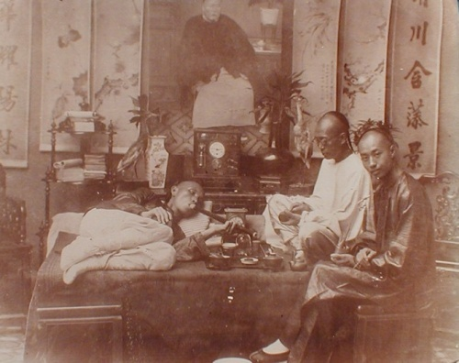

Slide 27
Opium War: China v. England
CHINA
ENGLAND
Lin Zexu
Queen Victoria
Outdated Navy
Mounting domestic problems
Exported millions of tons of tea
Benifited from extraterritorial rights
Self-sufficient for hundreds of years
imbalance of trade drained silver supply
Little interest in trade
Acquired Hong Kong as result of Opium War
Opium illegal
Opium illegal
stable unified government
Imports greatly outnumbered exports (1820s)

Slide 28
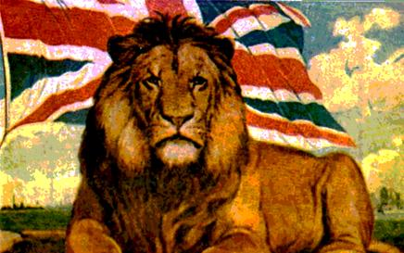
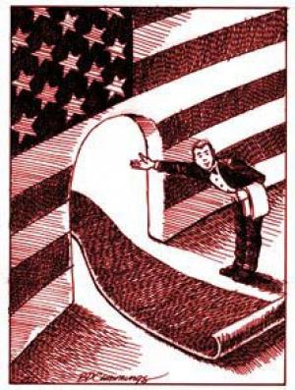
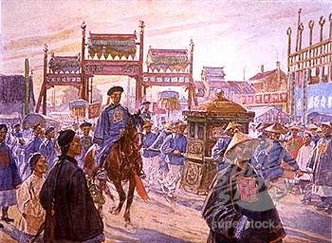
China Response to Pressure from the West
Main Idea – Western economic and militaristic pressures forced China to open to foreign trade and influence.

Slide 29
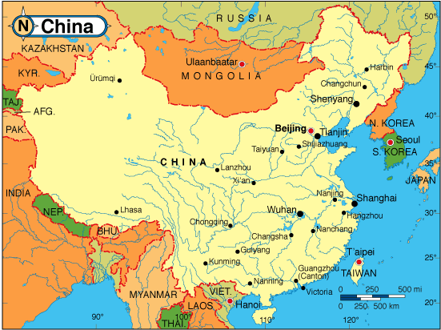
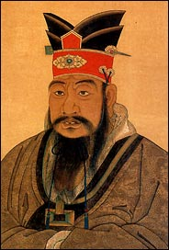
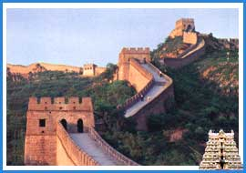
CHINA
General Background
Divided into 2-social classes
Upper & Lower Class
Family most important
Arranged marriages
First born son looks after parents
Great Civilization
Produced all of wants and needs
Rich in resources
Prior to 1800, China had limited contact with the West and allowed limited trade with foreign powers. They viewed Western culture as barbaric.

Slide 30
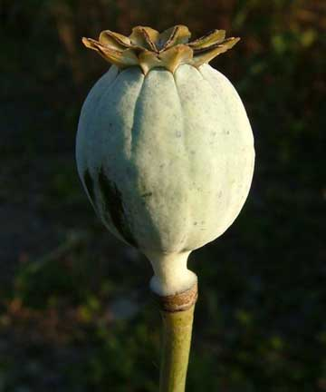
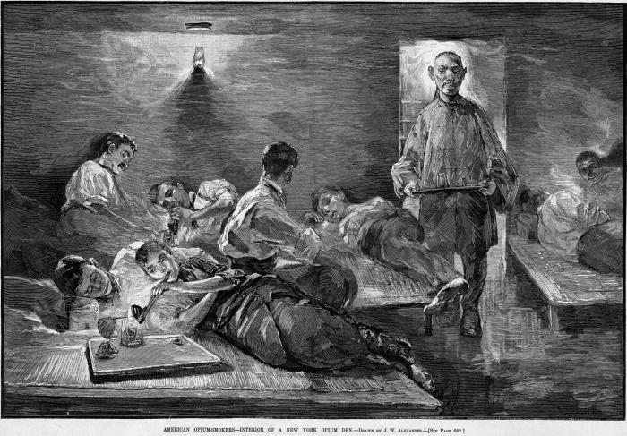
British look to increase trade
1800s
After years of imbalanced trading with China, England looked to find a product that Chinese were willing to purchase.
British Traders discovered that Opium Trade = Large Profits
British traded Opium for tea & silk → LARGE PROFITS
Chinese officials learned about the dangers of opium & looked to declare it illegal.

Slide 31
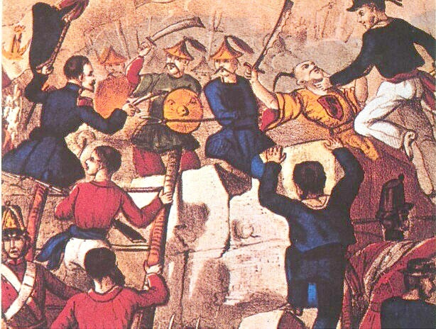
Response to Pressure from the West
Warm Up → A VOICE FROM THE PAST
By what right do they [British merchants] . . . use the poisonous drug [opium] to injure the Chinese people? . . . I have heard that the smoking of opium is very strictly forbidden by your country; that is because the harm caused by opium is clearly understood. Since it is not permitted to do harm to your own country, then even less should you let it be passed on to the harm of other countries.
LIN ZEXU, quoted in China’s Response to the West
Why did Lin Zexu oppose the Opium trade with Britain? Explain.

Slide 32
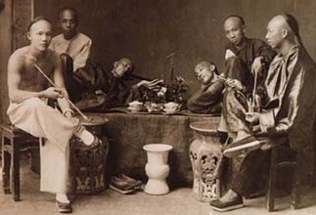
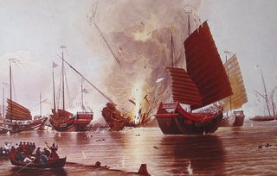
Opium War (1839-1842)
Chinese banned opium & destroyed shipments
WAR → 1839-1842
England wanted to protect their investment
China
Outnumbered British
No cannons
Outdated Navy
Outcomes
British defeated the Chinese
Signaled the end to Chinese self-rule
Forced to open more ports
Great Britain gained control of Hong Kong

Slide 33
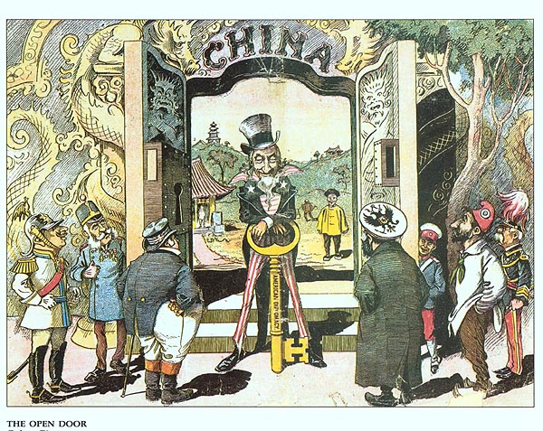
Concessions to Open Door
Japan, Russia, Germany, Great Britain, & France looked to get special trading rights in China
China forced to make concessions
Special Rights Included
Rights to develop mineral mines
Rights to build Railroads
Rights to establish Navy Bases
Leases to port cities
U.S.A is being left out of CHINA

Slide 34
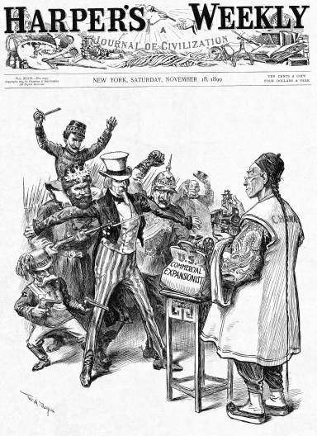
Concessions to Open Door
U.S. felt that their interests were being threatened
U.S. Proposes Equal Trading Rights in China
Policy called the OPEN DOOR POLICY

Slide 35
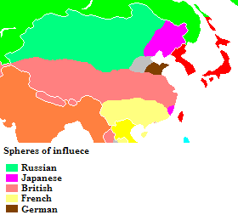
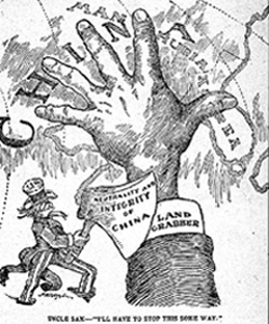
Concessions to Open Door
The U.S. proposes Open Door Policy (1900)
Major imperial powers agreed to respect trading rights
Treaties were unequal & unfair to China
EFFECTS
Increased foreigners in China
China remained “free” from colonial rule
Japan eventually ignored Policy (1920s)

Slide 36
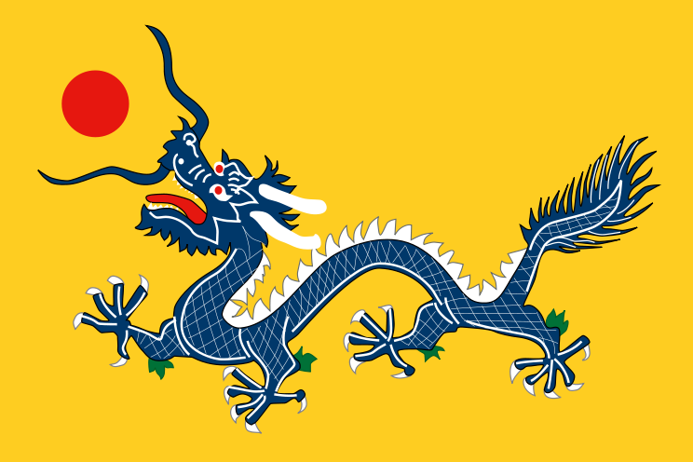
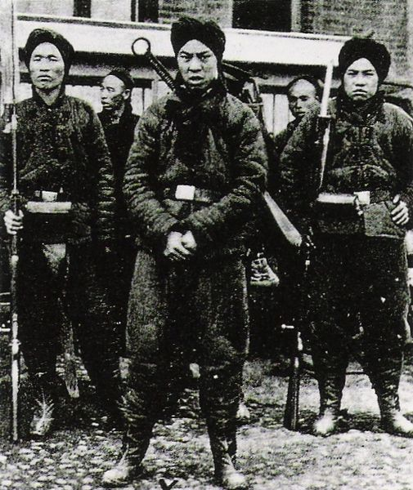
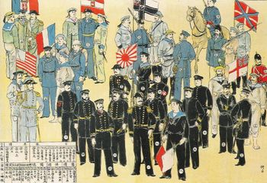
Boxer Rebellion (1900)
Chinese nationalist movement looked to expel all foreigners
International Force of 20,000
Soldiers from England, France, Germany, Austria, Italy, Russia, Japan, and the U.S.
Despite rebellion China remained weak & divided
Number of foreigners increased
"Death to the foreign devils."

Slide 37
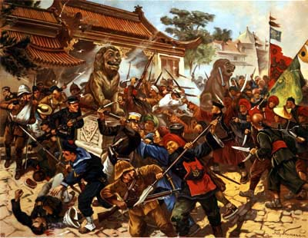
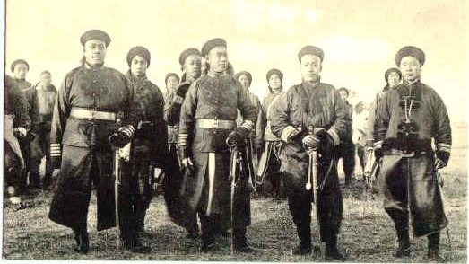
Boxer Rebellion (1900)
Movement failed & China fell almost completely in the control of foreign nations
Strong sense of nationalism emerged
Qing Dynasty was forced to accept reforms (1911)
Strong foreing presence remained in China until 1947.

Slide 38
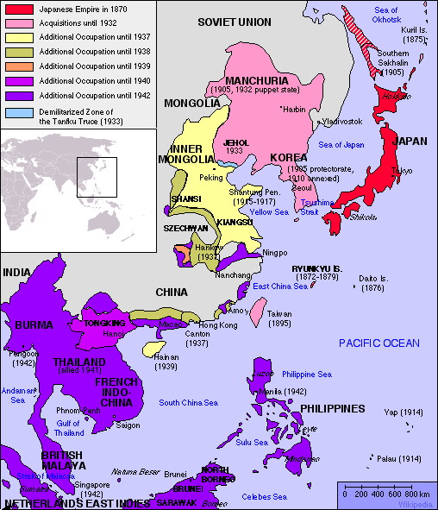
Japan
Goal → Emulate the West
Impressed by military & industrial strength of the west
Wanted to modernize the nation
Nationalism

Slide 39
How did they create an Empire?
Abolished feudalism → focused on industry
Restored the power of the Emperor
Established Meiji Restoration
“Modernized” Japanese Culture
New Calendar, adopted western clothing
Modernized Navy & Army
Removed the samurai
In less than 30-years, established themselves as a world power
Unequal treaty
Racism

