Slide 1
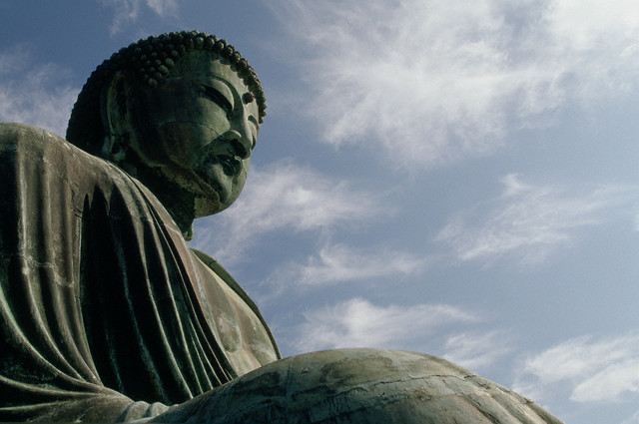
Unit 3
Ancient India and China

Slide 2

STANDARD WHI.3a
The student will demonstrate knowledge of ancient river valley civilizations, including Egypt, Mesopotamia, the Indus River Valley, and China, and the civilizations of the Hebrews, Phoenicians, and Kush, by
locating these civilizations in time and place.
Indian civilization—Indus River Valley (South Asia)
• Chinese civilization—Huang He Valley (East Asia)
These river valleys offered rich soils for agriculture, and they tended to be in locations easily protected from invasion by nomadic peoples.
b) describing the development of social, political, and economic patterns, including slavery.
• Hereditary rulers (dynasties of kings, pharaohs)
• Rigid class system, where slavery was accepted
Development of political patterns
• World’s first states (city-states, kingdoms, empires)
• Centralized government (often based on religious authority)
• Written law codes (Ten Commandments, Code of Hammurabi)
Development of economic patterns
• Metal tools and weapons (bronze, iron)
• Increasing agricultural surplus (better tools, plows, irrigation)
• Increasing trade along rivers and by sea (Phoenicians)
• Development of the world’s first cities
• Specialization of labor
c) explaining the development of religious traditions.
Development of religious traditions
• Polytheism was practiced by most early civilizations.
e) explaining the development of language and writing.
• Pictograms (earliest written symbols)

Slide 3
STANDARD WHI.4b
The student will demonstrate knowledge of the civilizations of Persia, India, and China in terms of chronology, geography, social structures, government,
economy, religion, and contributions to later civilizations by
b) describing India, with emphasis on the Aryan migrations and the caste system.
Physical barriers such as the Himalayas, the Hindu Kush, and the Indian Ocean
made invasion more difficult.
Mountain passes in the Hindu Kush provided invasion routes into the Indian subcontinent.
The Indus and Ganges were the most important rivers in the Indian subcontinent.
Aryans (Indo-Aryans)
• Migration, assertion of dominance
• Rigid caste system (hereditary), which influenced all social interactions and choices of occupations
Gupta empire
• Golden age of classical Indian culture
• Contributions—mathematics, new textiles, literature
c) describing the origins, beliefs, traditions, customs, and spread of Hinduism.
Hinduism
• Caste system in religious law based on occupations
• Belief in many forms of one major deity
• Reincarnation: Cycles of rebirth
• Karma: Future reincarnation based on present behavior
• Vedas and Upanishads: Sacred writings
d) describing the origins, beliefs, traditions, customs, and spread of Buddhism.
Buddhism
• Founder: Siddhartha Gautama (Buddha)
• Four Noble Truths
• Eightfold Path to Enlightenment
Asoka’s missionaries and their writings spread Buddhism from India to China and other parts of Asia.

Slide 4
STANDARD WHI.4e, f
The student will demonstrate knowledge of the civilizations of Persia, India, and China in terms of chronology, geography, social structures, government,
economy, religion, and contributions to later civilizations by
e) describing China, with emphasis on the development of an empire and the construction of the Great Wall;
f) describing the impact of Confucianism, Taoism, and Buddhism.
Migratory invaders raided Chinese settlements from the North. The Great Wall was built by Qin Shi Huangdi as a line of defense against invasions.
China was governed by a succession of ruling families called dynasties.
Chinese rulers were considered divine, but they served under a Mandate of Heaven only as long as their rule was just.
The Silk Roads facilitated trade and contact between China and other cultures as far away as Rome.
Contributions of classical China
• civil service system
• paper
• porcelain
• silk
Contributions of Confucianism in forming the social order in China
• Belief that humans are good, not bad
• Respect for elders
• Code of politeness, still used in Chinese society today
• Emphasis on education
• Ancestor worship
Contributions of Taoism in forming Chinese culture and values
• Humility
• Simple life and inner peace
• Harmony with nature
Yin/Yang represented opposites for Confucianism and Taoism. Chinese forms of Buddhism spread
throughout Asia.

Slide 5
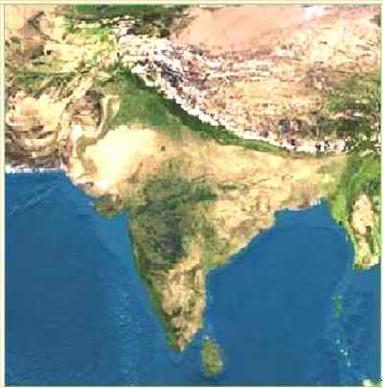
Section 1
India is a land of great: Diversity
India has over 110 different languages with over 1100 dialects spoken. Its geography ranges from fertile forests, to desert, to high mountains.
Indian Subcontinent: A landmass that is smaller than a continent. India is a subcontinent of Asia. It is divided from Asia by the Himalaya and Hindu Kush mountain ranges.

Slide 6
Khyber Pass
Himalaya
Tallest mountains in the world.
Hindu Kush
Hindu Kush
To the NW, above the Indus river.
Himalaya
Khyber Pass
Mountain pass in the Hindu Kush.
This was the passage for invaders who entered India.

Slide 7

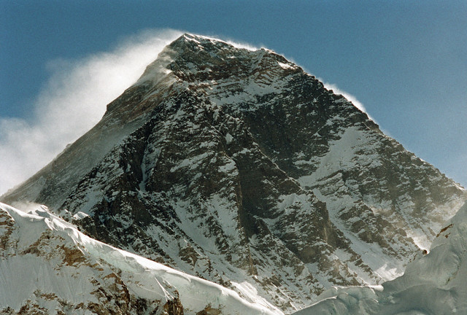
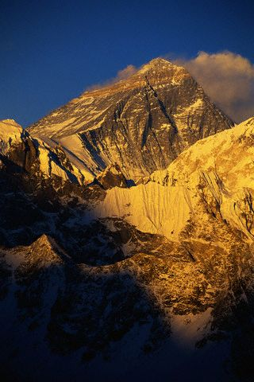
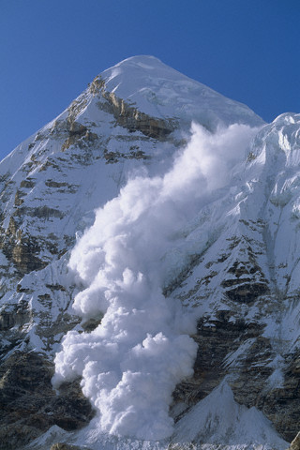
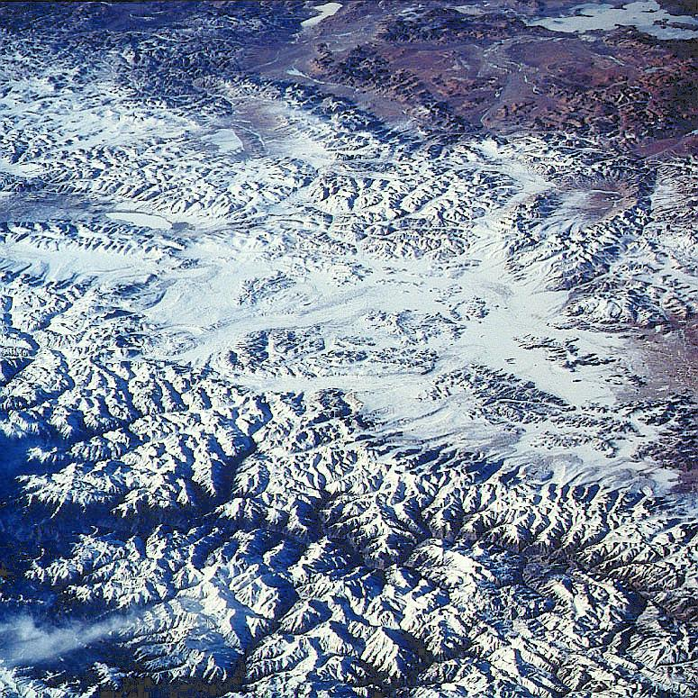
Himalaya
29, 035 ft

Slide 8
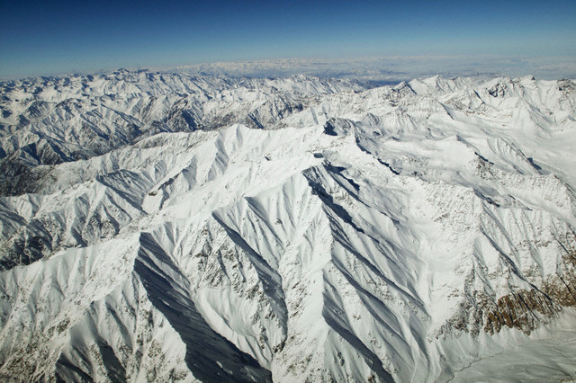
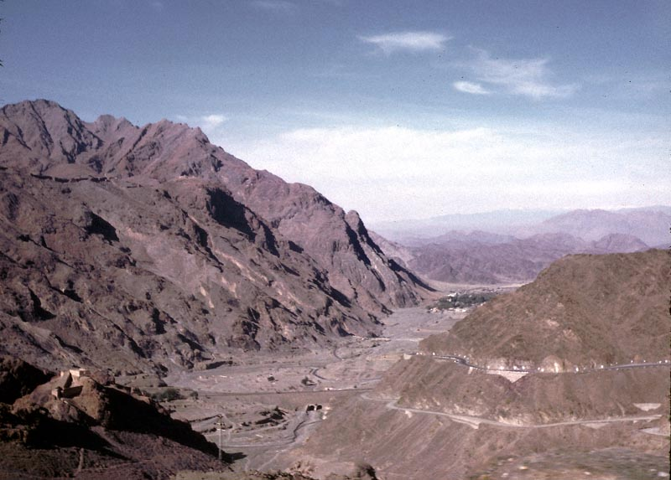
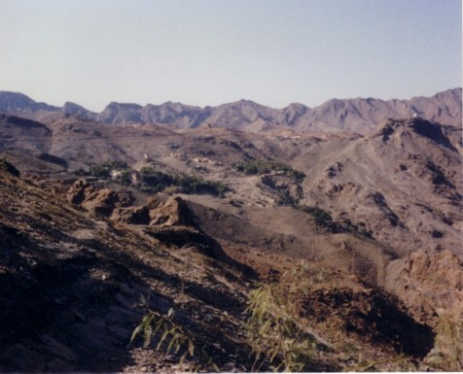
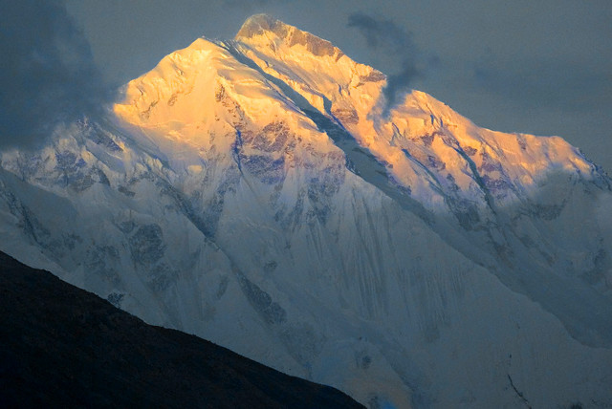
Hindu Kush
Khyber Pass

Slide 9
Ganges River
Most sacred river of India.
Indus River
Site of the first Indian Civilization
Deccan Plateau
Triangular region in central India between E. and W. Ghats.
Is very arid.
Eastern and Western Ghats
Mountains frame the Deccan, have fertile coastal plains
Indus
Ganges
Deccan
Plateau
W. Ghats
E. Ghats

Slide 10
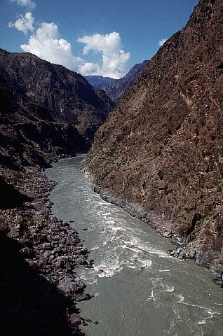
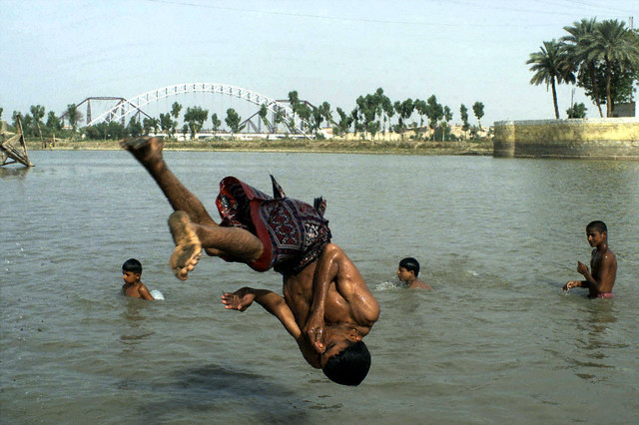
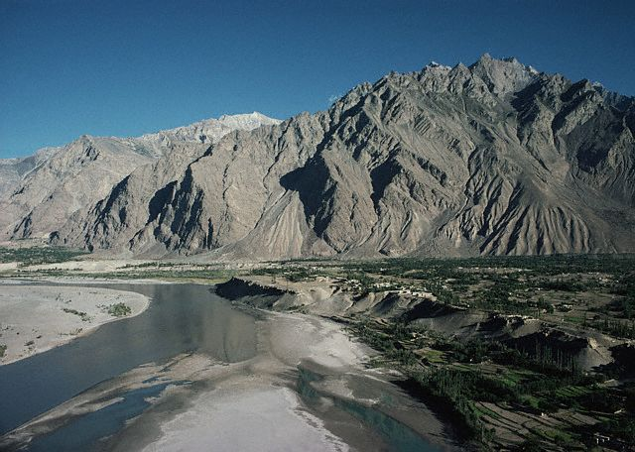
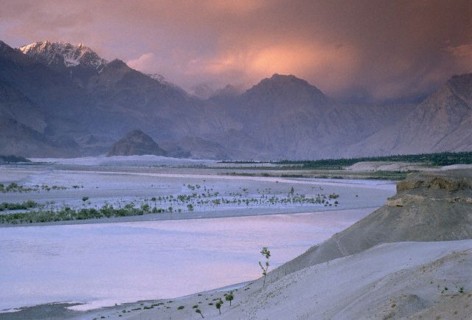
Indus River

Slide 11
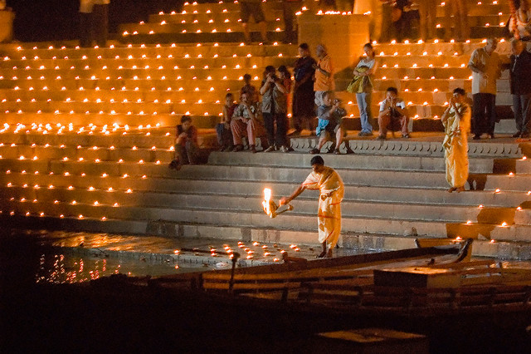
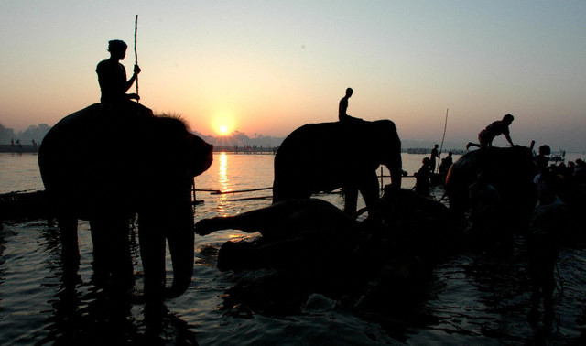
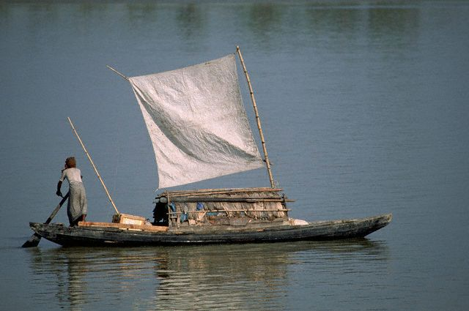
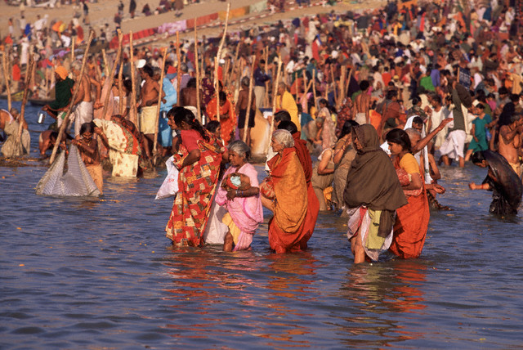
Ganges River

Slide 12
Monsoons
Monsoons are seasonal winds. These winds blow from different directions during different times of the year.
Winter
Monsoon
Summer Monsoon
Blows over the Arabian Sea and Indian Ocean bringing rain to India.
Arabian
Sea
Bay of
Bengal
Summer
Monsoon
Winter Monsoon
Blows over land and is dry.
Indian Ocean

Slide 13
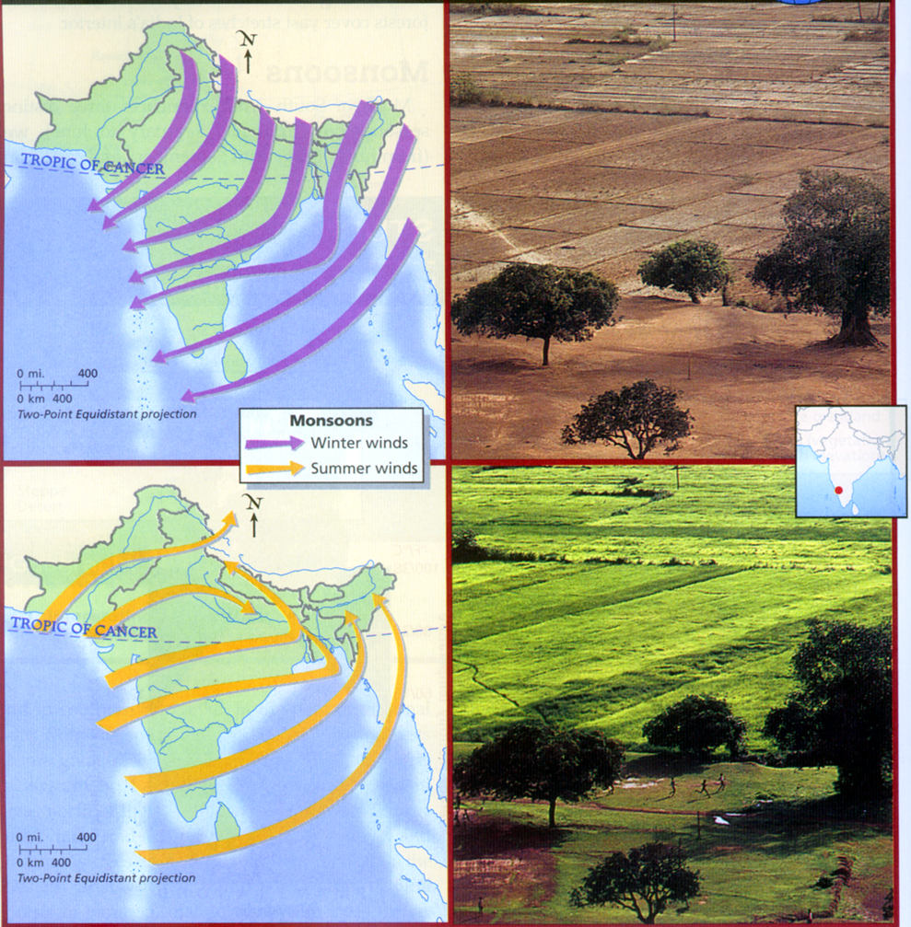

Slide 14
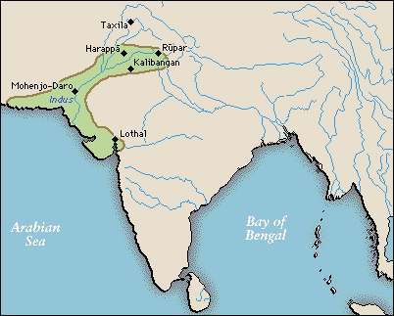
Began in: 3000 B.C. to 1500 B.C. in the Indus River Valley. It is thought that a civilization existed here that reached hundreds of miles from the Himalaya mountains to the shore of the Arabian Sea.
Two main cities found are:
Harappa and Mohenjo-Daro
Harappa and Mohenjo-Daro
Population: It is thought that Harappa had up to 35,000 people at its height and that Mohenjo-Daro has between 35,000-40,000 people.
Organization: These cities were very carefully planned.

Slide 15
Features: There is evidence of streets laid out in grids, walled neighborhoods, multi-story buildings, water and sanitation systems, garbage chutes that took trash from houses to street-level garbage bins.
Houses were made of mud bricks baked in ovens are were square forming a grid pattern.
Rulers and Economy: Rulers said their powers came from the gods. It is thought that religious and political life were closely linked.
Their economy was based on agriculture, including wheat, barely, and peas. They probably traded with other city states in Mesopotamia by sailing across the Persian Gulf. They traded copper, lumber, gemstones, and luxury goods for Textiles and food. Trade may have also gone over land through the Khyber pass.

Slide 16
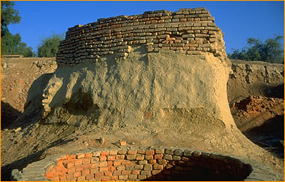
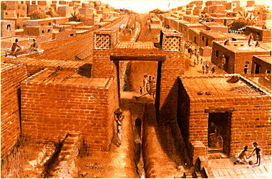
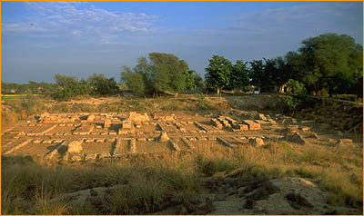
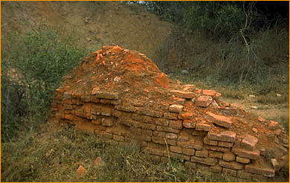

One of 8 public wells found so far

Slide 17
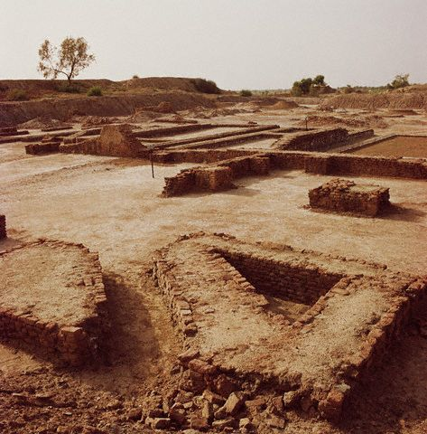
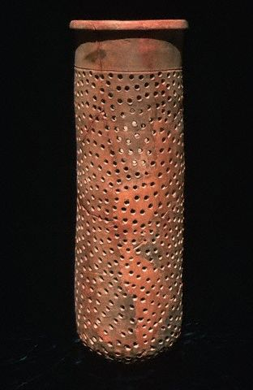
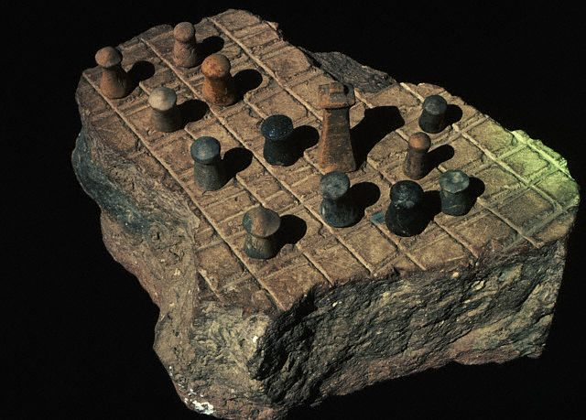
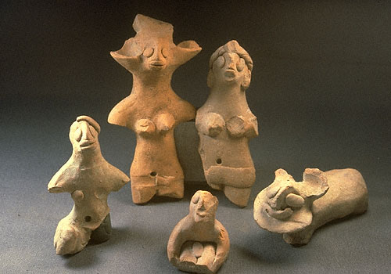
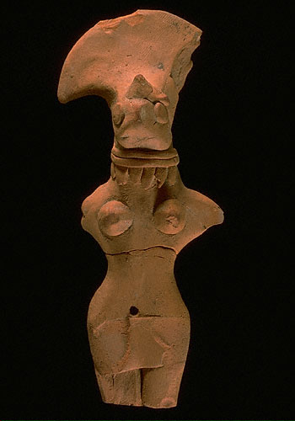
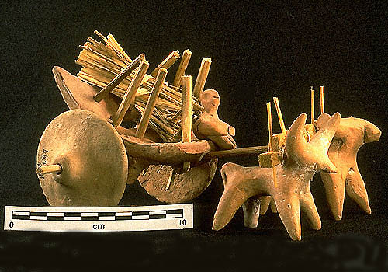

Slide 18
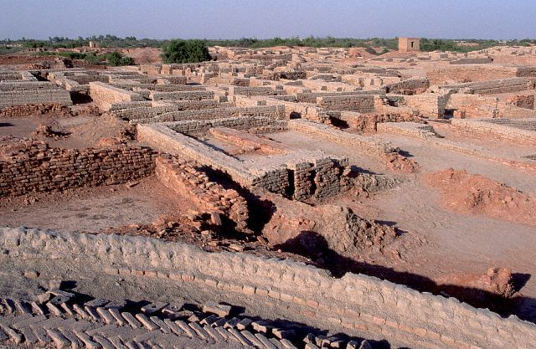
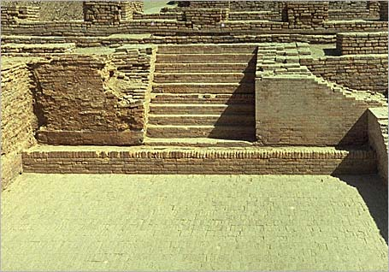
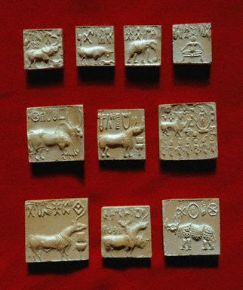
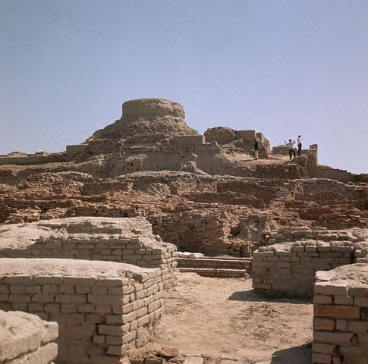
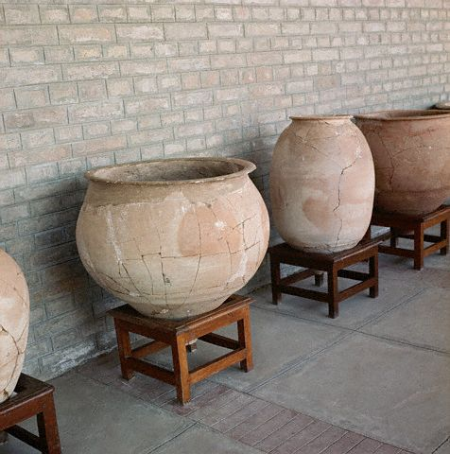


Slide 19
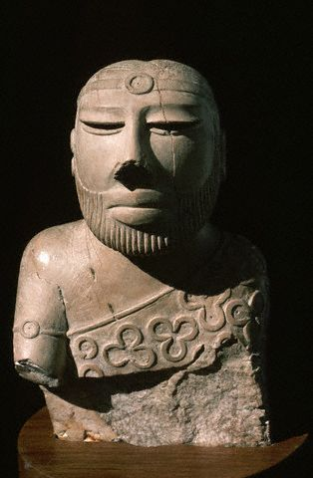
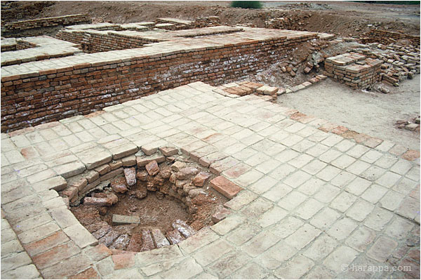
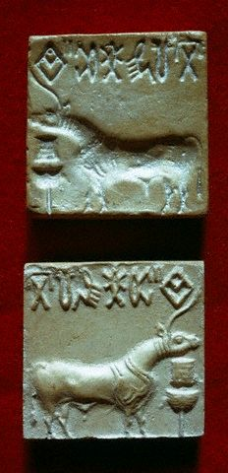
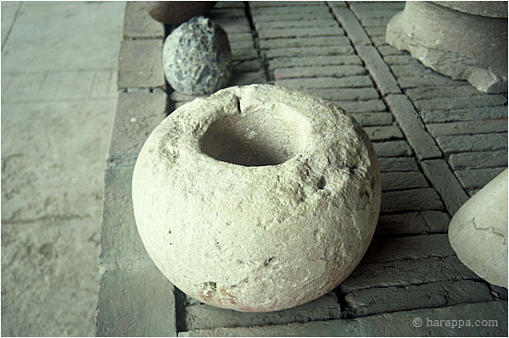
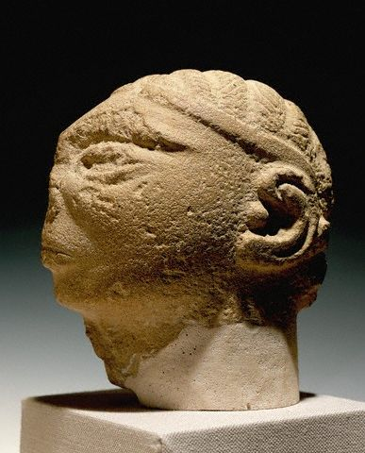

Slide 20
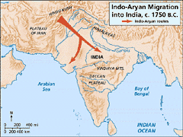
The Aryan Invasion Theory of India
Historians are not exactly sure what brought an end to the Indus Valley Civilizations. It may have been a natural disaster, climate change or a change in the course of the Indus River.
1500 B.C.: In this year many historians believe a group of Indo-European nomads began to move out of C. Asia. These people were known as the Aryans.
It is thought that they migrated south through the Hindu Kush using the Khyber pass.
Arrival in India: Advanced East from the Indus Valley, eventually occupying almost all of India. Some theorize that the Dravidians (The original people of India) recognized the advanced technology of the Aryans and eventually assimilated into Aryan culture and were not forced to migrate south.
Warfare: Were advanced fighters.

Slide 21
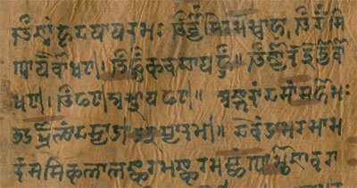
Influence of Iron: Iron tools allowed for improvements in Agriculture including the plow.
Agriculture: Tools and irrigation made it possible for the people to clear the jungle around the Ganges and create a rich farming region.
Basic crops in the north were grains, and in the south rice was common. People also began to grow cotton and spices.
Sanskrit: 1000 B.C: The written language known as Sanskrit enabled the peoples to write down their stories and religious chants and rituals. These eventually became the sacred texts of Hinduism, the Vedas.
Rajas: Princes of the Aryans, warring chieftains who fought each other seizing territory and prisoners.

Slide 22
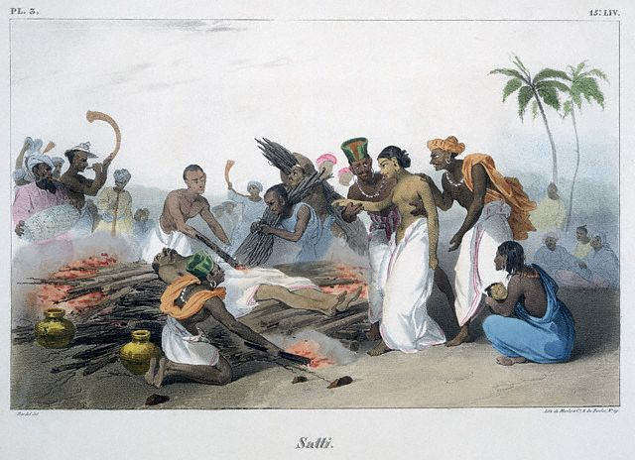
Family Life in Ancient India
Family was the most basic unit of Indian society. There was an ideal of an extended family including multiple generations living together.
Patriarchal: Indian society was male dominated. Only men could inherit property and only boys were educated.
Arranged Marriages: Parents usually arranged marriages for political and economic reasons when children were very young.
Status of Women: Women had very low social status.
There was a ritual of Suttee (Sati) where women were expected to throw themselves on the crematory fires of their dead husbands.
If they refused they were disgraced.

Slide 23
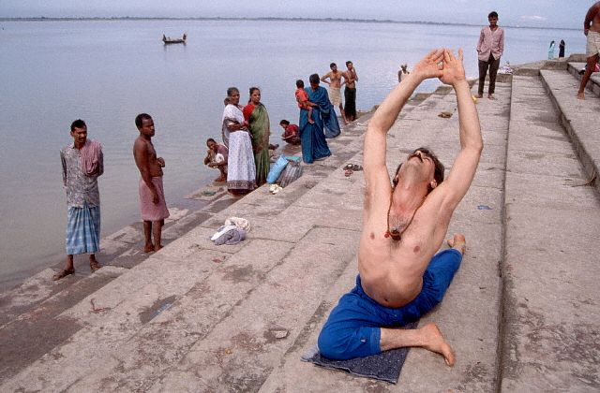
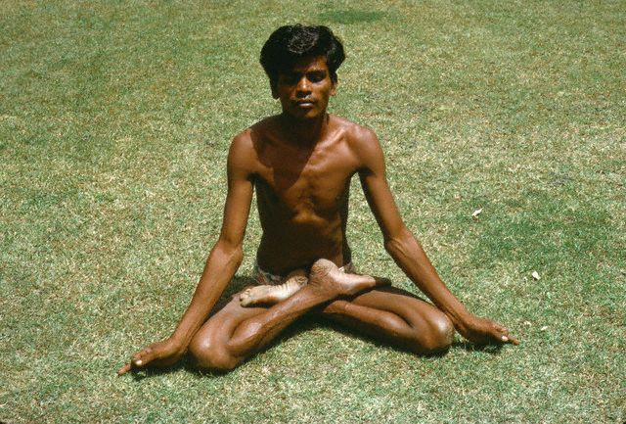
Yoga
Was developed as a method of training the body to achieve oneness with Brahman.
It is a form of meditation
Yoga entails mastery over the body, mind, and emotional self, and transcendence of desire. According to the followers, the Yogi eventually reaches the enlightened state (Moksha) where there is a cessation of thought and an experience of blissful union.
(Wikipedia)

Slide 24
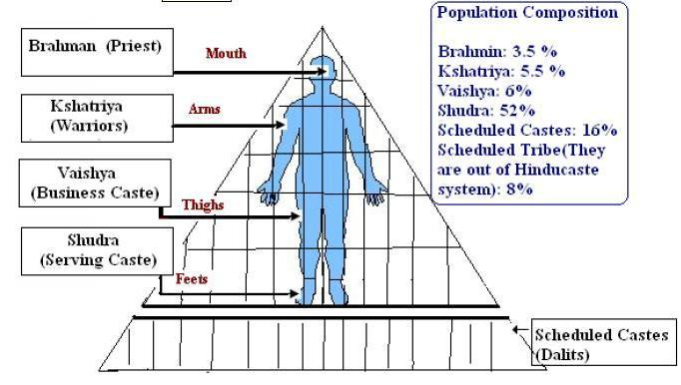
The Caste System
The Caste System is a system of social division in India.
There is some debate as to it origins, but it is made up of four main castes and several sub-castes. You are born into your caste and may not change your caste within your lifetime.
Brahmins
The top caste, the priests. They are the closest to Brahman
Kshatryias
Second Caste, the
warriors and princes
Vaishya
Merchants, artisans and landowners
(Skilled workers)
Shudra
The workers, the lowest caste.
(unskilled workers)
Each caste has its own Dharma, or duty. You must obey the dharma of your caste to earn good Karma and be able to be reincarnated at a higher caste in the next life.

Slide 25
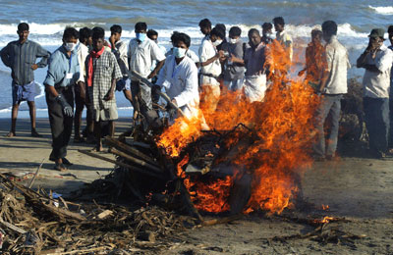
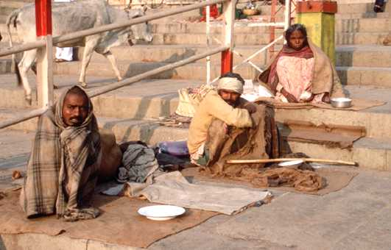
Untouchables
These people were the bottom of Hindu society, they are not considered part of the caste system.
About 5% of the population of India. They are required to perform the dirtiest jobs dealing with trash, human waste, and death.
People of other castes refuse to do these jobs because they may damage their Karma.
In the past Untouchables were not allowed to associate with people of other castes. They were even required to carry of noisemaker to warn people of the approach so they would not accidentally run into someone.
Discrimination against them continues today, even though the caste system has been declared illegal.

Slide 26
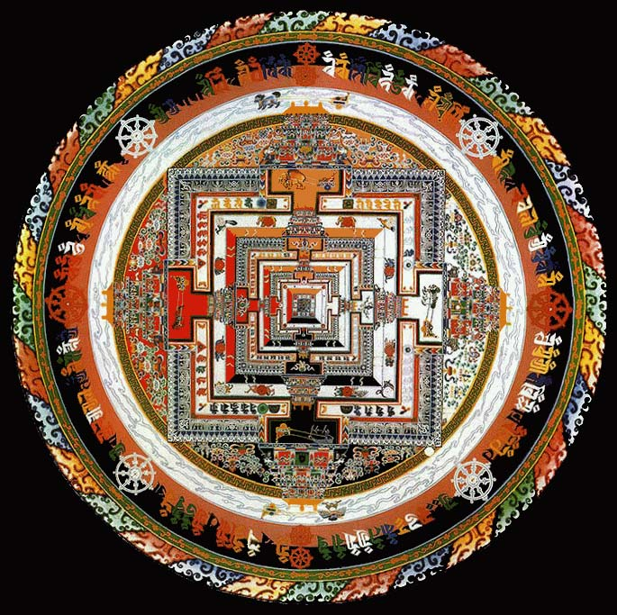
The Sand Mandala (tib: kilkhor) is a Tibetan Buddhist tradition which symbolizes the transitory nature of things. As part of Buddhist canon, all things material are seen as transitory. A sand mandala is an example of this, being that once it has been built and its accompanying ceremonies and viewing are finished, it is systematically destroyed.

Slide 27
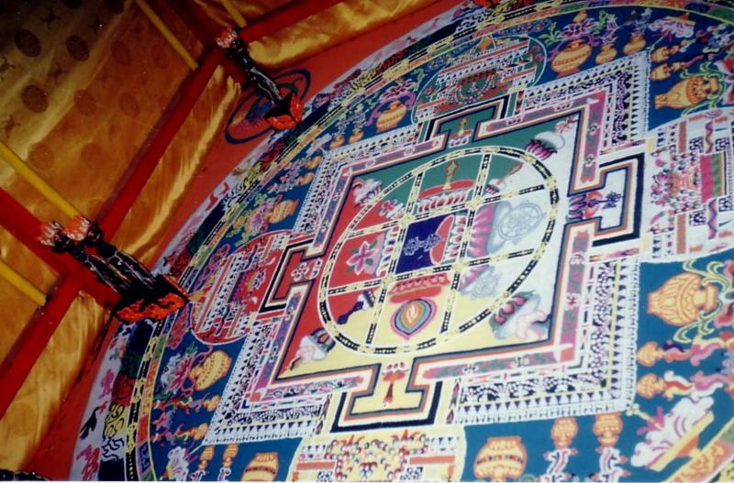

Slide 28



Slide 29

Section 2
Mauryan Dynasty
Aryan Influence: Aryans influenced the language and social structure of Indian Society.
Aryan influence also led to the development of Hinduism and Buddhism.
Later Invasions: Alexander the Great eventually spread into India in 327 B.C., but his soldiers couldn’t deal with the Monsoon rains and so they forced him to turn back.

Slide 30


Founding of the Mauryan Dynasty
Founded by Chandragupta Maurya, who ruled from 324 to 301 B.C.
Organization
The King set up his government with governors and secret police. He feared being poisoned and so had people taste all of his food.

Slide 31


Asoka (Ashoka): The empire flourished under his rule
He is often considered the greatest ruler in the history
of India.
Religious Conversion
After he converted to Buddhism he used Buddhist ideals for his rule.
Buddhist Ideals
He set up hospitals for animals and people. He ordered trees to be planted along the roads to provide shade for travelers. He gave up war and violence being almost the exact opposite of his grandfather, Chandragupta. He freed his prisoners and gave them back their land
Missionaries
Asoka sent missionaries throughout Asia.
He is greatly responsible for spreading Buddhism outside India into the rest of Asia.

Slide 32




Ashoka erected pillars and stupas throughout his empire and beyond. He inscribed them with Buddhist teachings to spread the religion.

Slide 33

The Guptas: India had its golden age under the Guptas
Chandragupta (No Relation): Founder of the Gupta Empire. He established his capital at the old Maurya city of Pataliputra.
Samudragupta: Expanded the Empire
Dominant Political Force
The Guptas became the most powerful force in the region.
They engaged in trade with China, SE Asia, and the Mediterranean.

Slide 34



Chandragupta II: The Gupta Empire reached its greatest point under him. He controlled a vast empire, from the mouth of the Ganges to the mouth of the Indus River and from what is now North Pakistan
Trade: The Guptas traded with people from China, SE Asia, and the Mediterranean.
Pilgrim routes: Religious trade was also vital to their economy. Religious travelers, or pilgrims, journeyed through India for different religious reasons.
Huns: Eventually the Huns invaded from central Asia and brought an end to the Golden age of the Guptas.

Slide 35


Indian Culture
Literature
Vedas: main scriptural texts of Hinduism
Upanishads: are part of the Vedas and form the Hindu scriptures which primarily discuss philosophy, meditation, and the nature of God
Ramayana: an ancient Sanskrit epic attributed to the poet Valmiki and is an important part of the Hindu canon
Mahabharata (Bhagavad Gita): Holy text of a conversation between Krishna and Arjuna taking place on the battlefield of just prior to the start of a war. It explains many moral principles of Hinduism and explains Karma

Slide 36


Architecture
Ashoka erected pillars to spread Buddhist teachings throughout his empire.

Slide 37




Stupa: A shrine that houses Buddhist relics

Slide 38






Pagodas, also associated with Buddhism evolved from Stupas.
They are usually Buddhist temples or shrines.

Slide 39



Science and Mathematics
The decimal numeral system, including the concept of zero, was invented in India during the reign of the Guptas
Algebra
Our Numbering System, now called
Arabic Numbers
During the Gupta empire philosophers first proposed that the earth was not flat, but was instead round and rotated on an axis by viewing a lunar eclipses.

Slide 40





Gupta Structures

Slide 41



Slide 42
Chapter 3 Section 3
Huang He
The Yellow River, aka China’s sorrow because of frequent flooding.
Yangtze
(Chang Jiang)
Yellow Sea
North China Plain
Plain between two major rivers. Most populated area of China.
Huang He
Yangtze
Yellow
Sea

Slide 43
Tian
Fertile Land
10% of the land is good for agriculture
Physical Landscape
Desert: Gobi
Taklimakan Desert
Mountains
Himalaya
Tian Shan
Plateau of Tibet
High plateau N. of the Himalaya.
Taklimakan
Gobi
Plateau
of Tibet
Himalaya

Slide 44


First Dynasty Xia Dynasty c.2070 BC–1600 BC
It was during this period that Chinese civilization developed a ruling structure that had civilian government and harsh punishment for breaking the law. From this the earliest forms of Chinese legal codes came into being.
Second: Shang 1750-1122 B.C.
Aristocracy: Rich upper-class land owners, ruled.
Economy was based on agriculture.
The Aristocracy was constantly at war.
Capital Cities
It is thought that they moved their capital several times, finally establishing their capital at Anyang, north of the Huang He.

Slide 45





Shang Bronze
The Shang were master bronze makers.

Slide 46



Political and Social Structure
The Shang King ruled from his palace at Anyang.
He split his territory up among different generals.
He could appoint and remove these generals.
The Shang frequently waged war on the fringes of their kingdom.
When a Shang king died, the servants were buried in the tomb with the king. The tomb was also filled with riches for the afterlife.

Slide 47



Religion and Culture
Possessed a very strong belief in life after death.
The Shang practiced human sacrifice to win the favor of the gods or give the king company in the afterlife.
Ancestor Veneration
The ancestors were seen as a link between the present world and the spiritual world. They could bring good or bad fortune to a family. Offerings of food and drink were offered to them
Oracle Bones
A way to communicate with the ancestors. Animal bonds were carved with questions, then heated or broken. A priest then interpreted the breaks.

Slide 48

Zhou Dynasty 1045-256 B.C.
Duration
Lasted for almost 900 years, longest lasting dynasty in Chinese History.
Political Structure
Head was a king who ruled over an imperial bureaucracy. The king was seen as the link between heaven and earth and had divine-like powers.
The rulers of the different provinces were aristocrats, similar to the way it was in the Shang dynasty.

Slide 49

The Mandate of Heaven/Dynastic Cycle
Mandate of Heaven:
The Zhou used the Mandate of Heaven to justify their rule.
Heaven, the law of nature, kept order in the universe by choosing the king. The king was responsible for being a good ruler.
Dao: The Way
The King was responsible to rule by the Dao, he had to keep the gods happy to protect people from natural disaster, or bad harvest.
If he didn’t do this he would lose power.
The mandate of heaven was used to explain the rise and fall of different dynasties. When a ruler took over they claimed they had earned the mandate of heaven, or they would not have been able to win. This was closely tied to the Dynastic Cycle

Slide 50

The Dynastic Cycle
New Ruler Gains the Mandate of Heaven
Dynasty founded by powerful leader
Period of Rebellion
Ruler loses the Mandate of Heaven
Period of Great Power and Prosperity
Golden Age
Period of Decline and Corruption

Slide 51


Decline of the Zhou
Later Zhou rulers began to become corrupt.
Civil war broke out between the kingdoms
This is called the “Warring States Period”
Changes in Warfare
Iron Weapons were developed.
Infantry (foot soldiers) and Cavalry (soldiers on horseback) became more prevalent.
Began to use the crossbow

Slide 52

Life under the Zhou
Economic and Technological Growth
Made major advancements during this period that improved life for the people.
Irrigation and Water Projects
Began to control the flow of rivers to water crops. Farming could be more reliable without dependence on rains.
Farming Advancements
Iron plows, increase arable land.
An agricultural surplus led to an increase in trade.
The most important trade item was silk.
It’s secret was closely guarded.
Sharing the secret of silk was punishable by death.

Slide 53
Family
In an agricultural society families had to work together to survive. Family, and extended families, were very important.
Filial Piety
Family members were responsible to obey the needs and wants of the male head of the family.
Everyone had to know their place.
Children were expected to provide for their parents in old age.
Role of Women
Ancient China was a patriarchal, or male dominated, society.
Some women had power, but this was generally looked down upon.
Women were expected to raise children and work in the home.

Slide 54



Chinese Language
Pictograms
Written Chinese is made up of pictograms, or characters.
These are symbols that represent things.
Ideograms
Two or more characters arranged to represent an idea.
東
Pictograms for mountain, sun, and moon
Ideogram for East, all the pictograms are combined.

Slide 55



Trade
An agricultural surplus led to an increase in trade.
The most important trade item was silk.
It’s secret was closely guarded.
Sharing the secret of silk was punishable by death.
Silk is made from the cocoons of silkworms
These worms feed on Mulberry leaves.
The cocoons are boiled to kill the silkworm
Then the cocoons are unwound and combined to make silk thread

Slide 56


Chinese Philosophies
Chinese philosophers were less concerned with the afterlife, and more concerned with how to improve life presently on earth.
Confucianism
Founder: Confucius
famous Chinese thinker and social philosopher, whose teachings and philosophy have deeply influenced Chinese, Korean, Vietnamese, and Japanese life and thought.
Is known to the Chinese as the first teacher, his name was “Master Kung”
Was born in 551 B.C.

Slide 57

Wanted to be
Confucius originally wanted to be a political advisor.
He traveled around the country trying to persuade political leaders to listen to him.
He was rejected and so he decided to become a teacher instead.
Confucius developed a great following of students.
These students collected his teachings after his death.
This teachings are collected in The Analects.
A collection of sayings and advice.
"In teaching, there should be no distinction of classes.“
-Confucius

Slide 58
Thought that people were:
Confucius taught that people were born good and that bad behavior, or evil was learned behavior.
Treatment of Others
Confucius taught that you should be respectful of others.
Confucius believed that personal interests were subordinate to the needs of the family and community.
Government Leaders
In order to govern others one must first govern oneself.
Leaders should practice self control and be moral.
Merit: Leaders should rule by example. If a ruler is fair and just then his people will follow and do the same.
To govern by virtue, let us compare it to the North Star: it stays in its place, while the myriad stars wait upon it." (Analects II, 1)

Slide 59

Filial Piety
Confucius taught that people should have Filial Piety, respect for your elders and superiors.
Confucius taught that order in the university would only exist if people followed their role. He established five key relationships which brought about an orderly society.
Ruler to Subject
Father to Son (Parent to Child)
Husband to Wife
Older Brother to Younger Brother
Friend to Friend
The only equal relationship was friend to friend.

Slide 60
Specific duties were prescribed to each of the participants in these sets of relationships. Such duties were also extended to the dead, where the living stood as sons to their deceased family. This led to the veneration of ancestors.
In time, filial piety was also built into the Chinese legal system: a criminal would be punished more harshly if the culprit had committed the crime against a parent, while fathers exercised enormous power over their children.

Slide 61

Daoism (Taoism)
Founded by Laozi, the “Old Master”
It was said that he lived without leaving any traces.
Holy Text: Tao Te Ching
Way of Life
He believed a person's conduct should be governed by instinct and conscience. He believed "simplicity" to be the key to truth and freedom. Lao Tzu encouraged his followers to observe, and seek to understand the laws of nature; to develop intuition and build up personal power; and to wield power with love, not force.
View of Government
Daoism views government as being unnatural.
“The universe is sacred, You cannot improve it. If you try to change it, you will ruin it. If you try to hold it, you will lose it.”

Slide 62

Yin and Yang
Yin is the darker element; it is passive, dark, feminine, downward-seeking, and corresponds to the night. Often symbolized by water or earth
Yang is the brighter element; it is active, light, masculine, upward-seeking and corresponds to the day. Often symbolized by fire or wind.
These are complementary opposites rather than absolutes. They do not represent good and evil, one force is not seen as morally superior to the other.

Slide 63

Yin and Yang do not exclude each other.
  Everything has its opposite: although this is never absolute, only relative
Yin and Yang are interdependent.
  One cannot exist without the other
Yin and Yang can be further subdivided into Yin and Yang.
  Any Yin or Yang aspect can be further subdivided into Yin and Yang.
Yin and Yang consume and support each other.
  Yin and Yang are usually held in balance: as one increases, the other decreases
Yin and Yang can transform into one another.
  At a particular stage, Yin can transform into Yang and vice versa. For example, night changes into day
Part of Yin is in Yang and part of Yang is in Yin.
  The dots in each serve as a reminder
  that there are always traces of one in the other

Slide 64

Legalism
Founded by: Han Feizi
Nature of Man
Legalism believed that man was born bad and had to learn to be good.
The state is more important than the individual
Rulers
Rulers should be strong and rule with absolute power.
Laws
Legalists believed that if the punishments were heavy and the law equally applied, neither the powerful nor the weak would be able to escape state control

Slide 65

Section 4
Qin (Chin) Dynasty (221 BC - 206 BC)
The fall of the Zhou dynasty led to a period of Chaos called the “Warring States Period”, at the end of this the emperor Qin Shihuangdi unified China under a single leader, becoming the first Emperor of China.
First Emperor came to power in 221 B.C.
Shi Huangdi (Shihuangdi) First Emperor of China.
He came to power at the age of 13.
He dramatically changed life in China.

Slide 66

Ruling Philosophy
Qin adopted Legalism to rule his regime (government in power)
Style of Rule
Centralized power to avoid another civil war.
Treatment of People
People who opposed his rule were punished or executed.
He held mass book burnings to get rid of ideas contrary to what he believed.

Slide 67
Written Language
Shi Huangdi made many reforms
He unified written Chinese, having a common written language allowed for easier communication.
He created a single currency to make trade easier
He built roads throughout his empire to make travel easier.
He dug the Grand Canal from the Yangtze to Central China to make trade and travel easier.

Slide 68
Military Division
Dealt with government/
defense issues.
Inspectors who checked on government officials.
Dealt with issues that affected the people
Larger divisions
Smaller Divisions

Slide 69

Xiongnu
Nomadic warriors to the north of China.
They kept invading along the northern borders.
Mastered the art of fighting on horseback, using horse archers to attack.
Construction of The Great Wall
Shihuangdi ordered that a wall be built across the northern border of the empire.
There were already some walls along the borders, he had them jointed together.
This was a massive construction project, many people died during construction and are allegedly buried inside the wall itself.

Slide 70



The Great Wall is the world's longest man-made structure, stretching over 6,352 km
(3,948 miles)

Slide 71

Fall of the Qin Dynasty
The harsh rule of Shihuangdi angered many in his Empire
After his death there was another period of civil war
The next dynasty to arise was one of the greatest and longest lasting in Chinese History.

Slide 72
The Han Dynasty (206 BC–AD 220)
Liu Bang: A man of peasant origin, was the founder of the Han Dynasty.
Ruling Philosophy
The Han adopted Confucianism as their ruling philosophy
Choosing of rulers
Officials and rulers were chosen by merit, rather than by birth. That way they were better qualified to rule.
Civil Service Exam
The Han set up schools to train people for government work.
Students had to learn Chinese history, law, and the teachings of Confucius.
They had to pass an exam to be able to work in the government.

Slide 73


Expansion of Empire
Han rulers added territory to the north and out to the South China sea into what is today Vietnam.
The Han Emperor Wudi, forced the Xiongnu back north through war and diplomacy, and brought peace to the empire for 150 years.
The Silk Road expanded during the Han Empire under Wudi, it was said he heard of Heavenly Horses that were very powerful
Culture under the Han
Confucian schools were established during this time.
Life of Peasants
Peasant life was not good during this time.
A growth in population reduced the amount of available farm land, forcing many farmers out of business.
Many were forced to sell their land and become tenant farmers.
Wealthy land-owners gained much of the land.

Slide 74


Technological Advancements
Rudder and Fore and Aft Rigging
The rudder allowed for the steering of ships.
The rigging and shape of the sails allowed ships to use wind coming from different directions.
A Chinese Junk (Ship)
Textiles
Began to weave cotton cloth
Paper
Writing on paper began about 100 A.D.
Paper was made with hemp/linen and Bamboo.
The Chinese also invented the Magnetic Compass and gunpowder

Slide 75


Iron Casting: Steel
The Chinese were able to invent steel.
This led to stronger, and more durable, tools and weapons.
Reproduction of a Han style sword
Decline of the Han
Han rulers became corrupt over time.
Power of the Central government declines and aristocrats began to fight over power.
China fell into another period of civil war.

Slide 76
Culture of Han
Confucian Schools
Became the basis of education in China for many years to come.
Culture of Qin
Terra Cotta Army
Was created to guard the emperor Qin Shihuangdi in the afterlife.
Each soldier is unique.
The army, dressed in uniforms, with weapons, is made to scale.
There are horses, wooden chariots, and several thousand bronze weapons.
They were originally painted with bright colors, but this has faded over time.

Slide 77






