Slide 1
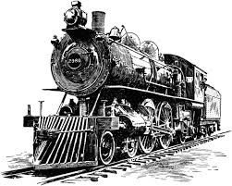
Industrial Revolution Answer the following question: Without the Agricultural Revolution could there have been an Industrial Revolution?
Objective: Students will better understand the nature of the Industrial Revolution and the enormous wealth it rapidly generated in Great Britain and elsewhere in the Western world.

Slide 2
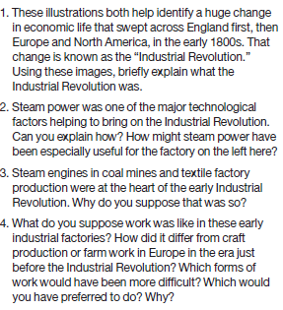
Illustration 1

Slide 3
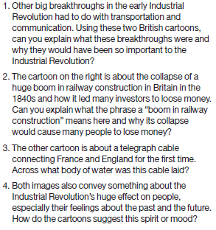
Illustration 2

Slide 4
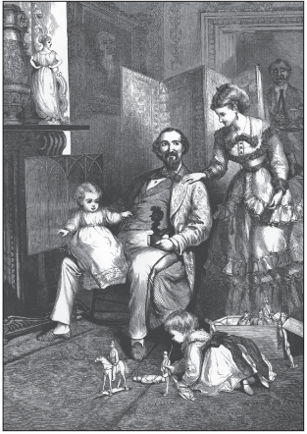
Illustration 3

Slide 5
Follow up activity
To answer this question, collect several recent illustrations you see as presenting an ideal image of family life today (ads, photographs, tv or movie stills, cartoons etc.) Use these and the above illustration to write a couple of paragraphs on “The Ideal Family and Home: Then and Now 1850 – 2015”.

Slide 6
Exit Question
What impact does the Industrial Revolution have on your life today? Are they positive or negative?

