Slide 1
The Globalization of Liberation: Comparing Feminist Movements
AP World History
Chapter 24
“Accelerating Global Interaction”
(Since 1945)

Slide 2
A Global Culture of Liberation
1960s = emergence of many protest movements suggested the creation of a global culture of liberation
In the United States | In Europe
Civil rights movements of African Americans and Hispanic Americans | Protests against unresponsive bureaucracy, consumerism, and middle-class values
Counterculture of rock music, sex, drugs, etc. (“hippie” movement) | Student-led protests against conditions in universities
Protests against the Vietnam War | Protests against police brutality

Slide 3
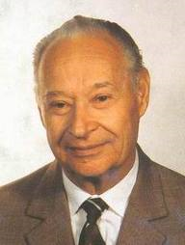
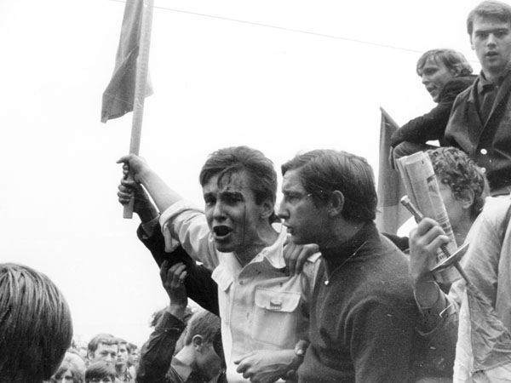
A Global Culture of Liberation
Protests hit the communist world too
1968 = the “Prague Spring” in Czechoslovakia = reforms initiated by leader Alexander Dubcek
End to censorship
Increased freedom of expression
Public emergence of unofficial “political clubs”
Rehabilitation of victims of repression
Emergence of secret ballots for party elections
Student protestors during the “Prague Spring”

Slide 4
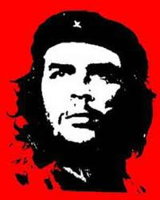
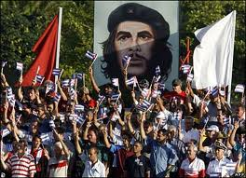
Icon of “Third World” Liberation
Che Guevara
Revolutionary – born in Argentina
Anti-imperialism
Had a self-sacrificing lifestyle
Embraced the Cuban Revolution
Attempted to replicate Cuba’s experience of liberation in parts of Africa and Latin America using guerrilla warfare
1967 = killed by the Bolivian military

Slide 5
Second Wave of Feminism
1st wave = in the 19th century
Emphasis then on: voting and political rights
2nd wave = began in the 1960s
Emphasis now on: education, employment, reproductive and sexuality rights, etc.

Slide 6
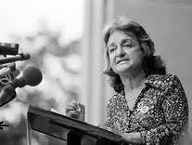
Feminism in the West
Famous book that became central to the women’s movement in the West = Betty Friedan’s The Feminine Mystique (1963)
Disclosed the identity crisis of educated women who were unfulfilled by marriage and motherhood
Made education and employment the forefront of the feminist movement in the West

Slide 7
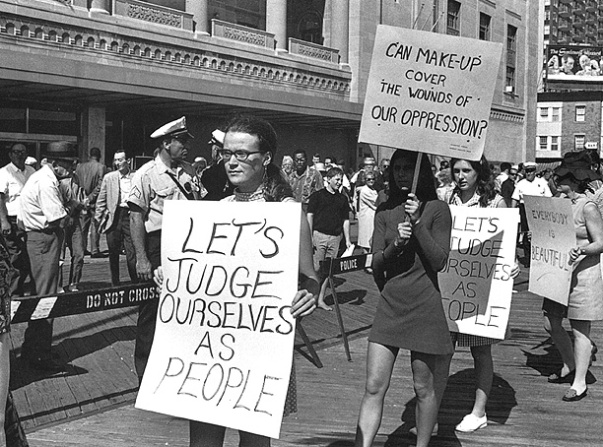
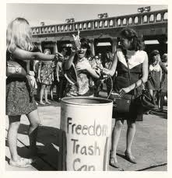
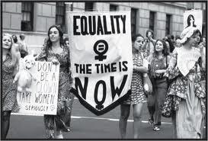
The “Women’s Liberation” Movement
Took broader aim at patriarchy as a system of domination, similar to those of race and class
Belief = liberation for women meant becoming aware of their own oppression
Preferred direct action vs. political lobbying
Example: releasing stink bombs at the 1968 Miss America pageant
Brought into open discussion “taboo” issues involving sexuality
Free love, lesbianism, celibacy, etc.

Slide 8
Feminism in the West: Women of Color
Women of color believed that the concerns of white, middle-class feminists had nothing to do with their oppression
They viewed mainstream feminism as a “family quarrel between white women and white men”
White Women in West | Women of Color in West
Focus = on fighting the oppressive “family” structure, education, employment | Focus = on fighting racism and poverty
Sought liberation from the “chains” of homemaking and domesticity | Had always worked outside of the home
 | Viewed the family as a secure base from which to combat racism
Wanted to work WITHOUT men | Wanted to work WITH men of color

Slide 9
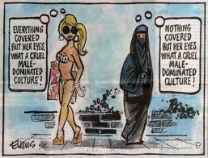
Feminism in the Global South
Different conditions in developing nations = created sharp criticism of Western feminism
Believed Western feminism was too individualistic and too focused on issues of sexuality, motherhood, marriage, and poverty
Resented Western feminists’ interests in cultural matters such as female genital mutilation and polygamy → what would they know about that?? → insulting and pretentious

Slide 10
Feminism in the Global South
Women’s movements in the Global South took shape around a wide range of issues, not all of which were solely based on gender → examples:
Country or Region | Focus of Women’s Movement
Kenya | Providing support for one another, community projects, buying land/businesses, etc.
Morocco | Changing the Family Law Code to recognize women as equals to their husbands & let them initiate divorce and claim child custody
Chile | Ending military dictatorship, stopping torture and the “disappearance” of political opponents, economic survival, democracy
South Korea | Democracy, better pay & working conditions, end to sexual harassment in the workplace

Slide 11
International Feminism
Feminism became a global issue → “women’s rights are human rights.”
1975 = UN declared it International Women’s Year & next 10 years would be the “Decade for Women”
By 2006 = 183 countries had ratified a UN Convention to Eliminate Discrimination against Women → committed to:
Promoting women’s legal equality
Ending discrimination
Encouraging women’s development
Protecting women’s human rights

Slide 12
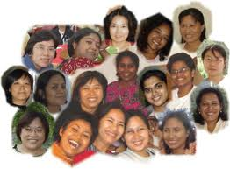
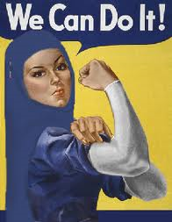
International Feminism
Several sharp divisions within global feminism began to emerge:
Who should speak on behalf of women? → Official delegates of male-dominate governments vs. more radical and unofficial representatives from nongovernmental organizations
Global North vs. Global South issues
Global North = focus on political and civil rights
Global South = focus on economic justice, decolonization, and disarmament
Different issues among nations in the Global South
Example: Muslim women AGAINST equal inheritance because it violates Islamic law

Slide 13
International Feminism
Global backlash to international feminism also began to emerge
Believed this movement was too radical
Believed it undermined family life, proper relationships between men and women, etc.
In the Islamic World → people found Western-style feminism highly offensive due to its focus on gender equality and open sexuality
Backlash from certain religions (i.e. Christianity) → especially with reproductive issues like abortion and birth control

