Slide 1
The Middle Ages
Postclassical period in western Europe known as the Middle Ages, stretches between the fall of the Roman Empire (476 CE) to the mid-15th c.
Christian missionaries converted Europeans from polytheistic faiths to monotheistic ones (mainly Christianity) – Cultural Diffusion
New tools and crops expanded agricultural output; advanced technologies improved manufacturing
Effective political and military power in Europe was localized w/ regional aristocrats

Slide 2
Periodization
Early Middle Ages: 500 – 1000
High Middle Ages: 1000 – 1250
Late Middle Ages: 1250 - 1500
Western Europe not as commercially or culturally developed as the great world civilizations

Slide 3
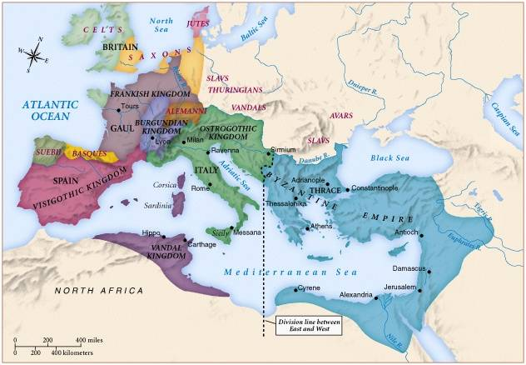
Europe in the 6th century
Europeans long lived under the threat of incursions from the stronger Islamic world and other invaders
The Catholic Church in the first centuries after 500 was the single example of a firm organization. People value religion above everything else

Slide 4
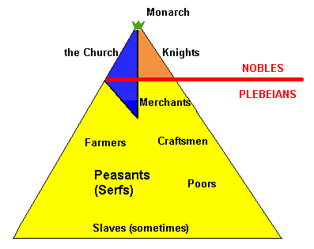

Slide 5
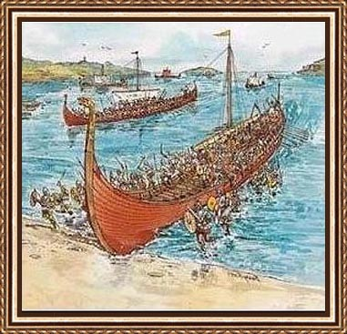
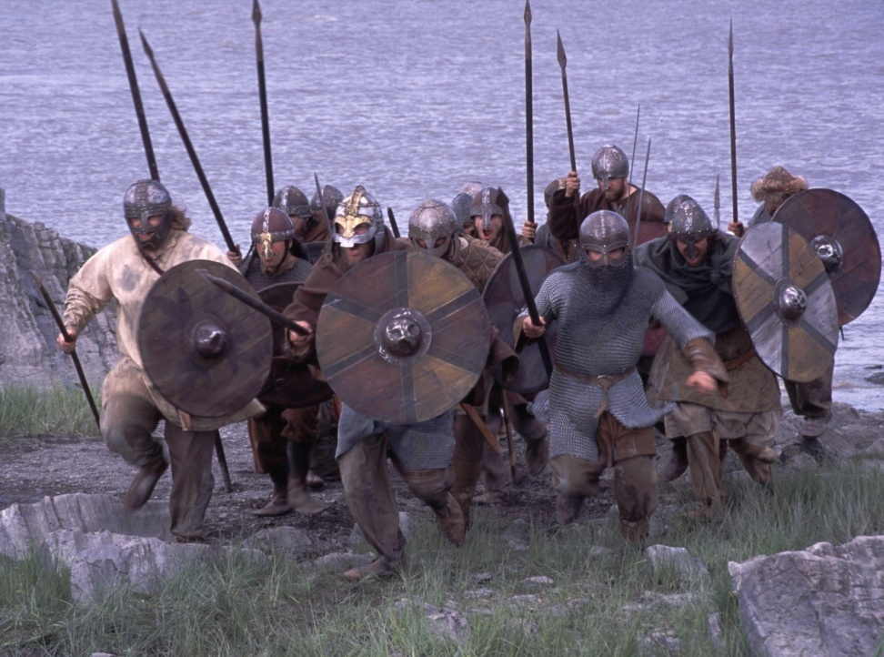
Vikings – Seagoing Scandinavian raiders who disrupted coastal areas of Europe from the 8th to 11th centuries; pushed across the Atlantic to Iceland, Greenland, and North America
From the mid-5th c. until about 900 CE disorder prevailed in western Europe
Muslims controlled Spain - maintained a vibrant intellectual and economic life

Slide 6
The pope headed a hierarchy based on the Roman imperial model; they appointed some bishops, regulated doctrine, and sponsored missionary activity
The conversion of Germanic kings, such as Clovis of the Franks demonstrated the spiritual and political power of the church

Slide 7
The Medieval Catholic Church
filled the power vacuum left from the collapse of the classical world.
provided schools for the children of the upper class.
provided inns, hospitals, & refuge in times of war.

Slide 8
The Power of the Medieval Church
played a large part in the feudal system.
the church controlled about 1/3 of the land in Western Europe.
crusades
tithe → 1/10 tax on your assets given to the church.
Peter’s Pence → 1 penny per person [paid by the peasants].

Slide 9
Scholasticism – Dominant medieval philosophical approach. Name originated because of its base in the schools or universities; based on the use of logic to resolve theological problems

Slide 10
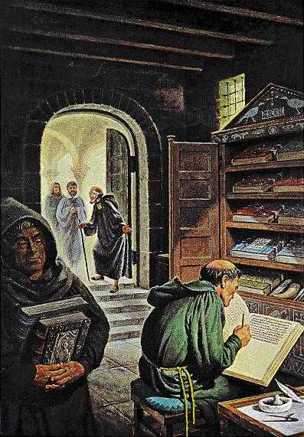
Roman Catholic Church – Church established in western Europe during the Roman empire and the Middle Ages; head of the church is the bishop of Rome (Pope)
Pope – Meaning papa or father; bishop of Rome and head of Catholic church

Slide 11
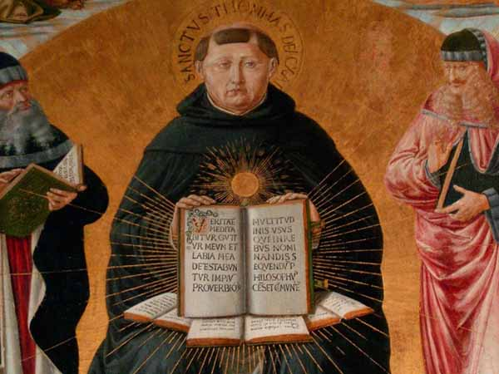
Thomas Aquinas – Creator of one of the great syntheses of medieval learning; taught at University of Paris; believed that through reason it was possible to know much about natural order, moral law, and the nature of God.

Slide 12
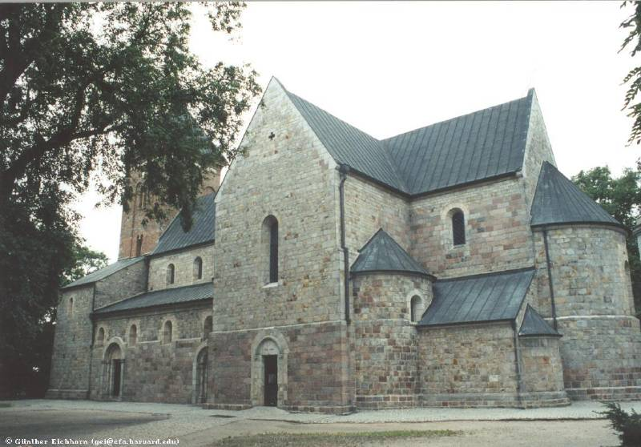
Roman Architectural Style
Rounded Arches.
Thick walls.
Dark & simplistic interiors.

Slide 13
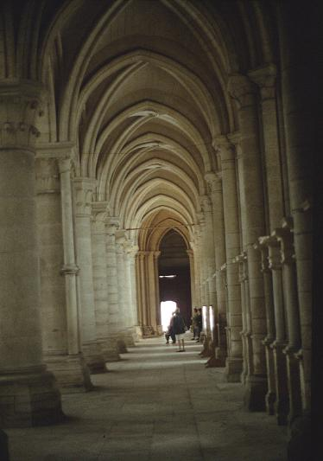
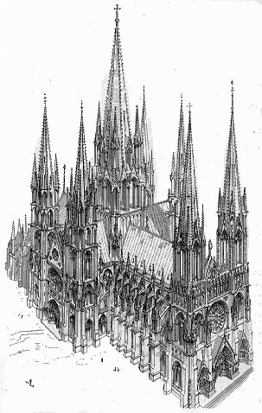
Gothic style – An architectural style developed during the Middle Ages in western Europe; featured pointed arches and flying buttresses as external support on main walls; 11th century.

Slide 14
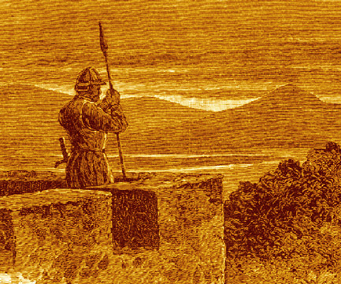
Manorialism – System of economic and political relations between landlords and their peasant laborers.
A manor would include the lord and all the serfs of a village or group of villages, their mutual obligations to provide protection, labor, & justice, for all people in the manor
In return for protection they (serfs) gave lords part of their crops and provided labor services

Slide 15
Feudalism – is a system in which weaker vassals (weaker lords) served stronger nobles (stronger lords), receiving protection in return. Feudalism was a prominent form of government during the Middle Ages
Vassals – Members of the military elite who received land from a lord in return for military service and loyalty
A “manorial system” is a way of living economically and socially, on a large farm, in a self-sufficient manner.

Slide 16
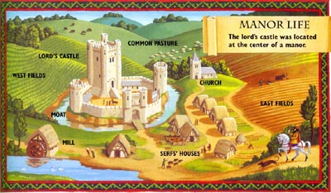
Intellectual activity sharply diminished; most literate individuals were Catholic monks and priests
Serfs bore many burdens, but they were NOT slaves; had heritable ownership of houses and land as long as they met their obligations
Most individuals were serfs living on self-sufficient agricultural estates (manors)

Slide 17
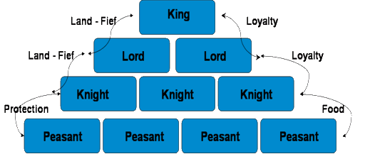
Feudalism
A political, economic, and social system based on loyalty and military service.
Vassal owned loyalty to their lord

Slide 18
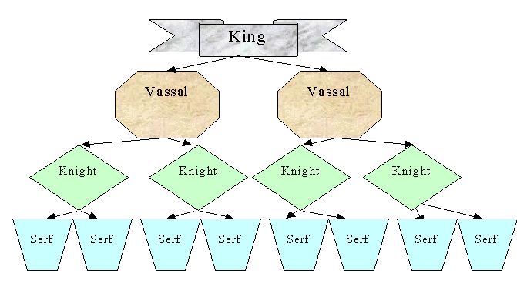

Slide 19
The Carolingian Renaissance – Dynasty took over the Frankish monarchy in the 8th century
The Carolingian dynasty of the Franks - ruled in France, Belgium, and Germany; grew stronger during the 8th c.
Charlemagne built a substantial empire by 800 CE; he helped to restore church-based education and revived traditions of Roman imperial government
The empire did not survive Charlemagne’s death; his sons divided the territory; the rulers reigning in Germany and northern Italy initially were the strongest

Slide 20
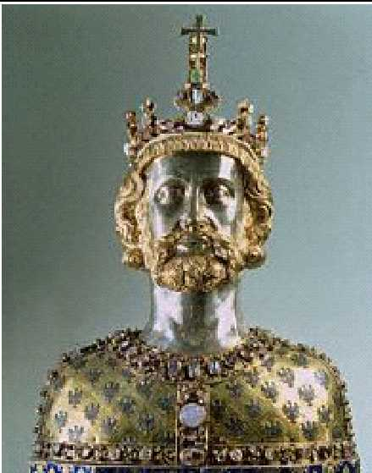
Charles the Great Charlemagne: 742 to 814
Charlemagne – Carolingian monarch who established a large empire in France and Germany
Holy Roman emperors – Rulers in northern Italy and Germany following the breakup of Charlemagne’s empire; claimed title of emperor but failed to develop centralized monarchy

Slide 21
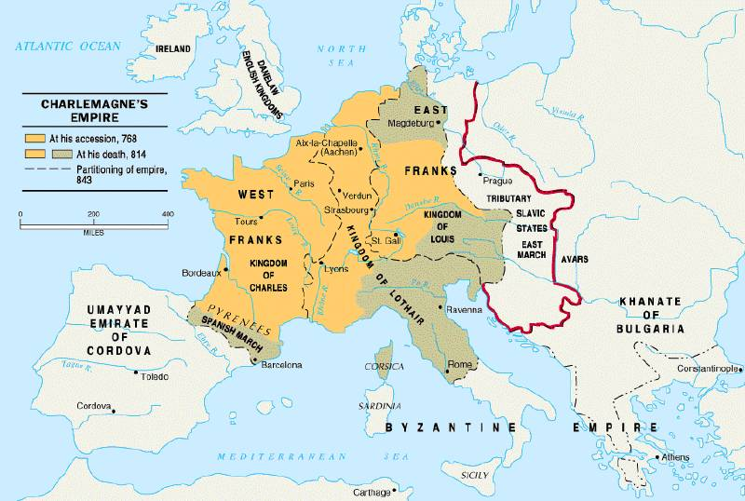
Charlemagne’s Empire

Slide 22
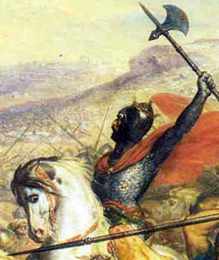
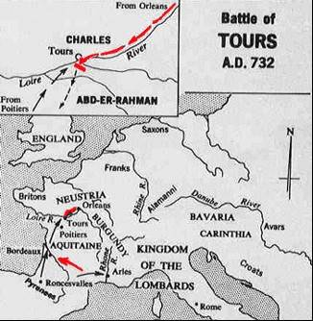
The Rise of European Monarchies England
Clovis – King of the Franks; converted to Christianity circa 496
Carolingians –Royal house of the Franks formed the 6th to the 10th c.
Charles Martel – Carolingian monarch of the Franks; defeated Muslims at Tours in 732

Slide 23
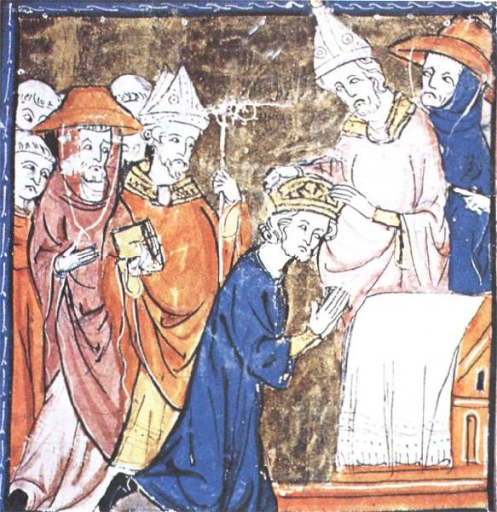
Pope Crowned Charlemagne Holy Roman Emperor: Dec. 25, 800

Slide 24
Western Europe remained politically divided
The Holy Roman Empire’s territories in Germany and Italy were controlled by local lords
The pope ruled in central Italy
Regional units prevailed in the Low Countries
King John of England in 1215 was forced to recognize feudal rights in the Magna Charta
Parliament emerges! - Most members of societies were not represented, but the creation of representative bodies was the beginning of a distinctive political process not present in other civilizations

Slide 25
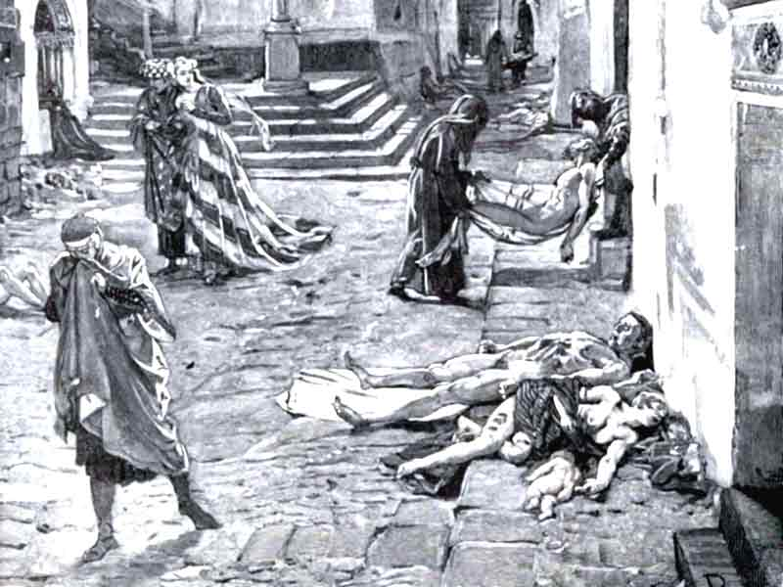
Black Death – plague that struck Europe in the 14th c., significantly reduced Europe’s population; affected social structure; Bubonic Plague

Slide 26
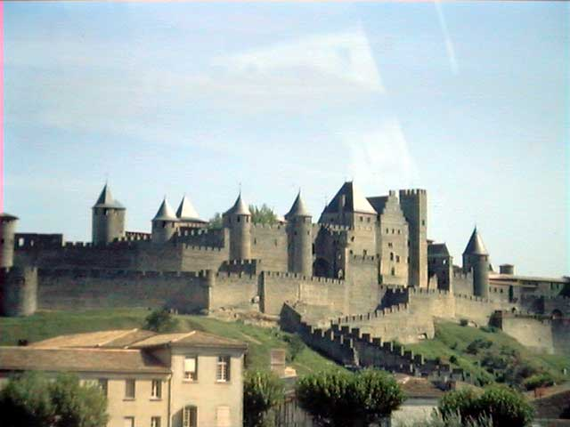
Carcassonne: A Medieval Castle

Slide 27
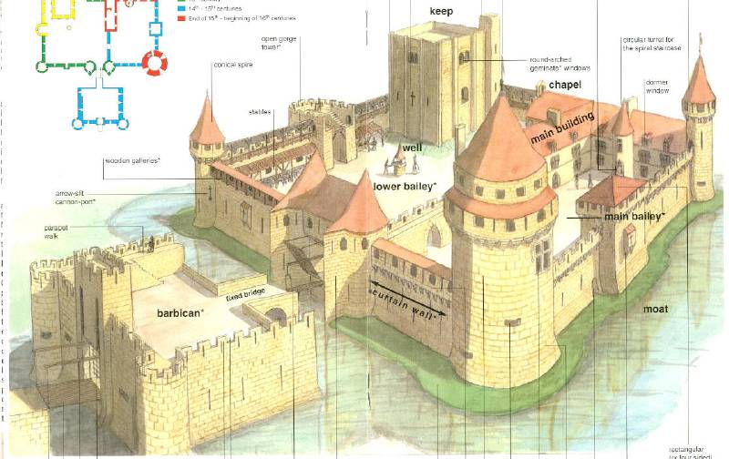
Parts of a Medieval Castle

Slide 28
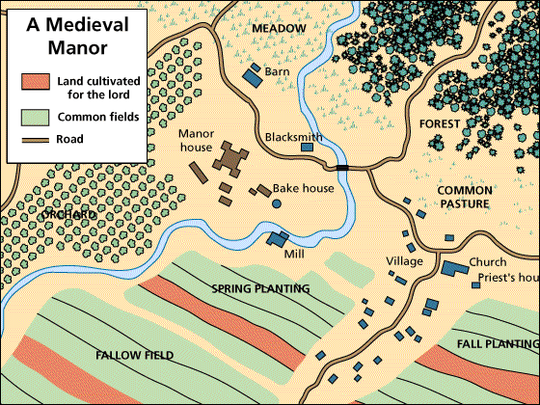
The Medieval Manor

Slide 29
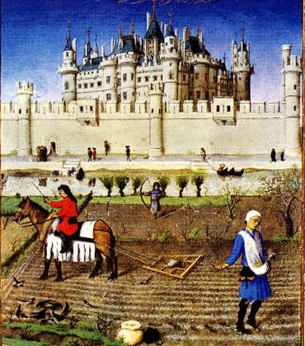
Peasants wanted more freedom and control of land, while landlords wanted higher revenues
After 800 CE peasant conditions improved and landlords controls weakened
Moldboard was a technological innovation, a plow that allowed deeper tuning of the soil

Slide 30
Manorialism | Feudalism
Described economic/political relationships between landlords and serfs | Relationships between military elite.
Serfs received protection and justice form lords in return for labor and portion of produce | greater lords provided protection and land to vassals in return for military service and loyalty.
Local community life; local government

Slide 31
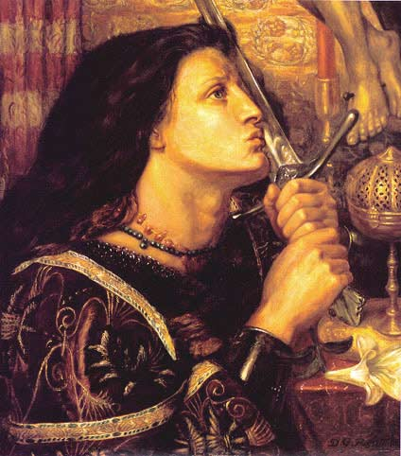
Hundred Years’ War – Conflict between England and France (1338-1453)
Joan of Arc – lead French army to victory

Slide 32
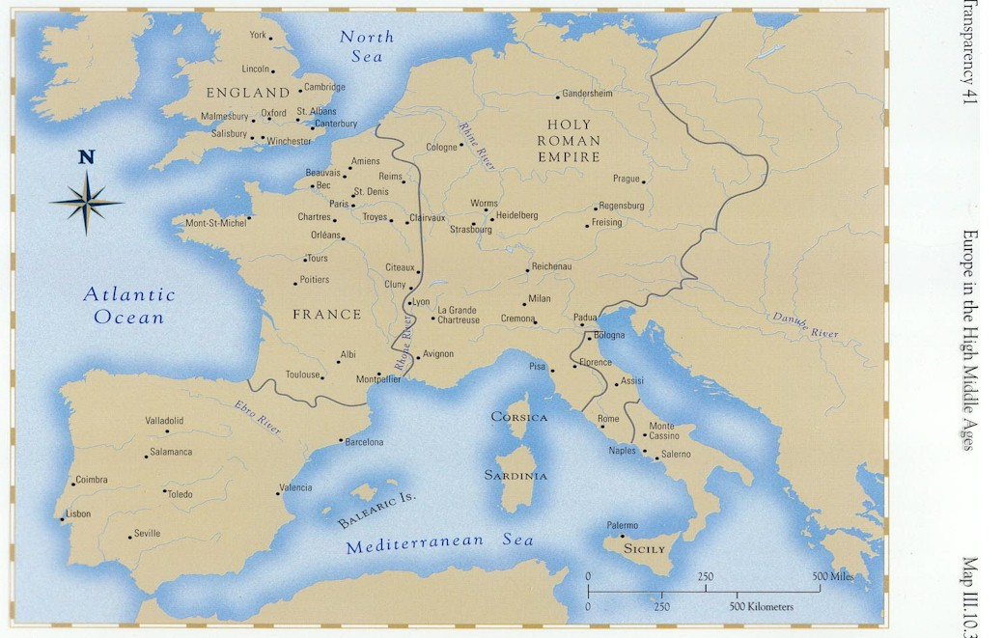
Europe in the “High Middle Ages” (1000 – 1250 CE)

Slide 33
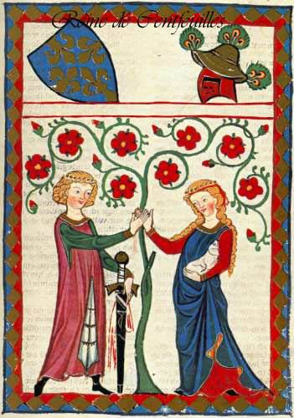
Chivalry: A Code of Honor and Behavior
Chivalry - Medieval code used by knights which included the ideals of courage, honor, and the protection of the weak

Slide 34
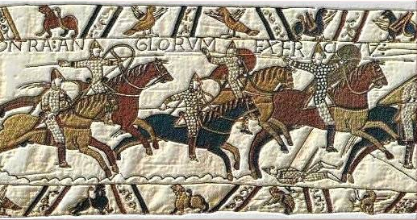
William the Conqueror: Battle of Hastings, 1066
William the Conqueror – Invaded England from Normandy in 1066; established tight feudal system and centralized monarchy in England

Slide 35
Evolution of England’s Political System – Achieved feudal monarchy prior to the end of the Middle Ages
Henry I:
William the Conqueror’s son.
set up court system.
Henry II:
established the principle of common law throughout the kingdom.
established a grand jury.
established trial by jury.

Slide 36
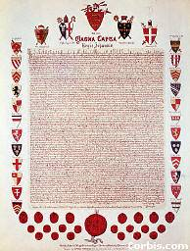
Magna Carta, 1215
King John I
the “Great Charter” (nickname)
monarchs were NOT above the law
kings had to consult a council of advisors
kings could not tax arbitrarily

Slide 37
The Beginnings of the British Parliament
Great Council:
middle class merchants, townspeople [burgesses in England, bourgeoisie in France, burghers in Germany] were added at the end of the 13th century.
eventually called Parliament.
by 1400, two chambers evolved:
House of Lords → nobles & clergy.
House of Commons → knights and burgesses.

Slide 38
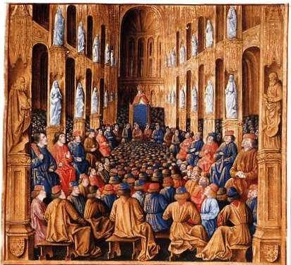
Pope Urban II: Preaching a Crusade
Pope Urban II - Called the First Crusade in 1095; appealed to Christians to free the Holy Land from Muslim control

Slide 39
First Crusade – 1096-1099 – Crusade called by Pope Urban II which captured Jerusalem
Third Crusade – 1189-1192 – Crusade led by King Richard the Lionheart to recapture the city of Jerusalem from Islamic forces led by Saladin; failed in attempt
Fourth Crusade – 1202-1204 – Crusade which attacked and sacked Constantinople

Slide 40
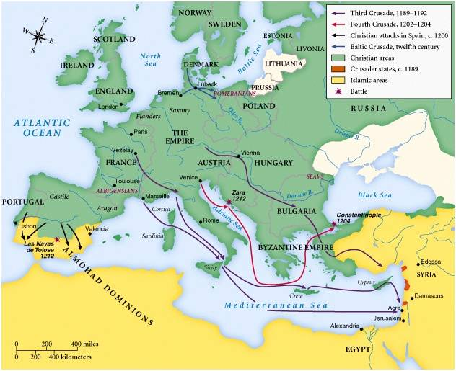
Christian Crusades: East and West

Slide 41
Comparing Medieval West from 1000-1500 with Islamic civilization during the same time period
Medieval West | Islam
Flourishing | Fragmenting
Active Commercial and merchant system | More extensive and significant commercial system
Banking, use of credit, guilds, creation of wealthy class, end of slavery | Both used religion to carry civilization to new territories
Use of Latin as common language – Classical rationalism based on Aristotle’s works | Islam expanded into Africa, north India and southeastern Asia
 | Islamic civilization more technologically sophisticated than the West

Slide 42
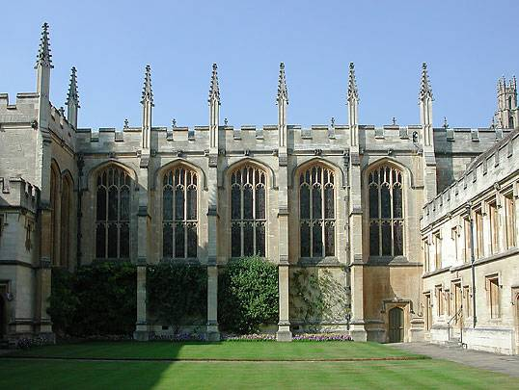
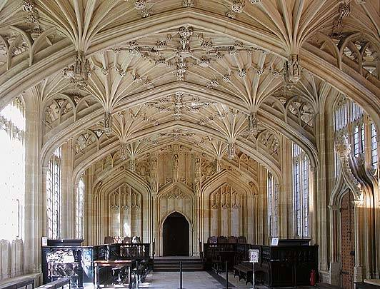
Oxford University
Peter Abelard – author of Yes and No; a university scholar who applied logic to problems of theology; demonstrated logical contradictions within established doctrine
St. Bernard of Clairvaux – Emphasized role of faith in preference to logic; stressed importance of mystical union with God; successfully challenged Abelard and had him driven from the universities

Slide 43
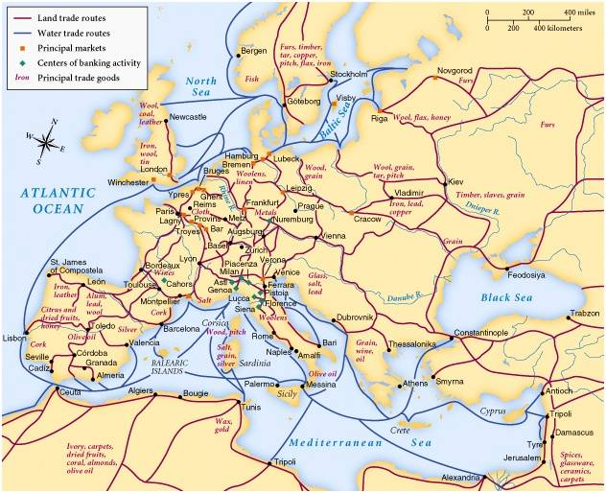
Medieval Trade
Guilds – Associations of workers in the same occupation in a single city; stressed security and mutual control; limited membership, regulated apprenticeship, guaranteed good workmanship, discouraged innovations; often established franchises within cities

Slide 44
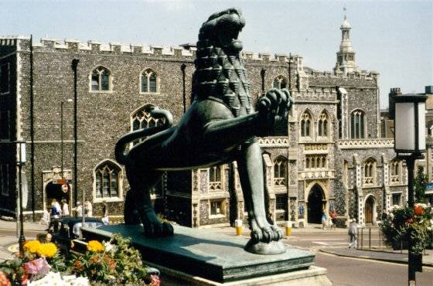
Medieval Guilds
Commercial Monopoly:
Controlled membership apprentice → journeyman → master craftsman
Controlled quality of the product [masterpiece].
Controlled prices

Slide 45
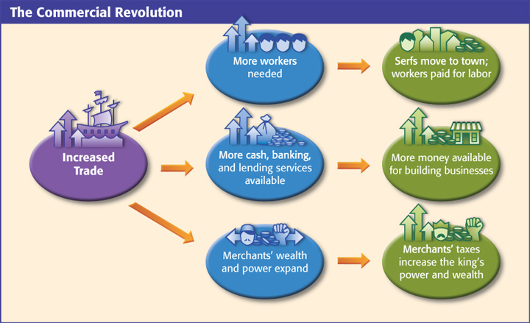

Slide 46
Western Europe in the Middle Ages and the world around it:
Early on - Europe threatened by Vikings, Asian nomads, & Islamic expansion
At the same time, Europeans copied many features from Islam and traded with Asians (diffusion!)
Through selective acceptance of benefits from the world around them, Western Europe developed a global awareness
Crises of the later Middle Ages:
bubonic plague
religious struggles
governmental strife

Slide 47
Ways in which the Middle Ages carried on the culture of ancient Mediterranean civilizations
Latin as common language
Manorialism – origins in great farming states
Christianity was widely adopted
Middle Ages added it’s own innovations:
Population growth
Credit, banking, accounting procedures, creation of a wealthy class
Vernacular literary forms and Gothic architecture

Slide 48
Characteristics of feudal monarchy (France and England)
England | France
Immediate after Norman Conquest in 1066 | Slow and gradual
Established central government | France responded in 13th c. development of taxation
Sheriffs as local administrators | Court system to support military action against England

