Slide 1
The Renaissance Outcome: The Renaissance in Italy

Slide 2
The Renaissance
The Middle Ages Ends
Europe is starting to take shape with England, France, and regions in Italy all started evolving
Revival of culture
Return to cities
The Church was still powerful
Writers and artists began to express new ideas and styles

Slide 3
How did the Crusades impact the Renaissance?
People had access to inventions and technologies from the Muslim world that were prohibited during the Dark Ages
Increased demand for Middle Eastern products
Encouraged the use of credit and banking
Church rule against usury and banks’ practice of charging interest helped secularize northern Italy
Usury: practice of lending money with high interest rates
Letters of credit expanded the supply of money to expedite trade
New accounting and bookkeeping practices (with Arabic numerals) were introduced

Slide 4
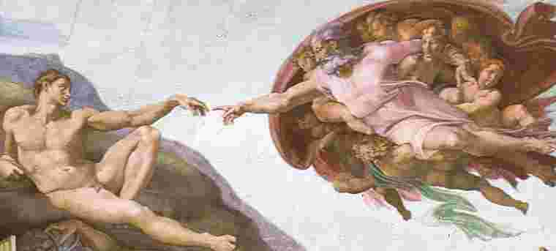
The Renaissance
What is the Renaissance?
Renaissance: Rebirth in art, writing, architecture, learning, and culture.
The educated hoped to bring back to life the culture of classical Greece and Rome
In doing so, they created something entirely new: innovative styles of art and literature
The Renaissance eventually spread from northern Italy to the rest of Europe
Occurred roughly 1300-1600

Slide 5
The Renaissance
Why Italy?
Italy had 3 distinct advantages
City-States
Overseas trade, spurred by the Crusades had led to growth of large city-states
Thus, northern Italy was urban while the rest of Europe was still rural
Cities were the place where people exchanged ideas and the site of an intellectual revolution
Survivors of plague could demand higher wages
Merchants had few opportunities to expand business so they pursued art

Slide 6
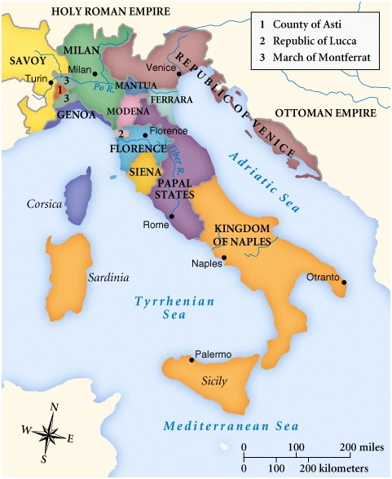
City States
Florence was the epicenter of the Italian Renaissance.
All of these cities:
Had access to trade routes connecting Europe with Middle Eastern markets
Served as trading centers for the distribution of goods to northern Europe
Were initially independent city-states governed as republics

Slide 7
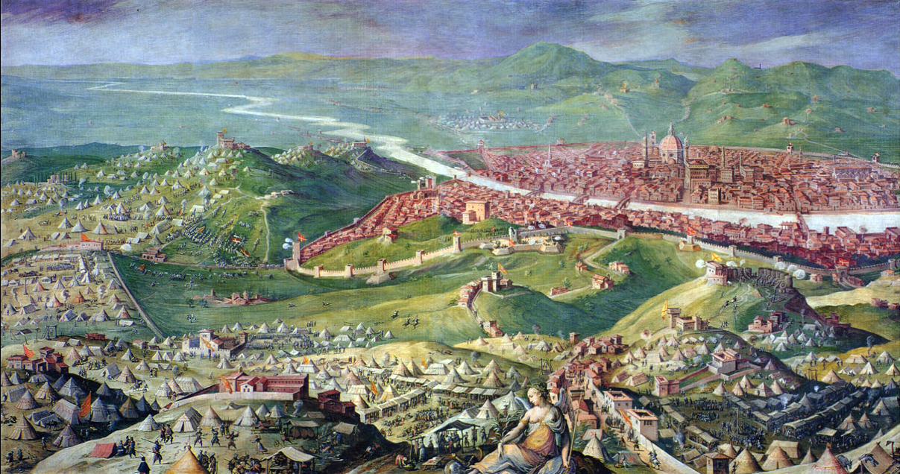
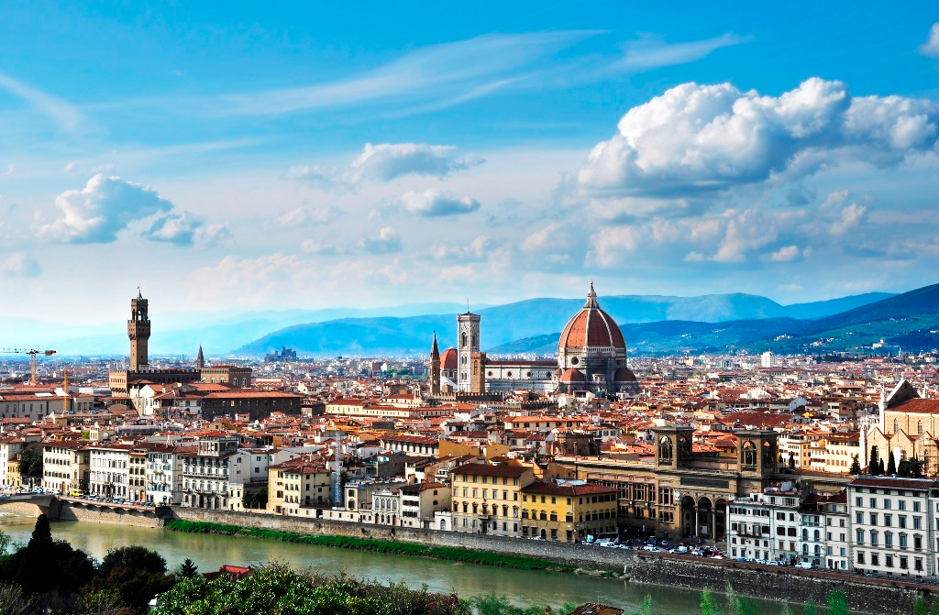

Slide 8
The Renaissance
Merchants and the Medici
A wealthy merchant developed in each Italian city-state
Merchants dominated politics
Merchants did not inherit social rank- used their wits to survive
This lead to the rise of importance of individual merit
The Medici banking family came to dominate Florence
Had branch offices all throughout Italy and Europe
Cosimo de Medici was the wealthiest European of his time
Grandson Lorenzo de Medici became great patron of the arts
Patron: someone who financially supports an artist or the arts

Slide 9
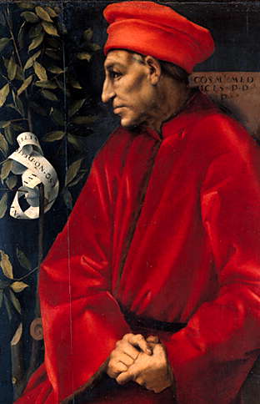
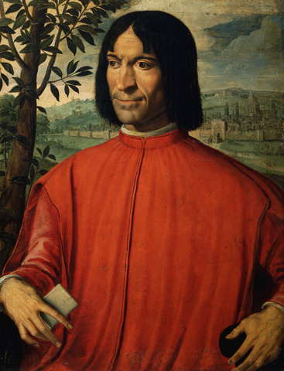
Cosimo de Medici & Lorenzo de Medici

Slide 10
The Renaissance
Classical heritage of Greece and Rome
Renaissance artists looked down on the art and literature of the Middle Ages
Instead they wanted to revive the learning of the Greeks and Romans
It was the heart of Ancient Rome – Ruins : architecture, statues, coins, etc.
Many Greek manuscripts made their way to Rome via Christian scholars returning to Europe after the crusades

Slide 11
The Renaissance
Classical and Worldly Views
As scholars studied manuscripts, they became more influenced by classical ideas. This lead to:
Humanism: an intellectual movement that focused more on human potential and achievements
Popularized the study of history, literature, and philosophy (all are known as humanities)
Worldly pleasure: Humanists suggested that a person could enjoy life without offending God. People began to put more focus on human beings
Ex. Wealthy could enjoy material luxuries, good music, and fine foods

Slide 12
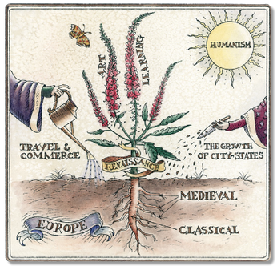
Humanism

Slide 13
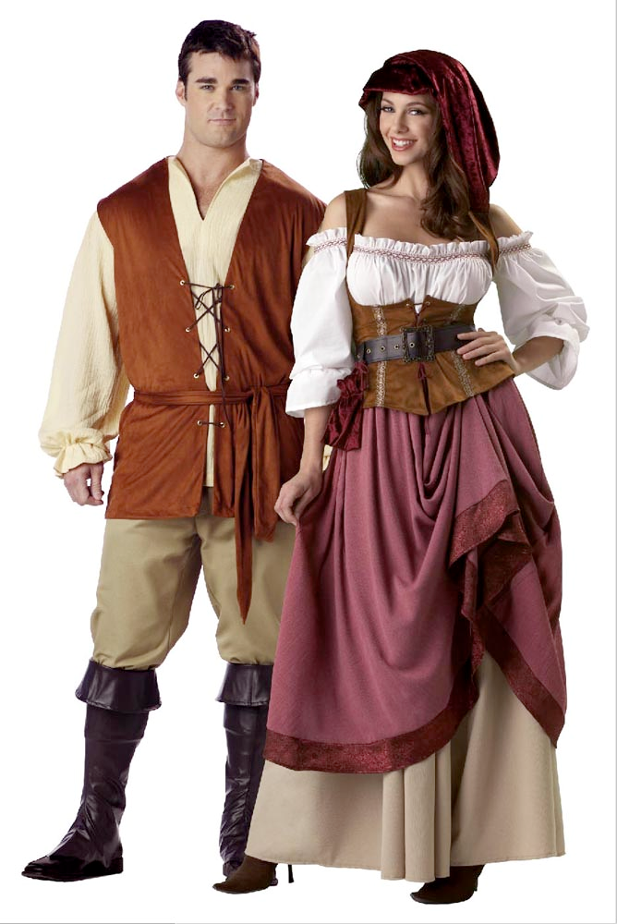
The Renaissance
The Renaissance Man and Woman
Renaissance Man: One strove to be a master in every area of study
Expected to be charming, witty, and well educated in the classics
Also should be a skilled rider, wrestler, and swordsman
Renaissance Woman: Upper-class women should know the classics and be charming
Not expected to seek fame
Inspire art but not create it
Little influence in politics

Slide 14
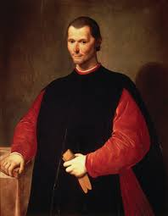
Political Ideas of the Renaissance
Niccolo Machiavelli -The Prince
Machiavelli observed city-state rulers of his day and produced guidelines for the acquisition and maintenance of power by absolute rule.
“One can make this generalization about men: they are ungrateful, fickle, liars, and deceivers, they sun danger and are greedy for profit.”

Slide 15
The Prince
He felt a ruler should be willing to do anything to maintain control without worrying about conscience – “The end justifies the means.”
Ruler should be quick and decisive in making decisions
Ruler should keep power by any means necessary
Be good when possible an evil when necessary
“Men worry less about doing any injury to one who makes himself loved than to one who makes himself feared.”

