Slide 1
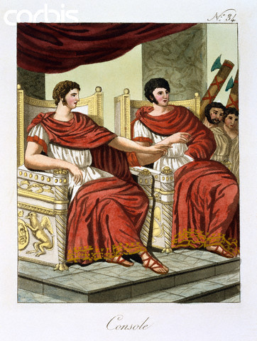
Voting
Men in both groups were citizens, and could vote.
Only Patricians could hold government office.
Consuls
Highest elected office of the Roman Republic.
They were the highest civil and military leader, they led armies into battle.
There were two consuls, who were supposed to be elected to one, one year, term.
The consuls shared power so one would not become too powerful, one could veto the other.
The Romans hated the idea of one person rule after getting rid of the kingship of the Etruscans.

Slide 2
Praetors
As the Roman Republic expanded the office of Praetor was created to look over judicial affairs.
The Praetor was in charge of civil law, as it applied to Roman citizens.
In civil cases the Praetor could act as judge, or appoint a judge to administer the trial.
Dictator
The Republic recognized the necessity of quick action in time of war or crisis.
The Romans had an institution where the Consul would appoint a dictator.
The Dictator held full power for 6 months. After that time he relinquished power back to the consuls and Senate.

Slide 3
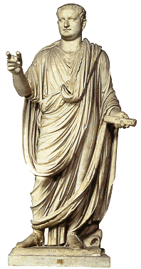
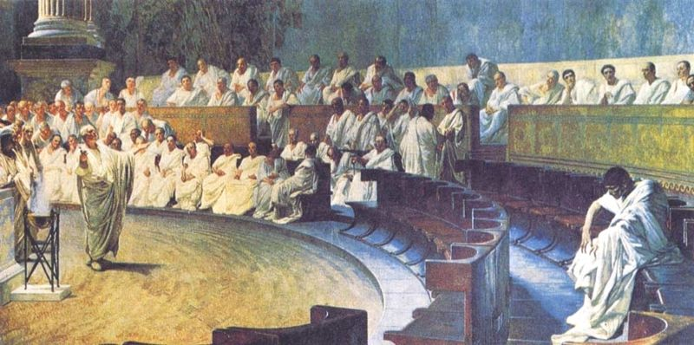
Senate
The Roman Senate was the select group of about 300 Patricians who served for life.
At first their role was to advise government officials but later approved laws, controlled finances and made public policy.

Slide 4
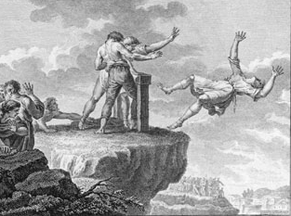
Tribunes
The elected representatives of the Plebeians
Had the right to veto laws of the Senate and other assemblies.
As the chief representative of the Roman plebeians, the tribune's house was required to be open to all at all times, day or night
The tribune also had the power to exercise capital punishment against any person who interfered in the performance of his duties (the favorite threat of the tribune was therefore to have someone thrown from the Tarpeian Rock, a steep cliff overlooking the Roman Forum).

Slide 5
Attempts at Reform
The land situation in Rome was grave.
The unemployed in the cities continued to grow.
Many Legionnaires went off to war, their farms lay uncultivated in their absence, they were sold off to repay debt.
When the soldiers returned, they had nowhere to go, they joined the restless urban unemployed.
Soldiers had to own land to serve in the military, this diminished the number of men eligible for military service.

Slide 6
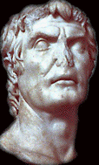
Generals in Politics
Marius gave the generals of the Roman army a power base for their entry into politics.
Generals could now use their armies to gain political power.
This led to many power struggles and civil wars.
The next General Lucius Cornelius Sulla, tried to restore power to the Republic, but it did not last.

Slide 7
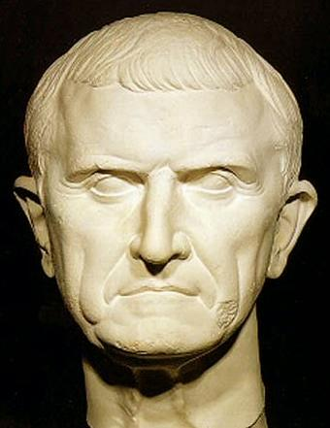
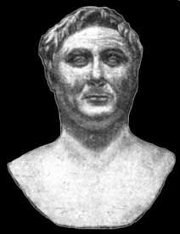
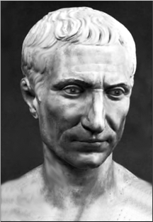
The First Triumvirate
Three men who emerged from the civil wars to take control of Rome
      Crassus
      Richest man in Rome
      He was a Roman General
      Pompey
      Another General, he had just won a campaign in Spain.
      Julius Caesar
      General who had also just waged a campaign in Spain

Slide 8
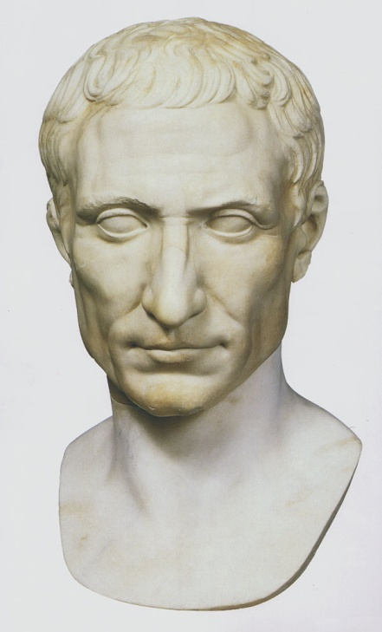
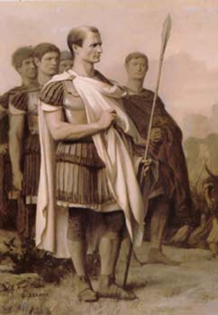
Caesar’s Rise to Power
Julius Caesar and the others members of the Triumvirate used each other’s wealth and power to gain political advantages.
Caesar had himself made general in Gaul
He won many military victories in Gaul and made it part of the Roman Empire.
He became a powerful and respected military leader.

Slide 9
Death of Crassus
Crassus died while fighting a military campaign in Syria
This left a power struggle open between Pompey and Caesar
Pompey’s Demand
Pompey feared the Caesar was becoming too powerful.
He was staying in Rome and had allied himself with the Senate.
He convinced the Senate to demand that Caesar return to Rome without his army.

Slide 10
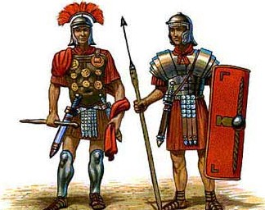
Caesar’s Refusal
Caesar knew that he would be arrested and lose all power if he entered Rome without his army.
He decided to take his legion and defy the Senate by crossing the Rubicon river into Roman territory.
This started another civil war in Rome
Victory for Caesar
Caesar was popular with the common people
Caesar was able to defeat his enemies.
It is said that when he defeated the forces of his enemies in Africa he states
“Veni, vidi, vici” I came, I saw, I conquered.

Slide 11
Dictator for Life
Caesar was declared dictator for life by the Senate and was given absolute power, but he was never made Emperor.
Reforms
Changes in the Senate
Caesar increased the number of people in the Senate and filled it with people who supported his ideas so they could be passed.
Public Works
He gave land to the poor
He cancelled debts of the poor and passed laws to limit discrimination of the poor.
He built many public buildings and revitalized the city of Rome and creating jobs for the jobless.

Slide 12
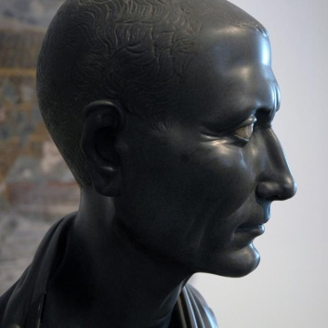
Citizenship
He expanded citizenship in the conquered regions.
Julian Calendar
Established a 365-day solar calendar with a leap year every four years.
This calendar was adopted from the Egyptians in Alexandria.

Slide 13
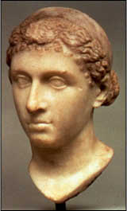
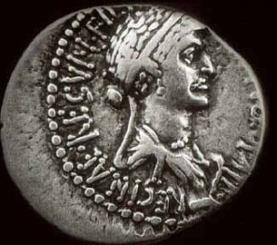
Affair with Cleopatra
When Caesar went to Egypt in pursuit of Pompey
he became involved in the civil war in Egypt
between Cleopatra and her brother Ptolemy XIII.
Ptolemy had angered Caesar by assassinating
Pompey and presenting Caesar with his head
picked in a jar.
Cleopatra allied herself with Caesar and he helped place her in power, co-ruling with her younger brother, who she later allegedly killed.
Caesar and Cleopatra had a son, Ptolemy Caesar, or, Caesarion “Little Caesar” who she appointed her co-ruler in Egypt. Caesar refused to make Caesarion his heir, he appointed his nephew Octavian to inherit his power and property.
She remained his mistress until his assassination.

Slide 14
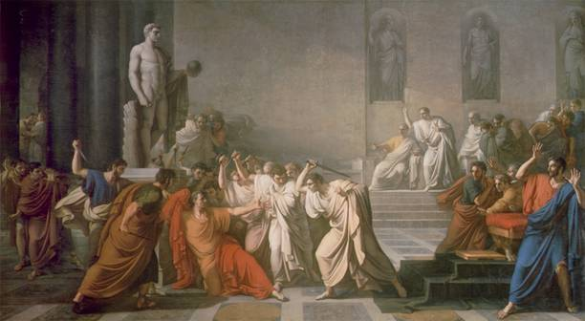
The Ides of March
Some Senators feared the Caesar was becoming too powerful and wanted to make himself king.
On the Ides of March, March 15, a group of Senators called Caesar to a fake meeting to read grievances of the Senate.
Caesar was attacked by the Senators and stabbed 23 times.
The poor were
outraged by the
murder of Caesar.
They made a statue
of him and rioted.
The Senators fled,
but were hunted
down by Caesar’s
successors.

Slide 15
Causes for the Decline of the Roman Republic
Spread of Slavery in the agricultural system
Migration of small farmers into cities and unemployment
Civil war over the power of Julius Caesar
Devaluation of the Roman Currency, Inflation

Slide 16
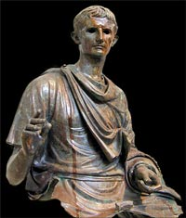
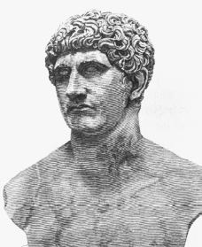
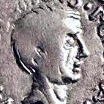
The Second Triumvirate
The men united and co-ruled after Julius Caesar’s death
      Octavian
      The adopted grand-nephew of Caesar and his heir.
      Mark Antony
      A friend of Caesar and one of his highest ranking generals.
      Lepidus
      Another general and friend of Caesar

Slide 17
Antony vs. Octavian
Lepidus is exiled and Antony and Octavian end up battling for power.
Octavian took control of the West and Antony took the East, including Egypt.
Antony marries the sister of Octavian, Octavia.
Antony defies Octavian and begins an affair with Cleopatra in Egypt.

Slide 18
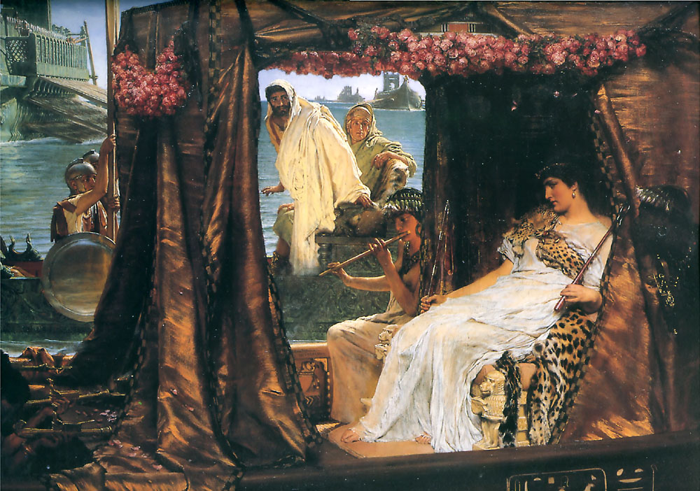
Antony and Cleopatra
Antony and Cleopatra had an affair for several years.
He married her using Egyptian customs because he was already married to Octavia.
They had three children
together.
It is said they had lavish
feasts and lived in luxury.
Octavian convinced the
people of Rome that Antony was corrupt. Octavian demanded he leave, but Antony refused.
Octavian convinced the Senate to declare war on Antony and Cleopatra.

Slide 19
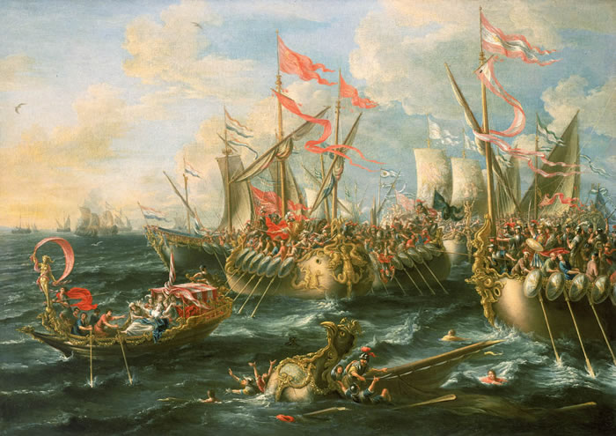
Battle of Actium
Octavian defeated the forces of Antony and Cleopatra

Slide 20
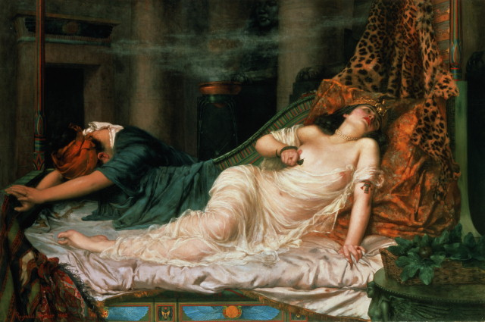
Death
Antony committed suicide, having been told Cleopatra was dead. According to the doctor Olympus (an eye-witness), he was brought to Cleopatra's tomb and died in her arms. Cleopatra was captured by the Romans
Several days later Cleopatra had her
servant sneak in two poisonous snakes
and she had them bite her.
Octavian was informed of her death,
and went to see for himself.
Cleopatra's son by Caesar, Caesarion, was proclaimed pharaoh but Octavian had him captured and executed.
The other children of Antony and Cleopatra were spared and raised in Rome by Antony’s wife, Octavia.

Slide 21
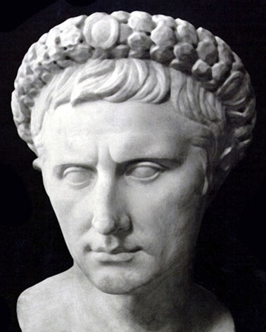
Octavian becomes Augustus:
Augustus becomes Princeps, or first citizen,
and Imperator (Commander in Chief)
The Age of Augustus
Augustus becomes the first Emperor
of the Roman Empire (exercising absolute power and naming
And naming his successor.
Reforms
Built many public works projects,
including roads, aqueducts, and public buildings.
Civil Service
Augustus wanted to make sure that the people who worked in the government were qualified and educated. Jobs based on merit and not class
Tax Reform/Census
He made the tax system more fair for the poor and counted the people of his territory.

Slide 22
Postal System
He set up a postal system to improve communication
Expansion of the Military
He added permanent forces to the military and increased its size.
Praetorian Guard
He created this guard to be the personal bodyguards of the Emperor. WHY????
Defeat in the North
He was never able to defeat the Germanic groups north of Rome. This was his only defeat.

Slide 23
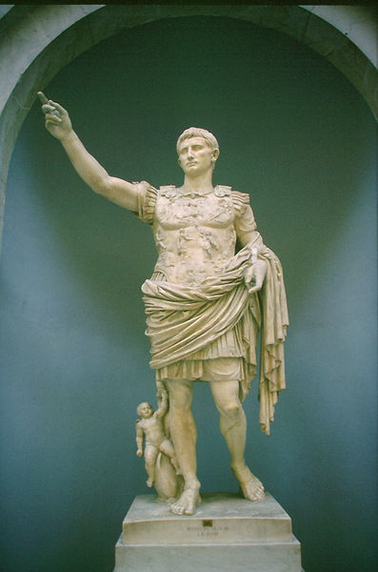
The Pax Romana
The Roman Peace
200 year period of peace in the Mediterranean region.
Economic impact of the Pax Romana
Established uniform system of money, which helped expand trade.
Guaranteed safe travel and trade on Roman roads
Promoted prosperity and stability.
Social impact of the Pax Romana
Returned stability to social classes
Increase emphasis on the family
Political impact of the Pax Romana
Created a civil service
Developed a uniform rule of law.

Slide 24
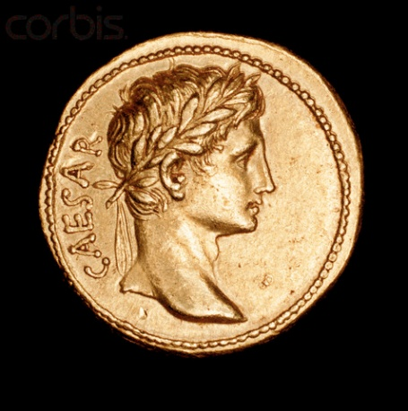
The first emperors to rule after Augustus
-Tiberius
-Caligula
These emperors used family succession to choose their successor, this established the Julio-Claudian Dynasty
-The first group of emperors were known as the Bad Emperors, their tactics were questionable and some people believe that some of them were insane. Ex. Caligula appointed his horse as consul
The problem with imperial succession is that there was no official way to choose the next emperor and there was usually conflict with the army over who would rule next.

Slide 25
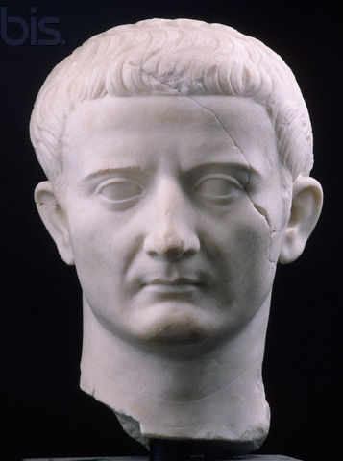
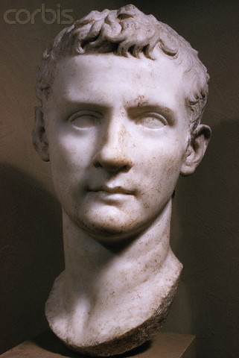
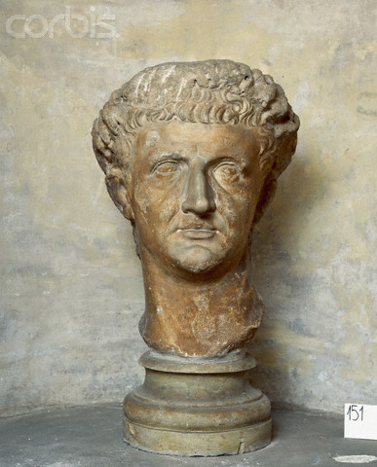
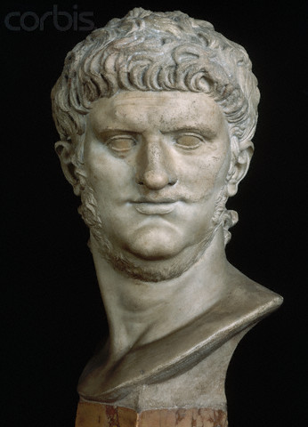
The Good, The Bad, and the Ugly!
Early Emperors
Had questionable policies and behaviors, but overall did not change too much related to the government structure.

Slide 26
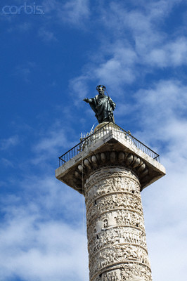
The Good Emperors
Nerva, Trajan, Hadrian, Antonius Pius, and Marcus Aurelius
Nerva
Reformed land laws to help the poor
Trajan
Expanded the empire to its greatest size

Slide 27
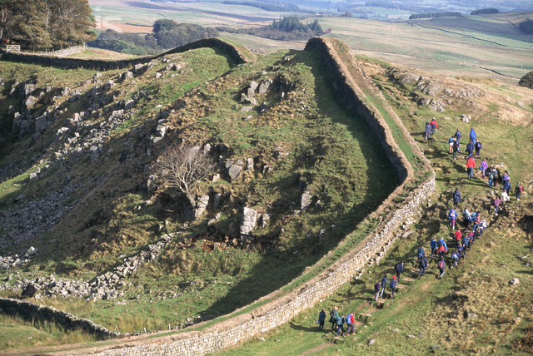
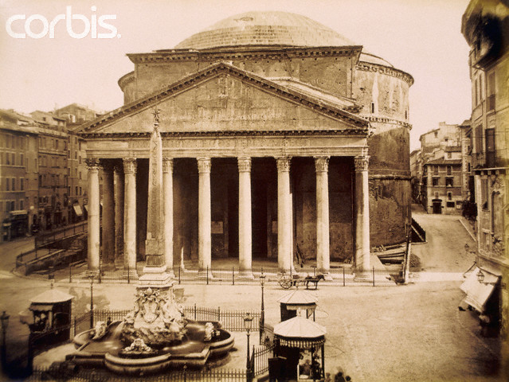
Hadrian
Hadrian pulled back Roman borders
Built Hadrian’s Wall in England as a fixed Roman border
He also built the Pantheon

Slide 28
Antoninus Pius
Promoted art and science
Public works
Legal reforms
Marcus Aurelius
Last emperor of the Pax Romana
Economic and legal reforms

Slide 29
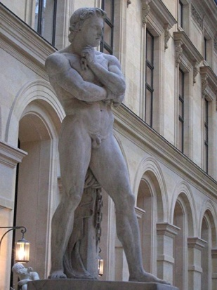
Roman Art and Architecture
When did the Romans adopt many features of Greek art.
During the third and second centuries the Romans began to adopt features of Greek art.
Mosaics-pictures made from chips of colored glass or stone
How did Roman sculpture contrast with Greek Sculpture?
Greek art focused on perfection while Roman art focused on realism.
The Romans adopted the vault, arch and dome

Slide 30
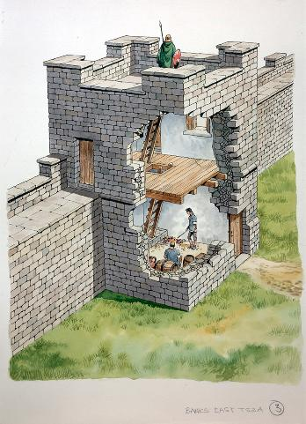
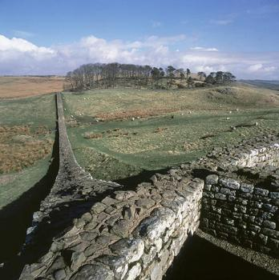
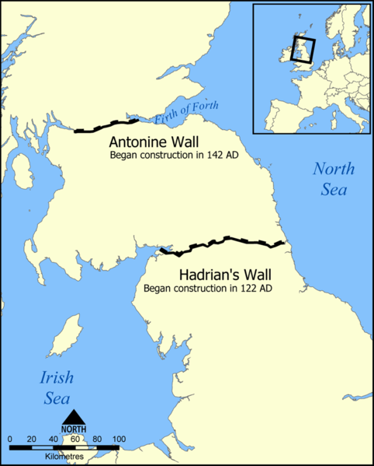
Hadrian’s Wall
Built by the Emperor Hadrian to form a solid northern border of the Empire and keep out barbarians tribes from northern Britain (England)

Slide 31
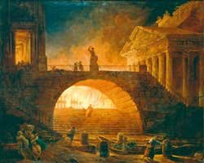
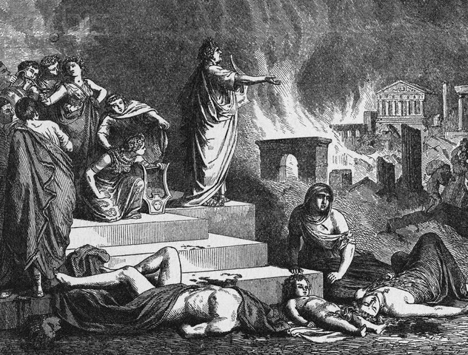
Fire of 64 AD
In 64 AD/CE a devastating fire swept through Rome.
It destroyed large part of the city.
The Emperor Nero is the person many people blame for the disaster.
He blamed the fire on the Christians and had many of them assassinated after the fire by burning them to death.

Slide 32
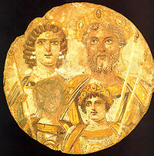
The Fall of Rome
Marcus Aurelius was the last emperor of the Pax Romana, or Roman Peace. He died in 180 AD.
Rome didn’t fall overnight, there were many things that led to its downfall.
The Severans were a series of harsh rulers who used the military to expand their power. After the fall of the Severans there was a time of military leadership, where many rulers met violent deaths. The
Empire became increasingly unstable.

Slide 33
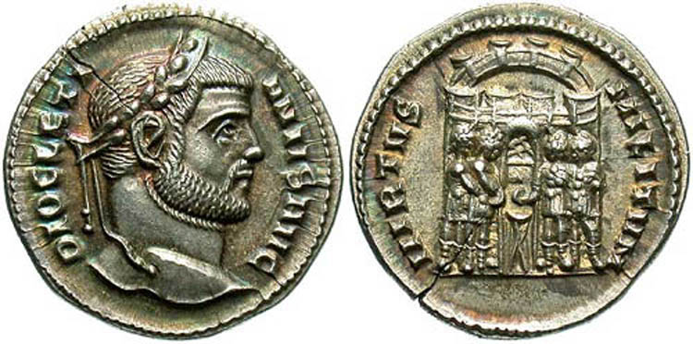
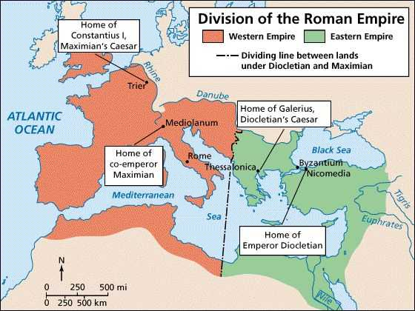
Reforms of Diocletian and Constantine
The Roman Emperors Diocletian and
Constantine both attempted reforms to slow the decline of the Empire
Diocletian divided the Roman Empire into East and West
Diocletian appointed a co-Emperor to help rule this now divided empire
Leadership was divided among four people

Slide 34
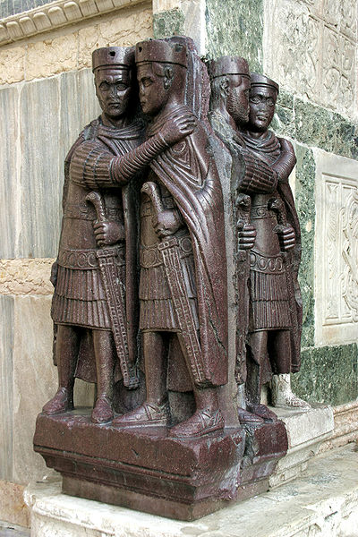
The new government was known as the Tetrarchy
Each Emperor had the title Augustus
Each Augustus had an heir known as a Caesar.
Diocletian originally wanted the two Augusti to retire after twenty years and for the Caesars to assume power, it didn’t work out the way that he wanted. After a civil war Constantine became Emperor.

Slide 35
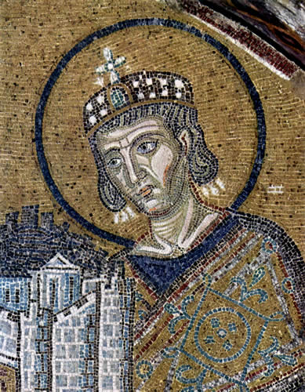
Byzantium becomes Constantinople
After the division of the Empire the Roman Emperor Constantine moved the capital of the Empire from the Western city of Rome to the Eastern city of Byzantium.
He renamed this city Constantinople.

Slide 36
The Fall of Rome
The Divided Roman Empire now had two capitals:
Rome in the West and Byzantium/Constantinople in the East
The Western capital of Rome was under pressure from barbarian tribes that were invading from Eastern Europe and Central Asia.

Slide 37
Why did Rome Fall?
There was no one thing which led to the fall of the Roman Empire
It included all of the following:
Economy: Devaluation of Roman currency from inflation and high military costs
Military: Breakdown in military discipline from the hiring of mercenaries.
Moral Decay: People lost faith in the Roman government
Political Problems: The Government became corrupt
Invasion: Barbarian invasions
Some people also believe it may have been lead poisoning from lead pipes, it may have been a lack of technology due to slavery, the new religion of Christianity may have caused people to turn from the government . . . The causes were many.

