Slide 1
STANDARD WHI.6a
The student will demonstrate knowledge of ancient Rome from about 700 B.C. (BCE) to 500 A.D.(CE) in terms of its impact on Western civilization by
assessing the influence of geography on Roman economic, social, and political development.
Location and place
• Rome—Centrally located in the Mediterranean Basin and distant from eastern Mediterranean powers
• Italian Peninsula
• Alps—Protection
• Mediterranean Sea—Protection, sea-borne commerce
b) describing Roman mythology and religion.
Roman mythology
• Based on the Greek polytheistic religion
• Explanations of natural phenomena, human qualities, and life events
Roman gods and goddesses
• Jupiter, Juno, Apollo, Diana, Minerva, and Venus
• Symbols and images in literature, art, monumental architecture, and politics

Slide 2
b) describing Roman mythology and religion;
Roman mythology
• Based on the Greek polytheistic religion
• Explanations of natural phenomena, human qualities, and life events
Roman gods and goddesses
• Jupiter, Juno, Apollo, Diana, Minerva, and Venus
• Symbols and images in literature, art, monumental, and architecture.
c) explaining the social structure and role of slavery, significance of citizenship, and the development of democratic features in the government of the Roman Republic;
Social structure in the Roman Republic
• Patricians - Powerful nobility (few in number) • Plebeians - Majority of population
• Slaves - Not based on race
Citizenship
• Patrician and plebeian men • Selected foreigners
• Rights and responsibilities of citizenship (taxes, military service)
Features of Democracy
• Representative democracy • Assemblies • The Senate
• Consuls • Laws of Rome codified as Twelve Tables

Slide 3
d) sequencing events leading to Roman military domination of the Mediterranean basin and Western Europe and the spread of Roman culture in these areas;
Punic Wars: Rome v. Carthage (264-146 B.C. [B.C.E.])
• Rome and Carthage were in competition for trade.
• Hannibal invaded the Italian Peninsula.
• Three wars resulted in Roman victory, the destruction of Carthage, and expanded trade and wealth for Rome.
Evolution of the Roman Empire and spread of Roman culture
• Mediterranean basin (Africa, Asia, Europe, including the Hellenistic world of the Eastern Mediterranean)
• Western Europe (Gaul, British Isles)
e) assessing the impact of military conquests on the army, economy, and social structure of Rome;
Causes for the decline of the Roman Republic
• Spread of slavery in the agricultural system
• Migration of small farmers into cities and unemployment
• Civil war over the power of Julius Caesar
• Devaluation of Roman currency; inflation

Slide 4
f) assessing the roles of Julius and Augustus Caesar in the collapse of the Republic and the rise of imperial monarchs;
The origin and evolution of Imperial Rome
• First triumvirate
• Julius Caesar - Seizure of power, assassination
• Augustus Caesar - Civil war, defeat of Marc Anthony, Rome’s first emperor
• Empire - Unified and enlarged, using imperial authority and the military
• Failure to provide for peaceful succession of Emperors
g) explaining the economic, social, and political impact of the Pax Romana;
The Pax Romana
• Two centuries of peace and prosperity under imperial rule
• Expansion and solidification of Roman Empire, particularly in the Near East
Economic impact of the Pax Romana
• Established uniform system of money, which helped to expand trade
• Guaranteed safe travel and trade on Roman roads
• Promoted prosperity and stability
Social impact of the Pax Romana
• Returned stability to social classes • Increased emphasis on the family
Political impact of the Pax Romana
• Created a civil service • Developed a uniform rule of law

Slide 5
h) describing the origin, beliefs, traditions, customs, and spread of Christianity;
Origins of Christianity
• Had its roots in Judaism
• Was led by Jesus of Nazareth, who was proclaimed the Messiah
• Conflicted with polytheistic beliefs of Roman Empire
Beliefs, traditions, and customs of Christianity
• Monotheism
• Jesus as both Son and incarnation of God
• Life after death
• New Testament, containing accounts of the life and teachings of Jesus, as well as writings of early Christians
• Christian doctrine established by early church councils
Spread of Christianity
• Popularity of the message
• Early martyrs inspired others
• Carried by the Apostles, including Paul, throughout the Roman Empire

Slide 6
explaining the development and significance of the Church in the late Roman Empire;
Impact of the Church of Rome in the late Roman Empire
• The Emperor Constantine converted to Christianity and made it legal.
• Christianity later became the official state religion.
• The Church became a source of moral authority.
• Loyalty to the Church became more important than loyalty to the Emperor.
• The Church became the main unifying force of Western Europe.
j) listing contributions in art and architecture, technology and science, literature and history, language, religious institutions, and law;
Contributions of ancient Rome
• Art/architecture: Pantheon, Colosseum, Forum
• Technology: Roads, aqueducts, Roman arches
• Science: Ptolemy
• Medicine: Emphasis on public health (public baths; public water system; medical schools)
• Language: Latin, Romance languages
• Literature: Virgil’s Aeneid
• Religion: Roman mythology; adoption of Christianity as the imperial religion
• Law: The principle of “innocent until proven guilty” (from the Twelve Tables)

Slide 7
k) citing the reasons for the decline and fall of the Western Roman Empire.
Causes for the decline of the Western Roman Empire
• Geographic size - difficulty of defense and administration
• Economy - The cost of defense and devaluation of Roman currency
• Military - Army membership starting to include non-Romans, resulting in decline of discipline
• Moral decay - People’s loss of faith in Rome and the family
• Political problems - Civil conflict and weak administration
• Invasion - Attacks on borders
Division of Roman Empire
• Move of capital by Constantine from Rome to Byzantium, renaming it Constantinople
• Survival of Western Roman Empire until 476 A.D. (C.E.), when it ceased to have a Roman Emperor
• Eastern Roman Empire (Byzantine Empire)

Slide 8
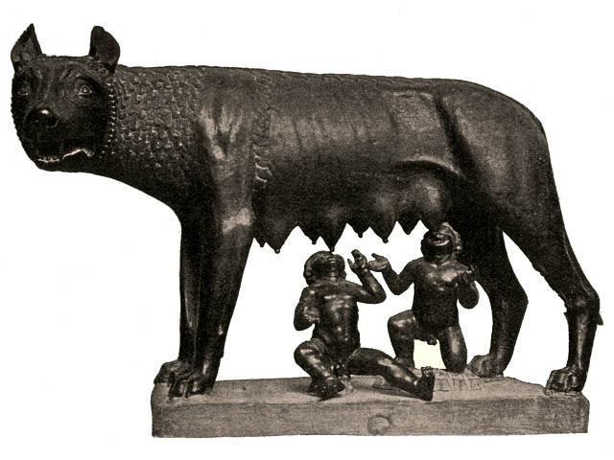
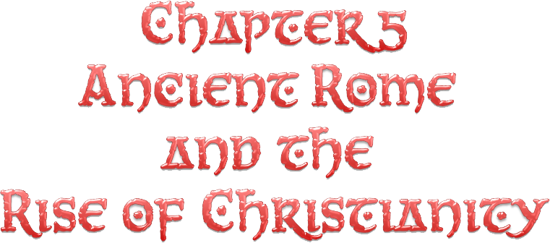

Slide 9
Land and People of Italy
Peninsula: 750 miles long and only about 120 miles wide.
Apennine Mountains: Backbone of Italy.
Rome: on Tiber River, center of Italy.
Tiber River
Po River: Fertile River valley in north.
Latium: Plain where Rome was established.
Alps
Po River
Apennine Mtns.
Tiber
Adriatic Sea
Corsica
Rome
Sardinia
Tyrrhenian
Sea
Ionian
Sea
Sicily
Carthage
Mediterranean
Sea
Africa

Slide 10
Influence of Geography
Rome’s location benefited it in several ways.
It was located 18 miles up river from the sea, the Tiber gave it access to the Mediterranean, but it was far enough inland to be protected from invasion.
It was built on seven hills, so it was easy to defend.
The Tiber narrowed near Rome, so the river could be crossed.
Farmland
Rome had more available farmland than Greece
Central Location of Rome
The City of Rome is in the middle of the Italian Peninsula.
Italian Peninsula
In the middle of the Mediterranean Sea
This gave Rome access to trade and conquest throughout the Mediterranean.

Slide 11
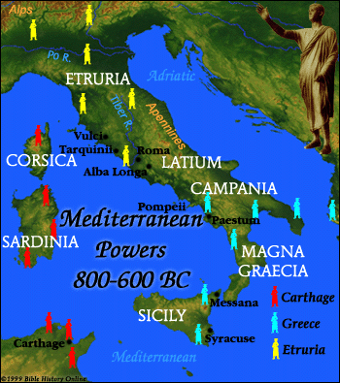
The Peoples of Italy
Latins
Indo European people who spoke Latin and settled on the plain of Latium
Greeks
Had settled during Greek colonization.
Were mostly in the south.
They influenced Rome in agriculture with the cultivation the grape and olive.
In culture including sculpture, architecture, and literature.
The Romans also adopted their alphabet.

Slide 12
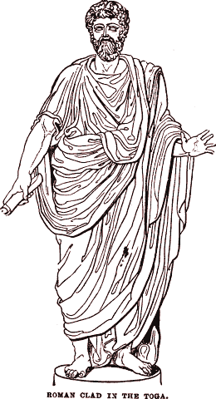
Etruscans
The Etruscans had the greatest influence on the Romans.
They were located north of Rome in Etruria, they expanded into Italy and came to control Rome and most of Latium.
They turned the Latin villages into the city of Rome.
The Romans adopted their dress, the toga and short cloak
The Romans also adopted their military organization.

Slide 13
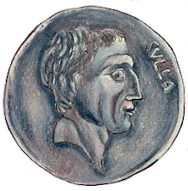
Under control of Kings
Early Rome was under the control of seven kings and several were Etruscans.
Establishment of the Roman Republic
The Romans overthrew the last Etruscan King in 509 B.C., they established the Roman Republic.
Republic: A form of government in which the leader is not a monarch and certain citizens have the right to vote.

Slide 14
War and Conquest
For about 200 years Rome battled its neighbors
In 338 Rome crushed the Latin states, then it fought the people from the central Apennines, and then Rome took over the Greek colonies in the south of Italy.
Rome established the Roman Confederation following a policy of Imperialism –controlling foreign lands and people
Rome allowed some peoples to have full Roman citizenship. Other communities were made allies, and people were allowed to run their own affairs as long as they provided soldiers for the Roman army.
Romans were careful to make conquered peoples feel like part of the Roman Republic.

Slide 15
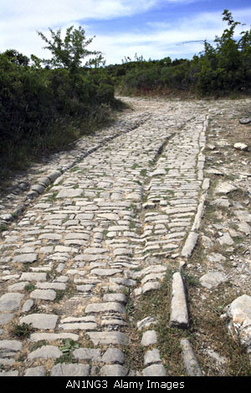
Why was Rome Successful?
To Ancient Romans
Romans believe their ancestors were successful because of a sense of duty, courage, and discipline.
Diplomacy
They extended Roman citizenship and allowed states to run their own internal affairs.
They could be firm when necessary, crushing rebellions without mercy.
Military
They were accomplished and persistent soldiers.
The Romans built fortified towns throughout Italy, they also built roads to connect the empire.

Slide 16
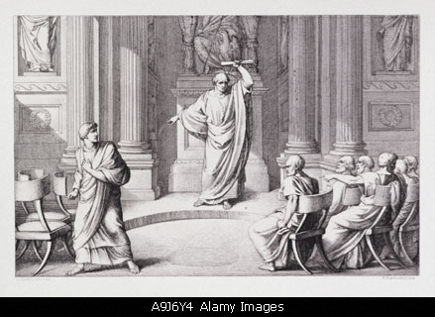
Law and Politics
The Romans did not try to build an ideal government, but created political institution in response to problems.

Slide 17
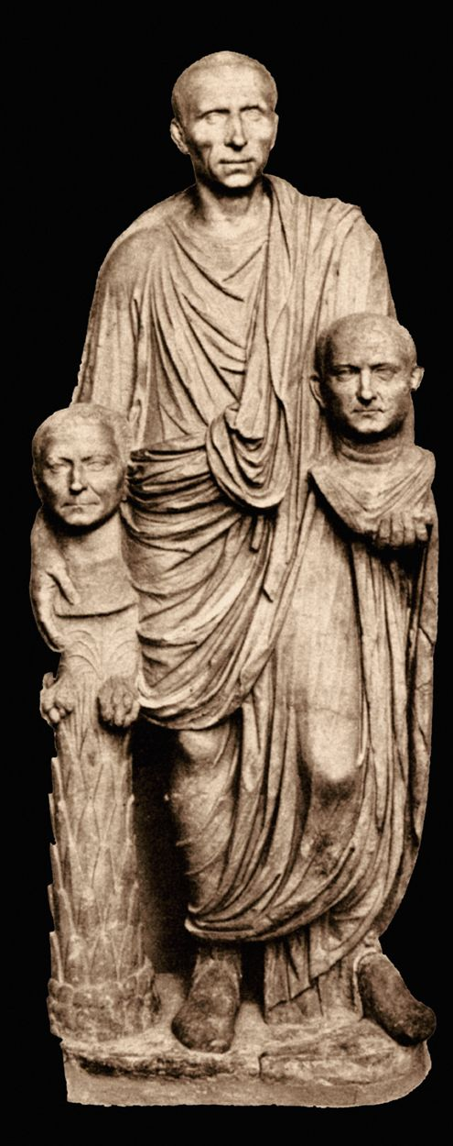
Patricians
Great landowners, they were the ruling class.
Patricians were the minority of the Roman Republic.

Slide 18
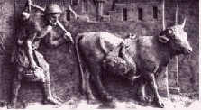
Plebeians
Lower class of the Roman Republic
Made-up of less wealthy landholders, craftspeople, merchants, and small farmers. They were the workers
Made up the majority of the population

Slide 19
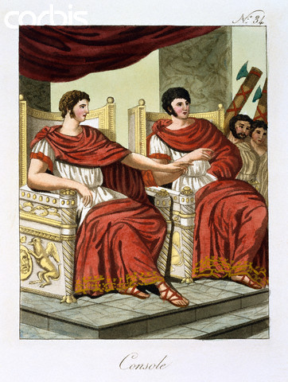
Voting
Men in both groups were citizens, and could vote.
Only Patricians could hold government office.
Consuls
Highest elected office of the Roman Republic.
They were the highest civil and military leader, they led armies into battle.
There were two consuls, who were supposed to be elected to one, one year, term.
The consuls shared power so one would not become too powerful, one could veto the other.
The Romans hated the idea of one person rule after getting rid of the kingship of the Etruscans.

Slide 20
Praetors
As the Roman Republic expanded the office of Praetor was created to look over judicial affairs.
The Praetor was in charge of civil law, as it applied to Roman citizens.
In civil cases the Praetor could act as judge, or appoint a judge to administer the trial.
Dictator
The Republic recognized the necessity of quick action in time of war or crisis.
The Romans had an institution where the Consul would appoint a dictator.
The Dictator held full power for 6 months. After that time he relinquished power back to the consuls and Senate.

Slide 21
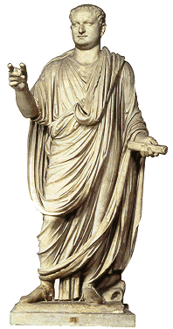
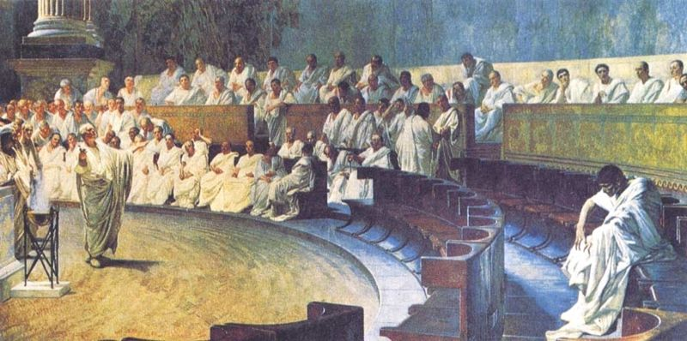
Senate
The Roman Senate was the select group of about 300 Patricians who served for life.
At first their role was to advise government officials but later approved laws, controlled finances and made public policy.

Slide 22
Centuriate Assembly
Another assembly in addition to the Senate.
It elected chief officials, such as the consuls, and praetors and passed the laws.
This assembly was also dominated by the Patricians.
Rights for Plebeians
The Struggle of the Orders
The Plebeians class was upset about the inequity of the Roman Republic.
They resented debt slavery, discrimination in courts, not being allowed to intermarry with Patricians, lack of political representation, and the absence of a written legal code.
They went on strike against the Patricians
The Plebeians were in control of agriculture and made up a large percentage of the military. They used this as their weapon to gain reform.

Slide 23
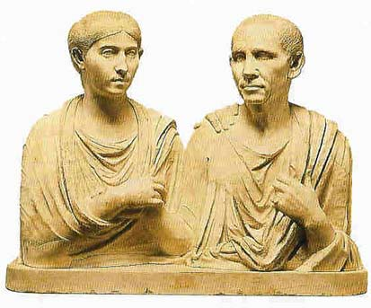
Council of the Plebs (Plebeians)
Assembly made up of the Plebeians class.
Later on it came to be called the Tribal Assembly
At first the Council had the right to elect the Tribunes and pass laws that applied to commoners only.
Later it gained the power to pass laws that affected all of Rome.
The Plebeians also, eventually won the right to become Consuls.

Slide 24
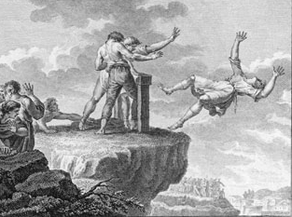
Tribunes
The elected representatives of the Plebeians
Had the right to veto laws of the Senate and other assemblies.
As the chief representative of the Roman plebeians, the tribune's house was required to be open to all at all times, day or night
The tribune also had the power to exercise capital punishment against any person who interfered in the performance of his duties (the favorite threat of the tribune was therefore to have someone thrown from the Tarpeian Rock, a steep cliff overlooking the Roman Forum).

Slide 25
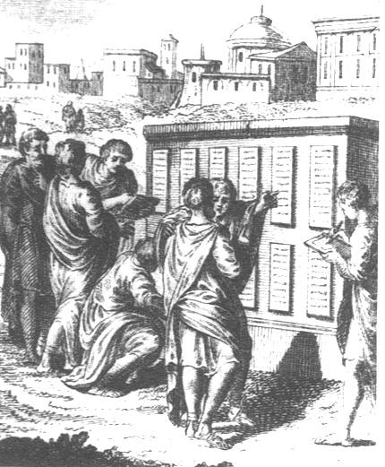
Roman Law
One of the grievances of the Plebeians was the fact that there was no written legal code.
The writing of a legal code standardizes the code so that it is not as easily manipulated.
Law of the Twelve Tables
First codification of Roman Law
It was written on twelve tablets and placed in
the Roman Forum so everyone could read it.
The Twelve tables only applied to citizens of the Republic.
Law of Nations
As the Republic, and later Empire, expanded the legal code was expanded to apply to everyone, a universal law based on reason.

Slide 26
Legal Principles of Today
Many legal ideas that we use now originated in Ancient Rome
Innocent until proven guilty
People accused of a crime are allowed to defend themselves before a judge.
A judge is expected to weigh evidence before reaching a legal decision

Slide 27
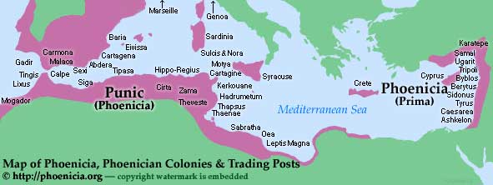
The Punic Wars
Rome vs. Carthage
The Punic wars were a series of three wars fought between the Roman Republic and Carthage.
Conquest of the Mediterranean: Sicily
Carthage was a Phoenician city in Northern Africa, they had a huge trading fleet.
Their empire included northern Africa, southern Spain, Sardinia, Corsica, and western Sicily.
The Romans were nervous about having an enemy so close to their home territory.
The two groups
Fought over
control of Sicily.

Slide 28
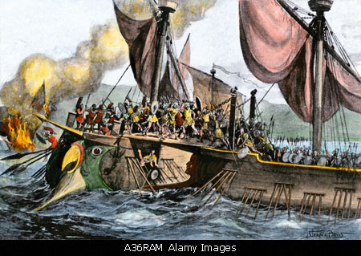
The First Punic War
-Began in 264 B.C.
The Romans sent an army to Sicily, and the Carthaginians considered it an act of war because they believed Sicily was their territory.
The Romans realized they could not
equal Carthage’s naval power, so they turned a naval battle into a land battle.
The Romans threw planks from their
ships over to the Carthaginian ships,
then their soldiers ran across and attacked the Carthaginians on their own ships.
Carthage surrendered Sicily and had to pay Rome a fine.

Slide 29
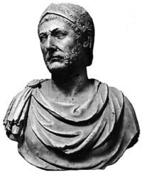
Second Punic War
Carthage vowed to take revenge for the loss of the first Punic War
Carthage took more territory in Spain, the Romans encouraged Spanish allies to fight Carthage.
Carthage struck back, beginning the second Punic War.
Hannibal
Carthaginian general, his father made him take a vow of revenge against Rome.
He decided to catch the Romans off guard.

Slide 30
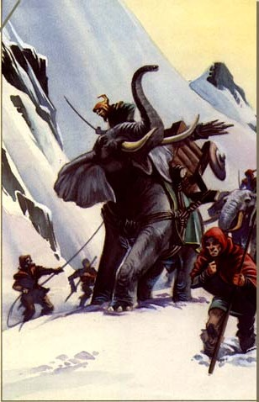
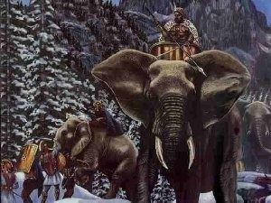
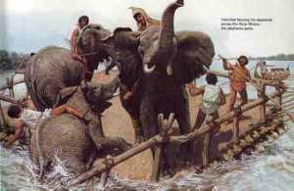
Hannibal knew he couldn’t attack by sea, so he decided to attack by land
Hannibal marched his army of 46,000 men and 37 war elephants across the Alps into Italy. He lost most of his men and all but one elephant by the time he got there.
He soundly defeated the Romans at the battle of Cannae, by forcing them into a funnel shape and surrounding them.

Slide 31
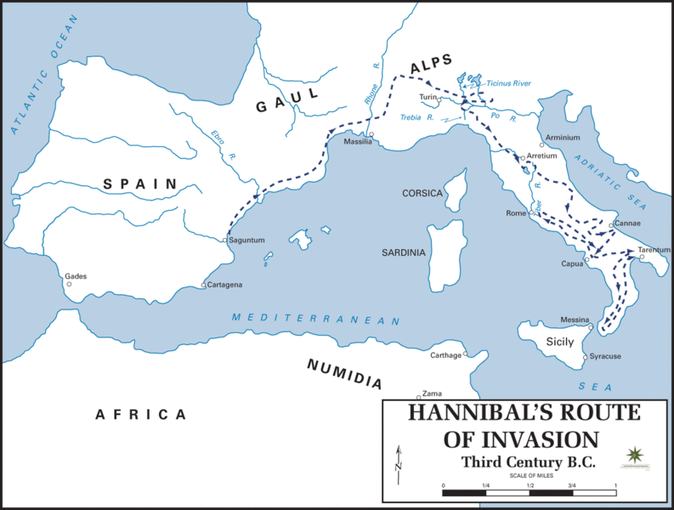

Slide 32
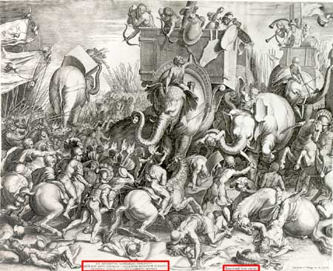
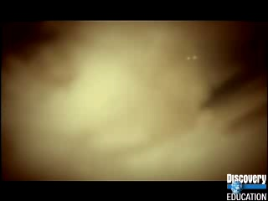
Hannibal conquered much of the Italian Peninsula, but was never able to take the city of Rome itself.
The Romans attacked Carthage in order to get Hannibal to leave.
Hannibal was defeated at the battle of Zama, ending the second Punic War.
Hannibal escaped.

Slide 33

Third Punic War
Rome had defeated Carthage twice, but was nervous that they would attack again.
The Romans attacked and burned the city of Carthage to the ground.
Many Carthaginians died of starvation during the siege of the city. The Romans sold the surviving 50,000 people into slavery.
The city was systematically burned between 10-17 until it was completely destroyed.
Legend says the Romans spread salt on the earth so nothing would ever grow there again.

Slide 34
Section 2: From Republic to Empire
Power of the Senate
The Senate became more and more powerful in the Republic.
Controlled both domestic and foreign policy, as well as finance.
The power of the Senate was concentrated in a small group of rich land-owners.
These few privileged people ran Rome.

Slide 35
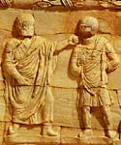
Plight of the poor farmers
Many Plebeian farmers could not compete with the large estates of the Patricians (Latifundia-large estates worked by slaves) Plebeians go broke.
These farmers were forced out of business, they sold their land and migrated to the cities.
This created a large number of landless poor in the cities.
This led to massive unemployment and civil unrest.
Latifundia and Slave Labor
Latifundia were the large landed estates of
the Patricians. The Latifundia used slave labor,
this allowed the Patricians to sell their goods for less than the small Plebeian farmers, forcing them out of business.

Slide 36
Attempts at Reform
The land situation in Rome was grave.
The unemployed in the cities continued to grow.
Many Legionnaires went off to war, their farms lay uncultivated in their absence, they were sold off to repay debt.
When the soldiers returned, they had nowhere to go, they joined the restless urban unemployed.
Soldiers had to own land to serve in the military, this diminished the number of men eligible for military service.

Slide 37
Tiberius Gracchus
Roman Tribunes who attempted sweeping land reforms.
He wanted the Senate to take public lands and redistribute them to the poor.
He knew the Senate would reject him, so he went to the Centuriate assembly instead, angering the Senators.
The Senators tried to get another Tribune to Veto him, he had that Tribune removed in violation of the law.
He shut down the whole city until the assembly would pass his laws.
He and many of his followers were killed in riots in the city led by the upper-class.
The riots were led by his own cousin

Slide 38
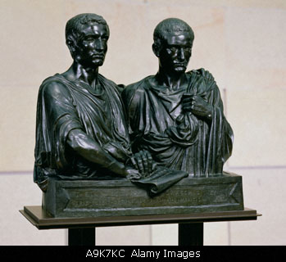
Gaius Gracchus
Younger brother of Tiberius, was also elected Tribune.
Continued the reforms of his brother.
Worked to have land that were illegally taken by the Patricians restored to the poor.
He tried to limit the time that men had to serve in the military.
He was reelected once and tried to run again, but was defeated the second time.
When the Senate got rid of his reforms, he and his followers revolted. He escaped and had his servant kill him so that he would not be captured. 3,000 of his followers were also killed.
One of his enemies cut the head off his body and turned it in for a bounty of 17 lbs of gold, because that is what is weighed.

Slide 39
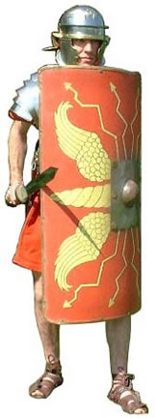
Changing Role of the Military
Originally made-up of citizen soldiers loyal to the Republic, the loyalty of the army changed.

Slide 40
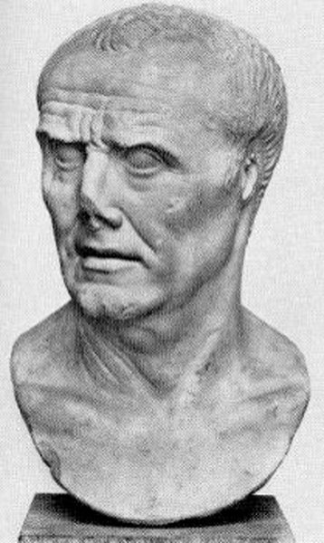
Marius
New Recruits
Before Marius the Roman Republic had no standing
army.
In a time of war it was the responsibility of the
Consul to recruit an army and prepare them for conflict. After the conflict the army would be dissolved.
To be eligible for the military soldiers had to be citizens, be of a certain social status, and be able to provide their own armour and weapons.
Marius changed the law so that he could recruit from the masses of the landless poor in the cities.
These new recruits would remain in the army for 25 years and be full-time soldiers. Now Rome had a full-time army with full-time training and readiness.

Slide 41
Loyalty
Marius recruited from the poor landless and unemployed of the cities.
He had the state provide them with armour and weapons.
He also promised them land when they retired.
Marius greatly changed the dynamic of the military in Rome.
Now the soldiers were more loyal to the generals who paid them and gave them land than they were to the Republic and the Senate.

Slide 42
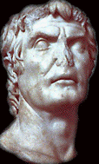
Generals in Politics
Marius gave the generals of the Roman army a power base for their entry into politics.
Generals could now use their armies to gain political power.
This led to many power struggles and civil wars.
The next General Lucius Cornelius Sulla, tried to restore power to the Republic, but it did not last.

Slide 43
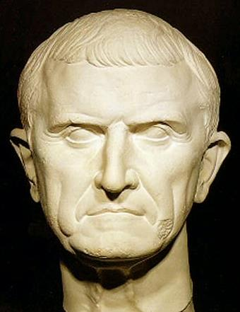
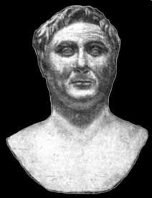
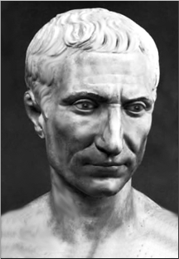
The First Triumvirate
Three men who emerged from the civil wars to take control of Rome
      Crassus
      Richest man in Rome
      He was a Roman General
      Pompey
      Another General, he had just won a campaign in Spain.
      Julius Caesar
      General who had also just waged a campaign in Spain

Slide 44
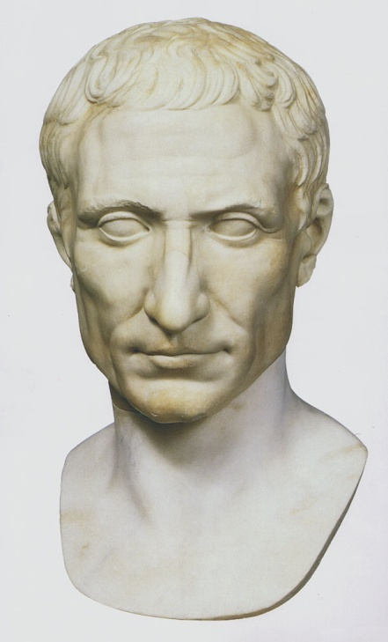
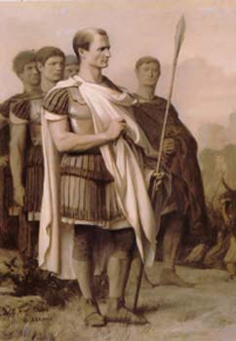
Caesar’s Rise to Power
Julius Caesar and the others members of the Triumvirate used each other’s wealth and power to gain political advantages.
Caesar had himself made general in Gaul
He won many military victories in Gaul and made it part of the Roman Empire.
He became a powerful and respected military leader.

Slide 45
Death of Crassus
Crassus died while fighting a military campaign in Syria
This left a power struggle open between Pompey and Caesar
Pompey’s Demand
Pompey feared the Caesar was becoming too powerful.
He was staying in Rome and had allied himself with the Senate.
He convinced the Senate to demand that Caesar return to Rome without his army.

Slide 46
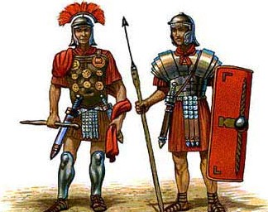
Caesar’s Refusal
Caesar knew that he would be arrested and lose all power if he entered Rome without his army.
He decided to take his legion and defy the Senate by crossing the Rubicon river into Roman territory.
This started another civil war in Rome
Victory for Caesar
Caesar was popular with the common people
Caesar was able to defeat his enemies.
It is said that when he defeated the forces of his enemies in Africa he states
“Veni, vidi, vici” I came, I saw, I conquered.

Slide 47
Dictator for Life
Caesar was declared dictator for life by the Senate and was given absolute power, but he was never made Emperor.
Reforms
Changes in the Senate
Caesar increased the number of people in the Senate and filled it with people who supported his ideas so they could be passed.
Public Works
He gave land to the poor
He cancelled debts of the poor and passed laws to limit discrimination of the poor.
He built many public buildings and revitalized the city of Rome and creating jobs for the jobless.

Slide 48
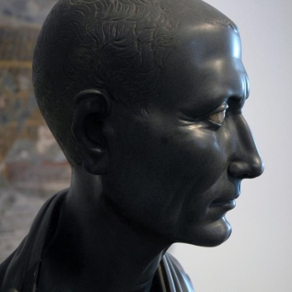
Citizenship
He expanded citizenship in the conquered regions.
Julian Calendar
Established a 365-day solar calendar with a leap year every four years.
This calendar was adopted from the Egyptians in Alexandria.

Slide 49
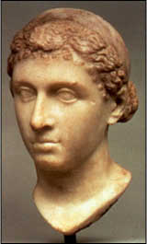
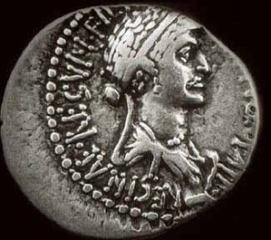
Affair with Cleopatra
When Caesar went to Egypt in pursuit of Pompey
he became involved in the civil war in Egypt
between Cleopatra and her brother Ptolemy XIII.
Ptolemy had angered Caesar by assassinating
Pompey and presenting Caesar with his head
picked in a jar.
Cleopatra allied herself with Caesar and he helped place her in power, co-ruling with her younger brother, who she later allegedly killed.
Caesar and Cleopatra had a son, Ptolemy Caesar, or, Caesarion “Little Caesar” who she appointed her co-ruler in Egypt. Caesar refused to make Caesarion his heir, he appointed his nephew Octavian to inherit his power and property.
She remained his mistress until his assassination.

Slide 50
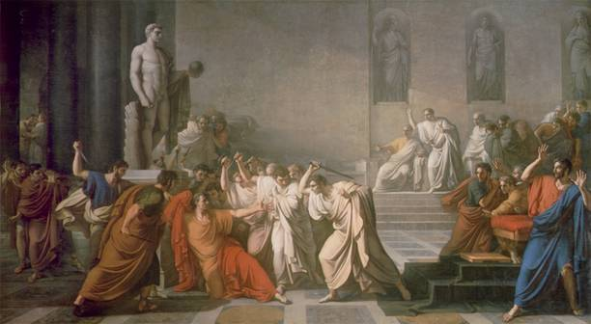
The Ides of March
Some Senators feared the Caesar was becoming too powerful and wanted to make himself king.
On the Ides of March, March 15, a group of Senators called Caesar to a fake meeting to read grievances of the Senate.
Caesar was attacked by the Senators and stabbed 23 times.
The poor were
outraged by the
murder of Caesar.
They made a statue
of him and rioted.
The Senators fled,
but were hunted
down by Caesar’s
successors.

Slide 51
Causes for the Decline of the Roman Republic
Spread of Slavery in the agricultural system
Migration of small farmers into cities and unemployment
Civil war over the power of Julius Caesar
Devaluation of the Roman Currency, Inflation

Slide 52
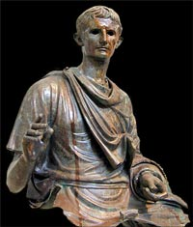
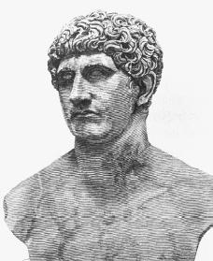
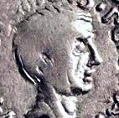
The Second Triumvirate
The men united and co-ruled after Julius Caesar’s death
      Octavian
      The adopted grand-nephew of Caesar and his heir.
      Mark Antony
      A friend of Caesar and one of his highest ranking generals.
      Lepidus
      Another general and friend of Caesar

Slide 53
Antony vs. Octavian
Lepidus is exiled and Antony and Octavian end up battling for power.
Octavian took control of the West and Antony took the East, including Egypt.
Antony marries the sister of Octavian, Octavia.
Antony defies Octavian and begins an affair with Cleopatra in Egypt.

Slide 54
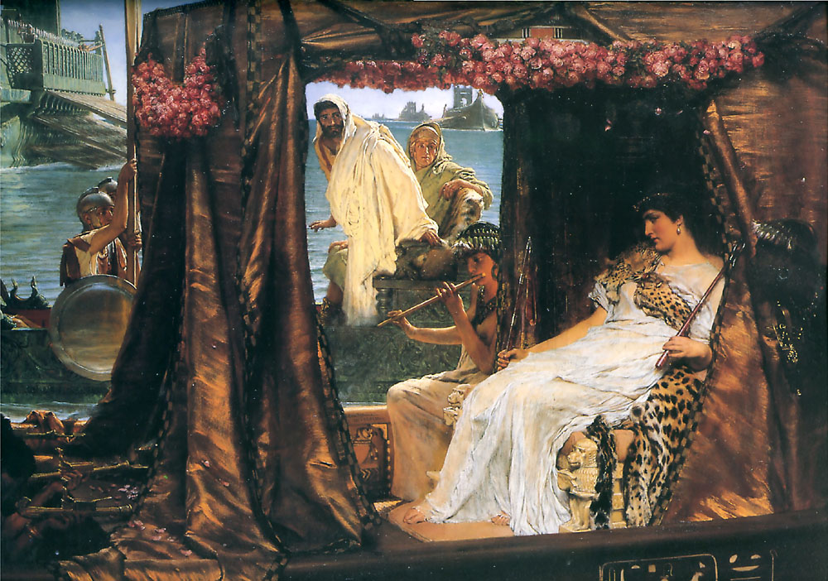
Antony and Cleopatra
Antony and Cleopatra had an affair for several years.
He married her using Egyptian customs because he was already married to Octavia.
They had three children
together.
It is said they had lavish
feasts and lived in luxury.
Octavian convinced the
people of Rome that Antony was corrupt. Octavian demanded he leave, but Antony refused.
Octavian convinced the Senate to declare war on Antony and Cleopatra.

Slide 55
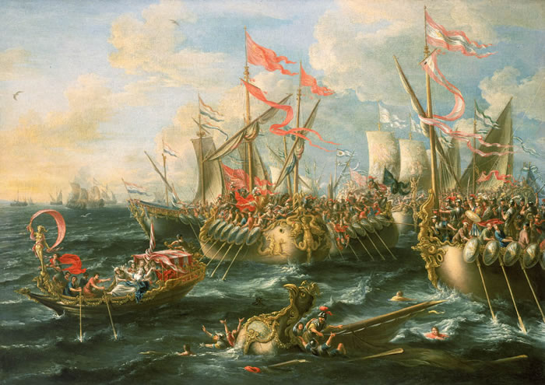
Battle of Actium
Octavian defeated the forces of Antony and Cleopatra

Slide 56
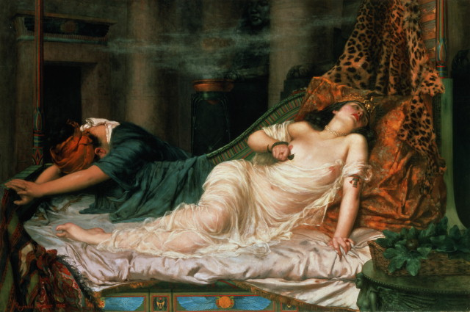
Death
Antony committed suicide, having been told Cleopatra was dead. According to the doctor Olympus (an eye-witness), he was brought to Cleopatra's tomb and died in her arms. Cleopatra was captured by the Romans
Several days later Cleopatra had her
servant sneak in two poisonous snakes
and she had them bite her.
Octavian was informed of her death,
and went to see for himself.
Cleopatra's son by Caesar, Caesarion, was proclaimed pharaoh but Octavian had him captured and executed.
The other children of Antony and Cleopatra were spared and raised in Rome by Antony’s wife, Octavia.

Slide 57
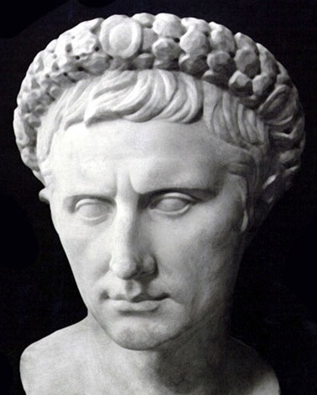
Octavian becomes Augustus:
Augustus becomes Princeps, or first citizen,
and Imperator (Commander in Chief)
The Age of Augustus
Augustus becomes the first Emperor
of the Roman Empire (exercising absolute power and naming
And naming his successor.
Reforms
Built many public works projects,
including roads, aqueducts, and public buildings.
Civil Service
Augustus wanted to make sure that the people who worked in the government were qualified and educated. Jobs based on merit and not class
Tax Reform/Census
He made the tax system more fair for the poor and counted the people of his territory.

Slide 58
Postal System
He set up a postal system to improve communication
Expansion of the Military
He added permanent forces to the military and increased its size.
Praetorian Guard
He created this guard to be the personal bodyguards of the Emperor. WHY????
Defeat in the North
He was never able to defeat the Germanic groups north of Rome. This was his only defeat.

Slide 59
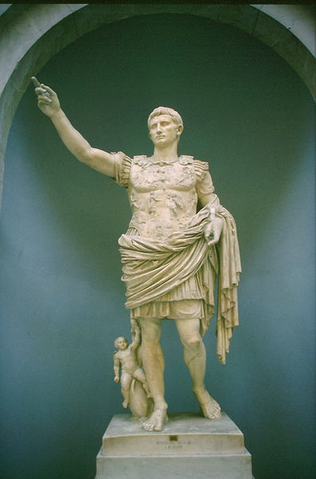
The Pax Romana
The Roman Peace
200 year period of peace in the Mediterranean region.
Economic impact of the Pax Romana
Established uniform system of money, which helped expand trade.
Guaranteed safe travel and trade on Roman roads
Promoted prosperity and stability.
Social impact of the Pax Romana
Returned stability to social classes
Increase emphasis on the family
Political impact of the Pax Romana
Created a civil service
Developed a uniform rule of law.

Slide 60
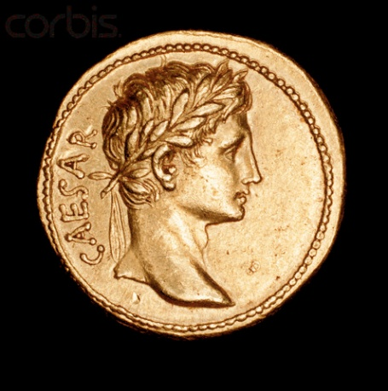
The first emperors to rule after Augustus
-Tiberius
-Caligula
These emperors used family succession to choose their successor, this established the Julio-Claudian Dynasty
-The first group of emperors were known as the Bad Emperors, their tactics were questionable and some people believe that some of them were insane. Ex. Caligula appointed his horse as consul
The problem with imperial succession is that there was no official way to choose the next emperor and there was usually conflict with the army over who would rule next.

Slide 61
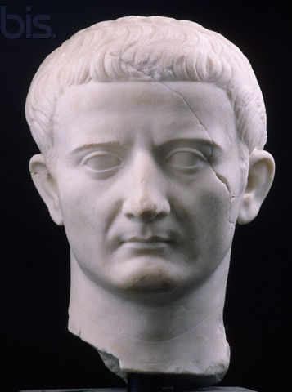
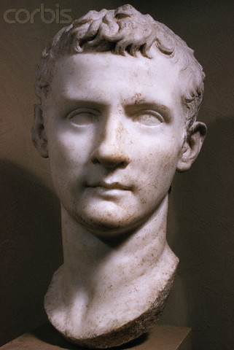


The Good, The Bad, and the Ugly!
Early Emperors
Had questionable policies and behaviors, but overall did not change too much related to the government structure.

Slide 62

The Good Emperors
Nerva, Trajan, Hadrian, Antonius Pius, and Marcus Aurelius
Nerva
Reformed land laws to help the poor
Trajan
Expanded the empire to its greatest size

Slide 63


Hadrian
Hadrian pulled back Roman borders
Built Hadrian’s Wall in England as a fixed Roman border
He also built the Pantheon

Slide 64
Antoninus Pius
Promoted art and science
Public works
Legal reforms
Marcus Aurelius
Last emperor of the Pax Romana
Economic and legal reforms

Slide 65

At its height the Roman Empire was 3.5 million square miles
In 212 CE Caracalla gave Roman citizenship to every free person
Why were Roman cities important?
Roman cities were vital for several reasons
They helped to spread Roman
culture, Roman law, and the
Latin language to newly
conquered areas.

Slide 66
What was the Language of the western Empire?
The language in the West was Latin
Romance Languages
Later languages developed that were based on Latin such as French, Spanish, Italian-These usually developed in areas once controlled by Rome.
-The Eastern Empire?
Language of the East was Greek
What was Greco-Roman civilization?
As the Empire expanded it absorbed the cultures that were a part of this. This combined culture of the Romans and the Greek culture they assimilated is called Greco-Roman culture.

Slide 67

How did the Early empire become so economically prosperous?
The relative peace of the early Empire led to an increase in trade and prosperity.
What was the occupation of most of the people?
Despite the good economy most people were still farmers
Latifundia, or large plantation-style farms, were common
Why were there so many urban unemployed?
The Latifundia were worked by slave labor.
Small farmers couldn’t
keep up and were put out of
business.
Soldiers were also losing their
land while off at war.

Slide 68

Problems caused by Gap between Rich and Poor
The population of Rome was never equally divided. There were a small number of rich and a very large number of poor. Many of these poor moved to urban areas (cities) in search of jobs and ended up forming a large community of unemployed. These people were in constant danger of causing a revolt.
Bread and circuses
To keep the mob from revolting the Roman government provided them with free food and entertainment.

Slide 69

Roman Art and Architecture
When did the Romans adopt many features of Greek art.
During the third and second centuries the Romans began to adopt features of Greek art.
Mosaics-pictures made from chips of colored glass or stone
How did Roman sculpture contrast with Greek Sculpture?
Greek art focused on perfection while Roman art focused on realism.
The Romans adopted the vault, arch and dome

Slide 70





Slide 71




Slide 72




Slide 73

Concrete
The Romans advanced concrete
They invented concrete that could be used under water
The use of concrete allowed the Romans to build very quickly and on a larger scale than if they used stone.

Slide 74


Roman Monuments
Colosseum
-Finished in 80AD, could seat 50,000 people.
-Fighting area was 272 ft by 157 ft
-Gladiator battles, naval battles, and the execution of criminals were held in the Colosseum

Slide 75

Hypogeum
Area below the Colosseum where the participants would wait to take their place in the Colosseum performances

Slide 76


Aqueduct
Aqueducts carried water into Roman cities
The water flowed from the highlands at a gradual angle into Roman cities.

Slide 77

Roman Forum
The Forum was the heart of any Roman City
It was the central marketplace and public meeting place for the Roman people.

Slide 78


Pantheon
Built by the Emperor Hadrian as a temple dedicated to all of the Roman Gods.
Finished around 126 AD

Slide 79



Slide 80

Roman Roads
The Romans built thousands of miles of roads to connect their large empire.
This allowed for the quick movement of people and goods throughout the empire.
They were paved with stone and had a drainage system which made them highly advanced. Some are still in use today.

Slide 81

Roman Bridges
The use of the arch allowed the Romans to span large areas with a minimum of building material.
Bridges were a part of the Roman Road System

Slide 82



Hadrian’s Wall
Built by the Emperor Hadrian to form a solid northern border of the Empire and keep out barbarians tribes from northern Britain (England)

Slide 83
Roman Literature
Virgil: Roman Poet, wrote the Aeneid
In the Aeneid, Aeneas portrays the ideal Roman with duty, piety, and faithfulness. He claimed that Aeneas was one of the founders of Rome.
Horace: Another Roman poet, wrote the Satires, where he poked fun at the weaknesses of people.
Livy: Roman Historian Wrote The History of Rome which
portrayed Roman Greatness. His histories were biased
towards Rome.
Science and Math
The Roman Scientist Ptolemy proposed that the Earth was the center of the universe, a Geocentric View.

Slide 84

The Roman Family
Paterfamilias: The male head of the Roman household. The father was the master of the family. He made all decisions about his wife and children.
A father could sell his children into slavery or prostitution if the family needed money.
“Under the laws of the Twelve Tables, the pater familias had vitae necisque potestas - the "power of life and death" - over his children, his wife (in some cases), and his slaves, all of whom were said to be sub manu, ‘under his hand’. “

Slide 85

Roman Education
The Paterfamilias was responsible
for the education of his sons.
The Romans usually hired tutors
(frequently Greek slaves) to teach their sons or the boys would be sent to school.
Boys learned reading, writing, moral lessons, law, physical training, military techniques, and Roman values.
Girls usually stayed at home. Some learned the basics of reading and writing, but girls were mostly trained in household matters.
Girls may go to primary school, but didn’t usually go to secondary school as they were married at a young age.

Slide 86

Roman boys were considered a man at the age of 16.
At that time they would exchange the purple toga
of their youth for the white one of an adult.
The Romans did not have a high opinion of women.
Women had to have male guardians at all times
and, early in the republic, they could not divorce.
Women were married very young, around 12-14
years old.
Later, in the Roman Empire, women gained the right to file for divorce

Slide 87

Changing Roles:
By the second century AD,
Roman women and children
gained some rights.
Fathers could not longer sell
children into slavery
Women earned the right to own, inherit, and sell property.
Upper-Class women were now free to go out in public, although they could not vote, they gained some political influence through the influence they had upon their husbands.

Slide 88

Slavery
Slavery was common in the Roman world.
As the empire expanded more and more slaves
were brought into the empire.
Greek, educated, slaves were used as tutors, doctors, musicians, and artists.
Other slaves were used for labor, agriculture, and as domestic servants.
Domestic slaves were treated fairly well, but slaves that worked on farms and on construction were treated poorly and many died.
One slave owner commented that it was cheaper to buy a new slave and replace a dead one than to take care of them.

Slide 89

Slave Revolts
The mistreatment of slaves led to slave revolts
The most famous revolt was led by a Gladiator Slave called Spartacus
In 73 BC Spartacus led a revolt which managed to defeat several Roman legions and eventually included thousands of slaves.
Finally defeated by the Romans in 71 BC Spartacus and 6,000 of his followers were crucified along the roads of Rome.

Slide 90

Daily life in Roman Cities
Cities were the heart of the Roman Empire
Cities were very crowded. There was heavy traffic and congestion.
There was a lot of unemployment and crime was a problem.
Fire was a constant danger as
many building were made of
wood and were very close
together.
There was a huge gap between
rich and poor. The rich would live
in lush villas while the poor
would live in crowded apartments
called insulae.

Slide 91


Fire of 64 AD
In 64 AD/CE a devastating fire swept through Rome.
It destroyed large part of the city.
The Emperor Nero is the person many people blame for the disaster.
He blamed the fire on the Christians and had many of them assassinated after the fire by burning them to death.

Slide 92

Public Programs
Unemployment and unrest was a major problem in Roman cities
To keep the people happy there were many public programs. The Romans gave the people free food and entertainment.
This was called
Bread and Circuses
People received free
tickets to the Colosseum
to watch gladiator
battles and to the
Circus Maximus to
watch Chariot Racing.

Slide 93
The Development of Christianity
Roman Mythology
Religion for the Romans was a lot like it was for the Greeks. Religion was a part of their every day life.
Roman Name Function Greek Name
Mars God of War Ares
Jupiter Chief god/King Zeus
Juno Queen of gods Hera
Venus Love and Beauty Aphrodite
Minerva Wisdom Athena
Mercury Messenger Hermes
Pluto Underworld Hades
Neptune Sea Poseidon
Vulcan Blacksmith, god of fire Hephaestus

Slide 94
The Romans believed that they would become closer to their gods through the practice of rituals and sacrifices.
The Romans viewed their gods and goddess much like the Greeks had done. Gods and goddesses were a part of their everyday life. They had human characteristics.
The Romans felt that the gods and goddesses needed to be kept happy so that they would have a prosperous life.
The Romans were fairly tolerant of other religions so far as they were not interfering with Roman religion.

Slide 95
Jewish Background
The Jews had been a part of the Roman Empire for a long time
Judea became of province of Rome in 6 AD
The region was placed under the rule of a Roman official called a Procurator
Jewish leaders varied in their opinion of Rome
The Priests, or Sadducees, favored Cooperation with Rome
Pharisees, or scholars, wanted to stick to strict obedience to Jewish Law
Essenes, wanted to be hermits and live apart from Roman Society
Zealots, wanted to revolt and overthrow Rome.
The Jews eventually revolted and were put down in 70 AD

Slide 96

Christianity
The religion of Christianity emerged
during the early Roman Empire.
Not much is known about the early life of
Jesus.
It is thought that he began to teach about the age of 30.
The teachings of Jesus led to the foundation of a new religion which was separate from its Jewish origins.

Slide 97

Concept of God: The Christian concept of God is that God is all knowing (Omniscient) and all-powerful (Omnipotent)
Holy Book: The Holy Book of Christianity is the Holy Bible
The four books of the Bible that tell the story of the life of Jesus are the Gospels
The make-up of the Bible was decided at the Council of Nicea. This was a council called by the Roman Emperor Constantine where decisions were made regarding the canonical, or accepted, gospels and the idea of the nature of Christ was also decided.
In 313 AD/CE Constantine passed the
Edict of Milan which granted tolerance
to all religions within the Roman Empire.

Slide 98
Jesus
Very little is known about the early life of Jesus, there are stories of his birth in the Gospels and a few stories of his youth
According to the Gospels, Jesus began to teach around the age of 30. He taught for about three years before he was executed as a criminal by the Roman Empire.
Jesus taught the idea of a New Covenant, a new religion based on moral ideals as opposed to the laws of Judaism.
The new symbol of the covenant was baptism as opposed to circumcision which was the Jewish symbol of the covenant.

Slide 99

The Passion refers to the Holy Week.
The week of Jesus’ entry into the city of
Jerusalem. It includes the trial and
execution of Jesus by the Romans.
Jesus was crucified by the Romans, a common
means of execution at the time for the Romans.
Christians believe that after three days that Jesus was resurrected, or arose from the dead.
The Christian holiday of Easter is based on their belief in this event.
The two principal holidays of Christianity are Christmas which celebrates the birth of Jesus and Easter which celebrates the resurrection of Jesus.

Slide 100
Key ideas of Christianity
-Announcement: Christians believe that Jesus coming
was foretold before his birth.
-Baptism-Baptism became the new symbol of the covenant for Christianity.
-New covenant- Jesus taught that belief in his teachings would establish a New Covenant with God.
Eucharist: The taking of the body and the blood, Communion.
Two views on the Eucharist
-Transubstantiation: It literally, through a miracle, becomes the body and blood of Jesus.
-Consubstantiation: Communion is symbolic.

Slide 101
-Metaphysical nature of salvation: Salvation in Christianity was different from Judaism because salvation focused on an other-worldly afterlife, not on military conquest and the holy land.
-Split between Catholic and Protestant: Eventually, during the Protestant Reformation, Christianity splits into two main branches
Catholic: Christians who follow the original version
of Christianity and have the Pope as their
spiritual leader.
Protestant: Any Christian who is not a Catholic.

Slide 102

Paul
Christianity spread to Gentile, or
non-Jews, mostly from the work
of the Apostle Paul.
Paul was a Roman who converted to the religion and became one of its greatest early leaders.
The teachings of Christianity were originally spread through oral tradition and letters between the various Christian groups.
These were eventually written down and collected into what we now know as the New Testament.

Slide 103

Persecution
Early Christians did not have the
protection that other religions had.
The Jews had an agreement with the
Romans that was not extended to
the new religion.
Christians were killed as criminals by the Romans in various ways.
Christians won tolerance in 313 AD with the Edict of Milan. This order by the Emperor Constantine made Christianity and all religion tolerated within the Empire.
Years later Theodosius the Great made it the only religion tolerated within the empire, became official religion.

Slide 104
Clergy: Were Church Officials
Laity: The common people
Christianity was forced to become organized because it was a persecuted religion. This persecution actually helped Christianity to pull together.
In a short time Christianity went from being a persecuted minority to the official religion of the Roman Empire.

Slide 105

The Fall of Rome
Marcus Aurelius was the last emperor of the Pax Romana, or Roman Peace. He died in 180 AD.
Rome didn’t fall overnight, there were many things that led to its downfall.
The Severans were a series of harsh rulers who used the military to expand their power. After the fall of the Severans there was a time of military leadership, where many rulers met violent deaths. The
Empire became increasingly unstable.

Slide 106

Barbarian Invasions
Over time various barbarian groups pushed at Rome’s borders.
Many groups were pushed into Roman territory as the Huns invaded from Central Asia.
These groups included the Vandals, the Visigoths, and the Ostrogoths among others.
These groups slowly took over Roman territory and staged several invasions of the city of Rome itself.

Slide 107
Economic and Political Problems
Rome experienced very high inflation toward the end of the Empire
There were heavy taxes and a lot of corruption in the government system
There were high rates of unemployment and discontent among the people.
Plague
En epidemic disease hit Rome in the late empire causing a labor shortage.
This caused shortages in the labor force and in the military

Slide 108

Mercenaries
Because of the labor shortage the Roman Military had to hire Mercenaries, or soldiers-for-hire
These soldiers were not as disciplined as the regular Roman military.
The effectiveness of the Roman army declined as soldiers did not train and would desert the army during battle.

Slide 109


Reforms of Diocletian and Constantine
The Roman Emperors Diocletian and
Constantine both attempted reforms to slow the decline of the Empire
Diocletian divided the Roman Empire into East and West
Diocletian appointed a co-Emperor to help rule this now divided empire
Leadership was divided among four people

Slide 110

The new government was known as the Tetrarchy
Each Emperor had the title Augustus
Each Augustus had an heir known as a Caesar.
Diocletian originally wanted the two Augusti to retire after twenty years and for the Caesars to assume power, it didn’t work out the way that he wanted. After a civil war Constantine became Emperor.

Slide 111
Some of the reforms of Diocletian and Constantine
They enlarged the army (by hiring mercenaries) and expanded the Civil Service
-The greatly drained money from the Empire
They set wage and price controls throughout the Empire
They forced people to stay in their jobs and made them hereditary
Inflation: A rapid increase in prices, was
Rampant during this time because of overspending

Slide 112

Byzantium becomes Constantinople
After the division of the Empire the Roman Emperor Constantine moved the capital of the Empire from the Western city of Rome to the Eastern city of Byzantium.
He renamed this city Constantinople.

Slide 113
The Fall of Rome
The Divided Roman Empire now had two capitals:
Rome in the West and Byzantium/Constantinople in the East
The Western capital of Rome was under pressure from barbarian tribes that were invading from Eastern Europe and Central Asia.

Slide 114


The Huns
The Huns were a nomadic group which came from Central Asia.
The Huns moved down into Eastern Europe which pushed the Barbarian groups from that region into Roman territory.

Slide 115


The Visigoths
One of the groups which was pressured by the Huns were the Visigoths. This group moved into Roman territory and originally settled along the Danube River, later they revolted against the Romans and defeated them at the battle of Adrianople in 378. They later sacked the city of Rome in 410.

Slide 116

The Vandals
The Vandals were yet another group to sack the city of Rome.
In 455 they attacked and burned the city.
The word Vandalism comes from this senseless destruction of Rome.

Slide 117
The Fall of the
Western Empire
In AD 476 the Germanic leader Odoacer overthrew the last Western Emperor Romulus Augustus.
After the fall of the Western Empire the Eastern Empire continued and eventually became known as the Byzantine Empire

Slide 118
Why did Rome Fall?
There was no one thing which led to the fall of the Roman Empire
It included all of the following:
Economy: Devaluation of Roman currency from inflation and high military costs
Military: Breakdown in military discipline from the hiring of mercenaries.
Moral Decay: People lost faith in the Roman government
Political Problems: The Government became corrupt
Invasion: Barbarian invasions
Some people also believe it may have been lead poisoning from lead pipes, it may have been a lack of technology due to slavery, the new religion of Christianity may have caused people to turn from the government . . . The causes were many.

