Slide 1
Russian Revolution
An Overview

Slide 2
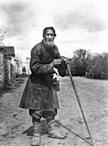
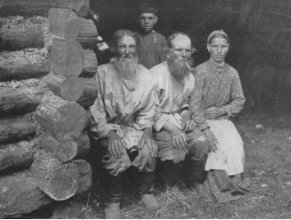
Life under the Czar
Most people in Russia were poor peasants called serfs who lived on land owned by wealthy landowners
Students protests, peasant revolts, and worker strikes were common

Slide 3
Life under the Czar
The Russo-Japanese War ended in a humiliating defeat for Russia and showed that Czarist rule was weak and disorganized.

Slide 4
Life under the Czar
World War I brought great suffering to the Russian people
It brought shortages in housing, food, and fuel
Russian armies were ill-equipped and were soundly defeated – 1.7 million killed, 5 million injured.

Slide 7
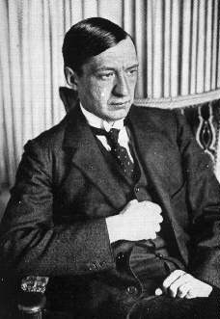
March Revolution 1917
Bread riots
Soldiers sent to end the violent protests side with the demonstrators
Czar Nicholas is forced to resign (abdicate)
Bloodless revolution
Provisional government set up with Kerensky in charge
Keeps Russia in the war

Slide 8
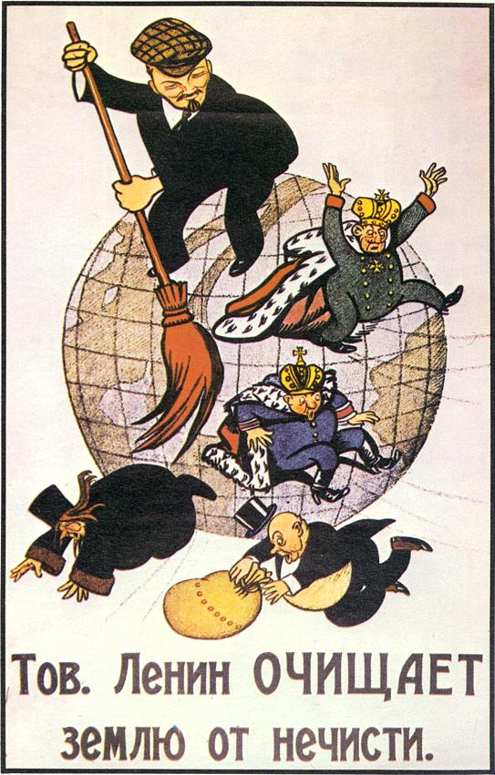
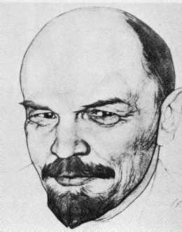
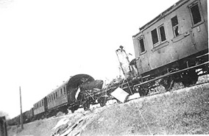
Germany takes advantage of Russian unrest
Germany knows USA coming to Western front; wants to get rid of Russians on Eastern front
Helps exiled Lenin to return

Slide 9
November Revolution 1917
Wages increased between revolutions
Cost of food and other necessities increased at a higher rate
On an average, food increased in price 556 per cent., or 51 per cent more than wages.
On an average the above categories of necessities increased about 1,109 per cent, in price, more than twice the increase of salaries
Bolsheviks (Reds) take power

Slide 10
November Revolution 1917

Slide 11
November Revolution 1917
Civil War breaks out – Reds vs. Whites
Bolsheviks prevail through shear brutality – even when out numbered.
Vladimir Lenin leads the revolution based upon his own interpretations of the writings of Karl Marx
Lenin signs Treaty of Brest-Litvosk with Germany to get out of war

Slide 12
November Revolution 1917

Slide 13
Marxism
Believed humanity was changing, Industrialization was to blame. Horrified by working conditions.
Capitalists were getting richer than workers creating a significant gap between the two
Believed one of the following would happen:
Rich must distribute wealth
A worker led violent revolution

Slide 14
Leninism
Lenin fascinated by industrialization, wanted to bring that to Russia
Differed from Marx in his belief that the world wide communist revolution had to be led by a power elite forcing it forward – not just the common man.

Slide 15
Leninism
Communist Party was the only party allowed.
The use of force and terror through the secret police (Cheka) was necessary and good for the cause
Used slogans, include “Bread, Land, Peace and All Power to the Soviets.”

Slide 16
Lenin’s Death
Died in January 1924.
Believed Leon Trotsky should replace him as leader. Trotsky had successfully lead Red Army against the White Army. Had a vision of the Soviet Union in line with Lenin. He wanted to focus on agriculture.

Slide 17
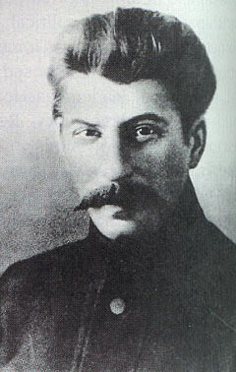
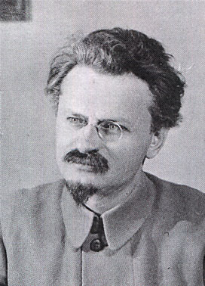
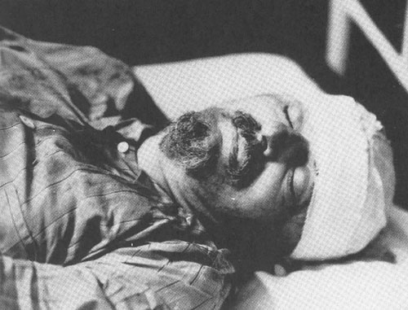
Lenin’s Death
Lenin believed that Stalin could not handle the power that came with leadership. Stalin believed in the industrialization of the nation.
Stalin takes control, has Trotsky killed.

