Slide 1
Can you do a better job than the Berlin Conference?
You are divided into a group of 6. Each of you represents a different imperialistic power. Everybody will get assigned a country and what your goals are. DON’T let the other countries know what your goals are!! Take 3-4 minutes and use your iPad to look up a natural resource map of Africa and also a topographical map of Africa. Other maps that may be useful… ethnicities, languages, religion. You want the most valuable territory possible so these maps will help you come up with a game plan!!
HOW TO CLAIM TERRITORY: Use the colors to claim territory.
The goal is to AVOID war and get territory that will benefit your country. If two countries claim the same territory a game of rock, paper, scissors will decide who wins. If you lose the round of rock paper scissors you do not get back your colored squares so be careful!!
Rules
1. Countries can not go to war with each other over the SAME territory more than 2 times.
2. If you want to claim a small sliver of land you may choose to use your one freebee( this allows you to claim land without controversy or confrontation).

Slide 2
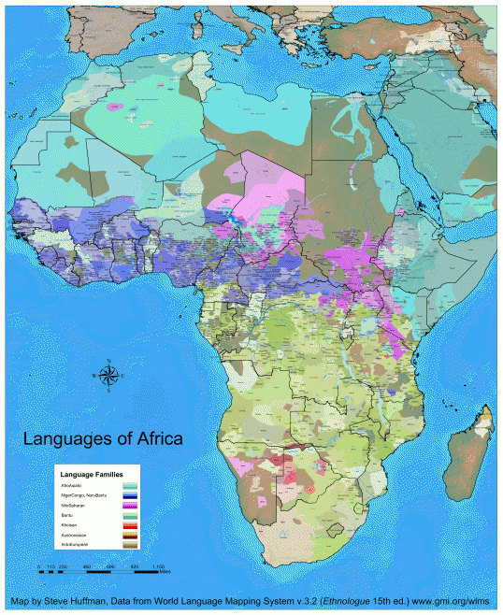

Slide 3
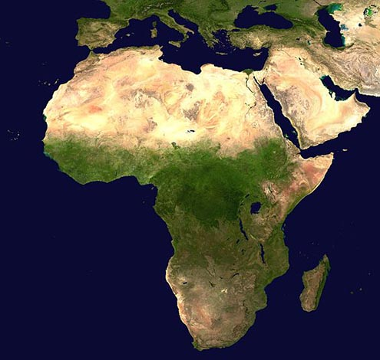

Slide 4
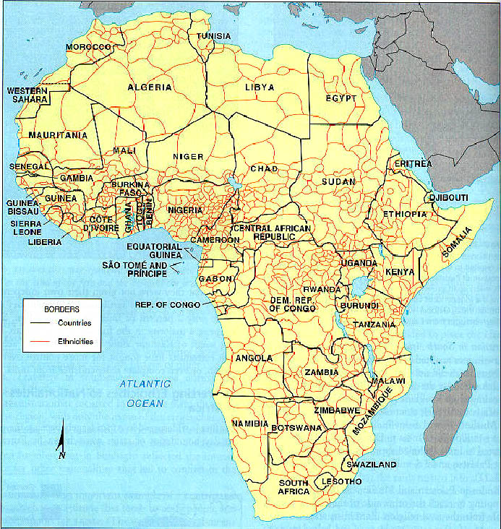

Slide 5
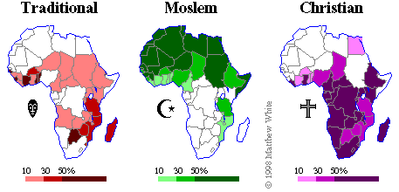
Major Religions of Africa

