Slide 1
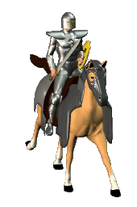
THE CRUSADES
A Quest for the Holy Land

Slide 2
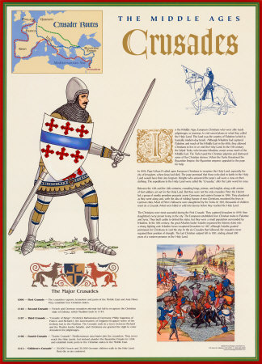
Crusades
A long series or Wars between Christians and Muslims
They fought over control of Jerusalem which was called the Holy Land because it was the region where Jesus had lived, preached and died

Slide 4
Causes of the Crusades
Muslim Turks
captured Jerusalem
from the Byzantine
Empire
Muslims stopped
Christians from
Visiting Holy Land
Christian pilgrims
were attacked
Byzantine Empire
feared attack on
Constantinople

Slide 5
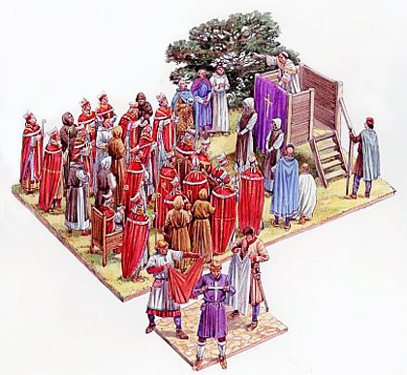
The Call to Arms
Pope Urban II called for the defeat of the Turks, returning the Holy Land to the Christians

Slide 6
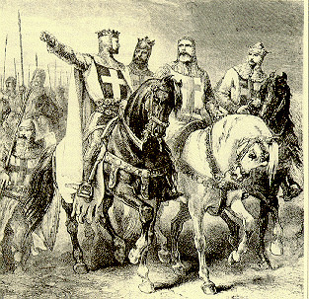
Who Answered the Call?
Feudal Lords
Knights
Peasants

Slide 7
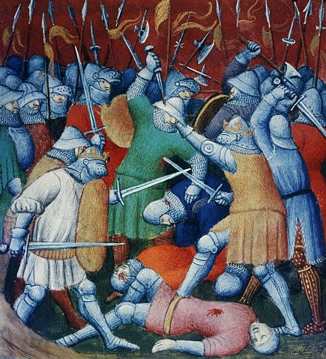
The First Crusade (1096-1099)
Peasant army
Untrained
Lacked military equipment
Many killed by Muslim Turks
Knights
Succeeded in capturing Jerusalem

Slide 8
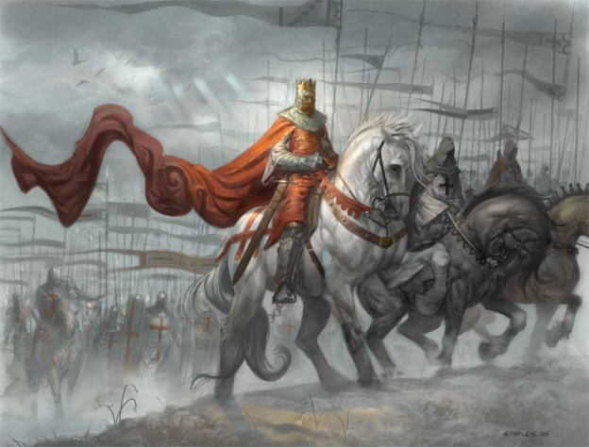
Second Crusade (1147-1149)
After victory many Christians went back home.
The Turks eventually took back much of the territory.
King of France and Emperor of Germany sent troops to stop the Turks.

Slide 9
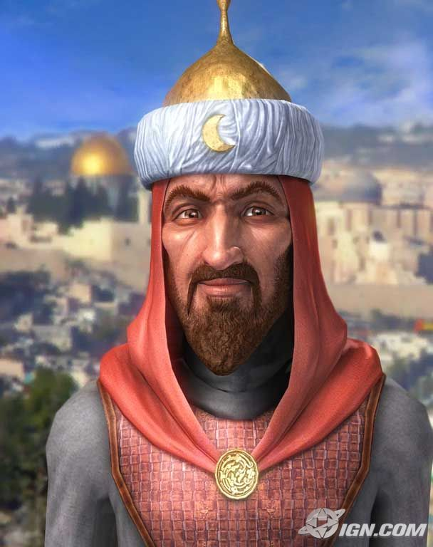
Second Crusade (1147-1149)
Saladin leads the Muslim Turks to victory, defeating the Christians
* He was considered a very wise ruler. He was known for his sometimes kind treatment of fallen enemies. Many Christians saw him as a model of knightly chivalry.

Slide 10
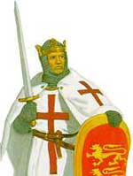
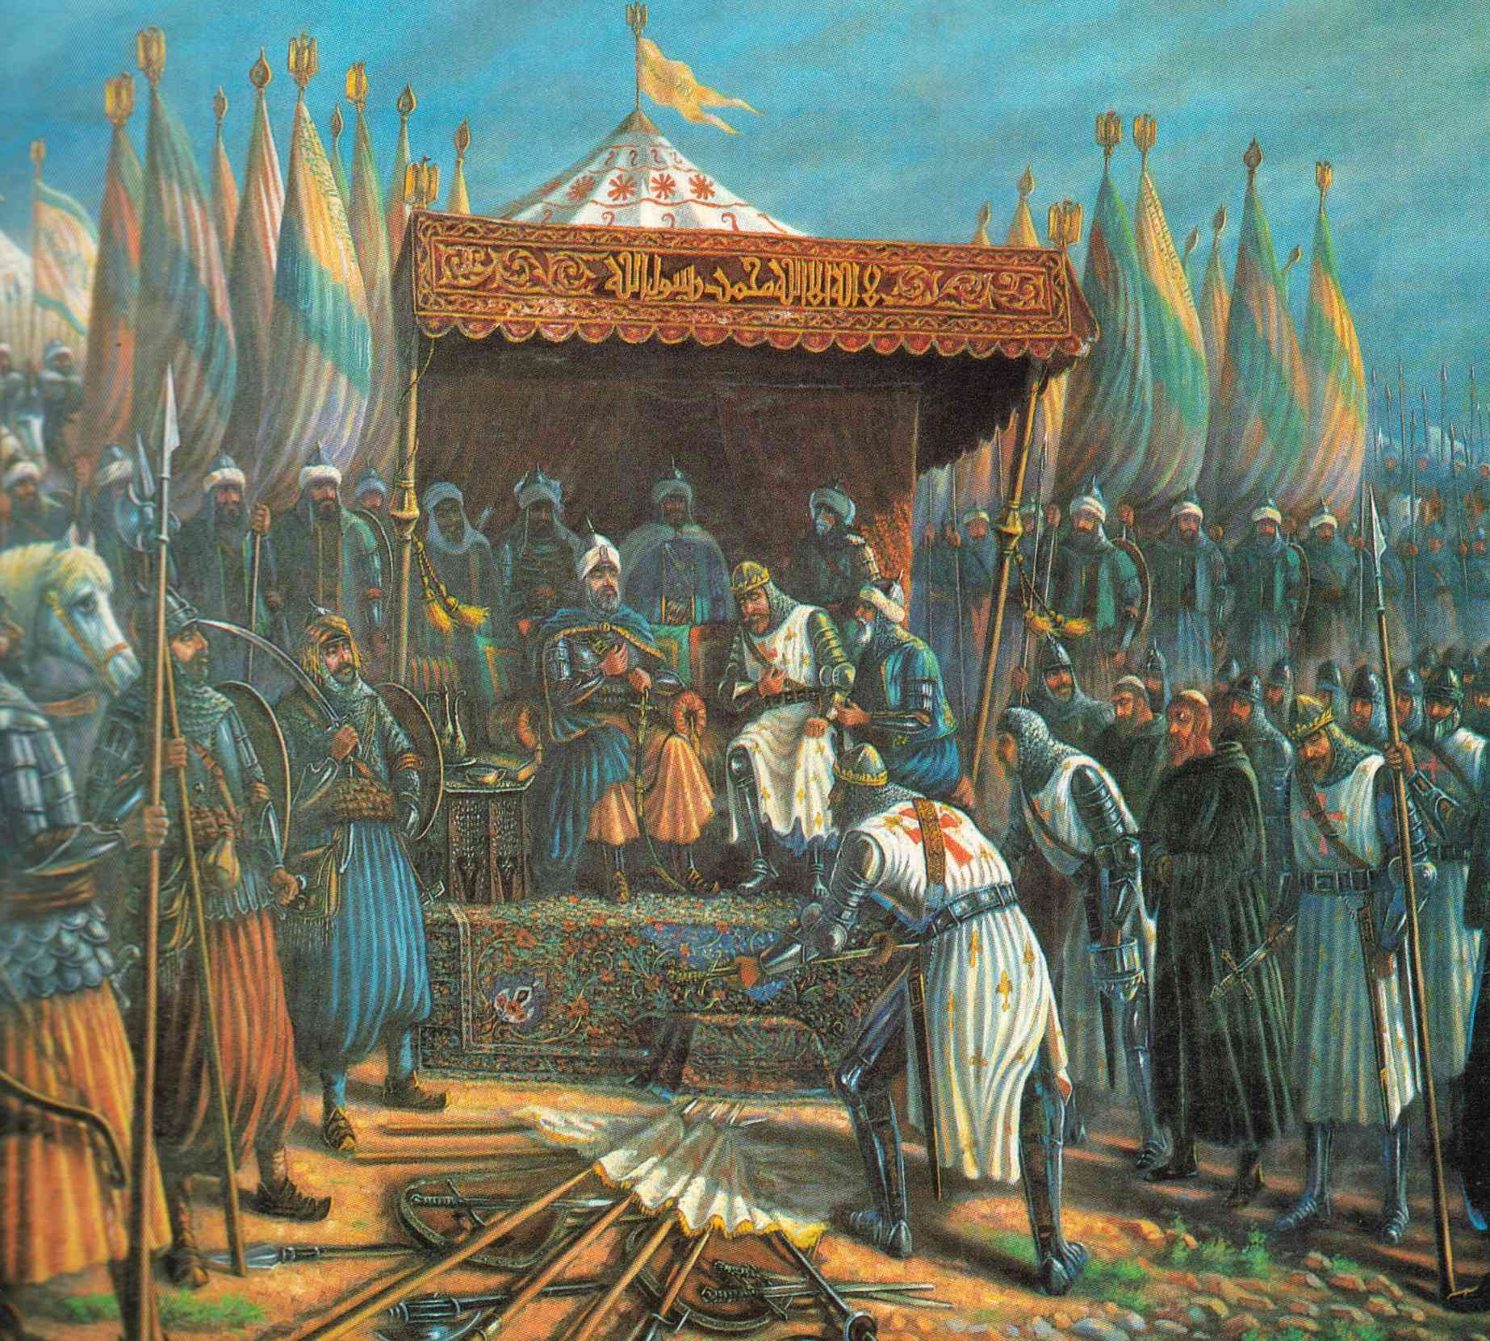
Third Crusade (1189-1192)
King Richard of England convinces the Turks to allow Christians to visit the Holy Land

Slide 11
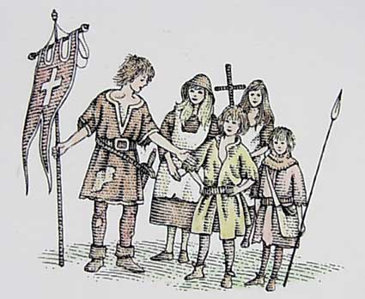
Crusades Continue Through 1200’s
Several more crusades attempted with no victories for the Christians
Children’s crusade, - 30,000 soldiers - many of them under 12 years old – Never made it to the Holy Land

Slide 12
Results of the Crusades
Improvements – Ships, Maps, Explorers
Feudalism declines because Feudal lords die or spend too much money on military.
Turks still rule the Holy Land
Travel – Europeans want to travel more
Trade – Europeans want product from the East such as sugar, cotton, silk, spices, etc.

Slide 13
Assignment: Recruitment Poster
Use this PowerPoint to create a recruitment poster on PicCollage. Your project should include:
A definition of the crusades.
A map of the crusades.
The four causes of the crusades.
Pope Urban’s call for defeat of the Turks to return the holy land to the Christians.
Who answered or needs to answer the call.
A description of all four crusades.
The results of the crusades.

