Slide 1
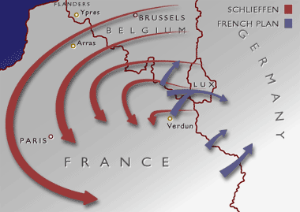
The Schlieffen Plan

Slide 2
How Could Germany Avoid a War on Two Fronts?
Germany, during the late 1800’s, tried to keep on friendly terms with Russia
If war came, Germany expected it to be with France, not Russia, which would mean battles to the west – a Western Front
If Russia joined France against Germany, it would mean battles to the east – an Eastern Front

Slide 3
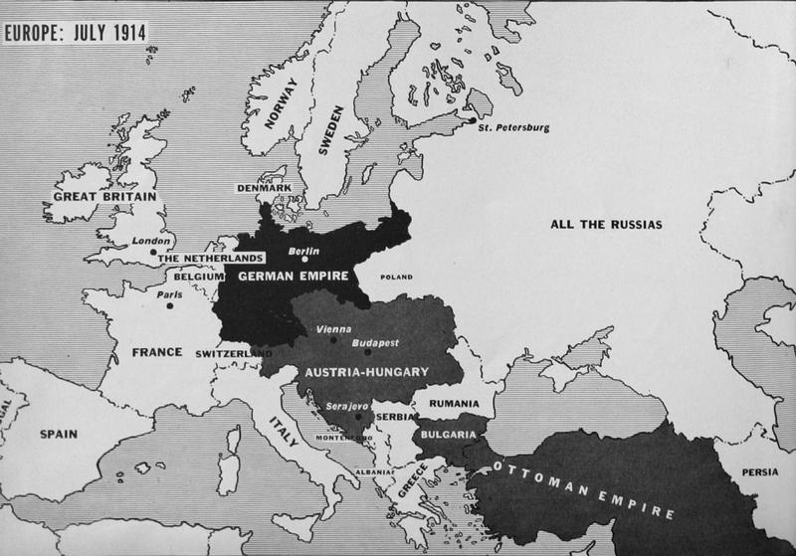

Slide 4
Germany wanted to avoid a war on two fronts at all costs
When Germany allied with Austria in 1879, Russia’s friendship was lost; Russia became France’s ally
Germany planned to defeat France rapidly and then turn to the eastern front for a major offensive on Russia
This was the basis for the Schlieffen Plan

Slide 5
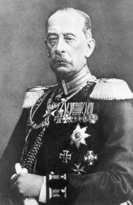
General Von Schlieffen
German General Von Schlieffen developed a six week plan to knock France out of the war before turning attention to the Russians
The Russian army was large but badly trained, poorly equipped, and scattered across a huge country
It would take time for Russia to prepare its armed forces for full-scale war
Schlieffen’s plan was to defeat France while Russia was struggling to get is army in order
Then Germany could turn its full attention and firepower on Russia

Slide 6
Assumptions
Schlieffen based his plan on the following assumptions:
Russia would take at least 6 weeks to mobilize
France would be easily defeated in 6 weeks
Belgium would not resist any German attack
Britain would remain neutral based on a 70 year old treaty with Belgium

Slide 7
The Reality
On August 2, 1914, the German army invaded Luxembourg and Belgium according to the Schlieffen Plan
The Germans were held up by the Belgium army, backed up by the British Expeditionary Force which arrived extremely quickly
Russia mobilized in just 10 days and Germany was forced to withdraw troops from the Schlieffen Plan to defend her eastern border
Germany did not take the chance to take Paris, instead decided to attack east of the capital; they were met by French at the Battle of the Marne which halted the German advance

Slide 8
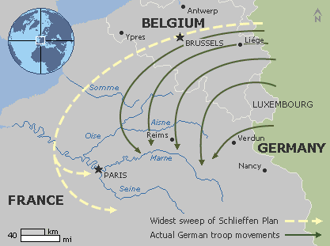

Slide 9
The Schlieffen Plan Fails
Instead of knocking France out of the war, the Germans found themselves trapped on the Western Front, facing the combined armies of France, Britain, and their empires, including Canada
Instead of a short, swift campaign as anticipated, Germany’s attack on France became a long, costly – and horrible – war

Slide 10
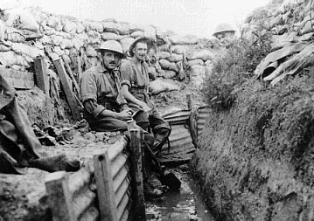
Four years of trench warfare had begun

