Slide 1
Rise of Totalitarianism

Slide 2
Rise of Totalitarianism

Slide 3
What is Fascism?

Slide 4
Joseph Stalin

Slide 5
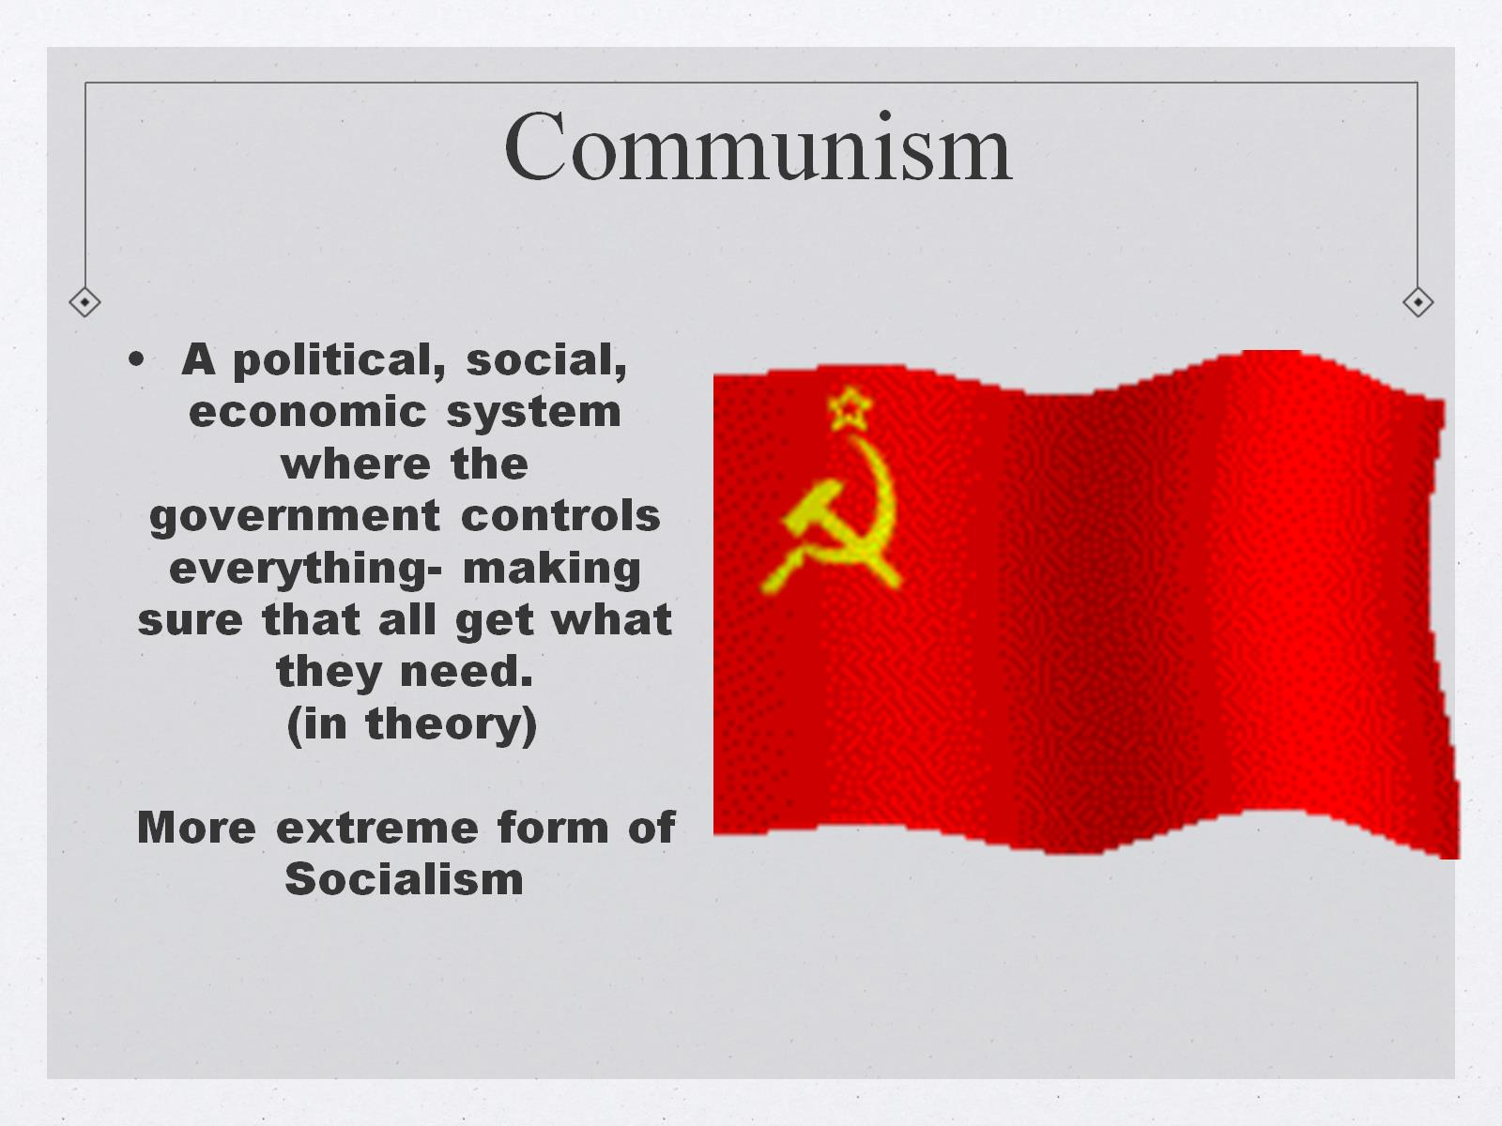
A political, social, economic system where the government controls everything- making sure that all get what they need. (in theory) More extreme form of Socialism

Slide 6
Joseph Stalin – the brief version (1879-1953)

Slide 9
Collectivization

Slide 11
Purges

Slide 13
Benito Mussolini

Slide 14
A New Roman Emperor?

Slide 16
Fascism – Italy under Mussolini

Slide 17
Italy

Slide 20
Adolf Hitler

Slide 21
Nazism

Slide 23
ADOLF HITLER

Slide 24
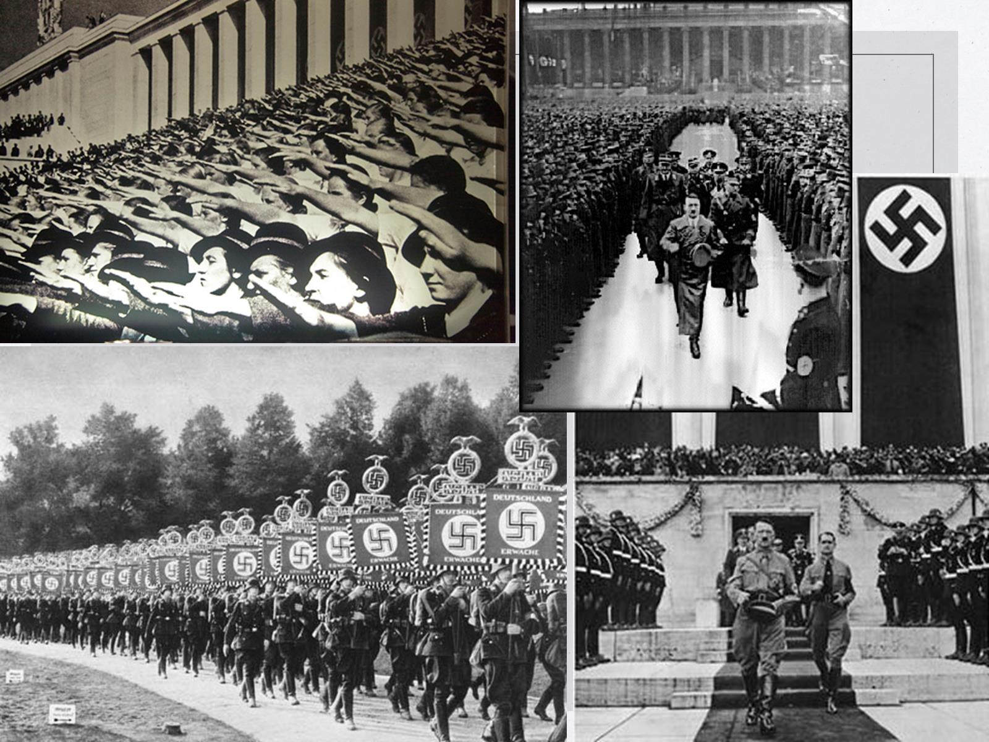

Slide 26
WWI and the Treaty of Versailles

Slide 27
Hideki Tojo

Slide 28
Imperial Japan

Slide 30
Francisco Franco

Slide 34
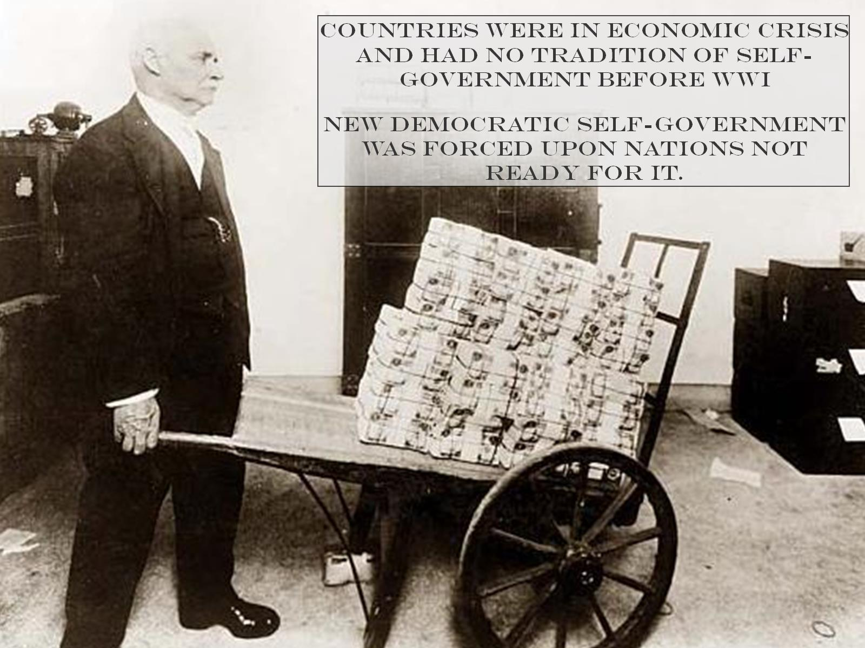

Slide 36
