Slide 1
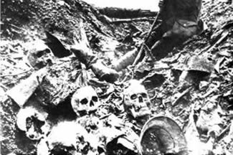
Trench Warfare

Slide 2
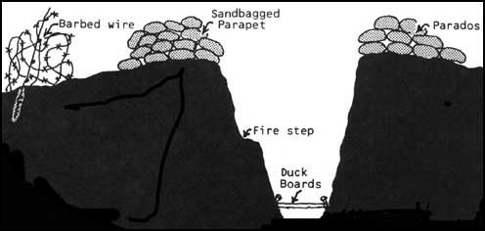

Slide 3
Rough Life In Trenches

Slide 4
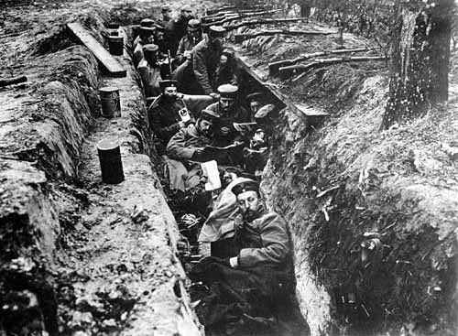
German soldiers in their trenches near Antwerp (September 1914)
#25

Slide 5
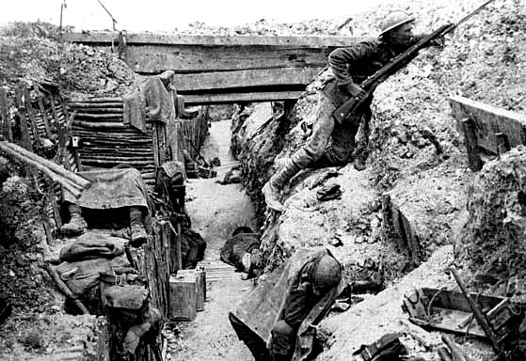
A British trench - the soldier on the right is on guard - the others are resting.
#26

Slide 6
Rough Life In Trenches

Slide 7
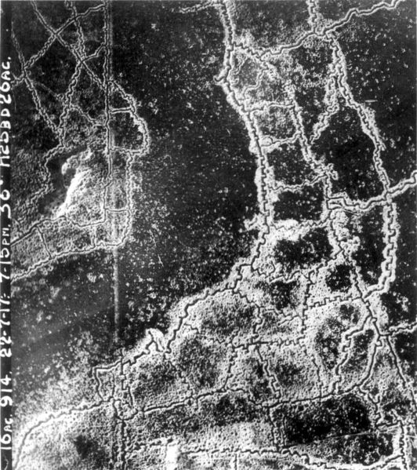
Trenches Get Elaborate

Slide 8
Trenches Get Elaborate

Slide 9
Trench Warfare

Slide 10
Trench Warfare Suicide Runs, Trench Foot, & Rats

Slide 11
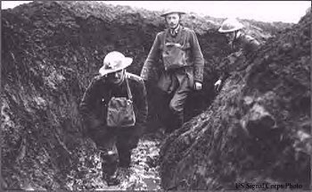
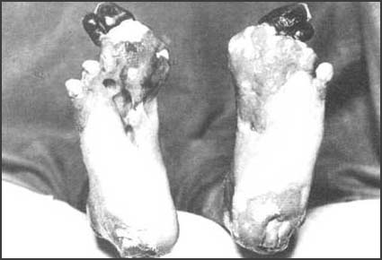
(2) Sergeant Harry Roberts, Lancashire Fusiliers, interviewed after the war. If you have never had trench feet described to you. I will tell you. Your feet swell to two or three times their normal size and go completely dead. You could stick a bayonet into them and not feel a thing.
If you are fortunate enough not to lose your feet and the swelling begins to go down. It is then that the intolerable, indescribable agony begins. I have heard men cry and even scream with the pain and many had to have their feet and legs amputated.

Slide 12
“Life in the trenches was hell on earth. Lice, rats, trench foot, trench mouth, where the gums rot and you lose your teeth. And of course dead bodies everywhere.
Rats. There are millions!! Some are huge fellows, nearly as big as cats. Several of our men were awakened to find a rat snuggling down under the blanket alongside them!”

Slide 13
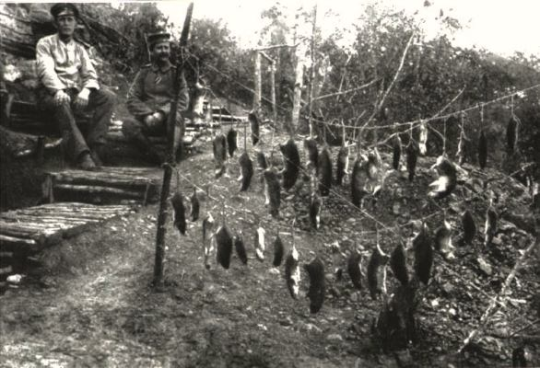
German soldiers after rat hunting in their trenches
#32

Slide 14
“In training the food was just about eatable but in France we were starving. All we lived on was tea and dog biscuits. If we got meat once a week we were lucky, but imagine trying to eat standing in a trench full of water with the smell of dead bodies nearby.”

Slide 15
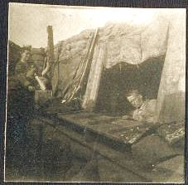
Nap Time?

Slide 16
New Weapons

Slide 17
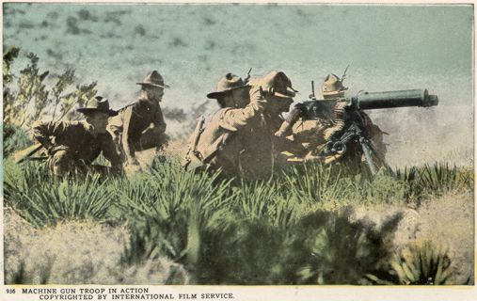
New Weapons

Slide 18
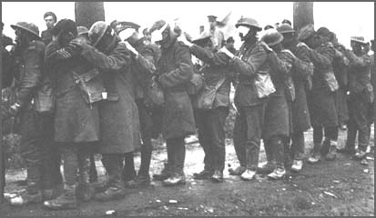
Blinded by Mustard Gas
#53

Slide 19
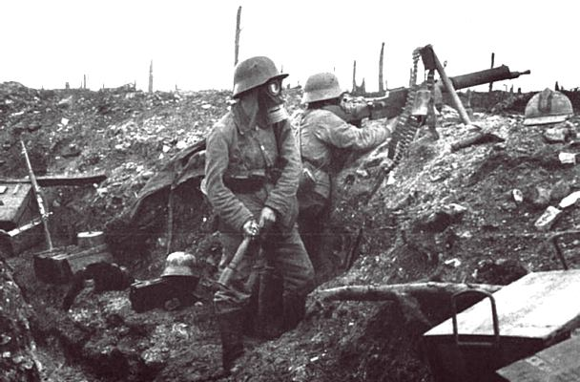
German machine-gun section with gasmasks (Verdun, 1916)
#34

Slide 20
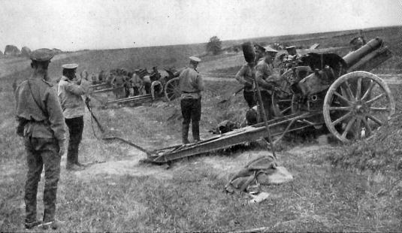
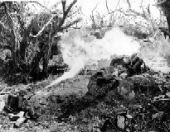
New Weapons

Slide 21
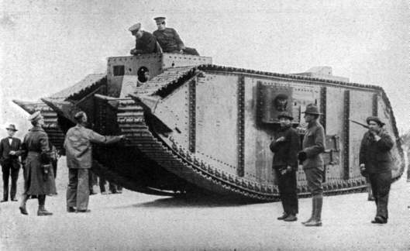
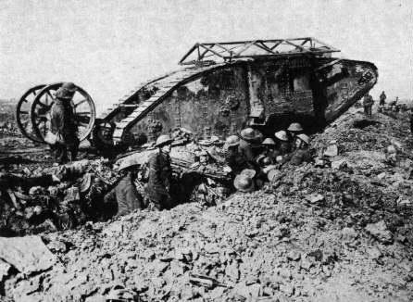
Early Tanks – How are they different from modern tanks?

Slide 22
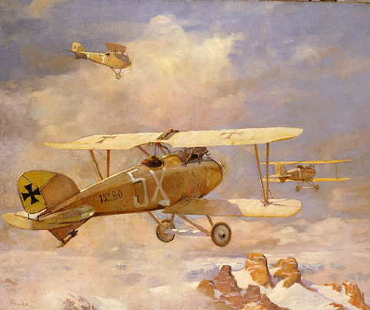
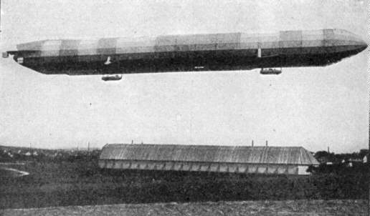
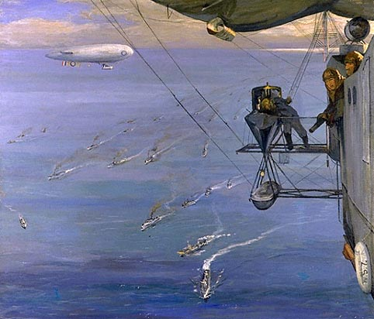
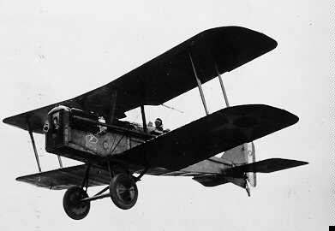
A “Led” Zeppelin ☺

Slide 23
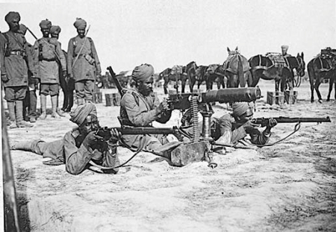

Slide 24
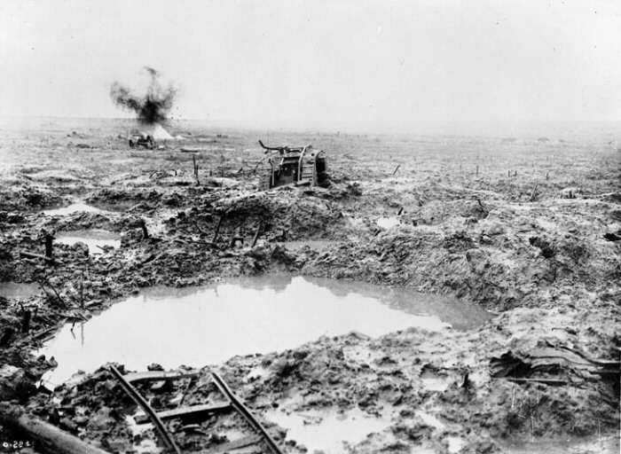
The Battlefield of Pashendale

Slide 25
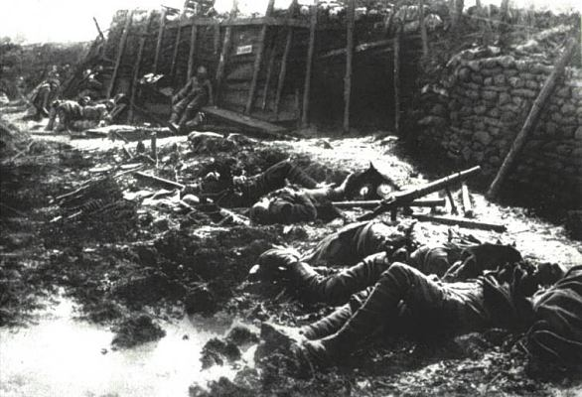
Dead bodies in a trench after an attack
#27

Slide 26
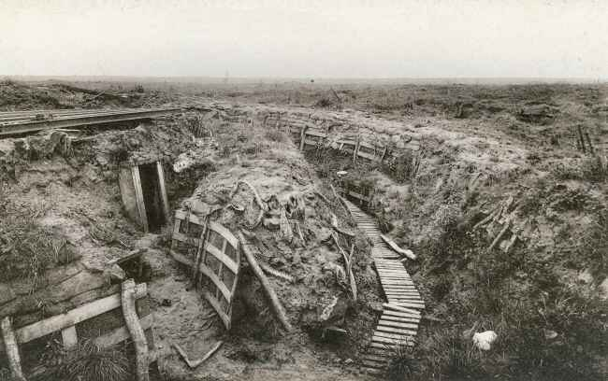
The Results of
Years of War

Slide 27
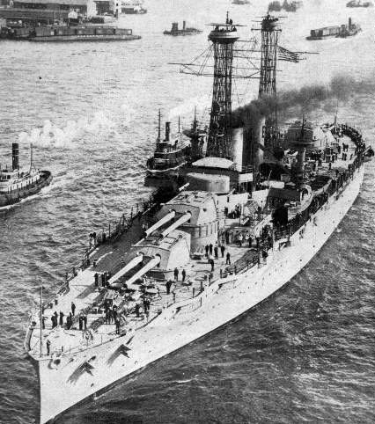
The War at Sea – Naval Tech
Battleships

Slide 28
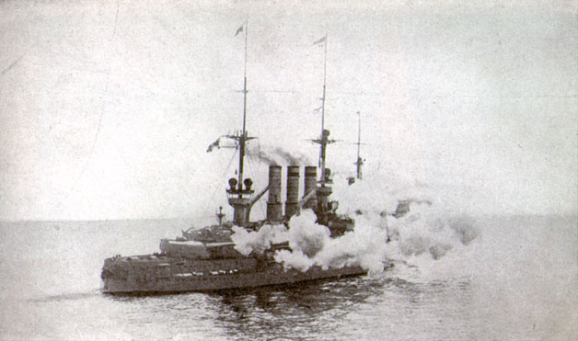
At the Battle of Jutland – the largest Naval Battle of WWI

Slide 29
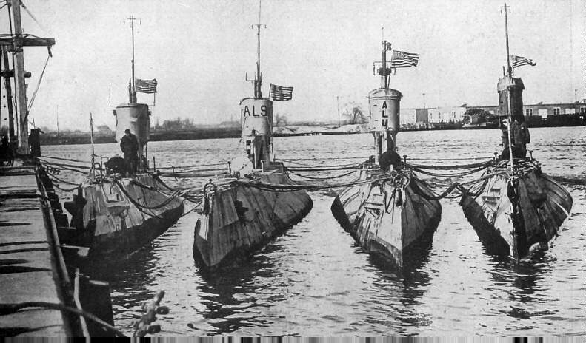
Submarines (U-Boats)

Slide 30
What’s a poor soldier to do?
How can you protect yourself against all of this new weaponry?

Slide 31
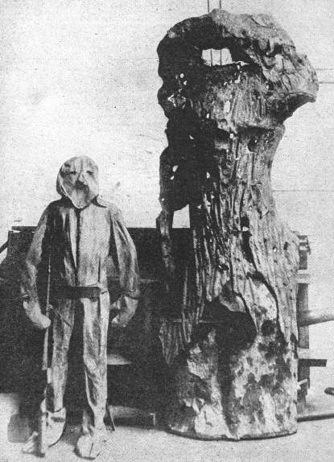
Camouflage
HIDE!

Slide 32
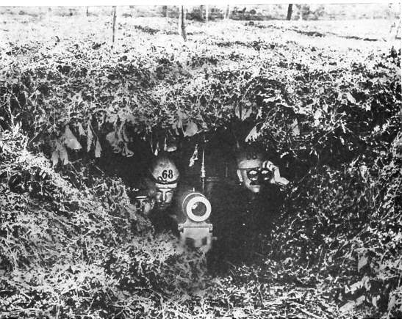

Slide 33
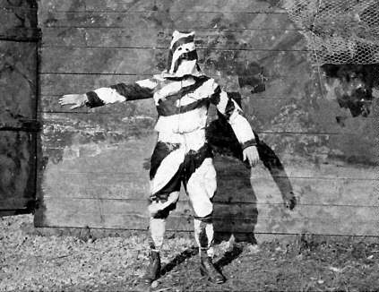

Slide 34
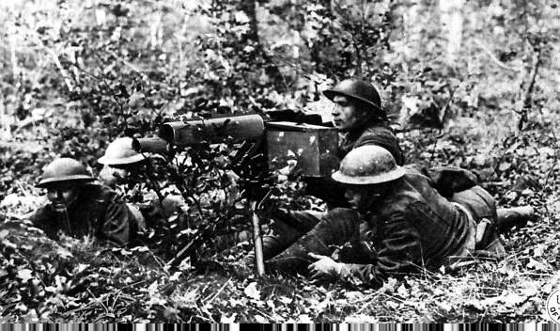

Slide 35
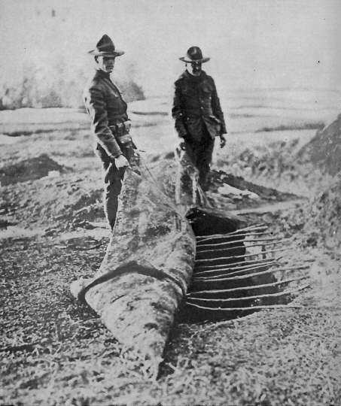

Slide 36
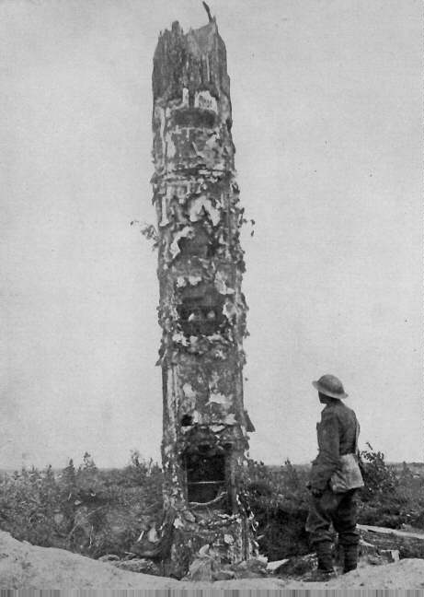

Slide 37
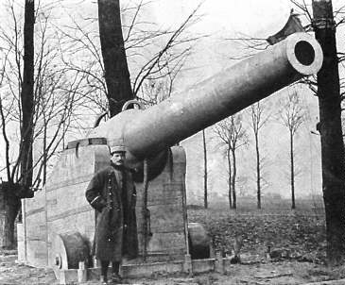
What’s wrong with this picture?

Slide 38
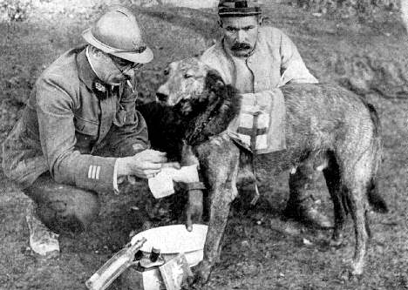
“Cry Havoc! And let slip the dogs of war!”
William Shakespeare
Animals
Are
Soldiers
Too!

Slide 39
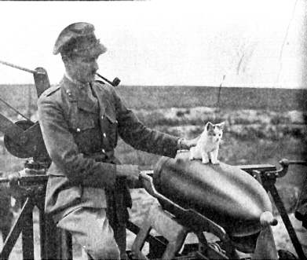

Slide 40
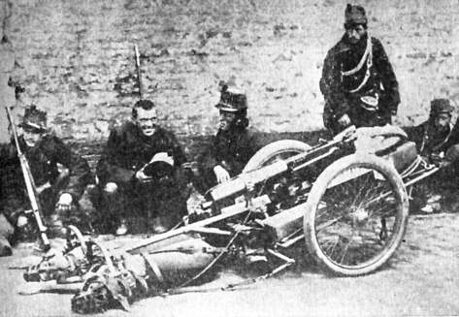

Slide 41
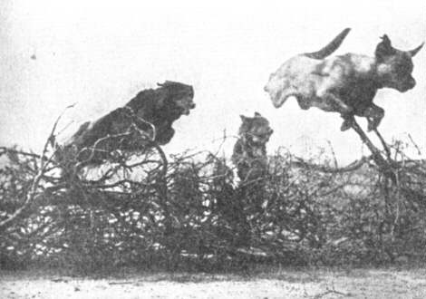

Slide 42
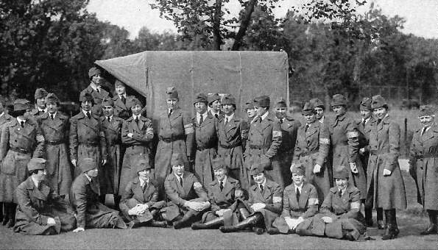
Women in the Army – The Army Nursing Corps.

Slide 43
1917-Russia Drops Out of War
Massive Russian losses discourage people of Russia
Communists blame Czar
People rise up against Czar
Civil war breaks out in Russia (Russian Revolution)
Lenin, Trotsky
Russia signs peace treaty w/ Germany
Treaty of Brest Litovsk

Slide 44
The U.S. Gets involved
German U-boat sinks British passenger ship Lusitania
150 Americans on board die
Germany sends The Zimmerman Note
Asks Mexico to help if US gets into war
US intercepts message
US declares war on Germany

Slide 45
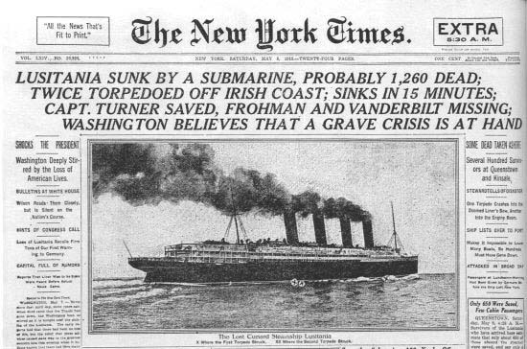

Slide 46
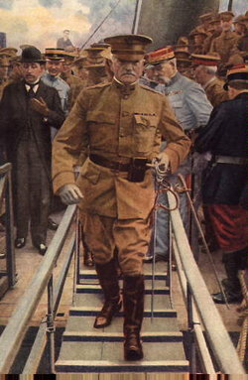
The Yanks Are Coming..
US unprepared for war
Army about the size of Italy’s army
Quickly expands Army
Massive force of fresh troops pour into Europe to help French and Brits
Poorly trained but enthusiastic
Enough to tip the scales in allies favor
Gen. John “Blackjack” Pershing

Slide 47
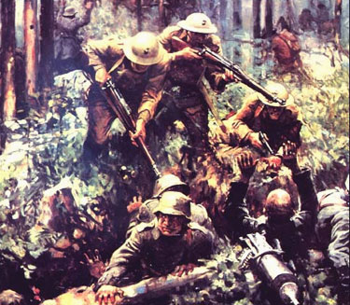
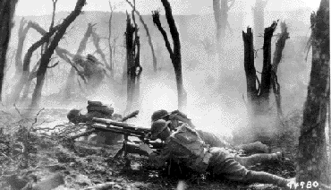
“Retreat hell, we just got here!”
American Battles
Belleau Wood
Argonne Forest
Chateau Thierry

Slide 48
How to Encourage People to Fight the War
Propaganda!

Slide 49
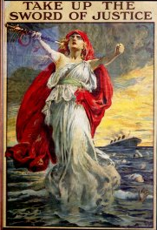
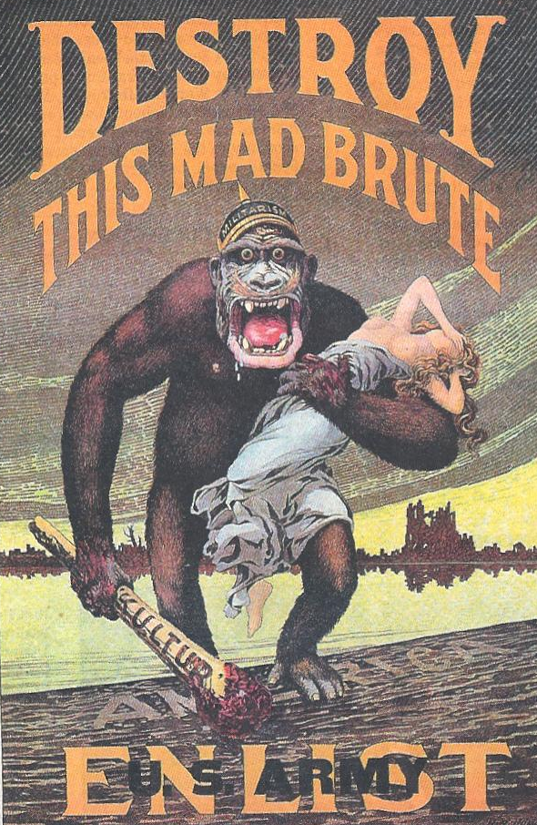
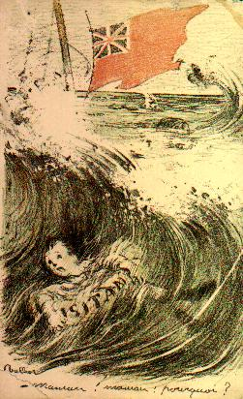
Propaganda
Each side tried to make the other look evil, and encourage people to fight

Slide 50
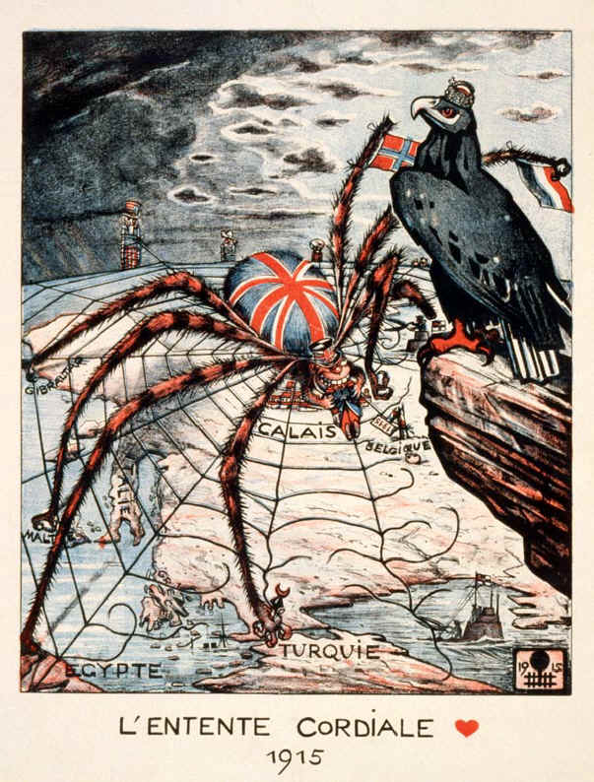
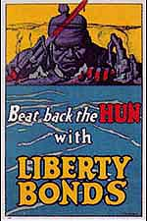

Slide 51
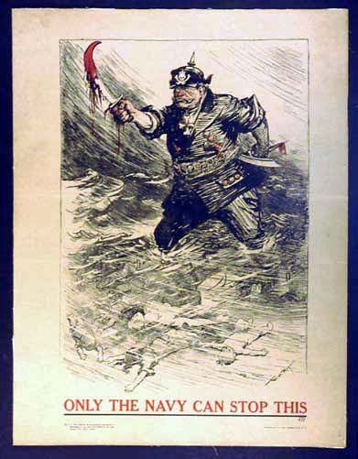

Slide 52
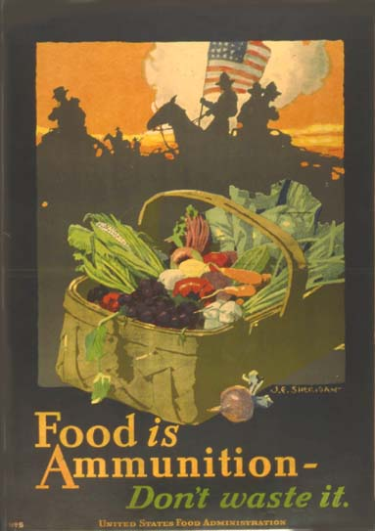

Slide 55
Artwork of WWI

Slide 56
Art
What point is the artist trying to get across?

Slide 61
Figure 31.1: Approximate Comparative Losses in World War I

