Slide 1
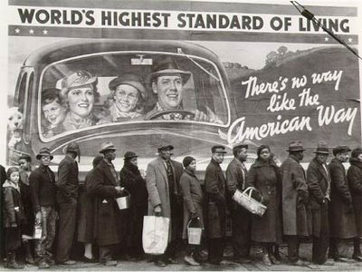
Worldwide Depression Mini Q
Question:
How did the world-wide depression impact Europe in the years between WWI and WWII

Slide 2
Background Info
Video: videos.howstuffworks.com/hsw/13433-american-history-causes-of-the-great-depression-video.htm
The Great Depression was not caused when the market crashed but they were related. Both were caused by the problems building up in 1920s. The 1920s were a period before the Depression and after WWI, when the stock market and economy boomed. The National Income jumped 40% to 87 billion. Credit also became popular. People were told to buy now and pay later.
During the Roaring 20s there was a farm depression. Farmers produced more food for WWI, but when the war ended there was less need for the goods. Prices of farm products fell 40%. The farm depression led up to the Great Depression. When the farmers went broke, they could not pay their mortgages. They had to rent farms and move. Banks also started to go bankrupt during the 1920s. The banks went broke because the farmers were not doing well. About 550 banks went broke in a year because of the farm failures. Another reason for the Depression was that not all people got richer during the Roaring 20s. The rich just got richer and the poor just kept getting poorer. The businesses were doing well. So, the rich people who owned them got wealthier. The workers pay didn't increase much. They did not have enough money for all the goods they wanted. So, they bought on credit. Soon their people bought less because they were in debt. With less and less people spending money, businesses went broke.
European nations had borrowed heavily from the USA to fight the Great War. Many ended the war with astronomical amounts of debt, including Great Britain (154% of GDP), France (258% of GDP) and Italy (153% of GDP). There were strict demands for austerity measures, Flat refusals to accept losses on certain debts, and constant infighting over bailout plan after bailout plan. Deadlines were missed; new plans proposed; the populous rose up in arms; and the whole process started over again. This serial restructuring saga continued throughout Europe for the entire interwar period. Without the realistic ability to pay its enormous war debt, Germany spent the next 14 years on a path of multiple restructurings, occasionally paying installments (often in coal and timber) but more often defaulting on its financial obligations. Other European countries, particularly war-ravaged France, demanded full payment from the fledgling Weimar Republic. Initially, with its economy decimated by war and austerity measures, Germany responded by printing more and more money. In a startling surprise, the world was aghast as it watched Germany slip into hyperinflation where, at its height, one U.S. dollar was worth 4 trillion German marks.

Slide 3
Background Questions
What was the period after WWI called (the 1920’s)?
What does buying on credit mean?
What was the cause of the farm depression in the 1920’s? Why is this important?
What group of people prospered most in the 1920’s? Who suffered? Why?
Credit became a BIG problem in the late 1920’s. Why was buying on credit a problem and what effect did it have on businesses?
How did the European nations pay to fight WWI?
Many countries owed large amounts of debt, much higher than their GDP. Why would this become a problem for countries like Britain and France?
Germany faced many problems after WWI largely due to the Treaty of Versailles, How did the German Government (Weimar Republic) handle it’s debts to the U.S. and other nations?
How low did the German Marks value ultimately fall during the interwar years?

Slide 4
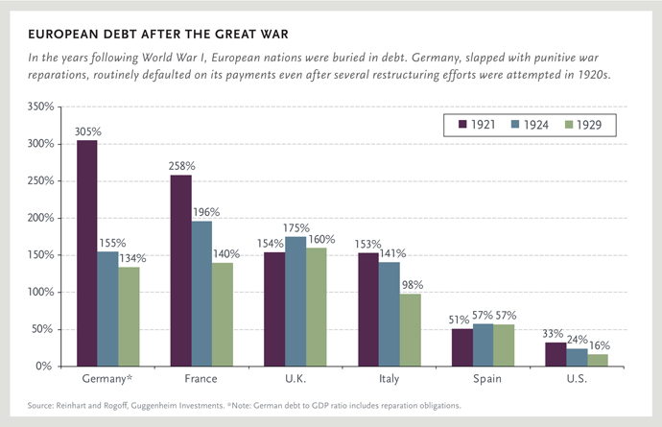
European Debt
What is the source of this chart?
This chart shows us debt to GDP ratio. Which country has the highest debt to GDP?
Examine the countries involved in WWI. What do they all have in common except for the USA?
The USA was the only modern country after WWI with a stable economy, therefore becoming the lender to the European nations. Given the debt to GDP of most countries in Europe, how could this ultimately hurt the United States of America?

Slide 5
Unemployment Rates
Which continent does this map show?
What is the title of this map?
What year seemed to show the largest increase In unemployment?
According to this map which country(s) showed the largest decline in production?
Overall who seemed hardest hit by the depression and why?

Slide 6
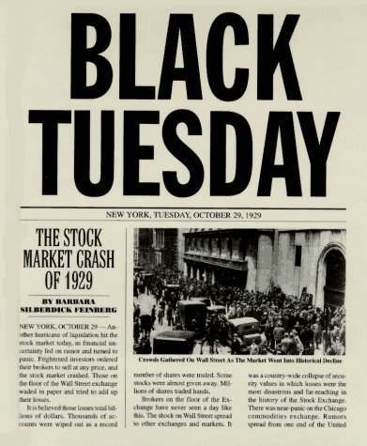
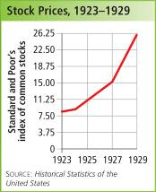
Stock Market Crash
What information does the chart below provide?
What is the source of the graph?
Explain what happened to stock prices from 1923-1929?
In 1929 something unimaginable happened, the collapse of the New York Stock exchange. What is this day forever known as?
What was the date of the stock market crash?

Slide 7
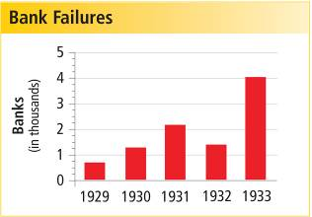
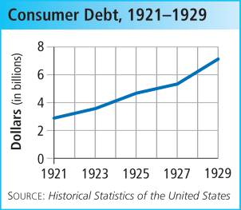
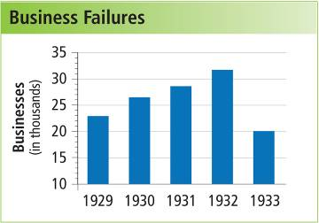
USA Debt Crisis
What information can we gain from each chart?
By looking at the consumer debt chart what can we say about debt form 1921-1929?
What is a consumer?
In what year did bank failures reach an all-time high?
What was happening to businesses after 1929? Why do you think it decreases in 1933?
The debt crisis comes to a head in 1929 with the stock market crash. Do you believe the debt crisis is linked to bank and business failures,? Explain.

Slide 8
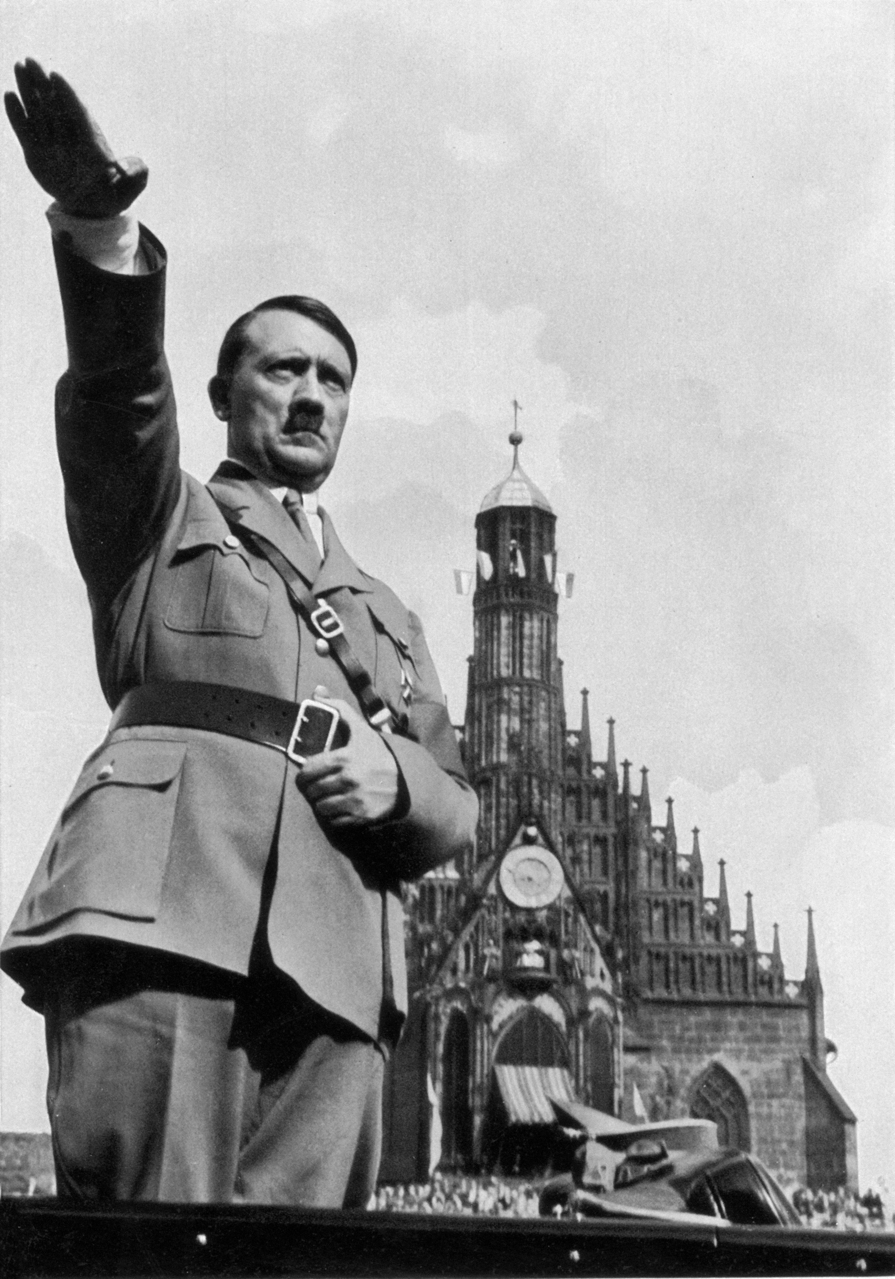
Depression in Germany
https://www.youtube.com/watch?v=EWFNiQkvg1k
In the video, how did life seem for Germans after WWI?
How were the German people feeling in the depression times? Why?
The German people believed the only way to recover was for something to change. What change did many felt were needed?
Describe the man pictured on this page, name him if you can.
Why did people look to this man as a leader?
What type of governmental change takes place in Germany under this man? Do you think it made things better for the country of Germany? Why

Slide 9
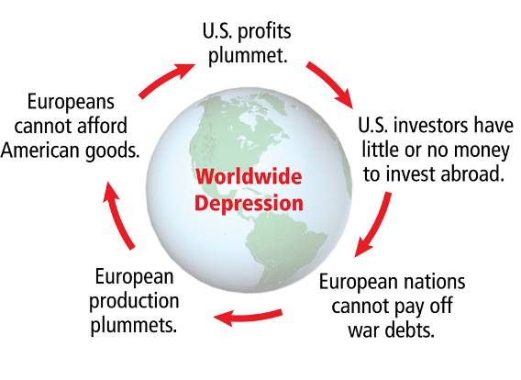
Worldwide Depression
What is the title of the flow chart?
The flow chart shows us the continual circle of the worldwide depression. If you were to choose one of the subheadings as a starting point which would it be and why?
Analyze the flow chart, how does production in Europe effect the USA?
European countries were unable to pay their war debts. How does this ultimately hurt the European nations form rebuilding?
From looking at the flow chart and all the other knowledge gained do you believe the USA and the stock market crash caused the depression? Why or why not.

Slide 10
Worldwide Depression
What are some causes from the left that were not included in this mini Q?
What us a tariff?
How could higher tariffs help to cause a depression?
In your groups discuss financial panic and what it means. Describe what you believe Americans were thinking when the market crashed and banks closed.
Herbert Hoover was elected President of the USA n 1928. How could his election be considered a cause of the Great Depression in America?

Slide 11
Task
IN your groups use what you learned to prevent the Great Depression. The year is 1931, You are in the depression. GET US OUT OF THIS MESS!

