Slide 1
The Road to World War II
Rise of Dictators

Slide 2
Causes of World War II
Germany blamed for causing World War I
Economy destroyed after WWI
Discrimination of ethnic groups, especially Jewish and Polish.
The rise of dictators as a result of WWI

Slide 3
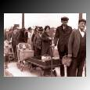
Trouble in Europe
The Great Depression is worldwide - but especially hard in Germany (due to the Treaty of Versailles - remember how brutal it was to the Germans?)

Slide 4
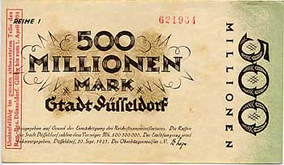
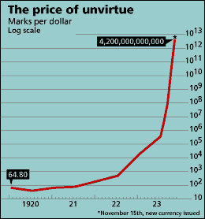
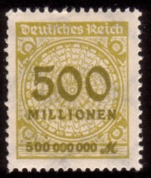
Hyperinflation strikes Germany
“By November 5th, 1923 a loaf of bread cost 140 billion marks. Workers were paid twice a day, and given half-hour breaks to rush to the shops with their satchels, suitcases or wheelbarrow, to buy something, anything, before their paper money halved in value yet again. By mid-November, when a new currency was issued, prices had added twelve zeros since the first world war began in 1914.”
The Economist

Slide 5
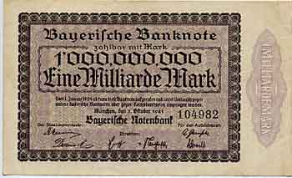
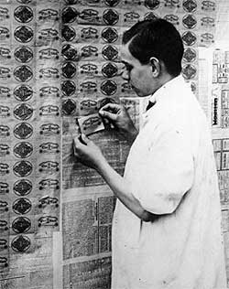
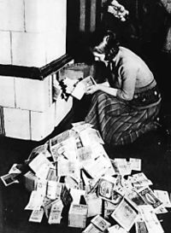
By the end of 1923 the German currency was of no value at all. The quarterly rate of inflation stood at 52,000%
Using money to wallpaper
the house
Using money to heat the house

Slide 6
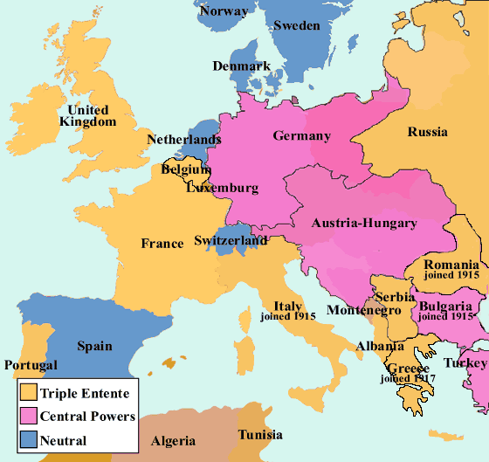
Europe
Before World War I

Slide 7
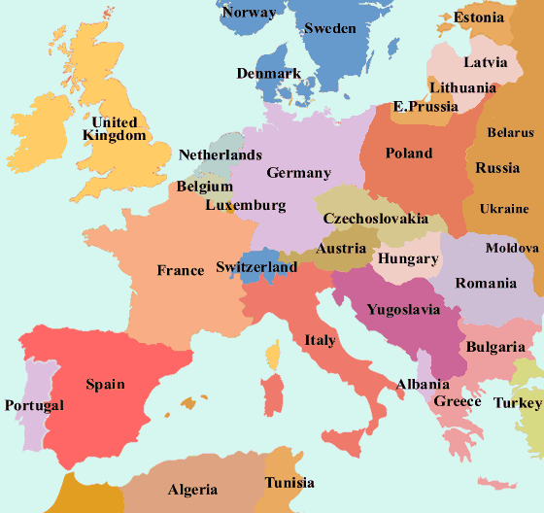
Europe
after
World
War 1

Slide 8
The Rise of Dictators
Soviet Union (USSR): Joseph Stalin
SPAIN: Francisco Franco
ITALY: Benito Mussolini
JAPAN: Emperor Hirohito
GERMANY: Adolf Hitler

Slide 9
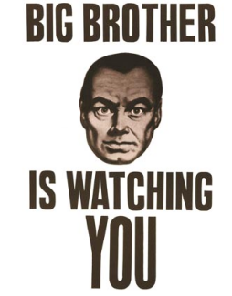
Rise of Totalitarianism
A system in which the state and its leader have nearly TOTAL control.
Individual rights are not viewed as important as the needs of the nation.
No right to vote
No free speech
Government controlled economy
Often a police state

Slide 10
Totalitarianism
USSR:
Communist
Dictatorship
Germany & Italy:
Fascist
Dictatorship
Japan:
Military
Dictatorship

Slide 11
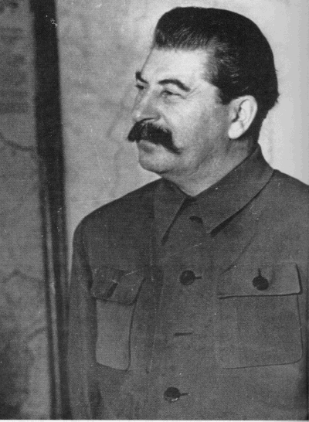
Josef Stalin
"Man of Steel"

Slide 12
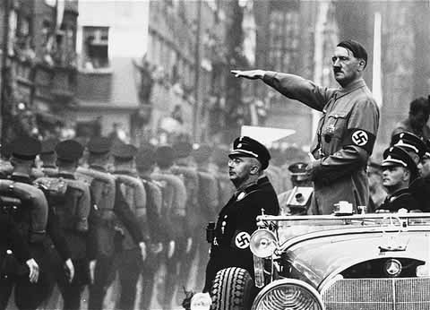
Adolf Hitler
“Fuhrer”

Slide 13
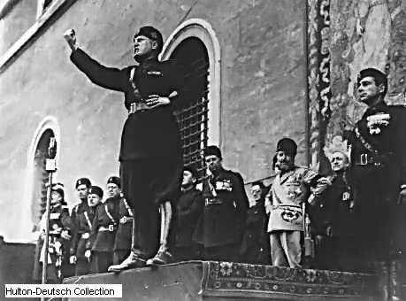
Benito Mussolini
"IL Duce"

Slide 14
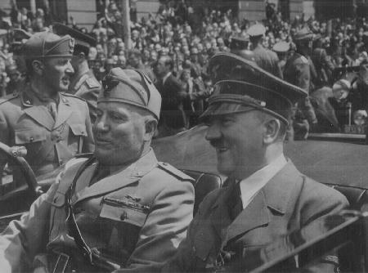
Mussolini and Hitler

Slide 15
Three Governments
Soviet Union – Communism
Italy - Fascism
Germany – Nazism

Slide 16
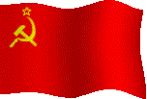
A political, social, economic system where the government controls everything- making sure that all get what they need. (in theory) More extreme form of Socialism
Communism

Slide 17
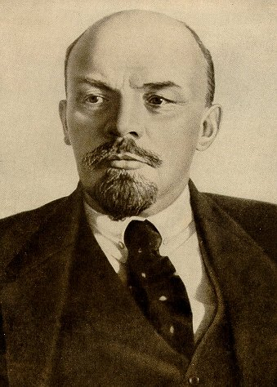
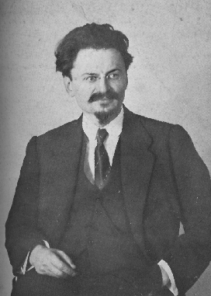
Lenin – father of the Soviet Union
Stalin – the over thrower
Trotsky-
Lenin's handpicked successor

Slide 18
JOSEPH STALIN
Totalitarian Regime in USSR.
Awaited world-wide Communist revolution.
Great Purge of the 1930s to clear out enemies from country
1939 – Signed nonaggression pact with Germany. (Divide Poland)
Germany broke the pact, opening up the Eastern Front of the War.

Slide 19
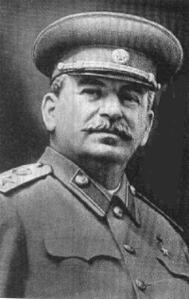
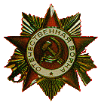
Joseph Stalin – the brief version (1879-1953)
1924 Lenin died
Lenin wanted Trotsky to take over
Stalin took over instead.
Bullied / threatened / murdered his way into power.
Killed those loyal to Trotsky
Eventually has Trotsky himself killed. (Mexico 1940)
Stalin launched a massive program for industrialization (railroads, steel mills, military hardware), despite what it would require in human suffering.
Five-Year Plan to “catch and overtake” the leading capitalist countries.

Slide 20
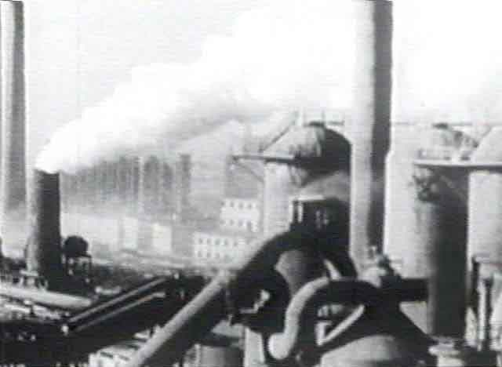
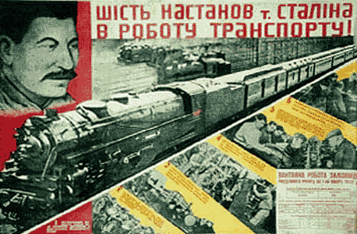
Stalin’s Five Year Plans
Concentrate on Heavy Industry

Slide 21
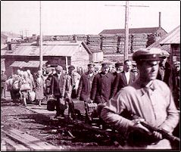
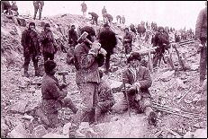
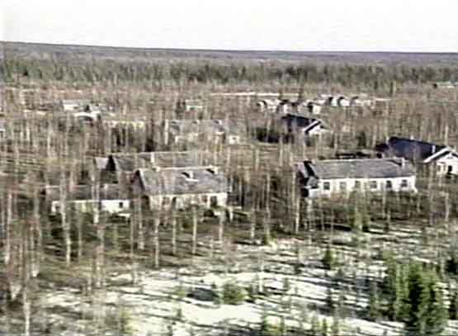
Workers laboring in the GULAG work camp system

Slide 22
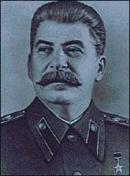
Stalin – the brief version
Stalin was a paranoid who oppressed and often killed anyone who was perceived as a threat to his power.
He purged (killed off) most of the best officers and politicians out of his army and government.
By the late 1930s, the USSR was weak from the removal of its best and brightest – but at least Stalin felt secure

Slide 23
Collectivization of farms
Individual farms (Kulaks)
Each has own farmhouse
Tractor
Equipment etc
Farmers make $ based on how productive they are. The more productive, the more $ they make.

Slide 24
Workers live in communal village, in govt housing projects
Collective farm – state (government) owned, all equipment and
Housing, pooled together. Everyone gets paid the same wages.
All profits go to government, which then pays the workers.
No incentive, no ownership of land

Slide 25
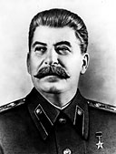
Collectivization
He also started a revolution in Soviet agriculture forcing peasants to participate in collectivization.
This meant the pooling of farmlands, animals, and equipment for the sake of more efficient, and state-run, large-scale production.
Knowing that the well-to-do peasants (kulaks) would not accept this, Stalin decided to “liquidate them as a class.”
Millions were killed outright or sent to forced-labor camps to suffer a slow death.

Slide 26
Purges
Many of the remaining peasants refused to go along, killing their herds and intentionally sabotaging their crops.
From 1931 to 1933, millions starved to death.
By 1935, practically all farming was collectivized.
To wipe out any remaining resistance, Stalin unleashed terror to crush opposition through a series of purges.
750,000 were executed between 1936 and 1938.
Those who were not executed were sent to forced labor camps, collectively known as the Gulag.
In the 1920s and 1930s, between 10 and 20 million people died as a result of Stalin’s policies.

Slide 27
Why didn’t anyone stop him?
It seems most Soviet people accepted this as a necessary response to the Soviet Union’s internal and external problems and as a method for creating a new world.
Violent crusade of building socialism in a hostile world.
Or maybe they were simply too beat down to care
Or maybe they feared for themselves
Or maybe, it was a case of “its not my problem” (reread “First they came for the Jews”)

Slide 28
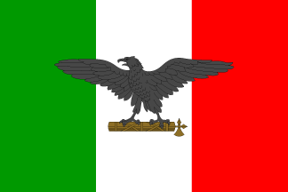
Fascism – Italy under Mussolini
Fascism - Glorification of the all powerful state at the expense of the individual

Slide 29
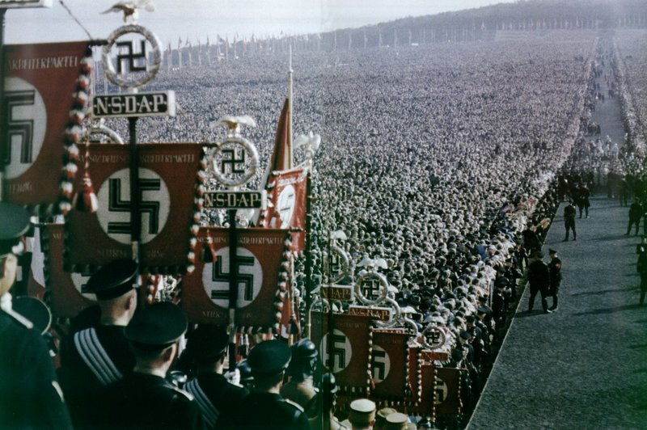
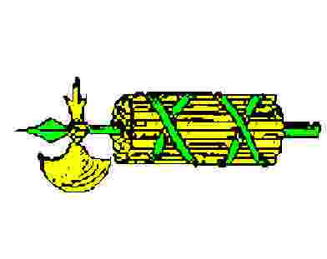
What is Fascism?
Political belief that says the individual is less important than the nation.
Glorifies violence, believes it is needed to “prove” strength of a people.
Uses nationalism and racism.
Dictatorships.
Italy and then Germany became fascist.
Hate Democracies, Communists, and Socialists

Slide 30
BENITO MUSSOLINI
Led fascist movement in Italy
Black-shirt army
Totalitarian State under his rule
AKA - Il Duce- The Chief
Anti-communist
Private property with strong government control

Slide 31
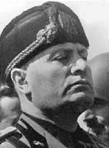
Italy
After World War I, the Italian monarchy was torn by rising threats from the Communist left and the Fascist right.
Former army officer Benito Mussolini founded the Italian Fascist party in 1920.

Slide 32
A New Roman Emperor?
or idiotic buffoon?
The slogan was "Mussolini, the man who made the Trains Run on Time."
It was simple, if the train was late... the engineer was arrested or tortured, along with the conductor and ticket clerk etc.
Or, they just changed the time the train was supposed to arrive – to coincide with when it ACTUALLY showed up. Simple

Slide 33
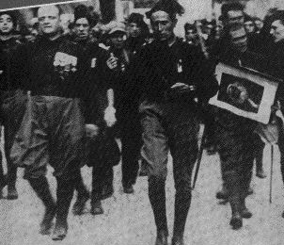
Italy
In 1922, Mussolini
March on Rome
thousands of his “Black Shirt” Fascist supporters captured the Italian capital to stop a fictitious Communist plot to overthrow the government.
Fearing the Communists, the king named Mussolini as Prime Minister.

Slide 34
ADOLF HITLER
Brought prominence to the National Socialist German Workers Party (NAZI Party)
Head of the 3rd Reich
Believed in Master Race – Aryan Race
Unite all German-speaking people
1933 took power
Anti-communist
Private property with strong governmental control
Das Fuhrer

Slide 35
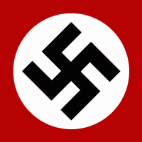
Nazism
Nazism (National Socialism) a political ideology promoting Germanic racial superiority . Held that the German nation and the purported "Aryan" race were superior to other races.

Slide 36
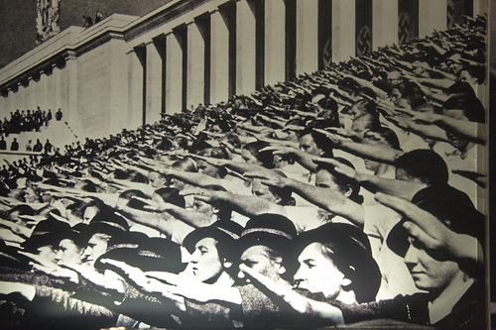
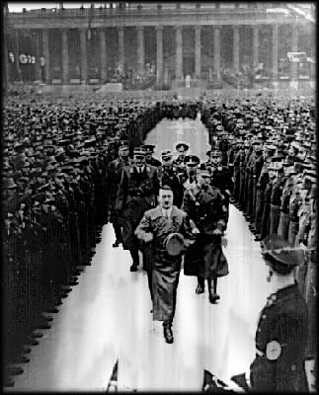
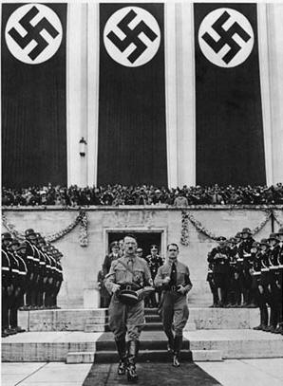
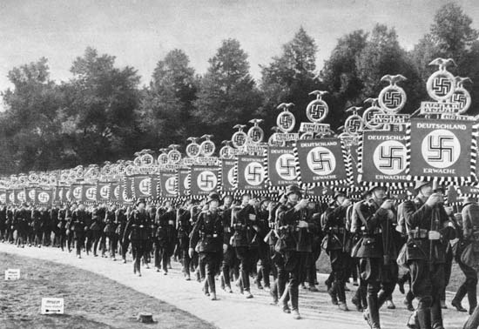

Slide 37
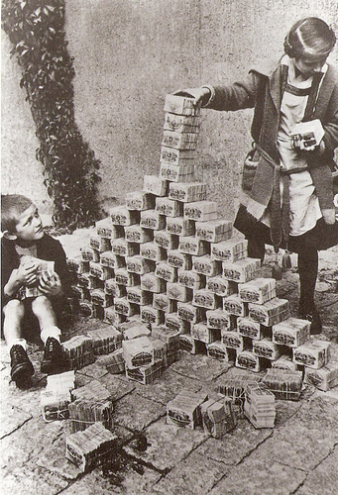
WWI and the Treaty of Versailles
Germany lost land to surrounding nations
War reparations
Allies collect $ to pay back war debts to US
Germany pays $57 trillion (modern day equivalent)
Germans are bankrupt, embarrassed, guilt ridden, and angry.
Desperate people turn to desperate leaders

Slide 38
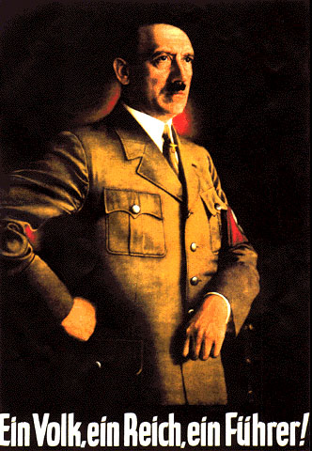
In Germany
Adolf Hitler comes to power in Germany by preaching socialism, nationalism, and militarism.
Hitler blamed the other European countries, and the minorities living in Germany for the poor German economy
Hitler’s party soon gained enough support so they could name him to office
“One people, one empire, one leader!”

Slide 39
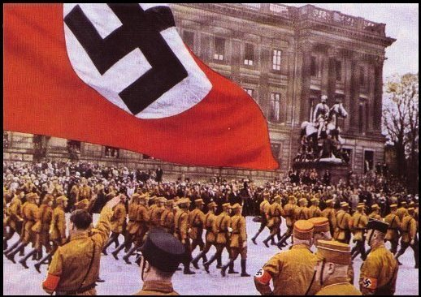
In Germany
Hitler began violating the Treaty of Versailles
building up his military (militarism)
Stopped paying war debts to the allies

Slide 40
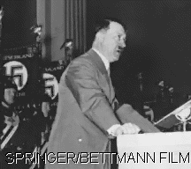
In Germany
Hitler also began getting his country ready for war.
Began drafting men into the army
Made very nationalistic speeches (very pro-German and anti-Semitic, anti-anything other than German)

Slide 41
Hitler Highlights
Nuremberg Laws: stripped German Jews of all of civil rights (rights to own property, vote, protection under the law, etc.)
Kristalnacht: Hitler orders a night of violence against Jews. 1000s of businesses and homes attacked on this Night of Broken Glass
Night of the Long Knives: On this night, Hitler removed his political enemies including Communists, remaining democratic leaders and even one of his closest friends
( Ernst Rohm)

Slide 42
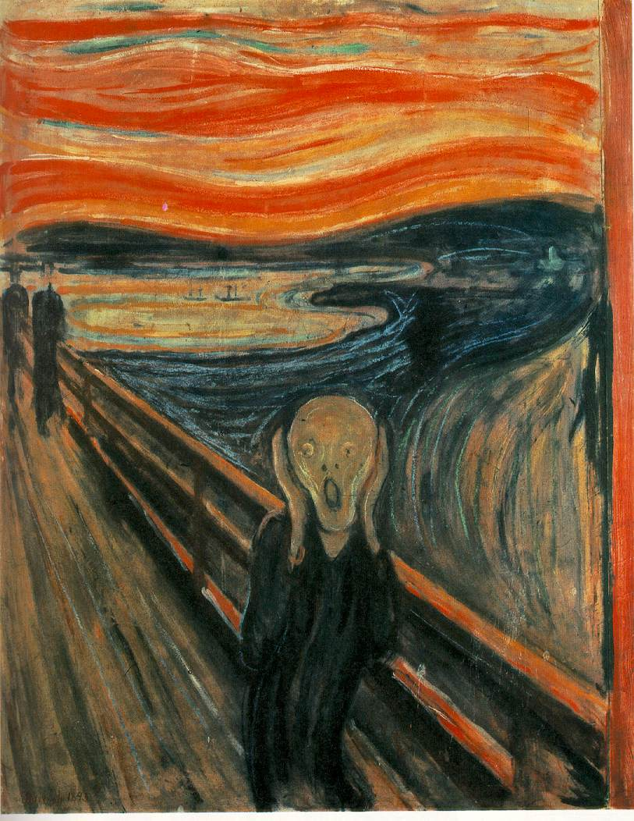
First They Came for the Jews
First they came for the Jews and I did not speak out because I was not a Jew. Then they came for the Communists and I did not speak out because I was not a Communist. Then they came for the trade unionists and I did not speak out because I was not a trade unionist. Then they came for me and there was no one left to speak out for me.
Pastor Martin Niemöller

Slide 43
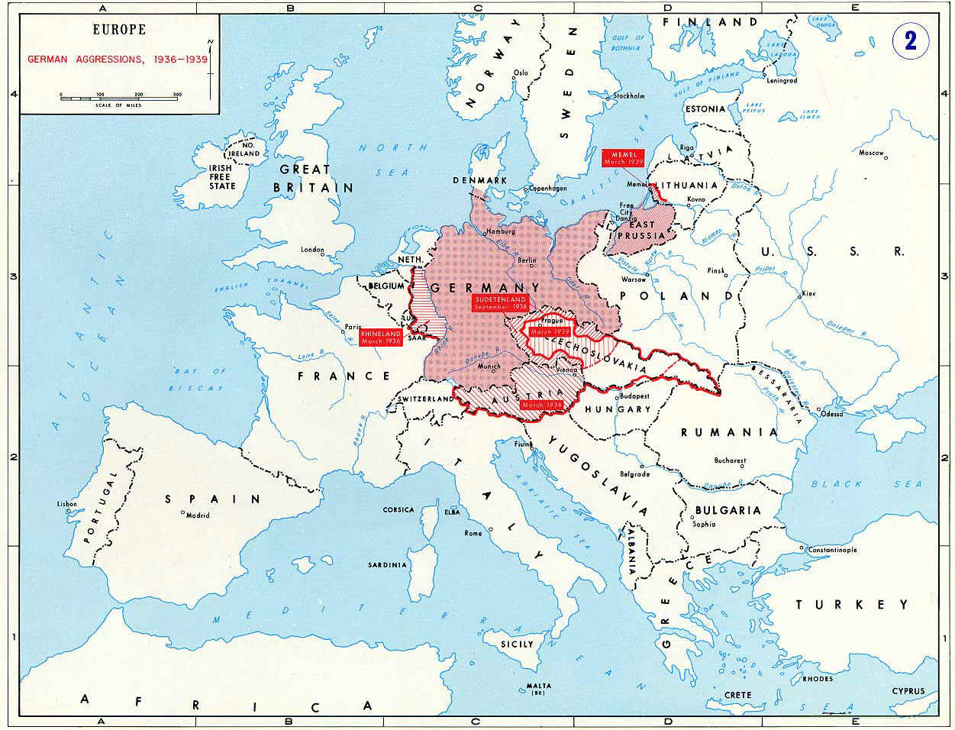

Slide 44
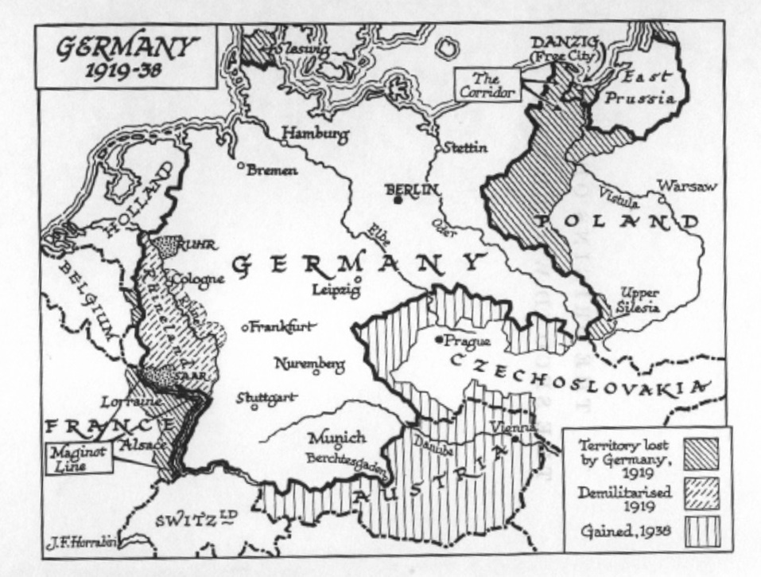

Slide 45
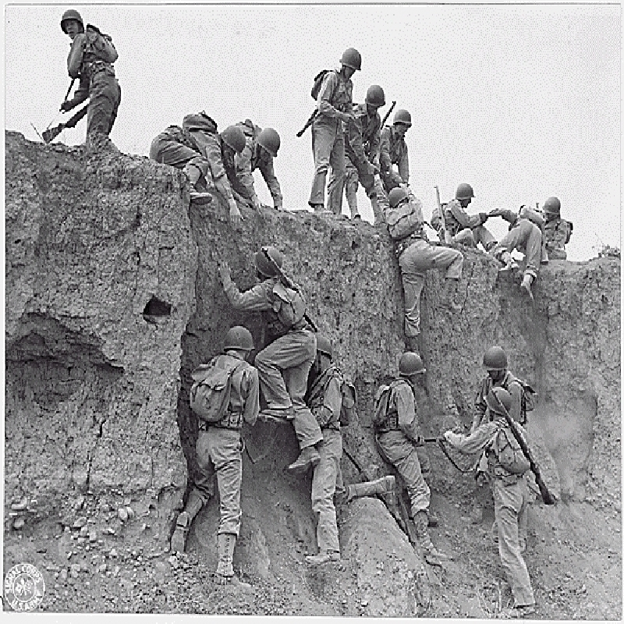
Causes
W WI and the Treaty of Versailles
Appeasement
Rise of Totalitarianism

Slide 46
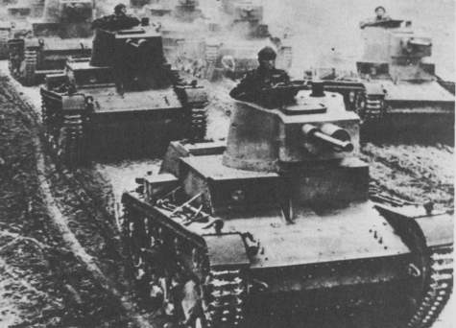
How did WWII start?
Germany invaded Poland.
Allies declare war on Germany.
Germany then invades France, Belgium, etc.
Then Hitler invades Russia.
Germans use “blitzkrieg” to overwhelm other armies.
Blitzkrieg means “lightening war” in German.
Surround with tanks and troops in trucks.

Slide 47
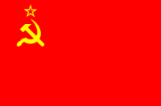
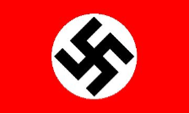
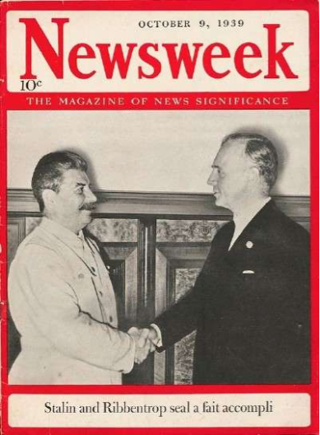
Non-aggression pact
Germany and Soviet Union sign in 1939.
Agree not to attack one another.
This shocked the world:
WHY? Fascists and communists work together.
Secret provision was the dividing of Poland.
However, Hitler knew he would eventually invade Soviet Union.

Slide 48
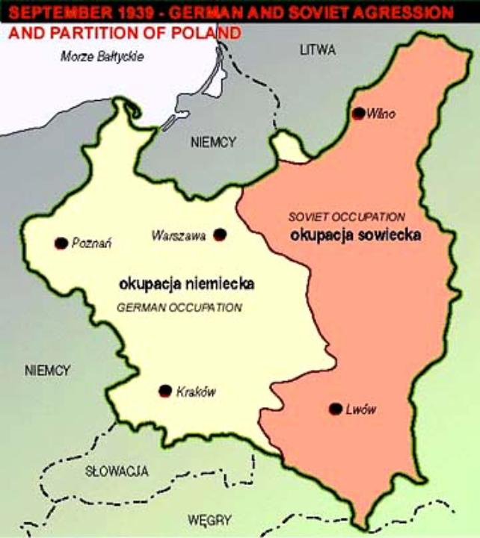
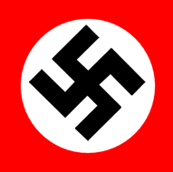

Slide 49
Who was on each side?
Axis Powers
Germany
Italy
Japan
Allied Powers
Great Britain
Soviet Union
United States
France
Surrendered to Germany in 1940 after 6 weeks

Slide 50
Major Events of World War II - American Involvement
Lend-Lease Program to aid Allies
Attack on Pearl Harbor – December 7, 1941- A Day that will live in infamy
US enters World War II
1942 – War turned in favor of the Allies
Victories in North Africa versus Germany
Victory in the Battle of the Midway in the Pacific

Slide 51
The Concept of Blitzkrieg
Airforce attacks enemy front-line and rear positions, main roads, airfields and communication centers. At the same time infantry attacks on the entire frontline (or at least at main places) and engages enemy.
This restrains the enemy from knowing where the main force will attack and makes it impossible to prepare any defenses.
Concentrated tank units breakthrough main lines of defense and advance deeper into enemy territory, while following mechanized units pursuit and engage defenders preventing them from establishing defensive positions.
Infantry continues to engage enemy to misinform and keep enemy forces from withdrawing and establishing effective defense.

Slide 52
Infantry and other support units attack enemy flanks in order to link up with other groups to complete the attack and eventually encircle the enemy and/or capture strategic position.
Mechanized groups spearhead deeper into the enemy territory outflanking the enemy positions and paralyzing the rear preventing withdrawing troops and defenders from establishing effective defensive positions.
Main force links up with other units encircling and cutting off and killing the enemy

Slide 54
How did WWII end in Europe?
Operation Overlord- Allied invasion of France. Also called D-Day.
Within a month 1 million Allied troops were stationed in Europe.
Germany is surrounded with the USSR to the east
Germany surrenders in 1945 after Hitler commits suicide.

Slide 55
D Day

Slide 58
How did WWII end in Europe?
V-E Day (Victory in Europe) May 8, 1945
Allies divide Germany up between them.
This helps start the Cold War.
Trials are held in Germany (and Japan) to try the people responsible for the war.
Many are executed and jailed for war crimes.

Slide 59
What was the Holocaust?
Nazi plan to kill all Jews.
Why? Hitler’s provided a to Germany’s problems
6 million Jews murdered in camps in Europe.
5 million others (gypsies, mentally ill, homosexuals)
Total of 11 million exterminated
What is genocide?
Purposely trying to exterminate an entire group of people (ethnic, religious, racial).

Slide 61
What about the Pacific War?
The US (mostly) fought the Japanese.
December 7, 1941 Japan bombed Pearl Harbor in Hawaii to sink US ships there.
Two hours = most US navy destroyed and 2,000 sailors killed
Japan surrenders after US drops atomic bombs on Hiroshima and Nagasaki.

Slide 62
HIDEKI TOJO
Militant Japanese general
Took control of Japan in 1941
Pushed for vast colonial empire stretching from China to Thailand
Organized attack on Pearl Harbor

Slide 65
Imperial Japan
Japanese military leaders had increased control in post WW I Japan.
Emperor Hirohito
General Hideki Tojo was Prime Minister.
Admiral Yamamoto planned the attack on Pearl Harbor.

Slide 67
Navajo Code Talkers
Served in the Marine Corps in WW II.
Used Navajo language to transmit messages.
The Navajo code talkers took part in every assault the U.S. Marines conducted in the Pacific from 1942 to 1945.
The Japanese never were able to break the code.

Slide 68
Kamikaze
Means “Divine Wind”
Suicide attacks by warplanes from the Empire of Japan against Allied naval vessels in the closing stages of the Pacific campaign.
First used at Battle of Leyte Gulf (Philippines)
A total of 57 ships were sunk by the Kamikazes.

Slide 69
Manhattan Project
Codename for a project conducted during WW II to develop the first atomic bomb.
The project's roots lay in fears that Nazi Germany was developing nuclear weapons of its own.
Eventually employed more than 130,000 people and cost nearly $2 billion.
It resulted in the creation of production and research sites that operated in secret.

Slide 70
Project Success
The Manhattan Project will eventually produce 3 bombs: The Gadget, Little Boy and Fat Man

Slide 71
Hiroshima
August 6, 1945.
B-29 Superfortres the Enola Gay drops 1st atomic bomb in history.
Codenamed Little Boy.
Col. Paul Tibbets
Destroyed about 70% of the city.

Slide 72
Nagasaki
August 9, 1945
B-29 Superfortress Bockscar, flown by Major Charles W. Sweeney, carried the bomb code-named "Fat Man“.
Original target was Kokura, switched because of cloud cover.

Slide 73
Japanese Surrender VJ Day
September 2, 1945
Tokyo Bay, Japan.
Aboard the USS Missouri
The Japanese delegation surrendered to Gen Douglas MacArthur.

Slide 74
Quick Facts
War Costs
US Debt 1940 - $9 Billion
US Debt 1945 - $98 Billion
WWII cost $330 billion – 10 times the cost of WWI & equivalent to all previous federal spending since 1776

Slide 75
Losses of the Major Wartime Powers in WWII, 1939-1945
Germany
4.5 million military
2 million civilian
Japan
2 million military
350,000 civilians
Italy
400,000 military
100,000 civilian
China
2.5 million military
7.4 million civilians
USSR
10 million military
10 million civilians
Great Britain
300,000 military
50,000 civilians
France
250,000 military
350,000 civilian
United States
274,000 military

